Slide 1
Socio Religious Ideologies
Compiled by
Dr.D.Nirmala
Assistant Professor
Department of Social Work
Bharathidasan University
Tiruchirappalli

Slide 2
Buddhism
Founded by Siddhartha Gautama
wealthy prince
Mom had vision of him becoming a wandering holy man
Family locked him within palace walls
Siddhartha Gautama left his family and riches behind in an attempt to find the realm in life where there is no suffering or death
Followed Hinduism for a while however he did not fully accept it
Eventually began meditating and fasting

Slide 3
Continues …….
Social security to the downtrodden sections of the society
And parts of its funds utilised for the relief of blind, destitute, invalid, infirm, orphan and widowed women

Slide 4
Buddhism
The advent of Buddhism changed the character of the society to class based agrarian society
It’s philosophy attempted to explain the class differences
Emphasised upon the Punya and Dana( charity)
Charity was not merely a means to ameliorate the conditions of the marginalized populace
Also as the giving of gifts to Sangha,
Centers of shelters and learning guilds
Arose as significant corporate body entrusted with political and economic functions

Slide 5
Beginning of Buddhism
49 days meditating under Bodhi tree
Eventually believed he understood cause/cure for suffering/sorrow
From this point on, Known as the Buddha or Enlightened one
Spent the rest of his life teaching and spreading what he had learned
Enlightened one meditating
Temptations

Slide 6
Basic Buddhist Beliefs
Not about humanity’s relationship with god
Main goal- reach Nirvana ( State of oneness with the universe)
Worship and meditate at home or at shrines and temples
The four Noble Truths and the Eightfold path are the core beliefs

Slide 7
The four Noble Truths
All life is full of suffering pain and sorrow
The cause of suffering is want
The only cure for suffering is to overcome want
The way to overcome want is to follow the Eightfold Path

Slide 8
The Eightfold Path
To have the right of understanding
To deal with right livelihood
To have the right thoughts
Right speech
Right actions
Right effort
Right Mindfulness
Right Meditation

Slide 9
The spread of Buddhism
Religion just like trade, custom, cultures of people spreads throughout Asia
2 sets of from Buddhism
Theravada (Traditional)
Mahayana ( New age, easy to follow for “common folk”)
Mauryan Emperor Asoka was the first major ruler to actively encourage the spread of Buddhism

Slide 10
Jainism
Jainism is the way of life and its one of the oldest religion of the world
Believes in cyclical nature of universe, it discourage superstition and blind belief and encourages free and rational thinking
Jainism lays heavy emphasis on non- violence and discipline
Jains have always practiced non-violence
vegetarianism
Meditation and Yoga
Environmentalism

Slide 11
Principles of Jainism
Non- Violence
Multiplicity of views
Strengthens autonomy of thoughts, speech, and non- possessiveness
Non- Possessiveness
Truthfulness
Non stealing

Slide 12
Philosophy of Jainism
Jainism believes in Godhood but does not believes God to be the first cause, God is not a creator, Preserver, Destroyer of the universe
“God” does not punish or reward
Each person is responsible for improving one’s life by one’s self endeavor
Each person is capable of achieving Godhood
All living being have souls and are equal
Elimination of karma is the path of liberation and achievement of godhood
To be free from all karma is the ultimate goal of life

Slide 13
Daily life of a Jain
Code of conduct for Monks and Nuns
Code of Laymen and Laywomen
Vegetarianism and Non-Violent Practices
Meditation and Introspection
Forgiveness is a Moral Doctrine
Compassion, Charity and Community service
Preservation of the Environment

Slide 14
Sikhism
Sikhism comes from the word “Sikh” –Disciple
It’s a distinct and unique religion not a set of Hinduism or Islam
Gurudwara- House of worship( Sikh temple)
There is one god
True is the name of god
The creator, without fear, without enmity
Timeless, without birth i.e, unborn and Self illumined

Slide 15
Sikhism
The first master Guru Nanak Dev Ji (1469-1539)
Founder of the Sikhism based on Equality and Justice for all
Origin of the universe is from ONE eternal light source
Men and Women have same rights
Human life – a precious blessing
Freedom and Liberty for all
Truth, fearless, non-hateful spirit are important in attaining salvation
Justice and liberty for all
Respect all religions
Equality

Slide 16
Values and Practices
Welfare of all
Selfless services to humanity
Sharing with needy
Honest labor

Slide 17
Sikhism – Behold all human race as one
The hymns of Muslim, Hindu and lower caste were incorporated into Guru Granth Sahib Ji alongside Sikh Gurus Hymns without any of distinction
A Sikh serving water to friend and foes alike in the battle field
LANGAR- Free Community Kitchen
The tradition of langer (where everyone sit together and share a meal after services regardless of social class or whether they are rich or poor)
Express the ideals of equality
Sharing
Oneness
Humankind

Slide 18
Continues……..
Honest Labour and Work
Equal Right to women
Community services ( Helping the poor and needy)

Slide 19
Christianity
Place of origin – Israel
Founder – Jesus of Nazareth
Sacred building- Church, Chapel and Cathedral
Christianity shares a number of beliefs and practices with other religions (Judaism and Islam)

Slide 20
Christianity
Christianity began in Judea
Care for the poor/needy
Led in the fight against infanticide, degradation of women, slavery, child labour, etc.
Founded first hospitals,schools,science academics, orphanages
Source of artistic development in architecture, music, literature, and fine art

Slide 21
Continues….
Worked contrary to concept of deserving/underserving poor
Responded to the needs of the poor in Christ’s name
Church hired ‘friendly visitors”
Developed first relief agencies
Maintain the belief that all people need to be saved through faith in Jesus Christ
Respect human dignity, autonomy and the right to self direction

Slide 22
Introduction to Hinduism
“There is only one God, but endless are his aspects and endless are his names”

Slide 23
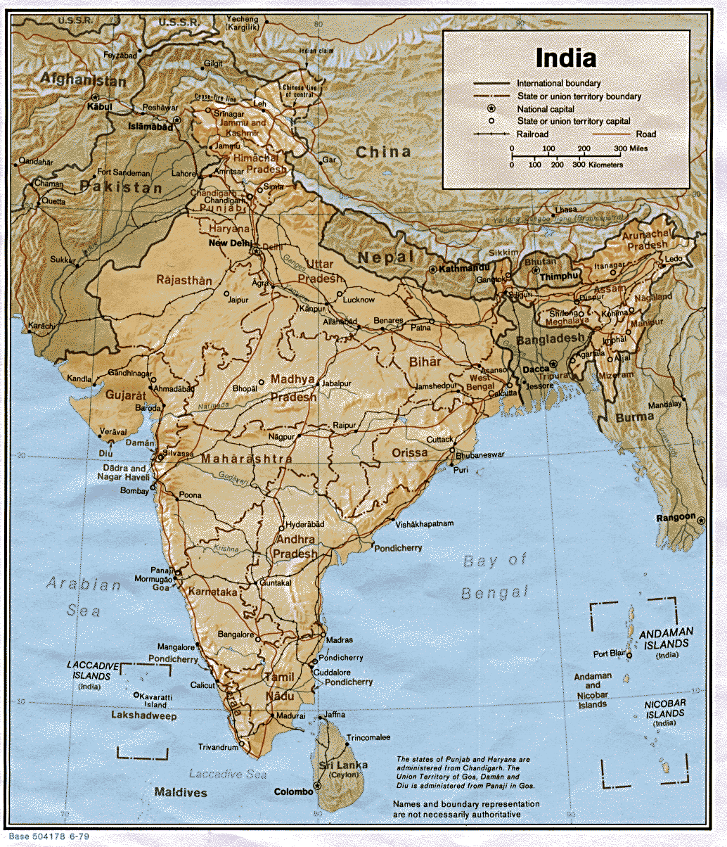
The vast majority of Hindus live in India and Nepal

Slide 24
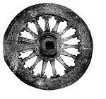
Goal of Hinduism
Moksha: “release or liberation
United forever with the divine
Infinite bliss and awareness

Slide 25

Reincarnation
Samsara is the wheel of rebirth which means the soul is reborn
from one life form to another.
People may be reincarnated at a higher or lower level of existence depending on their karma from their present life.
People may be reborn as plants or animals or they may be elevated to a higher caste as a human.
Death is not final for Hindus as they expect to be reborn many times.

Slide 26
Karma & Dharma
Karma: “action” or “deeds”
Every action produces a Justified effect based on its moral worthiness.
Karma determines all the particular circumstances and Situations of one’s life.
Dharma: ethical duty based on the divine order of reality. The word is the closest equivalent to “religion.”

Slide 27
Four Stages of Life
Stage One: Student stage
Stage Two: Householder
Stage Three: Forest-dweller --after the birth of
first grandchild
Stage Four: Sannyasin - wondering ascetic

Slide 28
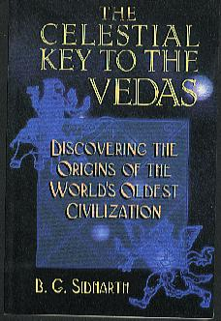
Sacred Texts
Rig Veda: Hinduism’s oldest text- nearly 4000 years.
Bhagavad Gita:
Hinduism’s most popular sacred text
.

Slide 29
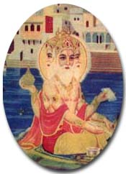
Brahman: essence of reality
He is not ultimate reality because he can be visualized.
Brahma’s life span = each day is 1000 times the whole of human history.
The world will end with the appearance of Vishnu is about 4000 years from now.

Slide 30
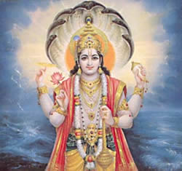
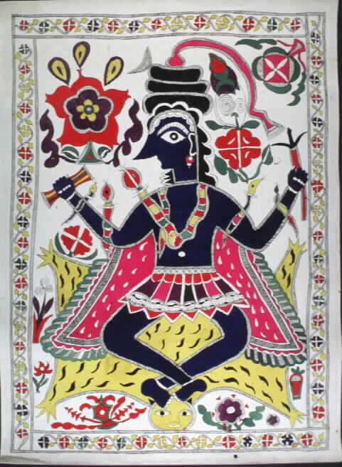
THE TWO MOST POPULAR GODS
SHIVA
VISHNU

Slide 31
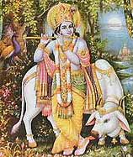
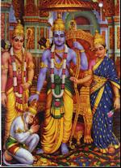
Avatars of Vishnu
Krishna
Rama

Slide 32
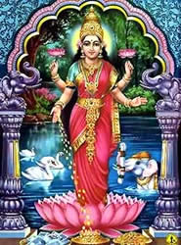
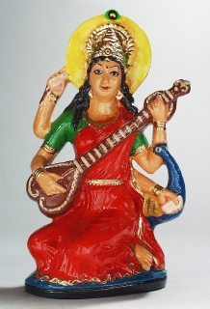
Goddesses
Lakshmi
Saraswati

Slide 33
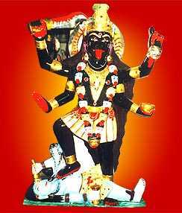
Kali
wife of Shiva
black in color & wearing a necklace of skulls.
She is a bloodthirsty goddess.
A violent destroyer of her enemies
affectionate and caring for her devotees.
.

Slide 34
Festivals and Holy Days
no set day of the week is holy-each days has its possibilities
Religious festivals may be solar or lunar-lunar is preferred
In order to keep festivals consistent, an additional lunar month is added to the calendar about every three years.
Some numbered days of the month are more important than others. There are 125 special days in the Hindu year.

Slide 35

Festival: Divali
Divali: “Row of lights
Takes place in Oct. or Nov.
It is a series of five festivals
Lights are floated on small rafts
If the candle remains lit, good luck
will follow.

Slide 36

The Ganges River
Falling from
Its source of
Vishnu’s feet
onto Shiva’s
head and out
from his hair,
the water of
the Ganges is
sacred enough
to purify all
sins.

Slide 37

Banaras - Hindu’s Holy City
Pilgrims come from all over to bathe in the Ganges.
Countless Hindus come to Banaras to die.
It has 1500 temples, most of them devoted to Shiva.
It is a gathering place for the religiously learned and their disciples.

Slide 38
Sacred Cow of India

Slide 39
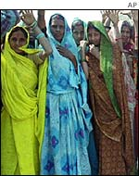
Caste System
Four major castes
Brahmin : priests
Kshatriya: warriors and administrators
Vaistrya: farmers, merchants, teachers, artisans
Sudras: servants,laborers

Slide 40
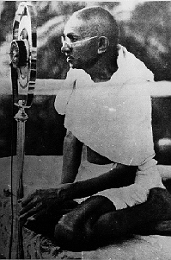
Gandhi: the Father of India
For Gandhi, social concern was deeply rooted in his conviction of the
Sacredness of life.
Gandhi believed that human beings should strive to live as simply as possible since overindulgence often meant that others may have to do without their basic needs.
Gandhi was assassinated by a Hindu fanatic on January 30, l948 as India was gaining its independence.
Notes:
overindulgen

Slide 41
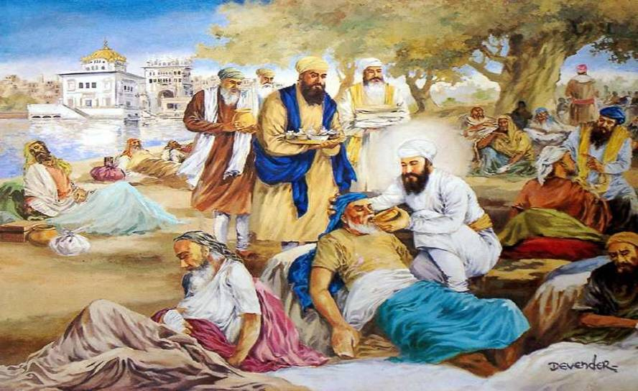
Sikhism: An Introduction

Slide 42
Sikhism
Sikhism comes from the word “Sikh”- Disciple
Is a distinct and unique religion, not a sect of Hinduism or Islam
Guru is made from two words: Gu (dispeller of ignorance) and ru (bringer of enlightenment)
Gurdwara - House of worship (Sikh Temple)
Waheguru – One of the Name of God/Almighty
Khalsa - belonging to the divine, ‘Pure’
Guru Granth Sahib ji - The Spiritual Scripture of Sikhs
Mool Mantar – Basic Tenet(s)
There is but one God
True is his name
The Creator, without fear, without enmity
Timeless, Without birth i.e. unborn and Self illumined

Slide 43
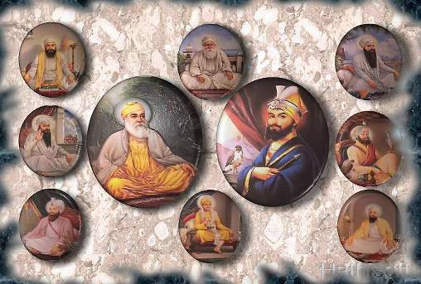
Ten Gurus (Religious Teachers) - One Eternal Light
Guru Nanak Dev Ji
Guru Angad Dev Ji
Guru Amar Das Ji
Guru Ram Das Ji
Guru Arjan Dev Ji
Guru Hargobind Ji
Guru Har Rai Ji
Guru Harkrishan Ji
Guru Tegh Bhadur Ji
Guru Gobind Singh Ji

Slide 44
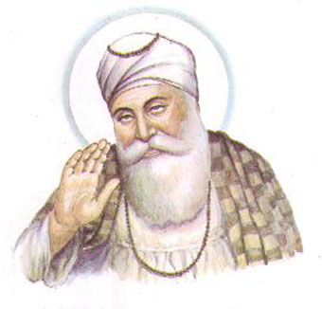
THE FIRST MASTER Guru Nanak Dev ji (1469 - 1539)
Founder of the Sikhism based on Equality & justice for all

Slide 45
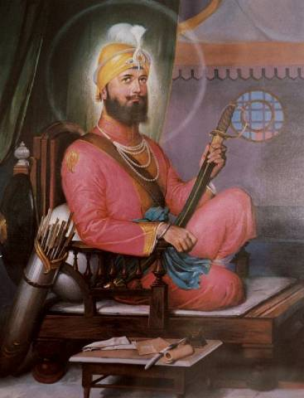
THE TENTH MASTER Guru Gobind Singh ji
Father Martyred to protect the Right of Freedom of Religion
Created the Sikh Nation: Khalsa – legion of the pure with Saint/Soldier qualities to protect anyone from oppression and injustice
Amrit - Baptism Ceremony in 1699
Prescribed the 5 Articles of Faith
Declared Guru Granth Sahib as the eternal Guru and ultimate spiritual authority for the Sikhs.

Slide 46
Guru Granth Sahib Ji
Compiled by the Sikh Guru’s themselves
Guru Granth Sahib ji revered as living Master
Any member, male or female, of the congregation can read from Guru Granth Sahib Ji.
All religious activity of the Sikhs are focused upon and revolves around the Spiritual Scripture, the Guru Granth Sahib.
Contains teachings of the Gurus and also other Muslim and Hindu saints

Slide 47
Sikh Beliefs
Origin of universe is from ONE eternal light source
One god/creator - ALL humans created equal
Men and Women have same rights
Human life - a precious blessing
All carry a spark of divine light: consequently no race, pigmentation, gender, is intrinsically superior to others
We are to behave as Role Models for those around us
Freedom and Liberty for all
- Protect yours and others rights
Truth, fearless, non-hateful spirit are important in attaining salvation
Justice and liberty for all
Only Those who practice LOVE obtain God
Respect for all Religions
Equality of all faiths, caste, creed, race, and all are welcome to the Gurudwara

Slide 48
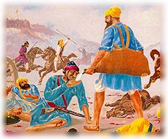
Values & Practices
Sarbat da bhalla : Welfare unto all
Seva: Daily selfless service to humanity
Service to god through selfless service to humanity and Gods creation.
Vand Chakna: sharing with the needy
Kirat Karniyee: Honest Labor
Honest earnings by hard work
Do not become burden on the society
Daily Prayers & Meditation
Bhai Kanhayia -
pioneer of the Red Cross & humanitarian aide organizations

Slide 49
Behold All Human Race as One
The Hymns of Muslim, Hindu and so-called ‘lower caste’ saints were incorporated into Guru Granth Sahib ji alongside Sikh Gurus Hymns without any kind of distinction.
A Sikh (Bhai Kanhaiya Ji) serving water to friend and foes alike in the battlefield.
LANGAR – Free Community Kitchen
The tradition of Langar (wherein everyone sit together and share a meal after services regardless of social class or whether they are rich or poor) expresses the ideals of equality, sharing and the Oneness of all humankind

Slide 50
Practices & Dress Code
No magic: antidote for evil is to remember God (recite His name)
No rituals.
No superstitions.
No statues or idol worship
Sikh men and women keep uncut hair
Dress code given by tenth Guru: Guru Gobind Singh, as a form of identity and uniqueness.
Sikhs wear the five K’s: Kesh (unshorn hair) Kanga (small comb) Kara (iron bangle) Kirpaan (symbolic sword) Kachera (underpants)
Color of turban is personal preference

Slide 51
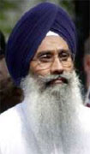




The Five K’s (Unique Identity - Discipline & Spirituality)
Kesh: uncut hair: Sikhs do not cut hair or beards to demonstrate their Love and obedience to their faith.
Kachera: undershot to represent modesty & fidelity
Kanga: wooden comb to keep uncut hair neat and clean
Kara : bracelet, made of steel worn on dominant hand
: a reminder of noble actions, a symbol of eternity
Kirpaan: ceremonial knife symbolizing freedom, liberty and justice
→ Never to be used as an offensive weapon
DON’Ts
Shaving or cutting of Hair
Eating Halal ( Kutta ) meat
Adultery
Use of tobacco or intoxicants (Smoking, Drugs, Alcohol etc)

Slide 52
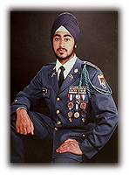

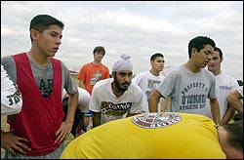
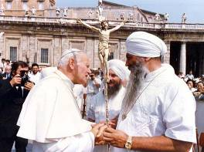
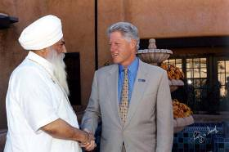
Turban - The Heritage & Pride of Sikhs 90% of people wearing turbans in Netherlands are Sikhs
Covers long, uncut hair
Approx. 15 feet of cloth wrapped neatly around the head every time it is put on
Symbolizes discipline, integrity, humility, and spirituality
Religious requirement - must be worn at all times in public

Slide 53
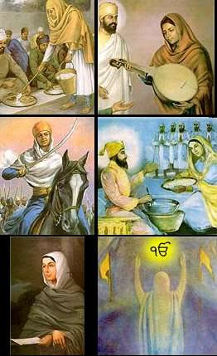
Sikhism and Women Rights
Spiritual scripture ( Guru Granth Sahib ) mandate women must be respected and treated as equal to man
Sikh Gurus rejected the old myth of females being inferior to men.
Sikh followers are instructed not to associate with those who discriminate against Women
Sikh Women can do everything
Both men and women are considered capable of reaching the highest levels of spirituality

Slide 54
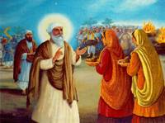
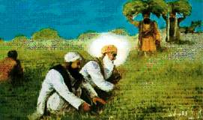
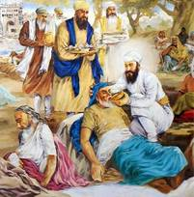
Guru’s Lead by Example
Honest labor and work ("Kirat karni") are the approved way of life in Sikhism.
Equal Right to Women
Guru Amardas ji conferred equal status on Men & Women
Bhai Lehna ji working
with Guru Nanak Dev ji
in the fields
Guru Arjan Dev ji
(5th Guru) serving the
lepers
Community Service
- Helping the poor and needy

Slide 55
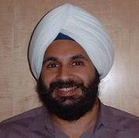
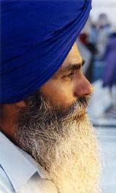
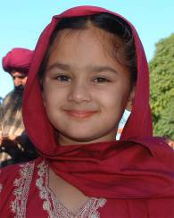
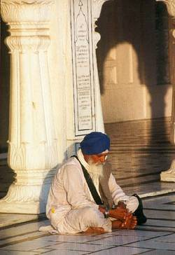

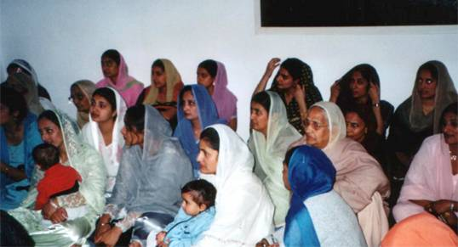
Appearance

Slide 56
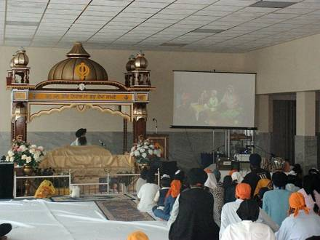
Sikhs In The Netherlands
Sikhs came to Netherlands
over 50-60 years ago
Majority of Sikhs came from India and more recently from Afghanistan.
Around 6-8 thousand Sikhs today in Netherlands
There are total of three Gurdwaras. They are located
in Amsterdam, The Hauge and Rotterdam
Around 90% people wearing turbans in Netherlands are Sikhs.

Slide 57
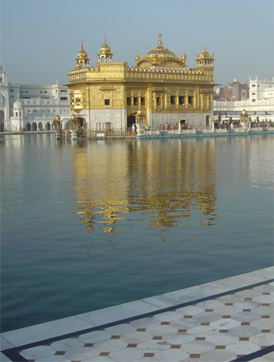
Visit a Gurdwara
Harmander Sahib (also known as Golden Temple): It has four entrances: symbolizing people of any faith, any race are welcomed and encouraged to attend the services.
This concept underscores the peaceful co-existence with all other religions and people. Daily prayer ends with asking God for the good of all humanity
Worshipers of both sexes remove their shoes and cover their heads before entering the Gurdwara, to show respect to teachings of Guru.

