Slide 1

OCCUPATIONAL HEALTH
-Compiled by
Dr.D.Nirmala
Assistant Professor
Department of Social Work
Bharathidasan University
Tiruchirappalli
1

Slide 2
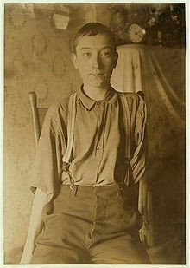
Harry McShane, age 16, 1908. Pulled into machinery in a factory in USA. His arm was ripped off at the shoulder and his leg broken.
No compensation paid.
2

Slide 3
Definition
"Occupational health should aim at the promotion and maintenance of the highest degree of physical, mental and social well-being of workers in all occupations;
the prevention among workers of departures from health caused by their working conditions;
the protection of workers in their employment from risks resulting from factors adverse to
health;
3

Slide 4
Definition
the placing and maintenance of the worker in an occupational environment adapted to his physiological and psychological equipment, and,
to summarize, the adaptation of work to man and of each man to his job.
The Joint ILO/WHO Committee on Occupational Health,1950
•
4

Slide 5
Objectives
The maintenance and promotion of workers’ health and working capacity
•
The improvement of working environment and work to become conducive to safety and health
Development of work organizations and working cultures in a direction which supports health and safety at work and in doing so also promotes a positive social climate and smooth operation and may enhance productivity of the undertakings.
•
•
—Joint ILO/WHO Committee on Occupational Health
11/20/15
5

Slide 6

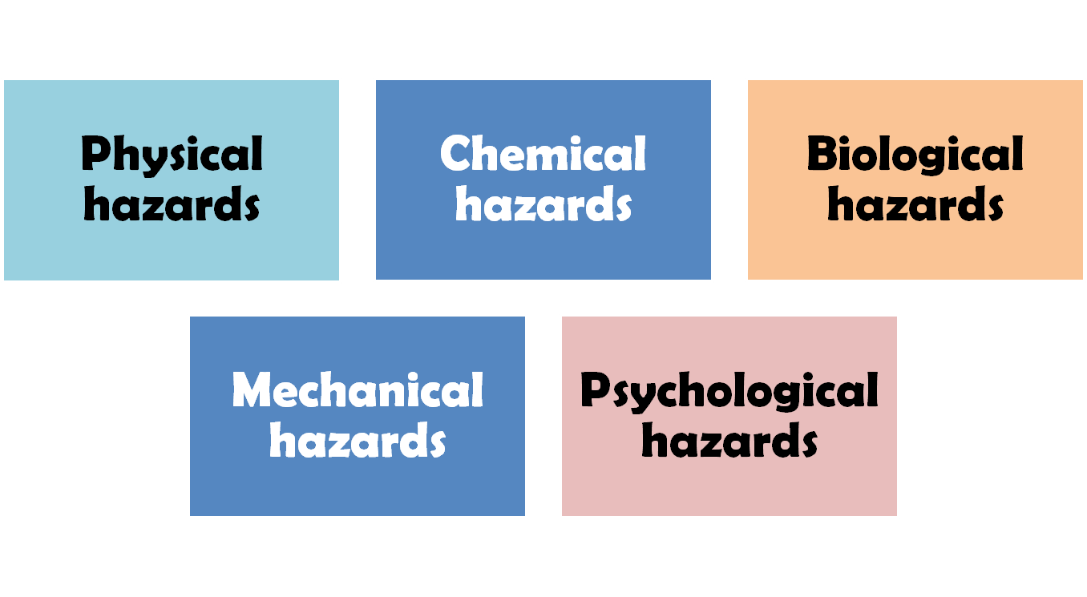
OCCUPATIONAL HAZARDS
ARUN PIRAVOM
6
11/20/15

Slide 7

Physical hazards
Heat and cold
Light
Noise
Vibration
Ultraviolet radiation
Ionizing radiation

Slide 8
^{He}Tªh^{t}e indirect effects The direct effects are are
Decreased efficiency,
Increased fatigue
Enhanced accident rates.
Burns
Heat exhaustion
Heat stroke
Heat cramps

Slide 9
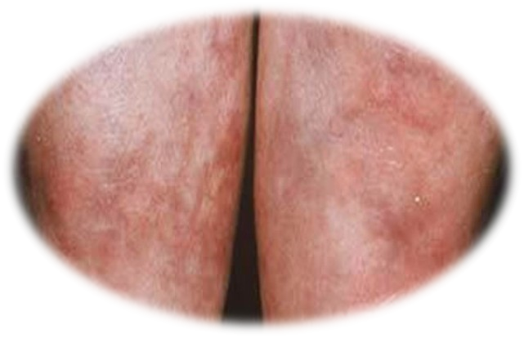
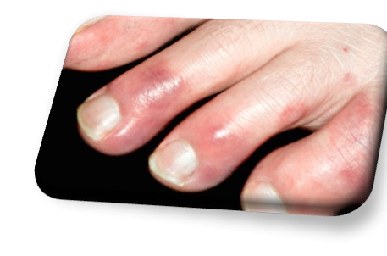
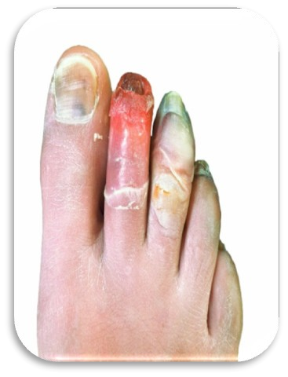
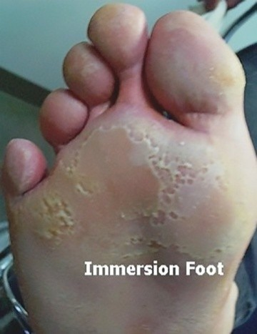
Cold
Chilblains
Erythrocyanosis
Immersion foot
Frostbite as a result of cutaneous vasoconstriction.
¹¹G^{/20/}e¹⁵neral hypothermia
9

Slide 10
Erythrocyanosis
A condition caused by exposure to cold and characterized by swelling of the limbs and the appearance of irregular red-blue patches on the skin, occurring especially in girls and women.
Immersion foot
Trench foot or immersion foot is a type of tissue damage caused by prolonged exposure to cold and wet conditions. It leads to swelling, pain, and sensory disturbances in the feet. It can lead to damage to the blood vessels, nerves, skin, and muscle
Frostbite as a result of cutaneous vasoconstriction.
Frostbite tend to occur when the body is exposed to intense cold, resulting in vasoconstriction. The resulting decrease in blood flow fails to deliver heat to the tissues and eventually leads to ice crystal formation. Body parts most prone to frostbite include the feet, hand, ears, lips, and nose

Slide 11
Hypothermia is defined as a body temperature (core, or internal body temperature) of less than about 95 F (35 C). Usually, hypothermia occurs when the body's temperature regulation is overwhelmed by a cold environment.

Slide 12
Light
The acute effects of poor illumination are
Eye strain,
Headache,
Eye pain,
Lacrymation, Lacrimation: Shedding tears, or shedding more tears than is normal (for example, as a result of eye injury or irritation)
Congestion around the cornea
The cornea is the transparent part of the eye that covers the front portion of the eye.
Eye fatigue.
The chronic effects on health include "miner's nystagmus"
MINERS' nystagmus is a disease which incapacitates a large number of coalminers, and is estimated by Dr. Lister Llewellyn to cost the country 100,000l. a year. It is characterised by rapid involuntary movements of the eyes, associated with defect of vision, photophobia, and night-blindness.
10

Slide 13

Noise
(i) Auditory effects
θ Temporary or permanent hearing loss
(ii) Non auditory effects
Nervousness,
Fatigue,
Interference with communication by speech,
Decreased efficiency
¹θ^{1/20/}a¹⁵nnoyance
11

Slide 14

Vibration
Exposure to vibration may also produce injuries of the joints of the hands elbows and shoulders.
12

Slide 15

Ultraviolet radiation
ConjunctivitisConjunctivitis, also known as pinkeye, is an inflammation of the conjunctiva. The conjunctiva is the thin clear tissue that lies over the white part of the eye and lines the inside of the eyelid.
Keratitis (welder's flash)
Keratitis is a condition in which the eye's cornea, the clear dome on the front surface of the eye, becomes inflamed.

Slide 16
Ionizing radiation
The radiation hazards comprise
Genetic changes
Malformation
Cancer
Leukaemia-Leukaemia is a cancer which starts in blood-forming tissue, usually the bone marrow.
Depilation-Depilation is the removal of the part of the hair above the surface of the skin.
Ulceration
Sterility-sterility is being unable to conceive a child
in extreme cases death.

Slide 17
Ionizing radiation
The International Commission of Radiological Protection has set the maximum permissible level of occupational exposure at 5 rem per year to the whole body.

Slide 18
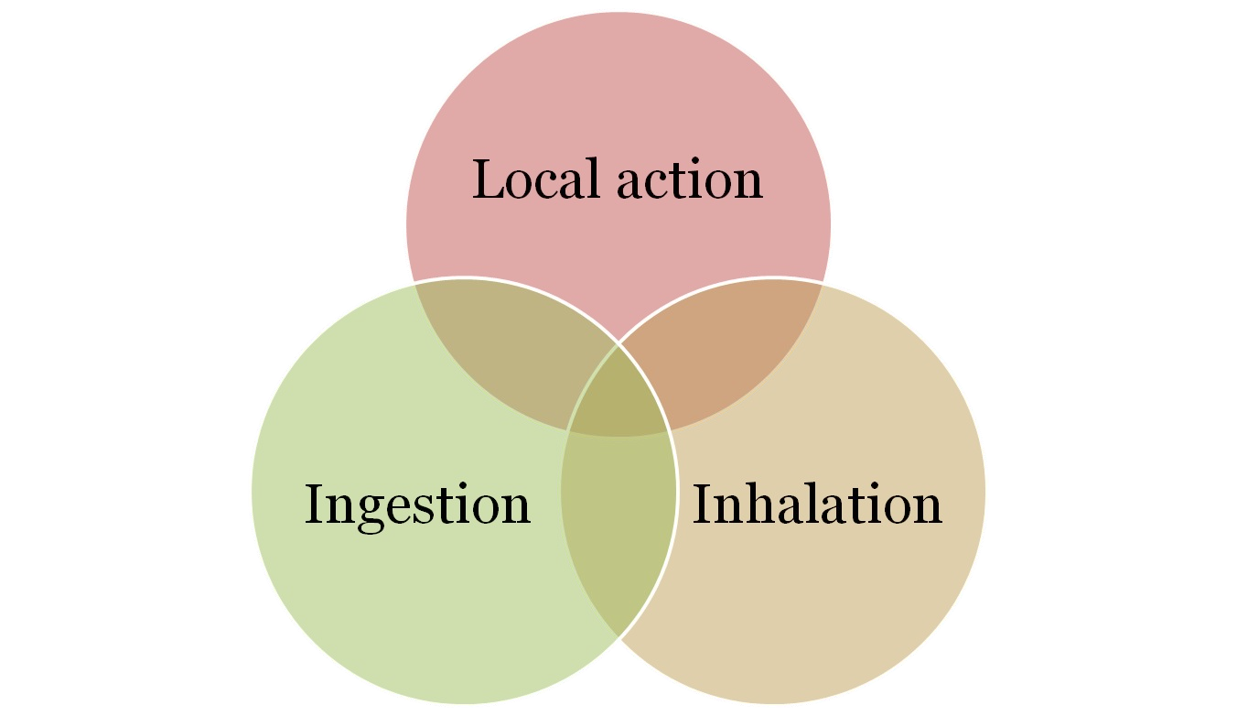
Chemical hazards

Slide 19
Chemical hazards
1)Local Action :
Dermatitis Eczema Ulcers
Cancer by primary irritant action

Slide 20
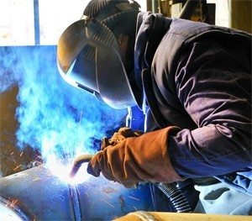
Chemical hazards
(2) Inhalation :
Dusts
Gases
Metals and their compounds

Slide 21
Chemical hazards
Dusts
Dusts are finely divided solid particles with size ranging from
0.1 to 150 microns
Dust particles larger than 10 microns settle down from the air rapidly,
IndefinitelyParticles smaller than 5 microns are directly inhaled into the lungs and are retained there and is mainly responsible for pneumoconiosis.

Slide 22
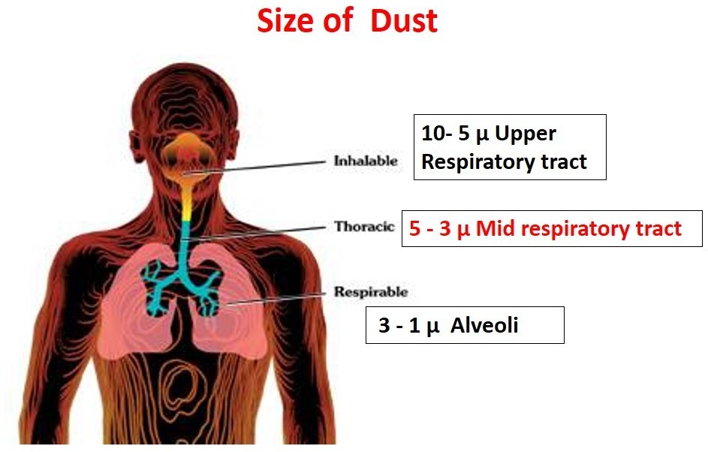
22

Slide 23
Chemical hazards
Classification of dusts
Inorganic and organic dusts;
Soluble and insoluble dusts.
23

Slide 24
Chemical hazards
Gases
Simple gases (e.g., oxygen, hydrogen),
Asphyxiating gases (e.g. carbon monoxide, cyanide gas, sulphur dioxide, chlorine)
Anaesthetic gases (e.g., chloroform, ether, trichlorethylene).
24

Slide 25
Chemical hazards
Lead, antimony, arsenic, beryllium, cadmium, cobalt, manganese, mercury, phosphorus, chromium, zinc and others
•
Metals and their compounds
25

Slide 26
Chemical hazards
(3) Ingestion:
Occupational diseases may also result from ingestion of chemical substances such as lead, mercury, arsenic, zinc, chromium, cadmium, phosphorus etc.
26

Slide 27
Biological hazards
Brucellosis-Brucellosis is an infectious disease caused by bacteria.
Leptospirosis-Leptospirosis is a blood infection caused by the bacteria Leptospira
Anthrax-Anthrax is an infection caused by the bacterium Bacillus anthracis. It can occur in four forms: skin, lungs, intestinal, and injection.
Hydatidosis-Hydatidosis is a zoonosis caused by Echinococcus granulosus, and ingesting eggs released through the faeces from infected dogs infects humans.
Tetanus-Tetanus is a serious disease caused by a bacterial toxin that affects your nervous system, leading to painful muscle contractions, particularly of your jaw and neck muscles.
25

Slide 28
Encephalitis
fungal infections
Schistosomiasis-Schistosomiasis, also known as snail fever and bilharzia, is a disease caused by parasitic flatworms called schistosomes. The urinary tract or the intestines may be infected. Symptoms include abdominal pain, diarrhea, bloody stool, or blood in the urine.
1•1/20a/15 host of others

Slide 29
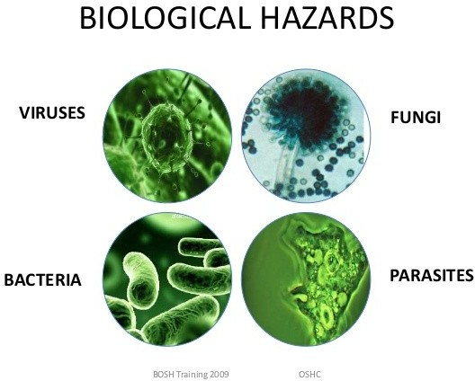

Slide 30


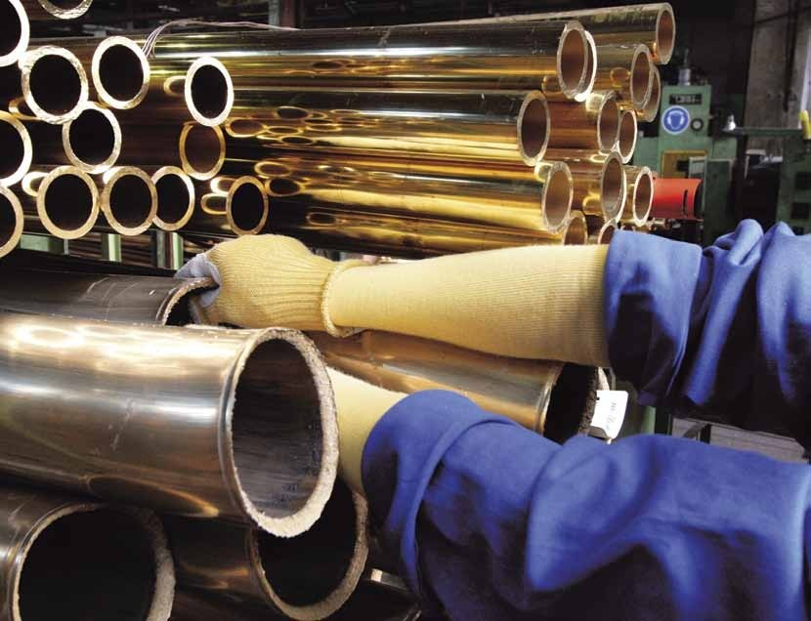
Mechanical hazards

Slide 31


Psychosocial hazrds
Factors affect health
Frustration
Lack of job satisfaction,
Insecurity
Poor human relationships,
Emotional tension

Slide 32

Psychosocial hazrds
The health effects can be classified in two
Psychological and behavioural changes
Psychosomatic ill health

Slide 33
OCCUPATIONAL DISEASES
DISEASE DUE TO PHYSICAL AGENT
Heat
Cold
Light
Pressure
Noise
Radiation
Mechanical factors
Electricity
11/20/15
ARUN PIRAVOM
30

Slide 34
OCCUPATIONAL DISEASES
DISEASE DUE TO CHEMICAL AGENT
•
•
Gases
Dusts (pneumoconiosis)
Inorganic dust: coal dust; silica; asbestos; iron
Organic(vegetable dust): cane fiber; cotton dust; tobacco; hay or grain dust
Metals and their compounds: lead ,mercury, cadmium, manganese, beryllium, arsenic,chromium.
Chemicals: acids, alkalies, pesticides
Solvents: carbon bisulphide, chloroform , benzene
•
•
ARUN PIRAVOM
34
11/20/15

Slide 35
OCCUPATIONAL DISEASES
III. DISEASE DUE TO BIOLOGICAL AGENT
Brucellosis, leptospirosis, anthrax, tetanus, encephalities, fungal infection.
IV. OCCUPATIONAL CANCER
Cancer of the skin, lungs, bladder
V. OCCUPATIONAL DERMATOSIS
Dermatitis, eczema
VI. DISEASE OF PSYCHOLOGICAL ORIGIN
Industrial neurosis, hypertension, peptic ulcer.
ARUN PIRAVOM
35
11/20/15

Slide 36
PNEUMOCONIOSIS
Dusts within the range of 0.5 micron to 3 micron is a health hazard producing, after a variable period of exposure, a lung disease known as pneumoconiosis, which may gradually cripple a man by reducing his work capacity due to lung fibrosis(thickening and scarring of connective tissue, usually as a result of injury.) and other complications.
ARUN PIRAVOM
36
11/20/15

Slide 37
PNEUMOCONIOSIS
Silicosis
Anthracosis
Byssinosis
Bagassosis
Asbestosis
Farmers lungs
ARUN PIRAVOM
37
11/20/15

Slide 38
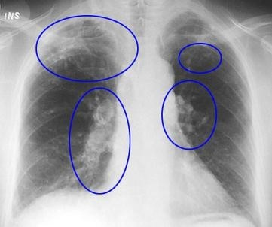
Silicosis
Caused by inhalation of dust containing free silica or silicon dioxide
Snow storm appearance in X ray

Slide 39
Anthracosis
It is caused by inhalation of dust containing coal miners.
First phase is called simple pneumoconiasis which is associated with little impairment.
Second phase is characterized by Progressive massive fibrosis

Slide 40
Byssinosis
Inhalation of cotton fibre dust over long periods of, time.
The symptoms are
Chronic cough
Progressive dyspnoea,
Chronic bronchitis
1•1/20E/15mphysema.
37

Slide 41
Bagassosis
Caused by inhalation of bagasse or sugar-cane dust.
Bagassosis has been shown to be due to a thermophilic actinomycet for which the name
The symptoms
Breathlessness
Cough
haemoptysis
11•/20/s15light fever.
38

Slide 42
Bagassosis
Preventive measures
Dust control
Personal protection
Medical control
Bagasse control
11/20/15
39

Slide 43
Asbestosis
Asbestos is of two types- serpentine or chrysolite variety and amphibole type.
Clinically the disease is characterized by dyspnoea.
Clubbing of fingers,
Cardiac distress and cyanosis.
The sputum shows "asbestos bodies"
An X-ray of the chest shows a ground-glass
^{11/20}a^{/1}p⁵ pearance in the lower two thirds of the lung fields
40

Slide 44
Asbestosis
PREVENTIVE MEASURES
Use of safer types of asbestos (chrysolite and amosite)
Substitution of other insulants: glass fibre, mineral wool, calcium silicate, plastic foams, etc.
•
•
Rigorous dust control
Periodic examination of workers; biological monitoring (clinical, X-ray, lung function), and
¹¹•^{/20/}C¹⁵ ontinuing research.
41

Slide 45
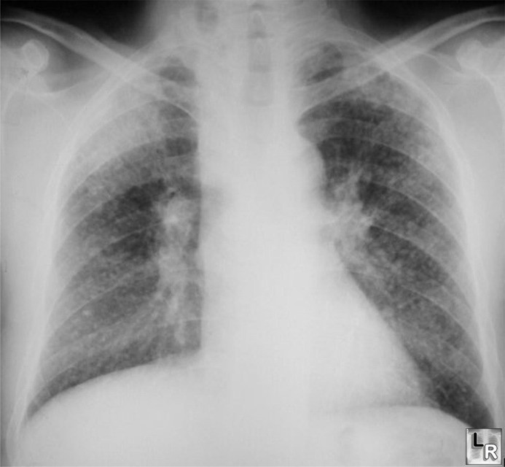
Asbestosis
Ground glass apperance in X ray chest

Slide 46
Farmer's lung
Farmer's lung is due to the inhalation of mouldy hay or grain dust.

Slide 47

LEAD POISONING
MODE OF ABSORPTION
INHALATION.
INGESTION.
SKIN

Slide 48
LEAD POISONING
CLINICAL PICTURE
•
•
•
•
•
•
•
•
•
The toxic effects of inorganic exposure
abdominal colic Constipation loss of appetite
blue-line on the gums stippling of red cells Anaemia
wrist drop
foot drop.

Slide 49
LEAD POISONING
The toxic effects of organic lead compounds are mostly on the central nervous system
Insomnia
Headache
Mental confusion
Delirium.

Slide 50
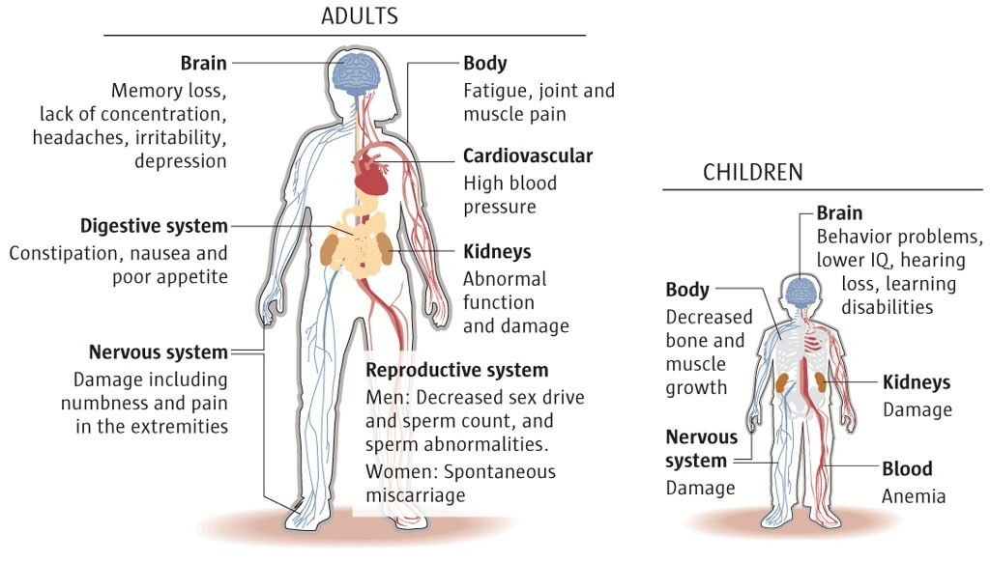
11/20/15 47

Slide 51
LEAD POISONING
DIAGNOSIS
HISTORY
CLINICAL FEATURES
LABORATORY TESTS:
Coproporphyrin in urine (CPU) :
Amino levulinic acid in urine (ALAU) :
•
•
Lead in blood and urine:
Basophilic stipling of RBC
51

Slide 52

LEAD POISONING
PREVENTIVE MEASURES
•
•
•
•
•
•
•
•
•
Substitution Isolation
Local exhaust ventilation Personal protection.
Good house-keeping Working atmosphere:
Periodic examination of workers Personal hygiene.
Health education :
52

Slide 53
OCCUPATIONAL CANCER
Skin cancer: gas workers, oil refiners, tar distillers, oven workers.
Lung cancer: gas industry, nickle and chromium work, mining of radio active substance
ARUN PIRAVOM
50
11/20/15

Slide 54

OCCUPATIONAL CANCER
Bladder cancer: dye stuff, dyeing industries, rubber, gas and electrical cable industry.
Leukemia: benzol, roengent rays and radioactive substance.
11/20/15
51

Slide 55
OCCUPATIONAL CANCER
The control measures
Elimination or control of industrial carcinogens.
Medical examinations
Inspection of factories, Notification,
Licensing of establishments, Personal hygiene measures,
Education of workers and management, research.
•
•
•
•
•
•
52

Slide 56
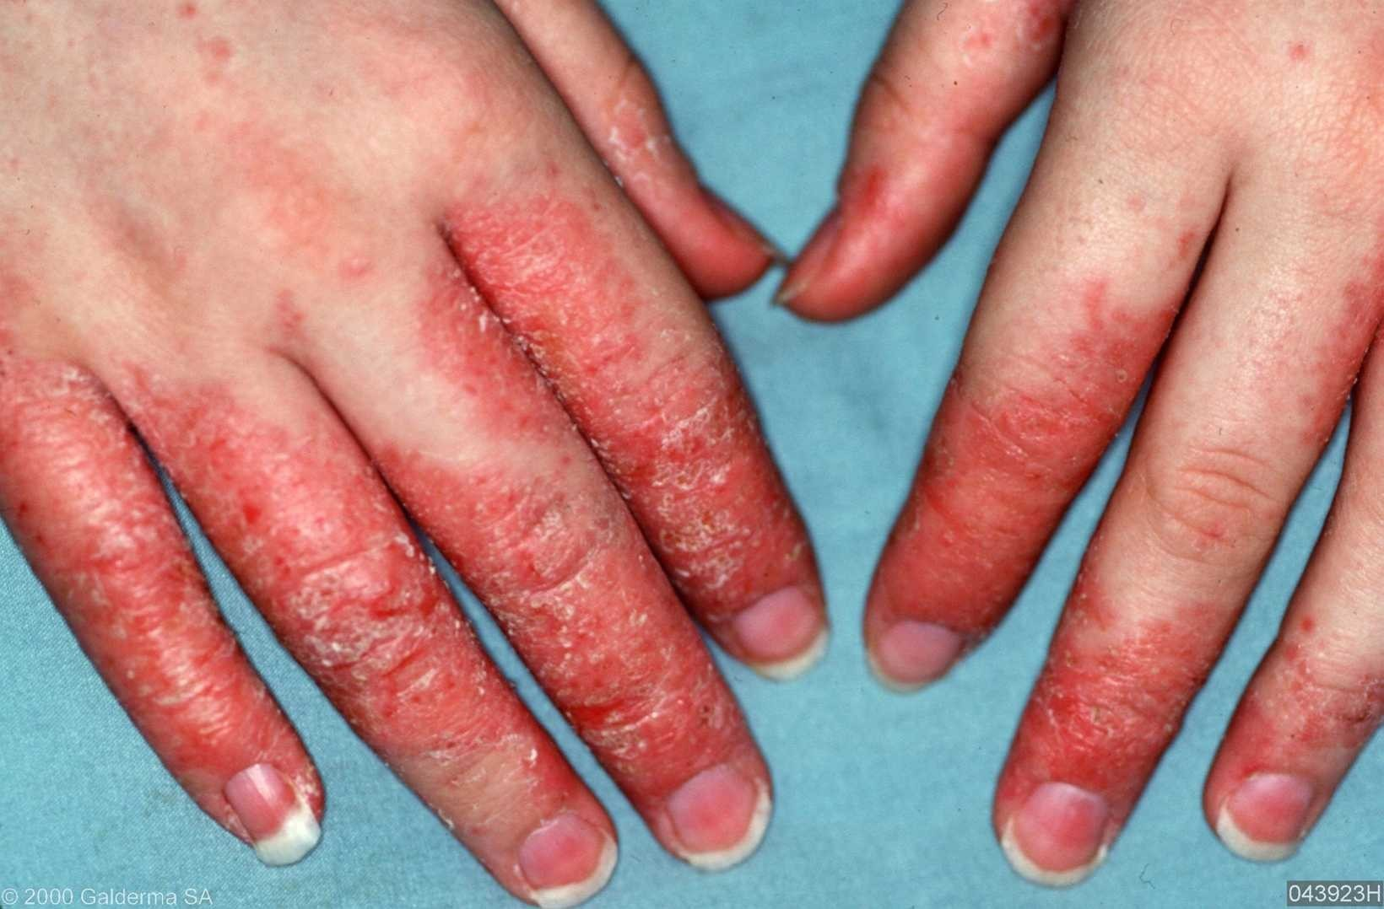
OCCUPATIONAL DERMATITIS
Causes
Physical
Chemical
Biological
Plant products
ARUN PIRAVOM
53
11/20/15

Slide 57
OCCUPATIONAL DERMATITIS
PREVENTION
Pre-selection
Protection
Personal hygiene
Periodic inspection
11/20/15
54

Slide 58
RADIATION HAZARDS
Shielding of workers
Monitoring the employees
Protective clothing
Adequate ventilation
Replacement and periodic examination
Avoidance of pregnant women to work
ARUN PIRAVOM 55
11/20/15

Slide 59
Sickness Absenteeism
Causes
Economic
Social
Medical
Non occupational causes

Slide 60
Sickness Absenteeism
Prevention
Good factory managementand practices
Adequate preplacement examination
Good human relations
Application of ergonomics

Slide 61

Accidents
Causes
Human factors
Physical
Physiological
Psychological
Environmental factors

Slide 62
Accidents
Prevention
Adequate preplacement examination
•
•
•
Adequate job training
Continuing education
Ensure safe working conditions
Establishing safety department in the organization under a competent safety engineer.
Periodic surveys for finding out hazards
•
•^{11/2}C^{0/1}a⁵ reful reporting
59

Slide 63
HEALTH PROBLEM DUE TO INDUSTRIALIZATION
Environmental sanitation problems
Communicable disease
Food sanitation
Mental health
Accidents and social problems
Morbidity and mortality
ARUN PIRAVOM
63
11/20/15

Slide 64

MEASURES FOR HEALTH PROMOTION OF WORKERS
Nutrition
Communicable disease control
Environmental sanitation
Mental health
Measures for women and children
Health education
Family planning
ARUN PIRAVOM
64
11/20/15

Slide 65

Nutrition
Under Indian factory act,
One canteen when number of employees exceeds 250
Education of workers on the value of balanced diet.

Slide 66
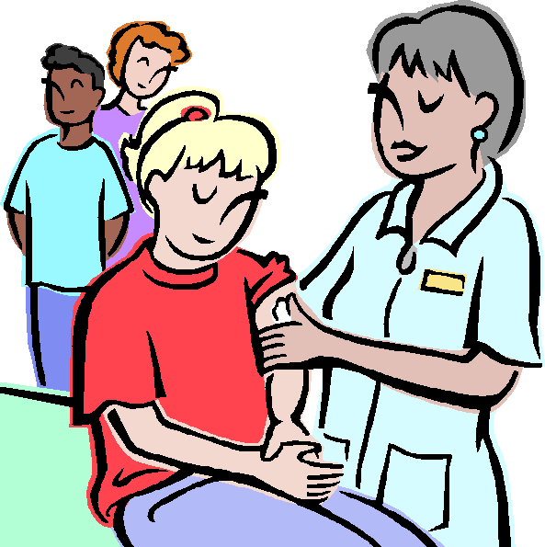
Communicable disease control
Adequate immunization against communicable diseases

Slide 67

Environmental sanitation
Water supply
Installation of drinking water fountains
Food
Sanitary preparation, storage and handling of food
Education of food handlers

Slide 68
Environmental sanitation
Toilet
One sanitary convenience for 25 employees for the first 100 employees and thereafter one for 50
General plant cleanliness

Slide 69
Environmental sanitation
•
Sufficient space
The recommended standard is of minimum of 500cuft
Lighting
Standards for illumination
High precision work 50-75 foot candles Regular work- 6 to 12 foot candles Corridoors and passages- 0.5 foot candles

Slide 70
Environmental sanitation
Ventilation, temperature
Protection against hazards
Housing

Slide 71
Mental health
To promote the health and happiness of the workers.
To detect signs of emotional stress and strain and to secure relief of stress and strain where possible
The treatment of employees suffering from mental illness and the rehabilitation of those
11/20w/15 ho become ill.
68

Slide 72
MEASURES FOR WOMEN AND CHILDREN
Expectant mothers are given maternity leave for 12 weeks,
Provision of free antenatal, natal and postnatal services.
The Factories Act (Section 66) prohibits night work between 7 p.m. and 6 a.m.;
The Indian Mines Act (1923) prohibits work underground.
The Factories Act, 1976 provides for creches in factories
_{11/2}w_{0/1}h₅ ere more than 30 women workers are employed,
69

Slide 73

Health education
73

Slide 74

Family planning
74

Slide 75
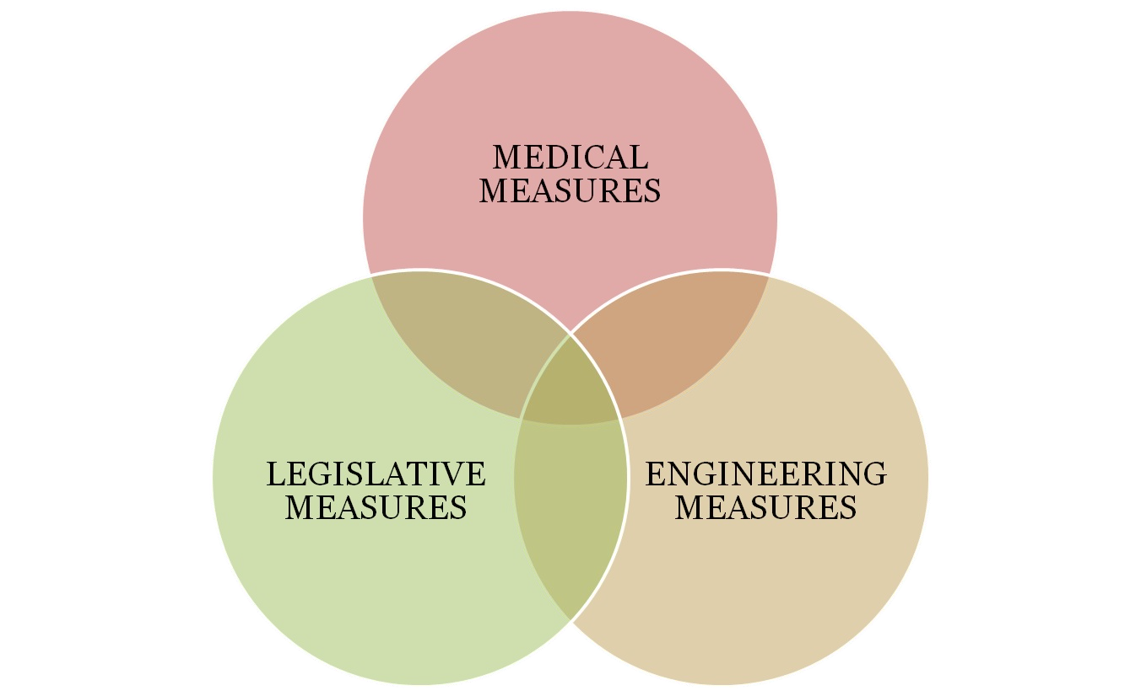
PREVENTION OF OCCUPATIONAL DISEASE
75

Slide 76

PREVENTION OF OCCUPATIONAL DISEASE
MEDICAL MEASURES
ϖPre-placement examination
ϖPeriodical examination
ϖMedical and health care services
ϖNotification
ϖSupervision of working environment
ϖMaintenance and analysis of records
ϖHealth education and counseling
ARUN PIRAVOM
76
11/20/15

Slide 77

PREVENTION OF OCCUPATIONAL DISEASE
ENGINEERING MEASURES
ϖDesign of building
ϖGood housekeeping
ϖGeneral ventilation
ϖMechanization
ϖSubstitution
ARUN PIRAVOM
77
11/20/15

Slide 78

PREVENTION OF OCCUPATIONAL DISEASE
ENGINEERING MEASURES
ϖDust-enclosure and isolation
ϖLocal exhaust ventilation
ϖProtection device
ϖEnvironmental monitoring
ϖStatistical monitoring and research
11/20/15
75

Slide 79


PREVENTION OF OCCUPATIONAL DISEASE
LEGISLATION
ϖThe Factory Act-1948
ϖThe Employees state insurance act-1948
ARUN PIRAVOM
76
11/20/15

Slide 80
FACTORIES ACT,1948
Scope
For purposes of the act, a factory means an establishment,
In which 10 or more workers have been employed during the preceding 12 months in a manufacturing process, operated on power Or
In which 20 or more workers have been employed during the preceding 12 months in manufacturing process without power.
•
•

Slide 81

FACTORIES ACT,1948
Appointment and employment
Inspector of factories
Medical practitioners

Slide 82


FACTORIES ACT,1948
Provisions for Industrial workers
Employment provisions
Welfare provisions
Safety provisions
Sanitary provisions

Slide 83
THE EMPLOYEE STATE INSURANCE ACT,1948
The ESI Act of 1948 covered all power-using factories other than seasonal factories where in 20 or more persons were employed (excluding mines, railways and defense establishments).
83

Slide 84
ESI Act
The provisions of the ESI (Amendment) Act of 1975 were extended to the following new classes of establishments:
Small power-using factories employing 10 to 19 persons, and non-power-using factories employing 20 or more persons
Shops:
Hotels and restaurants;
Cinemas and theatres;
Road-motor transport establishments; and
f1)1/2N0/e15wspaper establishments
81

Slide 85
ESI Act- Administration
ESI Corporation
Chairman – The Union Ministry of labour
Vice Chairman- Secretary to Govt. of India
11/20/15
82

Slide 86

ESI Act- Administration
Chief executive officer- Director general
Assisted by four principal officers
Insurance commissiners
Medical commissioners
Finance commissioners
Acturay
11/20/15
83

Slide 87

THE EMPLOYEE STATE INSURANCE ACT,1948
Benefits to employees
Medical benefit
Sickness benefit
Maternity benefit (4\ Disablement benefit
Dependent’s benefit
Funeral expenses
(7) Rehabilitation allowance84
11/20/15

Slide 88
THE EMPLOYEE STATE INSURANCE ACT,1948
•
•
Medical benefit
The services comprises
out-patient care
supply of drugs and dressings
specialist services in all branches of medicine
pathological and radiological investigations
domiciliary services
11(/620)/15antenatal, natal and postnatal services
85

Slide 89
THE EMPLOYEE STATE INSURANCE ACT,1948
Medical benefit
immunization services
family planning services
emergency services
ambulance services
health education and
in-patient treatment.

Slide 90
THE EMPLOYEE STATE INSURANCE ACT,1948
Sickness benefit
The benefit is payable for a maximum period of 91 days, in any continuous period of 365 days, the daily rate being about 50% of the average daily wages
34 diseases for which Extended Sickness Benefit where the insured person has been in continuous employment for 2 years:

Slide 91
THE EMPLOYEE STATE INSURANCE ACT,1948
Maternity benefit
For confinement, the duration of benefit is 72 weeks, for miscarriage 6 weeks and for sickness arising out of confinement etc. 30 days.

Slide 92
THE EMPLOYEE STATE INSURANCE ACT,1948
Disablement benefit
The rate of temporary disablement benefit is about 70 per cent of the wages as long as the temporary disablement lasts.
In case of total permanent disablement, the insured person is given life pension on the basis of loss of earning capacity determined by a medical board

Slide 93
THE EMPLOYEE STATE INSURANCE ACT,1948
Dependent’s benefit
Pension at the rate of 70 per cent of wages is payable, on monthly basis.
Funeral expenses
The amount not exceeding Rs. 5000. Rehabilitation
On monthly payment of Rs 10
93

Slide 94
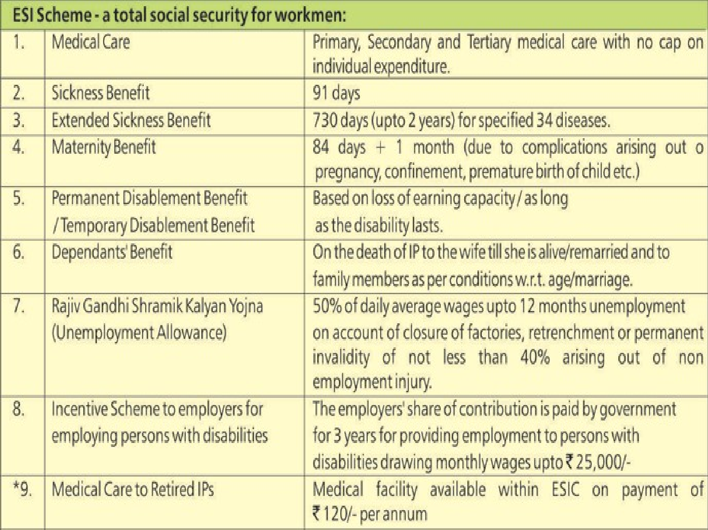
11/20/15 91

Slide 95

OCCUPATIONAL HEALTH TEAM
Occupational health nurse
Physiotherapist.
Specialist doctor
Industrial manager
Supervisor

Slide 96

OCCUPATIONAL HEALTH TEAM
Shift in charge
Rehabilitation specialist
Labour welfare officer
Labour union representative.
Representative of voluntary organizations
Other invited members as per the need

Slide 97


FUNCTIONS
Primary prevention
Secondary prevention
Tertiary prevention

Slide 98

ROLE
Clinician
Primary prevention
Emergency care
Treatment services
Nursing diagnosis
General Health advice and health assessment
Research and the use of evidence based practice

Slide 99
ROLE
Specialist
Occupational health policy, and practice development, implementation and evaluation
Occupational health assessment
Health surveillance
Sickness absence management

Slide 100

ROLE OF OCCUPATIONAL HEALTH WORKER
Rehabilitation
Maintenance of work ability
Health and safety
Hazard identification
Risk assessment
Advice on control strategies

Slide 101
ROLE OF OCCUPATIONAL HEALTH WORKER
Manager
Co-ordinator
Adviser
Health educator
Counsellor
Researcher

Slide 102
ROLE OF SOCIAL WORKER IN OCCUPATIONAL HEALTH WORKER
Home care
Cooperation of plant department
Special provision for services for women an children
Creche work
Rehabilitation of the ill and injured worke
Industrial plant survey
Administrative responsibilities
d
rs
11/20/15
99

Slide 103
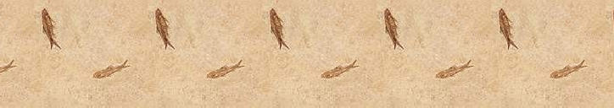
ERGONOMICS

Slide 104
DEFINITION
Ergonomics is the study of men at work with a view to identify stress factors operating in work environments and impairing the physical, mental and psychological health of workers and interfering with their work performance.

Slide 105

Occupational Disease

Slide 106
Definition
Occupational diseases
are diseases caused by work or work environment
Work-related diseases
are diseases initiated, hampered or easy to get by work

Slide 107
Occupational disease occur among workers exposed to specific hazards
In some situations may also occur among the general community as a consequence of contamination of the environment from the workplace.
e.g lead, pesticides

Slide 108
Occupational Disease occur as a result of exposure to physical, chemical, biological or psychosocial factors in the workplace.
These factors in the work environment are predominant and essential in the causation of occupational disease
exp. Lead in the workplace ◊ essensial for
lead poisoning
Silica ◊ silicosis

Slide 109
Occupational Diseases Factors
ω Occupational diseases are adverse health conditions in the human being, the occurrence or severity of which is realted to exposure to factors on the job in the work environment

Slide 110
Major categories of occupational illness by organ system
Musculoskeletal disorders
Respiratory disorders
Neurologic and psychiatric disorders
Skin disorders
Reproductive and development disorders
Cardiovascular disorders
Hematologic disorders
Hepatic disorders
Renal and urinary disorders

Slide 111
Occupational Diseases Factors
Physical Heat, noise, radiation
Chemical
Solvents, pesticides, heavy metals, dust
Tuberculosis, Hep. B, HIV
Biological
Ergonomic
Repetitive motion, improper designed tools or work areas
Lack of control over work, inadequate personal support
Mainly cause accident and injuries
Psychosocial stressor
Mechanical

Slide 112
Work Related Disease
WHO categories work related diseases as “ multifactorial” in origin
There are diseases in which workplace factors may be associated in their occurrence but need not be a risk factor in each case.

Slide 113
ω Work related diseases occur much more frequently than occupational disaese.
ω They are caused by interaction of several extrinsic risk fact

Slide 114
ω Work condition can aggravate pre existing disease
Hepatic dysfunction can be aggravated by exposure to certain chlorinated hydrocarbons
Bronchial asthma can be aggravated by dust exposure
Renal disease can be aggravated by inorganic mercury, cadmium and certain solvents

Slide 115
frequently seen in the general community.
  hypertension
  ischaemic heart disease
  psychosomatic illness
  musculoskeletal disorders
  chronic non specific respiratory disease/chronic bronchitis

Slide 116
Differences between Occupational Disease and Work Related Diseases
Work Related Diseases Occupational Disease
Occurs largely in the community
Multifactorial in origin
Occurs mainly among working population
Cause spesific
Exposure at workplace may be a factor
May be notifiable and compensable
Exposure at workplace is essential
Notifiable and compensable

Slide 117
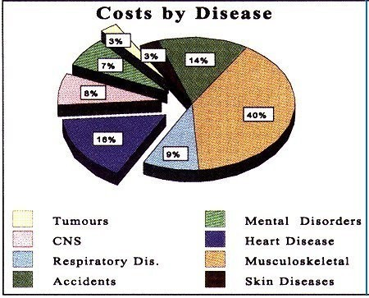
Costs of occupational and work- related diseases

Slide 118
Recognizing Occupational Disease
ω The identification of work-related medical problems depend most importantly on the occupational history

Slide 119
The Occupational History
Description of all jobs held
Work exposures
Timing symptoms
Epidemiology of symptoms or illness among other workers
Non-work exposures and other factors

Slide 120
History
Hippocrates
the standard three questions recommended
  name, age and residence

Slide 121
The component of an occupational history
Job description/nature of job
Hours of work/shift work
Types of hazards
Past occupation
Other jobs
Domestic exposures
Hobbies
Do other workers have a similar illness ?
Relationship of illness to period away from work

Slide 122
Additional information in occupational history
Smoking/ alcohol intake/drugs
Similar complaints among other workers
Time relationship between work and symptoms
Degree of exposure
Use of protective device
Methods of materials handling

Slide 123
Screening for Occupational Disease
Screening Approach :
History : questionnaire
Physical Examination
Tests :
  Chest x-ray
  Pulmonary Function Test
  Biologic monitoring
  Audiometry

Slide 124
Occupational diseases
ASBESTOSIS
Chronic inflammatory and fibrotic medical condition Affecting parenchyma tissue of the lungs.
Causes
Chronic Inhalaion of asbestos Clinical manifestations
Dyspnea
Reduction in lung volume
Hypoxia
lung cancer
respiratory failure

Slide 125
DIAGNOSIS
History
Physical examination X ray
CT
Lung biopsy

Slide 126
TREATMENT
Broncho dilators
Oxygen therapy
Respiratory physiotherapy
Postural drainage
Nebulization

Slide 127
PNEUMOCONIOSES
DEFINITION
IT IS A OCCUPATIONAL LUNG DISEASE CAUSED BY INHALATION OF DUST.

Slide 128
TYPES
COAL WORKER PNEUMOCONIOSES
ASBESTOSIS
SILICOSIS-MINERS PHTHISIS,GRINDERS ASTHMA,POTTERS ROT. CAUSED BY CRYSTALLINE SILICA DUST.
BAUXITE FIBROSIS-IT IS A FORM OF PNEUMOCONIOSES CAUSED BY BAUXITE
BERYLLIOSIS-BERYLLIUM
SIDEROSIS-IRON
BYSSINOSIS -COTTON

Slide 129
DIAGNOSIS
HC
PE
X-RAY
CT
LUNG BIOPSY

Slide 130
MANAGEMENT
Broncho dilators
Oxygen therapy
Respiratory physiotherapy
Postural drainage
Nebulization

Slide 131
Occupational Disease in Developing Countries
Asbestos is the major cause of disability and ill health
Pesticide :
  The majority of workers in developing countries are in agriculture
  Pesticide are often applied by hand, or without proper protection of workers who use spray equipment

Slide 132
Occupational Dermatoses
The most common occupational diseases
Are almost always preventable by a combination environmental, personaland medical measures

Slide 133
Type of occupational dermatoses
Acute contact eczema
Chronic contact eczema
Chloracne
Photosensitization
Hypo/hyperpigmentation
Keratoses
Benign tumors and epitheliomas
Ulcerss

Slide 134
Occupational cancer
The cause of cancer is still not completely understood
Epidemiological studies ◊ has been associated with certain exposures

Slide 135
Preventing Occupational Disease
Measures Applied to the Process or Workplace
  Substitution of a Non hazardous Substance for Hazardous One
  Installation of Engineering Controls and Devices
  Job Redesign,Work Organization Changes and Work Practice Alternatives
Measures Primarily Directed Toward Worker
  Education and Advice
  Personal Protective Equipment
  Organizational Measures

Slide 136
ω To prevent occupational disease effectively, health professionals must know how to anticipate and recognize conditions in those who present with symptoms and those who are presymptomatic

Slide 137
The three levels of prevention
Primary Prevention
Is designed to deter or avoid the occurrence of disease or injury
Secondary Prevention
Is designed to identify and adequately treat a disease or injury process as soon as possible, often before any symptoms have developed
Tertiary Prevention
Is designed to treat a disorder when it has advanced beyond its early stages, to avoid complications & limit disability, to address rehabilitative and palliative needs

Slide 138
Prevention of Occupational Disease
Primary Prevention Secondary Prevention
Control of new hazards Control of known hazards Environmental monitoring Biological monitoring
Identification of vulnerable workers (pre employment medical examination)
Substitution
Engineering controls to minimise exposure
Personal Protective Devices
Screening
Periodic medical examination

Slide 139
Prevention of Occupational Disease
Tertiary prevention aims to minimise the consequences in persons who already have disease
The goal is to limit symptoms or discomfort, minimize injury to the body and maximize functional capacity

Slide 140
OCCUPATIONAL HEALTH HAZARDS

Slide 141
CONTENT
Introduction
Types
Consequences due to differents types of hazards

Slide 142
OCCUPATIONAL HEALTH HAZARDS
Or called as occupational diseases
They are those diseases caused by the exposure to specific hazards at the workplace.
Characterstitics:-
Occurs mainly among working places
Exposure to workplace is essential
Notifiable and compensable

Slide 143
Occupational Hazards
Depending upon the occupation an industrial worker may be exposed to five types of hazards:-
Physical Hazards
Chemical Hazards
Biological Hazards
Mechanical Hazards
Psychosocial Hazards

Slide 144
Physical Hazards
Heat and cold Light
Noise Vibration
Ultraviolet radiation Ionizing radiation

Slide 145
A) HEAT AND COLD
DISEASES DUE TO PHYSICAL AGENTS
HEAT
COLD
Direct effects:-
Burns
Heat exhaustion
Heat stroke and
Heat cramps
Indirect effects are:-
Decreased efficiency
Increased fatigue
Enhanced accidents rates
Effects associated with cold works are:-
Chilblains
Erythrocyanosis
Frostbite
General hypothermia

Slide 146
B) LIGHT
POOR ILLUMINATION
Acute effects:-
Eye strain
Headache
Eye pain
Lacrimation
Congestion around cornea
Eye fatigue
Chronic effects:-
Miner’s nystagmus
EXCESSIVE BRIGHTNESS
Effects due to glare :-
Discomfort, annoyance and
visual fatigue
Blurring of vision

Slide 147
C) NOISE
Auditory effects
Non-auditory effects
It includes:-
Nervousness
Fatigue
Interference in communication by speech
Decreased efficiency and annoyance
It includes:-
Temporary hearing loss
Permanent hearing loss
The degree of injury from the exposure to the noise depends upon a number of factors such as intensity and frequency range, duration of exposure and individual susceptibility.

Slide 148
D) VIBRATION
It is encounter in work with drills and hammers
Continuous work with such machines affects hands and arms.
The blood vessels of fingers may become increasingly sensitive to spasm.
It may also produce injuries of the joints of the hands, elbow shoulder.

Slide 149
E) ULTRAVIOLET RADIATION
Mainly occurs in arc and other electric welding process
Effects due to ultraviolet radiation are:-
  It mainly effects the eye causing:-
    Intense conjunctivitis
    Keratitis

Slide 150
F) IONIZING RADIATION
Effects due to ionizing radiation are:-
Cancer
Leukemia
Ulceration
Genetic changes
  Chromosomal mutation eg sterility
Malformation
And ultimately death

Slide 151
A) Disease due to Physical agents
Heat | Prickly heat, syncope, heat hyper pyrexia, heat exhaustion
Cold | Hypo-thermia, frostbite, Treench foots
Light | Occupational cataract
Noise | Deafness
Radiation | Cancer, Leukaemia
Vivration | Sensitive to spasm

Slide 152
Chemical hazards
Local action Inhalation
Dusts
Gases
Metal and their compounds

Slide 153
LOCAL ACTION
Chemicals cause irritation, allergic reaction, dermatitis, eczema, ulcers and even cancer.
Chemicals causing occupational skin disease:-
Machine oil
Caustic
Lime
Some chemical like aromatic nitro and amino compounds absorb through skin and cause systematic effects
Eg alinine

Slide 154
Disease due the chemical Agents
Diseases due to chemical agents Diseases
1) Gases (co₂ , co, NH₃, N_{2,} H₂S, SO₂ Gas poisioning
,etc)
-
Dusts (Pneumoconiosis)
  Inorganic dusts:-
Coal dusts
Silica
Asbestos
Iron
Anthracosis Silicosis
Asbestosis, Lungs cancer Siderosis
II. Organic dusts:-
Cane fiber
Cotton duct
Tobacco
a. Hay or grain dust
Bagassosis Byssinosis Tobacossis Farmer’s lung

Slide 155
Metals and their compounds (due to inhalation) | Toxic hazards from lead, mercury, cadmium, arsenic, etc.
Disease due to biological agents | Anthrax, Tuberculosis, encephalitis Leismaniasis, Hepatitis, fungal infections etc
Occupational cancer | Cancer of skin, lungs, Bladder.
Occupational dermatitis | Dermatitis, Eczema

Slide 156
Biological Hazards
Workers exposed to infective and parasitic agents at the place of work.
Mainly prevalent in developing countries resulting in higher risk for the workers.

Slide 157
People exposed to the occupation like:-
  In health care setting workers are in high risk of Hepatitis, Tuberculosis, HIV, encephalitis, etc.
  Agricultural workers , people working on animal husbandry animal products are in risk of zoonotic disease, worm infestation, tetanus, etc.

Slide 158
Mechanical Hazards
May cause due to protruding moving parts of machinery.
Sometimes due to own carelessness

Slide 159
Psychosocial Hazards
Rise when worker fails to adopt to an alien psychosocial environment which leads to psychological factors such as:-
  Frustration
  Lack of job satisfaction
  Poor human relationship
  Emotional tensions etc

Slide 160
The health effects cause due to psychosocial hazards are:-
Psychological and behavioural change
Psychosomatic ill health

Slide 161
Psychological and behavioural change
It includes:-
Hostility/ unfriendly
Anxiety
Depression
Tiredness
Aggressiveness
Drug abuse
Absenteeism

Slide 162
Psychosomatic ill health
It includes:-
Fatigue
Pain in shoulder, neck and back
Prone to peptic ulcer
Hypertension
Heart disease
Rapid aging

Slide 163
THANK YOU….

