Slide 1
Diseases
Compiled by
Dr.D.Nirmala
Assistant Professor
Department of Social Work
Bharathidasan University
Tiruchirappalli

Slide 2
HYPERTENSION

Slide 3
Classification of blood pressure measurements
Category | Systolic(mm of Hg) | Diastolic
Optimal | <120 | <80
Normal | 120-129 | 80-84
High normal | 130-139 | 85-89
Grade 1 Hypertension | 140-159 | 90-99
Grade 2 Hypertension | 160-179 | 100-109
Grade 3 Hypertension | >_180 | >110
Isolated systolic hypertension | >_140 | <90

Slide 4
Organ Damage
The extent of organ damage often correlates with the level of blood pressure
The rate of progression of organ damage varies from one individual to another depending on many influences
Blood pressure and organ impairment should be evaluate separately
High pressures may be present without organ damage
Organ damage may be present with only moderate signs elevation of blood pressure
The presence of signs of organ damage confers an increased cardiovascular risk to any level of blood pressure

Slide 5
Classification
Hypertension is divided into primary and secondary
Hypertension is classifies as “essential” when the cause are generally unknown
Essential hypertension is the most prevalent form of hypertension accounting for 90% of all cases of hypertension
Hypertension is classified as “ secondary” when some other disease process or abnormality is involved in its causation
Prominent among these are diseases of kidney ,tumors of the adrenal glands, congenital narrowing of the aorta and toxemias of pregnancy
These are estimated to account for about 10% or less the cases of hypertension

Slide 6
Risk Factors
Non-modifiable risk factors
AGE: Blood pressure rises with age in both sexes and the rise is greater in those with higher initial blood pressure
Age probably represents an accumulation of environmental influences and the effects of genetically programmed senescence in body systems
Some populations have now been identifies whose mean blood pressure does not rise with age
These communities are for the most part primitive societies with calorie and often salt intakes at subsistence level

Slide 7
SEX
Early in life there is little evidence of a difference in blood pressure between the sexes
Adolescence, men display a higher average level
Difference evident in young and middle aged adults
late in life the difference narrows and the pattern may even be reversed
Post menopausal changes in women may be the contributory factor for this change
Studies are in progress to evaluate whether oestrogen supplementation protects against the late relative rise of blood pressure in women

Slide 8
GENETIC FACTORS
Considerable evidence that blood pressure levels are determined in part by genetic factors a of and that inheritance is polygenic
The evidence is based on twin and family studies
Twin studies have confirmed the importance of genetic factors in hypertension
The blood pressure values of monozygotic twins are usually contrast
No significant correlation has been noted between husbands and wives, and between adopted children and their adoptive parents

Slide 9
ETHNICITY
Population studies have consistently revealed higher blood pressure levels in black communities than other ethnic groups
Average difference in blood pressure between the two groups vary from slightly less than 5 mm Hg
The second decade of life to nearly 20mm Hg during the sixth
Black Americans of African origin have been demonstrated to have higher blood pressure levels than whites

Slide 10
MODIFIABLE RISK FACTORS
Obesity
Salt Intake
Saturated Fat
Dietary Fiber
Alcohol
Heart Rate
Physical Activity
Environmental Stress
Socio-economic status
Other factors

Slide 11
PREVENTION
Primary Prevention- Population Strategy
The population strategy approach is directed at the whole population, irrespective of individual risk levels
The concept of population approach is based on the fact that even a small reduction in the average blood pressure of a population would produce a large reduction in the incidence of cardiovascular complications such as stroke and CHD
Goal- Shift the community distribution of blood pressure towards lower levels or biological normality
This involves multifactorial approach ,based on the following non-pharmacotherapeutic intervention

Slide 12
POPULATION STRATEGY
Nutrition
Weight Reduction
Exercise promotion
Behavioural Changes
Health Education
Self-Care

Slide 13
HIGH-RISK STRATEGY
To prevent the attainment of levels of blood pressure at which the institution of treatment would be considered
This approach is appropriate if the risk factors occur with very low prevalence in the community
Detection of high risk subjects should be encouraged by the optimum use of clinical methods
Hypertension tends to cluster in families the family history of hypertension and “ tracking” of blood pressure from childhood may be used to identify individuals at risk

Slide 14
SECONDARY PREVENTION
Detect and control high blood pressure in affected individuals
Modern anti-hypertensive drug therapy can effectively reduce high blood pressure and consequently the excess risk of morbidity and mortality from coronary
Cerebrovascular and kidney disease

Slide 15
Continues…
Early case detection
Treatment
Patient Compliance

Slide 16
SEXUALLY TRANSMITTED DISEASES

Slide 17
WHAT IS STD
Sexually transmitted diseases (STD) are a group of communicable diseases that are transmitted by sexual contact and caused by a wide range of bacterial, viral, protozoal, and fungal agents
The contact is usually vaginal, oral, or anal sex. But sometimes they can spread through another intimate physical contact
This is because some STDs, like herpes and HPV, are spread by skin-to-skin contact.

Slide 18
AGENTS OF STD
BACTERIA
VIRUS
PROTOZOA
FUNGUS
ECTOPARASITES

Slide 19
FACTORS RESPONSIBLE FOR STD
Prostitution
Broken homes
Sexual disharmony
Easy money
Emotional immaturity
Urbanization & Industrialization
Social disruption
International travel
alcoholism

Slide 20
Gonorrhea
An infection caused by a sexually transmitted bacterium that infects both males and females.
Gonorrhea most often affects the urethra(urethra, duct that transmits urine from the bladder to the exterior of the body during urination.) , rectum or throat.
In females, gonorrhea can also infect the cervix. Gonorrhea is most commonly spread during vaginal, oral or anal sex.
babies of infected mothers can be infected during childbirth. In babies, gonorrhea most commonly affects the eyes.

Slide 21
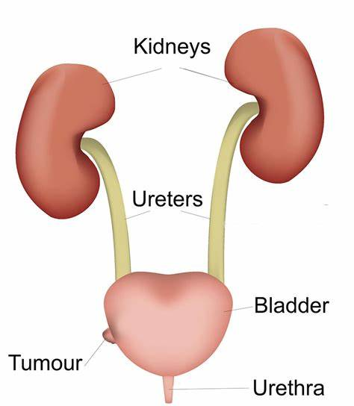

Slide 22
Signs and symptoms of gonorrhea infection
MEN
Painful urination
Pus-like discharge from the tip of the penis
Pain or swelling in one testicle
women
Increased vaginal discharge
Painful urination
Vaginal (The vagina is an elastic, muscular canal with a soft, flexible lining that provides lubrication and sensation. The vagina connects the uterus to the outside world.) bleeding between periods, such as after vaginal intercourse
Abdominal or pelvic pain

Slide 23
Gonorrhea at other sites in the body
Rectum.
Signs and symptoms include
anal itching,
pus-like discharge from the rectum,
spots of bright red blood on toilet tissue
and having to strain during bowel movements.
Eyes.
Gonorrhea that affects your eyes can cause
eye pain,
sensitivity to light,
and pus-like discharge from one or both eyes.

Slide 24
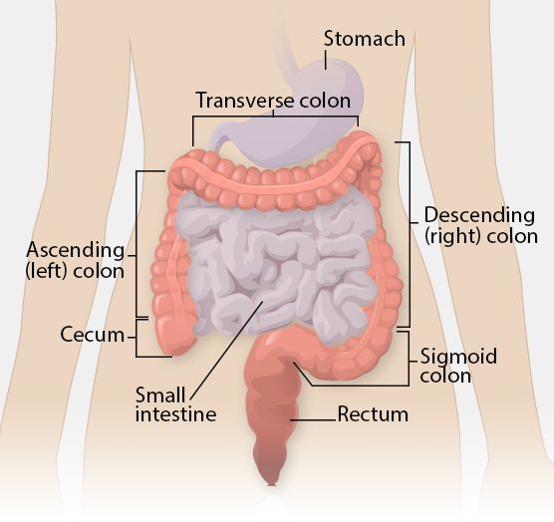

Slide 25
Throat.
Signs and symptoms of a throat infection might include
a sore throat and
swollen lymph nodes in the neck.
Joints.
If one or more joints become infected by bacteria (septic arthritis), the affected joints might be
warm,
red,
swollen,
and extremely painful, especially during movement.

Slide 26
Syphilis
Syphilis
is a bacterial infection.
It is easily spread through
unprotected anal, vaginal and oral sex without a condom.
It can also be passed on through
sharing contaminated needles and injecting equipment.
A mother can pass it on to her unborn baby during pregnancy.
It’s not as common as some sexually transmitted infections but if left untreated it can lead to serious health problems.

Slide 27
The infection can be passed on through:
vaginal, anal or oral sex without a condom or dental dam
genital contact
sharing sex toys with someone who has syphilis
sharing contaminated needles and injecting equipment
blood transfusions (this is very rare as most places test blood for infections).

Slide 28
Chlamydia
Chlamydia
is a bacterial infection.
The bacteria are usually spread through sex or contact with infected genital fluids (semen or vaginal fluid).
IT PASSES THROUGH
unprotected vaginal, anal, or oral sex
sharing sex toys that are not washed or covered with a new condom each time they're used
your genitals coming into contact with your partner's genitals – this means you can get chlamydia from someone even if there's no penetration, orgasm or ejaculation
infected semen or vaginal fluid getting into your eye
It can also be passed by a pregnant woman to her baby.

Slide 29
Trichomoniasis
Trichomoniasis is a common sexually transmitted infection caused by a parasite.
Men who have trichomoniasis typically have no symptoms.
In women, trichomoniasis can cause a foul-smelling vaginal discharge, genital itching and painful urination.

Slide 30
Symptoms
In women
A large amount of a thin, often foul-smelling discharge from the vagina — which might be clear, white, gray, yellow or green
Genital redness, burning and itching
Pain with urination or sex
Discomfort over the lower stomach area
In men
When men do have signs and symptoms, however, they might include:
Itching or irritation inside the penis
Burning with urination or after ejaculation
Discharge from the penis

Slide 31
Chancroid
Chancroid
is an STD caused by bacteria called Haemophilus ducreyi.
It causes
bumps that may feel tender when you touch them.
The bumps fill with pus and may open up and become sores.
These sores are most often on the genitals and are called ulcers.
While chancroid is easily treatable, it also spreads very easily.

Slide 32
Chancroid transmission.
Chancroid is passed from person to person in two ways.
The first is sexual contact with a person who has open sores.
The second is when the pus-like fluid from the sores is passed from person to person through another physical contact. If you have chancroid sores, touch one of them, and then touch another person, you may pass the infection to them.

Slide 33
Lymphogranuloma venereum
LGV is a long-term (chronic) infection of the lymphatic system.
It is caused by certain strains of the bacteria Chlamydia trachomatis.
The bacteria are spread by sexual contact.
LGV is more common in Central and South America than in North America.

Slide 34
SYMPTOMS
Drainage through the skin from lymph nodes in the groin
Painful bowel movements
Small painless sore on the male genitals or in the female genital tract
Swelling and redness of the skin in the groin area
Swelling of the labia (in women)
Swollen groin lymph nodes on one or both sides; it may also affect lymph nodes around the rectum in people who have anal intercourse
Blood or pus from the rectum (The rectum is a part of the lower gastrointestinal tract.) (The gastrointestinal tract is the tract or passageway of the digestive system (blood in the stools)

Slide 35
Donovanosis
Donovanosis
is caused by the bacterium Klebsiella granulomatis.
The disease is commonly found in
tropical and subtropical areas such as southeast India, Guyana, and New Guinea.
There are about 100 cases reported per year in the United States.
Most of these cases occur in
people who have traveled to or are from places where the disease is common.

Slide 36
Symptoms
Symptoms can occur 1 to 12 weeks after coming in contact with the bacteria.
Symptoms may include:
Sores in the anal area (in about half of cases)
Small,
beefy-red bumps on the genitals or
around the anus

Slide 37
Genital Herpes
Genital herpes is a sexually transmitted infection (STI). I
t causes herpetic sores, which are painful blisters (fluid-filled bumps) that can break open and ooze fluid.
Two types of the herpes simplex virus (HSV) cause genital herpes:
HSV-1. This type usually causes cold sores, but it can also cause genital herpes.
HSV-2. This type usually causes genital herpes, but it can also cause cold sores.
The World Health Organization stated that in 2016, about 3.7 billionTrusted Source people under age 50 years had contracted HSV-1. In the same year, around 491 million people ages 15 to 49 years had an HSV-2 infection.

Slide 38
The viruses enter the body through skin abrasions or mucous membranes.
Mucous membranes are the thin layers of tissue that line the openings of your body.
They can be found in your nose, mouth, and genitals.
Once the viruses are inside the body, they incorporate themselves into the cells.
Viruses tend to multiply or adapt to their environments very easily, which makes treating them difficult.

Slide 39
Human papilloma virus (HPV)
Human papilloma virus (HPV) is a common viral infection that can affect your skin.
It is passed on through any skin-to-skin contact of the genital area; vaginal, anal or oral sex
There are a number of different strains of HPV. Most have no symptoms, go away by themselves and don’t cause any health problems. Some types can cause
genital warts or
lead to cervical,
anal and
other cancers.

Slide 40
Symptoms
Symptoms of genital warts include:
one or more small, flesh-coloured or grey painless growths or lumps around your vagina, penis, anus or upper thighs
itching or bleeding from your genitals or anus
a change to your normal flow of pee (for example, sideways), that doesn't go away.

Slide 41
TRANSMISSION
vaginal, anal(Anal sex is any sexual activity that involves the anus ) or oral sex (sexual activity in which the genitals of one partner are stimulated by the mouth of the other) without a condom or dental dam, with someone who has an HPV infection (even if they don’t have symptoms)
close genital contact – this means HPV can be passed on even if there’s no penetration, orgasm or ejaculation.

Slide 42
WHO STATUS (2020)
More than 1 million sexually transmitted infections (STIs) are acquired every day worldwide, the majority of which are asymptomatic.
Each year there are an estimated 374 million new infections with 1 of 4 STIs: chlamydia, gonorrhoea, syphilis and trichomoniasis.
More than 500 million people aged 15 to 49 years are estimated to have a genital infection with herpes simplex virus (HSV) (1).
HPV infection is associated with 570 000 cases of cervical cancer in 2018, and over 311 000 cervical cancer deaths each year (2).

Slide 43
Almost 1 million pregnant women were estimated to be infected with syphilis in 2020, resulting in over 350 000 adverse birth outcomes including 200 000 stillbirths and newborn deaths (3).
STIs have direct impact on sexual and reproductive health through stigmatization, infertility, cancers and pregnancy complications and can increase the risk of HIV.
Drug resistance, especially for gonorrhoea, is a major threat to reducing the burden of STIs worldwide.

Slide 44
STATISTICS INDIA
Every year, about 6 percent of the adult population in India are infected with sexually transmitted infections and reproductive tract infections
Every year in India, there are more than 1 million cases of chlamydia reported.
Syphilis is an STD that starts as a painless sore and spreads through contact via genitals, rectum or mouth. Yet in 2020, around 16,128 men and 13,878 women were reportedly infected with the STD in India.
In 2020, a total of 677,769 cases of gonorrhea were reported in India
estimates that there were more than one million trichomoniasis infections in India in 2018
Chancroid has been reported as one of the most common sexually transmitted infections in India — but these reports seem to be based on data from small-scale studies in the 1980s and 90s. The fact is, the exact and current population-wide prevalence of most STIs is unknown in India.

Slide 45
in approximately 27%–43% of cases and may serve as ... the lymphogranuloma venereum serovars in the Indian population in 2019
We hereby report six cases of Donovanosis in Central. India registered in two years (2018-2019)
HSV-2 rates in the general adult population in India have been reported to range from 7.9 to 18.9% [4-6], translating into 100-200 million individuals who have acquired HSV-2 infection.(2020)
The current estimates indicate approximately 132,000 new HPV cases diagnosed and 74,000 deaths annually in India, accounting to nearly 1/3rd of the global cervical cancer deaths.

Slide 46
CONTROL OF STD
Initial planning
Intervention strategies
Support components
Monitoring and evaluation

Slide 47
Initial planning
Problem definition : disease problem must be define in terms of prevalence, psychological consequences and other health effects
Establishing priorities : priority based on age, sex, place of residence, occupation, drug addiction etc
Setting objectives : objectives for the plan
Considering strategies : use appropriate strategies

Slide 48
Intervention strategies
Case detection
Screening
Contact tracing
Cluster testing
Case holding and treatment
Epidemiological treatment
Personal prophylaxis
Health education

Slide 49
SUPPORT COMPONENTS
LABORATORY SERVICES
STD CLINIC
LEGISLATION
PRIMARY HEALTH CARE
SOCIAL WELFARE MEASURES
GOVERNMENT HOSPITALS
INFORMATION SYSTEM
ART CENTERS

Slide 50
Host Factors
AGE
The highest rates of incidence are observed in 20-24 years
15-19 years
The most serious morbidity is observed during the foetal development and in the neonate.

Slide 51
SEX
Morbidity rate is higher in men than women
Morbidity caused by infection is generally severe in women, example pelvic inflammatory disease
Marital Status
The frequency of STD infection is higher among single, divorced and separated persons
Socio-Economic Status
Individuals from the lowest socio-economic groups have the highest morbidity rate

Slide 52
Demographic Features
Certain demographic features contribute to increase STD
These includes population explosion and marked increase in the number of young people
The group at high risk for STD in the population
Rural to urban migration

Slide 53
Sexually Transmitted Diseases (STD) Control Program
The mission of the Sexually Transmitted Diseases (STD) Control Program is to reduce the occurrence of STDs through disease surveillance, case and outbreak investigation, screening, preventive therapy, outreach, diagnosis, case management, and education.
The annual incidence of STD in India as reported to the Central Bureau of Health Intelligence during 1989 was approximately 14 million.
A national STD control program has been in operation since the mid-1950s.
The program is clinic based, however, and covers only 5% of all STD patients in the country, with the majority of patients attending private health care providers, the informal sector, or resorting to self medication.
A phased approach to implementing the STD Control Program in the 32 states and union territories has been adopted.
Efforts to control STDs should focus upon increasing the availability and acceptance of curative and preventive measures by individual patients and the community.

Slide 54
Extension of National STD control Programme
The STD Control Component of National AIDS Control Programme has two major objectives.
Reduce STD cases and thereby control HIV Transmission by minimizing the risk factor and
Prevent short term as well as long term morbidity and mortality due to STDs
The national AIDS response was initiated by the Government of India in 1992 with the launch of the first phase of the National AIDS and STD Control Programme.
Since then, four phases of NACP have been successfully completed. The Phase-IV (Extension) of NACP concluded on 31st March 2021.

Slide 55
OBJECTIVES OF PHASE V
The annual new HIV infections in India have declined by 48 per cent against the global average of 31 per cent (the baseline year of 2010)
while the annual AIDS-related deaths have declined by 82 per cent against the global average of 42 per cent (the baseline year of 2010),
The HIV prevalence in India continues to be low with an adult HIV prevalence of 0.22 per cent,

Slide 56
TUBERCULOSIS

Slide 57
TUBERCULOSIS
Tuberculosis (TB) is caused by a bacterium called Mycobacterium tuberculosis. The bacteria usually attack the lungs, but TB bacteria can attack any part of the body such as the kidney, spine, and brain. Not everyone infected with TB bacteria becomes sick.
The prevalence of all forms of TB for all ages in India was 312 per lakh population for the year 2021 and the highest prevalence for all forms of TB was 747 per lakh in Delhi and the lowest was 137 per lakh population in Gujarat.
It is estimated that about 40% of the Indian population is infected with TB bacteria, the vast majority of whom have latent TB rather than TB disease.
The total number of new and relapsed tuberculosis patients notified in India during 2021 were 19,33,381

Slide 58
EPIDEMIOLOGICAL INDICES
INCIDENCE
Number of new and recurrent episodes of TB occurring in given year
PREVALENCE
Number of TB cases at a given point in time
MORTALITY
Number of deaths caused by TB

Slide 59
CASE FATALITY RATE
Risk of death from TB among people with active TB case
CASE NOTIFICATION RATE
New and recurrent episodes of TB notified to WHO for a given year expressed per 100000 population
CASE DETECTION RATE
NO of notification of new and relapse cases in a year divided by estimated incidence of such cases in the same year

Slide 60
PREVALENCE OF DRUG RESISTANT CASES
Patient excreting TB bacili resistant to anti TB drug
It indexed to following
PREVALENCE OF INFECTION
Percentage of individual who show a positive reaction to the standard TB test
Represents cumulative experience of a population to recent and remote infection with myco
INCIDENCE OF INFECTION
Percentage of population under study who will be newly infected by TB
It express the attacking force of TB in community

Slide 61
NATURAL HISTORY OF TB
AGENT
M. Tuberculosis
Intracellular parasite
SOURCE OF INFECTION
Human source (sputum of infected person)
Bovine source (usually infected by the milk using without boiling)
HOST FACTORS
Age ( 0-14 years, in India vulnerable chance to affect TB)
Sex ( more prevalent in men)
Malnutrition

Slide 62
SOCIAL FACTORS
TB is a social disease with medical aspect
Poor quality of life
Poor housing
Over crowding
Population explosion
Under nutrition
Smoking and alcohol consumption
Lack of education
Large families
Early marriage
Lack of awareness of causes of illness

Slide 63
MODE OF TRANSMISSION
Droplet infection
Droplet nuclei is generated by sputum positive patient
INCUBATION PERIOD
3 to 6 weeks
Development of disease depends upon close contact and host parasite relationship it may be weeks, months or years

Slide 64
CONTROL OF TB
Control of TB means reduction in the prevalence and incidence of disease in the community . Control measures can be divided into curative and preventive component
Curative component – case finding and treatment
Preventive component – BCG vaccination
This are the most important components for preventing and controlling the TB

Slide 65
Curative component CASE FINDING
Case
Early detection
Testing of sputum samples
Target group
Priority given for pulmonary symptomatic patients
Persistent cough and fever
Case finding tools
Sputum examination
Slide reporting
Radiography (chest X-ray)

Slide 66
TB TEST
TUBERCULIN
MANTOUX
INSTA TEST
RADIOMETRIC BACTEC
SPUTUM CULTURE TEST

Slide 67
Tests
TUBERCULIN
Discovered by Von Pirquet in 1907
Mostly common and widely accepted test
It is mainly used to estimating the prevalence of infection
MANTOUX
Carried out by injecting 1 TU of PPD
Intradermally on the flexor surface of the left forearm
INSTA TEST
Rapid detection test
It checking the complete viral load of the plasma
CHEMOTHERAPY
Effective treatment method
Elimination and destroy the multiplication of plasma
Elimination of plasma from the sputum

Slide 68
ANTI TUBERCULOSIS DRUGS
M. Tuberculosis
Rifamicin
INH
Streptomycin
pyrazinamide

Slide 69
BACTERIOSTATIC DRUGS
Ethambutol
Fluroquinolones
capreomycin
Cycloserine
Thioacetazone

Slide 70
PRE TREATMENT EVALUATION
Detailed history of patient
Weight
Height
Complete blood count
Blood sugar
Liver function test
Blood urea
Urine examination
Chest X ray

Slide 71
TYPES OF TB
Childhood TB
TB along HIV
TB along Diabetes
TB along Cancer
TB during pregnancy

Slide 72
Childhood TB
Usually found in age group of under 15 years
Source of infection is getting from infected adult in family
The frequency of childhood TB depends on
1. No. of infectious cases
2. closeness of contact with an infectious case
3. age of child to expose the TB
TREATMENT
Intermittent therapy is mainly using to paediatric
Rifampicin and Ethambutol are the drugs

Slide 73
TREATMENT DURING PREGNANCY
Usually treated with isoniazid, rifampicin and ethambutol for 2 months
Provide Vitamin B6 tablets
Providing peripheral neuropathy treatment to prevent TB daily once

Slide 74
BCG VACCINE
Koch discovered the BCG Vaccine
It have been made to prepare a prophylactic vaccine against TB using either attenuated or killed TB bacilli
Initially it given by orally during 1921 to 25
First intradermal technique used in human by 1927
1948 it was accepted by all over the world

Slide 75
BCG
AIM
Induce a benign
Reduce the morbidity and mortality
TYPES
Liquid vaccine
Freeze dried vaccine
artifical primary infection which will stimulate an acquired resistance

Slide 76
DOSAGE
New born aged below 4 weeks is 0.05 ml
AGE
Depend on the National vaccine policy of different country
Usual strength is 0.1 mg in 0.1 ml volume

Slide 77
ROLE OF HOSPITAL IN TB CONTROL
PROVIDE SURGICAL TREATMENT
MANAGEMENT OF SERIOUS TYPE OF TB
PROVIDE VACCINATION CAMPAIGNS
AWARENESS CREATION
MONITORING AND EVALUATE THE SURVEILANCE
CONTROL AND MAINTAIN THE DRUG

Slide 78
How Cancers Develop and Spread
Cancer develops only in cells with damaged genes (mutations).
Mutations can be inherited or caused by exposure to:
Low-dose radiation
Drugs
Toxic chemicals
Infection with certain viruses can cause mutations.
Lifestyle plays a major role in cancer prevention.

Slide 79
How Cancers Develop and Spread (continued)
Cells that begin to grow abnormally but are not yet cancer cells, may form benign tumors.
Benign tumors are surrounded by a fibrous capsule, and they do not spread or invade surrounding tissues.
Benign tumors are usually not life-threatening unless they interfere with vital processes.

Slide 80
Cancer Detection and Staging
Cancer screening is an examination to detect cancer before a person has symptoms.
American Cancer Society recommends screening for early detection, particularly for high-risk people or people with symptoms.
Visual examination
Self-examination
Clinical (physician) examination
Laboratory testing
Scans (MRI, CAT)
Notes:
80

Slide 81
Lung Cancer
Tobacco smoking is the leading cause of various cancers.
30% of cancer deaths, including 87% of lung cancer deaths, are attributed to tobacco use.
Lung cancer is the leading cause of cancer deaths in the United States.
Smoking cigarettes is most common cause.
Women are more susceptible to lung cancer than men due to presence of the GRPR gene, which is linked to the abnormal growth of lung cells and is more active in women.

Slide 82
Lung Cancer (continued)
Signs and symptoms
In the early stages, signs and symptoms may be difficult to detect.
Cigarette smokers may have chronic cough or chronic bronchitis
Risk factors and prevention
Risk increases with:
The number of cigarettes smoked/day
The number of years a person smokes
How deeply the smoker inhales
Smoking high-tar or unfiltered cigarettes

Slide 83
Lung Cancer (continued)
Quitting tobacco use reduces lung cancer risk, but it never returns to that of a nonsmoker.
Passive smoking may increase nonsmokers’ risk of lung cancer.
Environmental tobacco smoke is associated with 20% to 30% increase in lung cancer risk.
Asbestos and radon exposure also increase risk.

Slide 84
Cancers Related to Diet
About one-third of cancer deaths in the United States that occur annually are due to nutrition and physical activity factors.
For people who do not use tobacco, diet, and physical activity are the most important modifiable determinants of cancer risk.
Ex. Colorectal (3rd most deadly cancer in U.S.)

Slide 85
Breast Cancer
Breast cancer occurs primarily in women.
Signs and symptoms involve changes in breast tissue:
Risk factors
Family history
Women with mothers, sisters, or daughters who have breast cancer
Age
Rare before age 20
Risk increases throughout the 20s
Rises dramatically during the 30s through mid-70s (majority or cases occur in women 40 and over)
Drops significantly after mid-70s

Slide 86
Cervical Cancer
A causal association exists between infection with human papillomavirus (HPV) and cervical cancer.
Causes genital warts
Is sexually transmitted
Risk of infection increases with an increased number of sexual partners and/or non-monogamous partners
Women who became sexually active before age 17 have higher risk
Notes:
86

Slide 87
Cervical Cancer (continued)
Long-term use of oral contraceptives is associated with an increased risk of cervical cancer.
In 2006, the Food and Drug Administration (FDA) approved a vaccine to prevent cervical cancer.
The vaccine, Gardasil, prevents infection with four types of HPV.
The American Cancer Society (ACS) recommends that all women should have annual Pap tests three years after their first vaginal intercourse but not later than age 21.

Slide 88
Cancers Related to Ultraviolet Radiation
Related to exposure to ultraviolet (UV) radiation from the sun as well as tanning beds.
Three types of UV radiation: UVA, UVB, and UVC. All types are harmful and have potential to cause skin cancer.
UVA is associated with sunburn, skin cancer formation, and premature aging effects.
Notes:
88

Slide 89
Skin Cancer
Related to exposure to ultraviolet (UV) radiation from the sun as well as tanning beds.
Three types of UV radiation: UVA, UVB, and UVC.
All types are harmful and have potential to cause skin cancer.
UVA is associated with sunburn, skin cancer formation, and premature aging effects.

Slide 90
Skin Cancer (continued)
– Artificial UV sources may also generate UVC rays
UVC is potent cancer-causing radiation
Earth’s atmosphere filters natural UVC
Prevention
Limit sun exposure
Use sunscreens
Where protective clothing when exposed to sunlight
Avoid artificial sources of UV light (i.e., tanning beds).

Slide 91
Types of Skin Cancer (continued)
If you are high risk for malignant melanoma, check skin regularly for skin legions that:
Are asymmetrical (A)
Have irregular borders (B)
Have multiple colors (C)
Have a diameter greater than pencil eraser (D)
Prevention
Limit sun exposure
Use sunscreens
Where protective clothing when exposed to sunlight
Avoid artificial sources of UV light (i.e., tanning beds)

Slide 92
Reducing Cancer Risk
Eat a diet low in fat and red meats, especially high-fat and processed meats.
Eat a variety of fruits and vegetables daily.
Follow ACS’s recommendations for cancer screening tests.
Men should conduct monthly testicular self-examinations.
Know warning signs of cancer and see your health care provider immediately if you detect any.
Notes:
92

Slide 93
Reducing Cancer Risk (continued)
Sexually active people should use condoms to avoid contacting HPV.
Maintain a healthy weight.
Women should consult with their health care providers about risks of using oral contraceptives or hormone replacement therapy.
Exercise most days of the week.
When in the sun, takes steps to limit UV radiation exposure.

Slide 94
Reducing Cancer Risk (continued)
Don’t smoke or chew tobacco.
Avoid secondhand smoke.
Don’t drink excessive amounts of alcohol.
Avoid unnecessary exposure to ionizing radiation, such as x-rays and UV light.
Don’t lie in the sun or tanning beds.
Avoid direct sun exposure between 10 a.m. and 4 p.m.
Avoid exposure to toxic chemicals and fumes.
Avoid asbestos dust and radon gas.
Avoid eating cured or smoked meats.
Notes:
94

Slide 95
CHOLERA

Slide 96
CHOLERA
Acute diarrhoeal disease caused by V.Cholerae O 1 ( Classical or E1 Tor) and O139
It is now commonly due to the E1 Tor biotype and O139
Cases range from symptomless to severe infections are mild or asymptomatic
Typical cases are characterized by the sudden onset of profuse, effortless, watery diarrhoea followed by vomiting, rapid dehydration, muscular cramps and suppression of urine
Unless there is rapid replacement of fluid and electrolytes, the case fatality may be as high as 30 to 40 %

Slide 97
Problem Statement
The number of cholera cases reported to WHO continues to rise
2019- 9,23,037 cases were notified from 55 countries, including 2,420 deaths
Many more cases were unaccounted for due to limitations in surveillance systems and fear to trade and travel sanctions
True burden of the disease estimated to be 1.3-4.0 million cases and 21,000-1,43,000 deaths annually
Two serogroups of V. cholerae-O1 and O139- cause outbreaks
V.cholera O1 cause the majority of outbreaks
O139-first identified in Bangladesh in 1992
Non-O1 and non- O139 V.cholera can cause mild diarrhoea but do not generate epidemics
New E1 Tor variant strains have been detected in several parts of the Asia and Africa
These strains more severe cholera with higher case fatality rates

Slide 98
Problem Statement
Recent studies indicates global warming creates favorable environment for the bacteria
Cholera transmission is closely linked to inadequate environmental management
Risk area- Peri-urban slums, basic infrastructure not available consequences of a disaster, disruption of water and sanitation system, over crowded camps
Risk of cholera transmission increases, should the bacteria be present or introduced
Epidemics have never arisen from dead bodies

Slide 99
Problem Statement
Cholera remains a global threat to public health and a key indicator of lack of social development
The dynamics of cholera occurrences since 2005, combined with the emergence of new strains that lead to a severe clinical presentation
Increased antimicrobial resistance
Climate change
Cholera may well return to the forefront of the global public health agenda

Slide 100
INDIA
Cholera E1 Tor biotype in 1964
West Bengal – “ Home”of cholera
The bacteriology of cholera also presents a changed picture
For reasons that are not known, there has been no large scale epidemic of classical 1964
E1 Tor biotype of V. cholerae O1 has rapidly replaced the classical biotype in all parts of the country
Most of the E1 Tor biotype isolated today belong to the serotype Ogawa.

Slide 101
INDIA
During 2018,about 651 cholera cases were reported in India with 6 deaths
Majority of the cases were reported from Uttar Pradesh (153)
Delhi -134
West Bengal -126
Gujarat- 106

Slide 102
Epidemiological Features
Epidemic and endemic disease
The epidemicity and endemicity of a disease will depend on the characteristics of the agent and the system
Characteristics of the agent which influence its distribution include its ability to survive in a given environment
Virulence
Average number of organisms required to cause infection
Cholera creates problem only in the areas where sanitation is defective

Slide 103
Epidemiological features
Epidemics of cholera are characteristically abrupt and often create an acute public health problem
High potential to spread fast and cause deaths
The epidemic reaches a peak and subsides gradually as the “ force infection” declines
Cholera epidemic in a community is self- limiting
This attributed to the acquisition of temporary immunity
As well as due to the occurrence of a large number of subclinical cases

Slide 104
Epidemiological features
Force of infection is composed of 2 components
Force of infection through water
force of infection through contacts
Elimination of contaminated water does not immediately bring an outbreak to an end
But a so called “tail” of the epidemic in produced
This is due to the continuation of transmission through contacts

Slide 105
Epidemiological features
In areas where cholera is endemic, it does not show a stable endemicity
It undergoes seasonal fluctuations as well as epidemic outbreaks
The seasonal variation differs between countries and even between regions of the same countries
The seasonal incidence is also subject to change
For example:- The disease common in summer- Kolkata
Winter- Bangladesh
In both places is most frequent in autumn
The some parts of India, the peak incidence is in August

Slide 106
Epidemiological Determinants
AGENT
The organism that causes cholera is labelled as V. Cholerae O Group 1 or Vibrio cholerae O1 and O139
Endemic strain used for these vibrios
Vibrios that are biochemically similar to the epidemic strains but do not agglutinate in V. cholerae O1and O139 antiserum have been referred to n the past as non-agglutinating vibrios or as non-cholera vibirios
E1 Tor biotype was first isolated at the E1 Tor quarantine station in Egypt in 1905
Cholera is mostly by the E1 Tor biotype and O139
Classical and E1 Tor vibrios further divided each into three serological types namely Inaba, Ogawa and Hikojima
E1 Tor vibrios isolated in India- Ogawa serotype

Slide 107
Epidemiological Determinants
The E1 Tor biotype which are known for their haemolytic property
lost this property as the pandemic progressed
They may be distinguished from classical vibrios by the following tests
E1 Tor vibrios agglutinate chicken and sheep erythrocytes
Resistant to classical phage IV
Resistant to polymyxin B-50-unit disc and
The VP reaction and haemolytic test do not give consistent results

Slide 108
Resistance
V.Cholerae are killed within 30 minutes by heating at 56 deg. C
Few seconds by boiling
They remain in ice for 4-6 weeks or longer
Drying and sunshine will kill them in a few hours
They are easily destroyed by coal tar disinfectants such as cresol, bleaching powder
Toxin Production
The vibrios multiply in the lumen of the small intestine
Produce an exotoxin
Exotoxin has no effect on any other tissue except the intestinal epithelial cells

Slide 109
Reservoir of Infection
Human being is the only known reservoir of cholera infection
Case or carrier
Cases range from inapparent infections to severe ones
75% of the people infected with V.cholera do not develop any symptoms
20% develop acute watery diarrhoea with severe dehydration.
Carriers are usually temporary, rarely chronic
Carriers are best detected by bacteriological examination of the purged stool induced by the administration of 30-60 gram of magnesium sulphates in 100 ml of water by mouth

Slide 110
Infective Material
The immediate source of infection are the stools and vomit of cases and carriers
Large numbers of vibrios are present in the watery stools of cholera patients
Average patients excretes 10-20 liters of fluid
Carriers excrete fewer vibrios than cases
Infective Dose
Cholera is dose related
Infection occurs- Number of vibrios ingested exceeds the dose that is infective for the individual
Period of Communicability
A case of cholera is infectious for a period of 7-10 days
Convalescent carriers are infectious for 2-3 weeks
The chronic carrier state may last from a month up to 10 years

Slide 111
Carriers
Preclinical or Incubatory Carriers
Convalescent Carrier
Contact or Healthy Carrier
Chronic Carrier

Slide 112
Host Factors
Age & Sex:- All ages and both sexes, attack rate highest in children.
Gastric Acidity:- An effective barrier. The vibrio is destroyed in an acidity of Ph 5 or lower.
Population Mobility:- Movement of population results in increased risk of exposure to infection.
Economic Status:- The incidence of cholera tends to be the highest in the lower socio-economic groups, and this is attributable mainly to poor hygiene
Immunity:- An attack of cholera is followed by immunity to reinfection, but the duration and degree of immunity are not known.
Vaccination gives only temporary , partial immunity for 3-6 months

Slide 113
Mode of Transmission
Faecally contaminated water
Contaminated Food and Drinks
Direct Contact(Person to person through contaminated fingers, carelessly handling excreta and vomit of patients and contaminated linen and fomites)

Slide 114
Clinical Features
Stage of Education :- The onset is abrupt with profuse, painless, watery diarrhoea followed by vomiting. The patient may pass as many 40 stools in a day
Stage of Collapse:- The patient soon passes into a stage of collapse because of dehydration. Signs are: sunken eyes, hollow cheeks, scaphoid abdomen, abnormal temperature
Stage of Recovery:- If death does not occur, the patient begins to show signs of clinical improvement.
The blood pressure begins to rise, the temperature returns to normal, and urine secretion is re-established
If anuria persists the patient may die of renal failure

Slide 115
Laboratory Diagnosis of Cholera
Collection of stools
Vomitus
Water
Food samples
Transportation
Direct Examination
Culture Methods
Characterization
Biochemical Tests
Further Characterization

Slide 116
Control of Cholera
Verification of the diagnosis
Its is important to have confirmation of the outbreak as quickly as possible
All cases of diarrhoea should be investigated even on the slightest suspicion
Once the presence of cholera has been proved, not necessary to culture stools of all cases or contacts
Bacteriological diagnosis of cholera envisages a well organized system of laboratory services in the community

Slide 117
Notification
Notifiable disease locally and nationally
International Health Regulations, cholera is notifiable to the WHO within 24 hours of its occurrence by the National Government
The number of cases and deaths are also to be reported daily and weekly till the area is declared free of cholera
It is declared when twice the incubation period (10 days) has elapsed since the death, recovery or isolation of the last case

Slide 118
Prevention
Early case finding
Establishment of treatment centers
Rehydration therapy
Adjuncts therapy
Epidemiological investigations
Sanitation measures
Chemoprophylaxis
Vaccination
Health education

Slide 119
Diarrhoeal Diseases Control Programme
National Cholera Control Programme 1980-81
Oral Rehydration Therapy Programme -1986-87

Slide 120
Diabetes

Slide 121
Diabetes
Prevalence of Diabetes: 25.8 million adults in the US – 8.3%. UK rates are around 3.5-5.0%
Metabolic Syndrome: Risk factors related to obesity.
Type I: Beta cells produce little or no insulin.
Type II: Fat, Liver, and muscle cells do not respond to insulin (insulin resistance)
Gestational Diabetes: High sugars in Preg.
Notes:
Data from 2011 National Diabetes Fact Sheet
Diagnosed 18.8 million, Undiagnosed 7.0 million, Prediabeteic 79 million. Race and ethnic differences: After adjusting for pop age differences 2007-20097.1% non-Hispanic Whites, 8.4% Asian Americans, 12.6% Non-Hispanic blacks, 11.8% Hispanics. 1-2 Kids of Latino may develop Diabetes.
Metabolic Syndrome: Syndrome X or Insulin resistance: It is a name for a group of risk factors that occur together and increase the risk for coronary artery disease, stroke, and type 2 diabetes. BP130/85 or higher, FBS 100 or greater, Large waist circumference Men 40 or more, Women 35 or more. Low HDL m under 40, W under 50, Trig 150 or higher.
Type I: Is a lifelong chronic disease in which there are high levels of sugar in the blood. Most common in children, adolescents, or young. Symptoms: Polyuria, Polyphagia, Polydypsia, having blurry eyesight, feeling tired or fatigued, losing the feeling in your feet, losing weight without trying, urinating often. Diabetic Ketoacidosis: deep rapid breathing, dry skin and mouth, flushed face fruity breath odor, nausea or vomiting, stomach pain.
Type II: More common form 85-90% of diabetes is this type. Caused by the way your body make or uses insulin. Insulin is needed to move blood glucose into cells, where it is stored and later used for energy. No symptoms at first, early symptoms may include: bladder, kidney, skin or other infections that heal slowly. Fatigue, Hunger, Increased thirst, increased urination, blurred vision, erectile dysfunction, pain or numbness in feet or hands. Fasting blood glucose of 126 two times, A1C Normal 5.7%. Pre-Diabetes 5.7%-6.4%, Diabetes 6.5% or higher. Oral glucose tolerance test 200 after two hours of ingestion.
Gestational Diabetes: It usually starts halfway through the pregnancy. Women in the 24th-28th week of pregnancy go through a glucose tolerance test.

Slide 122

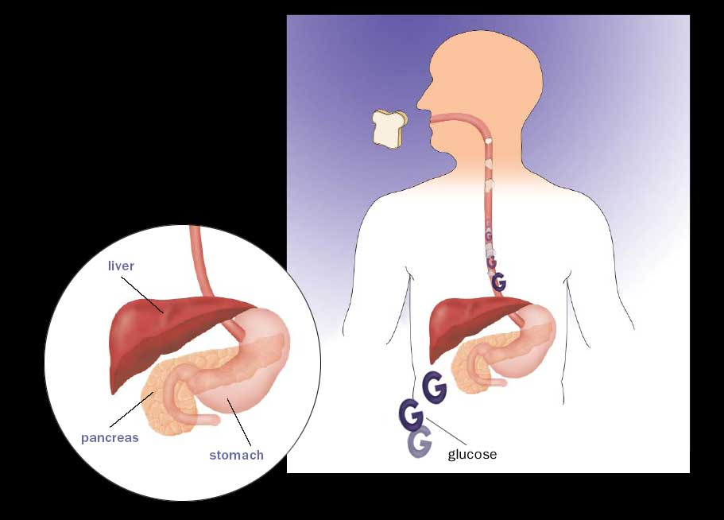

Pathophysiology of Diabetes
When you eat, your body breaks food down into glucose. Glucose is a type of sugar that is your body’s main source of energy.
6

Slide 123
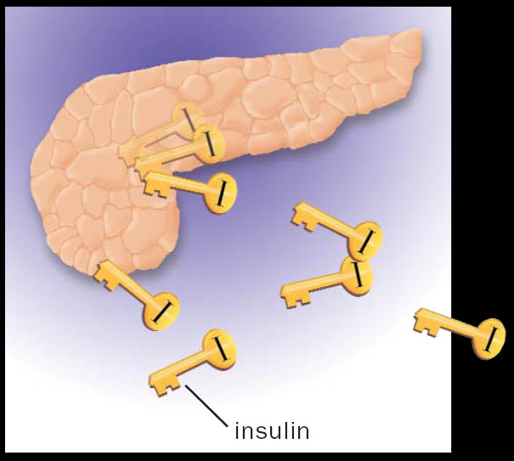

Pathophysiology of Diabetes
As blood glucose rises, the body sends a signal to the pancreas, which releases insulin.
7

Slide 124
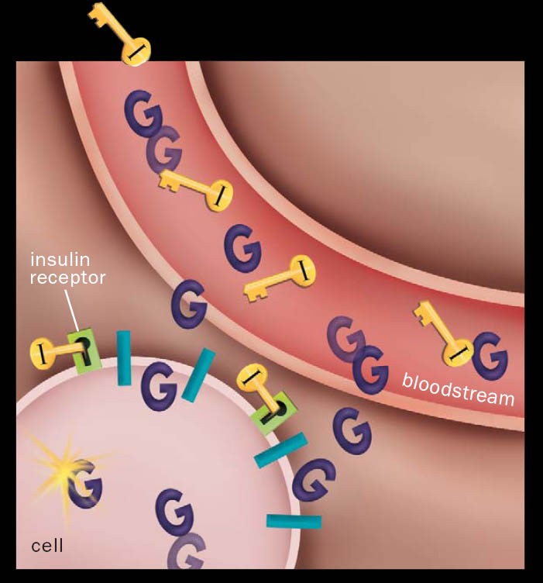

Pathophysiology of Diabetes
Acting as a key, insulin binds to a place on the cell wall (an insulin receptor), unlocking the cell so glucose can pass into it. There, most of the glucose is used for energy right away.
7

Slide 125
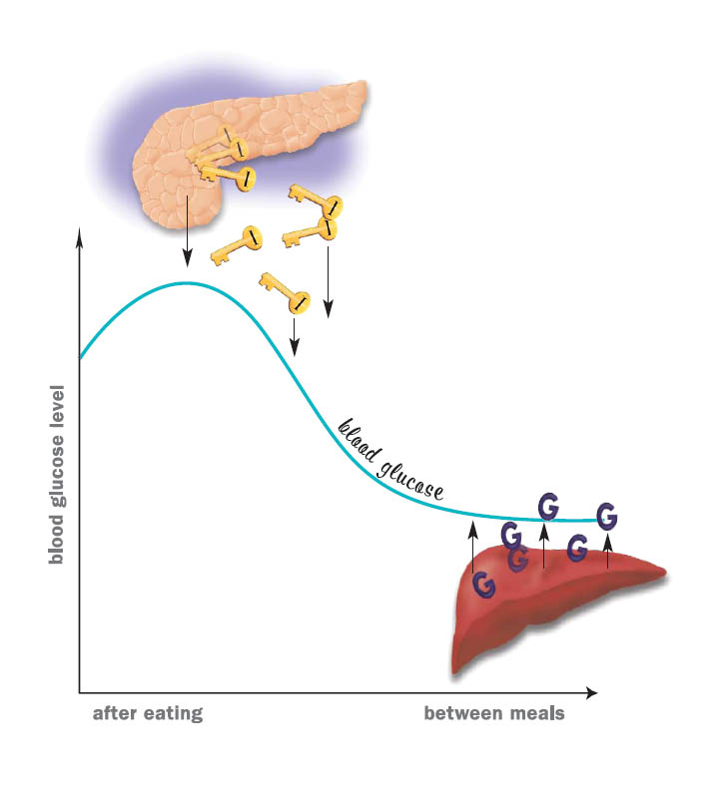
Blood glucose regulation
Blood glucose goes up and down throughout the day:
As your blood glucose rises
(after a meal), the
pancreas releases insulin.
8

Slide 126
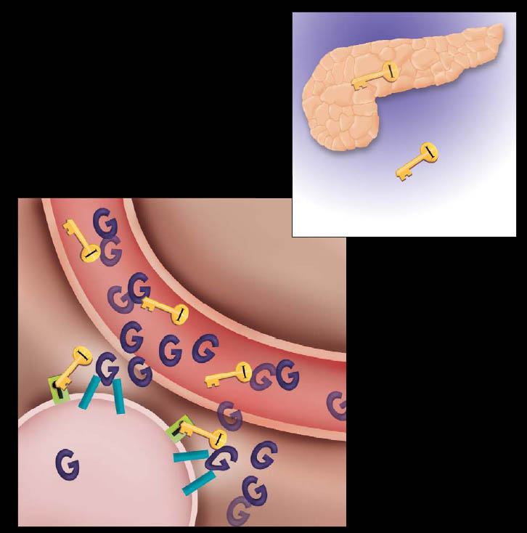
Type 2 diabetes
Your pancreas may not produce enough insulin (insulin deficiency).
Your cells don’t use insulin properly. The insulin can’t fully “unlock” the cells to allow glucose to enter (insulin resistance).
13

Slide 127
Natural History of Diabetes

Slide 128
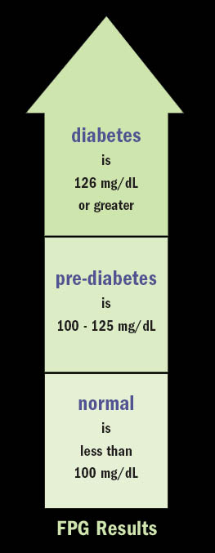
Diagnosing diabetes
Fasting plasma glucose test (FPG) results
diabetes
126 mg/dL or greater
pre-diabetes
125 mg/dL to 100 mg/dL
normal
less than 100 mg/dL
28

Slide 129
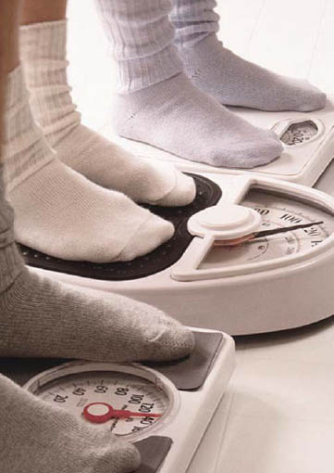
Risk factors for type 2 diabetes
Type 2 is more common in people who:
Are overweight.
Are 45 or older.
Are physically inactive.
Have a parent or sibling with type 2 diabetes.
Are African American, Native American, Hispanic American, or Pacific Islander.
Have abnormal cholesterol levels.
Have had gestational diabetes, or given birth to a baby greater than 9 lbs.
Have high blood pressure.
14
Notes:
Diabetes screening is recommended for: Overweight children who have other risk factors for diabetes, starting at age 10 and repeated every 2 years, Overweight adults BMI greater than 25 who have other risk factors and Adults over ager 45 every 3 years.
See your health care provider every three months. Have BP checked, skin and bones on your feet and legs, assess for numbness and tingling, examine the eyes, have A1C done every 6 months if your diabetes is well controlled otherwise every 3 months, Lipids done yearly (aim for LDL levels below 70-100). Yet yearly tests on microalbuninuria and serum creatine. Eye exam yearly, Dental yearly.
Main Tx: Diet and Exercise
Teach Blood glucose monitoring, what to eat, portion size, when to eat, how to take meds, how to recognize and treat low and high blood sugars, how to handle sick days, and keep up to date on new research and treatment options. Most people who have good blood sugar control check the blood sugar a few times a week. Daily if they are not controlled, in the am fasting, before meals, and at bedtime. Increased monitoring of blood sugars with sickness or stress.
Diet and weight control : Gastric bypass surgery and laparoscopic gastric banding.

Slide 130
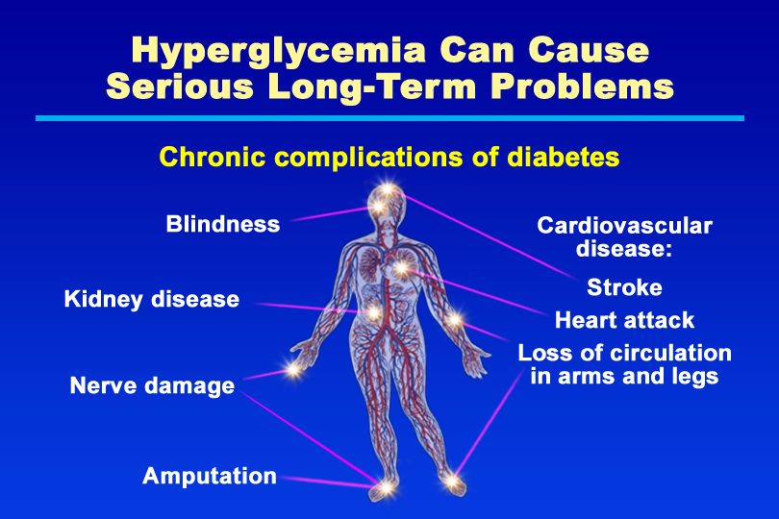
Hyperglycemia Can Cause Serious Long-Term Problems
Notes:
KEY MESSAGE: Over time, high blood glucose can lead to serious medical problems.
In 2004 68% of diabetes-related deaths were among people aged 65 years and older.
Stroke was noted on 16% of diabetes-related death certificates among people aged 65 and older.
Hypertension 2008: Adults aged 20 year or older with self-reported diabetes, 67% had blood pressures greater than or equal to 140/90 or used prescription meds.
Blindness: Diabetes is the leading cause of new cases of blindness among adults aged 20-74 years. 4.2 million (28.5%) of the people with diabetes 40 years or older had diabetic retinopathy, and of these, 4.4% had advanced retinopathy that leads to sever vision loss.
Kidney disease: Diabetes is the leading cause of kidney failure, accounting for 44% of new cases in 2008. 48,374 people with diabetes began treatment for end-stage kidney disease in the US. A total of 202,290 people with end-stage kidney disease were living on dialysis or with a kidney transplant in the US.
Nerve Damage: About 60-70% of the people with diabetes have mild to sever forms of nervous system damage.
Amputation: Diabetes for 10 years or more increases this risk and neuropathy or a previous ulcer is the most significant risk factor of developing lower extremity disease. Callouses can cause up to 30% more pressure on the feet and should be followed up by a professional. More than 60% of non-traumatic lower-limb amputation were performed in people with diabetes.
Cost of Diabetes Care: in 2007 $218 billion dollars in the US: 18 billion for undiagnosed diabetes, 25 billion for adults with prediabetes, and 623 million for gestational diabetes. National Diabetes Fact Sheet, 2011 the most recent comprehensive assessment of the impact of diabetes.
Supporting Points
Over time, hyperglycemia can damage large blood vessels, leading to stroke, heart attack, and loss of circulation in the arms and legs. According to the ADA, heart disease is the leading cause of diabetes-related deaths. People with diabetes are two to four times more likely to die of heart disease than those without diabetes.
Hyperglycemia also can damage small blood vessels and nerves, causing blindness, kidney disease, and other problems. Diabetes is the leading cause of kidney disease (nephropathy) and blindness (retinopathy) in adults under age 75. Diabetes also is a major cause of lower limb amputation. Other complications (not shown) include dental disease, complications of pregnancy, and sexual dysfunction.
Untreated diabetes can cause serious complications even if a person feels fine. Type 2 diabetes has been called a “silent killer” because many people are not aware they have the disease until they develop serious complications.
People with diabetes can reduce the risk of long-term complications by following their recommended diabetes care plans. For both type 1 and type 2 diabetes, major studies have shown that people who maintain their blood glucose as close to normal as possible reduce their risk of serious long-term complications.

Slide 131
Blood Glucose Targets for Adults
Pre-meal or fasting: 80-120
2 hours post-meal:
80-140
Bedtime: 80-140 or 100-140

Slide 132
When & How Often Should I Be Testing?
On insulin: 4 times per day.
Not on insulin: 2 times per day.

Slide 133
Test at Alternating Times of the Day Before or 2 Hours After Eating
Day of the week
Breakfast
Lunch
Dinner
Bedtime
Mon.
X
X
Tues.
X
X
Wed.
X
X

Slide 134
Meal plan works like this
Maximum
CHO
Breakfast
Lunch
Dinner

Slide 135
Meal plan works like this
CHO
CHO
CHO
Breakfast
Lunch
Dinner

Slide 136
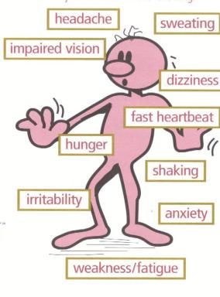
Hypoglycemic Symptoms
Notes:
ADA Recommended Targets for blood glucose control in non-pregnant individuals with diabetes: Plasma glucose before eating: normal < 110 , Target 90-130, When to take action if, 90 or greater than 150. 2 hours after eating: less than 130, Target , 180, When to take action If , <80 or >200. Bedtime: Less than 120, Target 110-150, When to take action if <110 or> 180.
Monitoring blood sugars depends on your treatment plan. Type II insulin injections 2-3 times usually before giving an injection and always at bedtime. Pump therapy 4-8 times a day usually before meals and after meals and always at bedtime. Changing tx or routine: 3 or more times a day

Slide 137
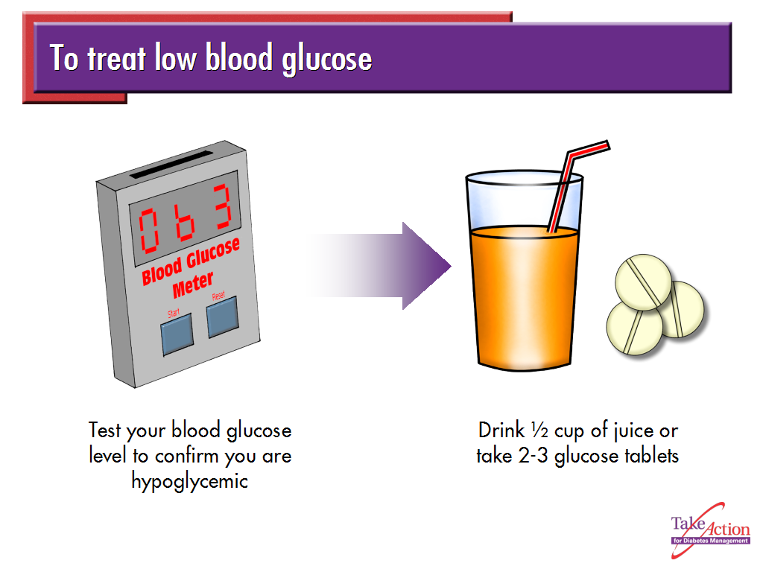

Slide 138
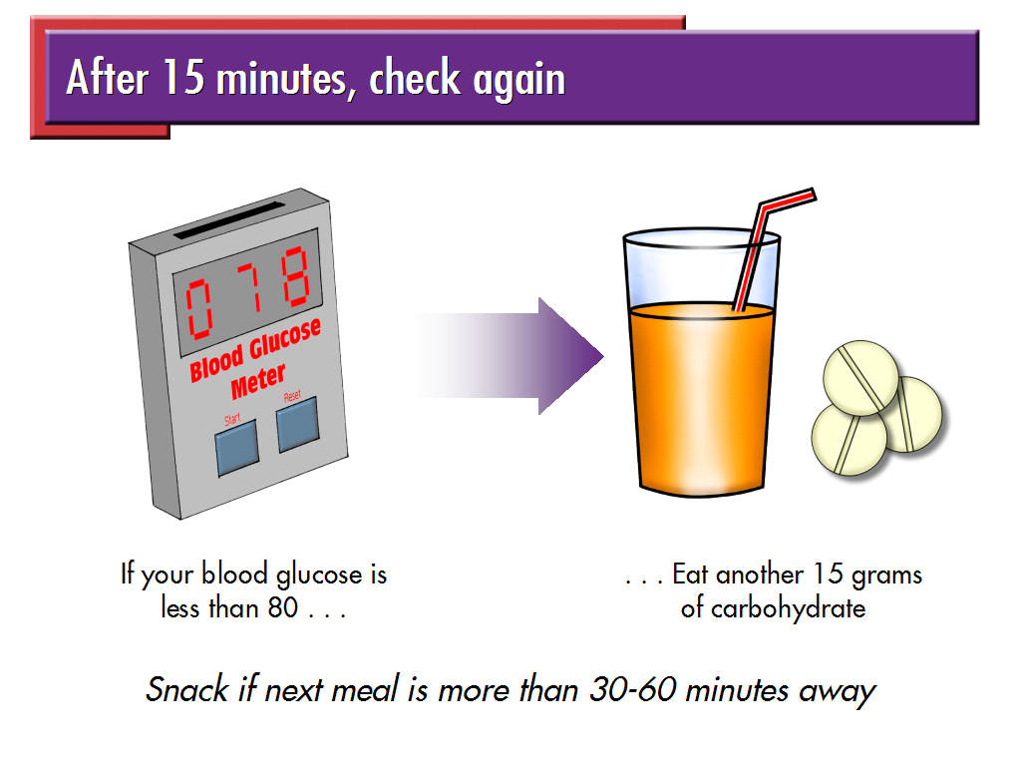

Slide 139

How to care for yourself when you’re hypoglycemic
Eat or drink 15 grams of fast-acting, low-fat carbohydrate right away.
Quick energy sources
The following items are quick energy sources that contain about 15 grams of carbohydrate:
½ cup fruit of orange, apple, or grapefruit juice
1/3 cup grape, prune, or cranberry juice
2 tbsp raisins
6 crackers
3-5 pieces hard candy
1 cup skim milk
1 piece bread
3-4 glucose tablets, or 1 tube glucose gel
½ cup regular soft drink (not diet)
11 jellybeans
96

Slide 140
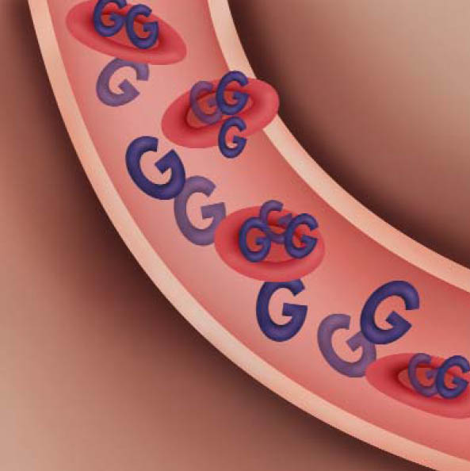
HbA1c: the blood test with a memory
What is HbA1c?
Hemoglobin is a protein that makes your red blood cells red-colored.
When hemoglobin picks up glucose from your bloodstream, the hemoglobin becomes glycosylated.
Glycosylated hemoglobin is HbA1c. The HbA1c test measures the percentage of HbA1c in your blood— a number that corresponds to your average blood glucose for the previous 3 months.
HbA1c in your bloodstream.
45

Slide 141
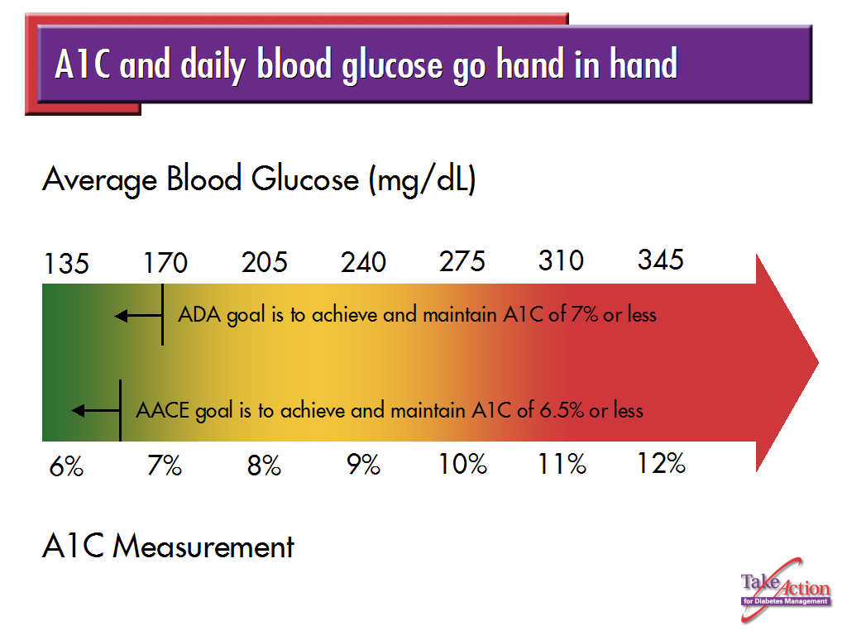

Slide 142
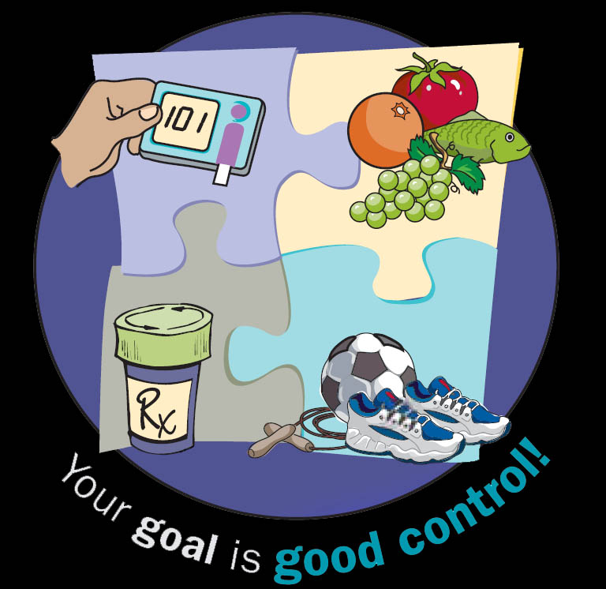
Introduction to self-management
Key pieces of diabetes self-management:
Following a meal plan
Monitoring blood glucose
Getting regular exercise
Taking medication
34

Slide 143
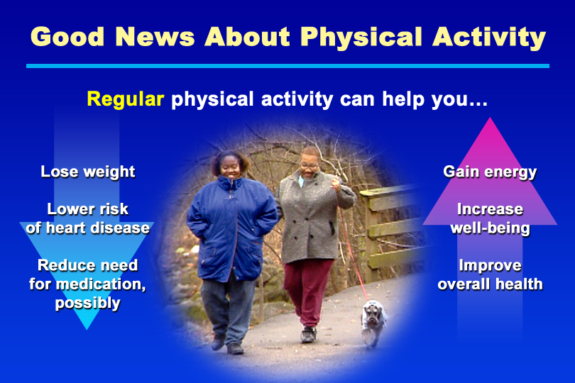
Good News About Physical Activity
Notes:
KEY MESSAGE: Regular physical activity provides numerous physical and psychological benefits for people with diabetes.
Supporting Points
An individualized plan of regular physical activity can help people with diabetes to:
Lose weight or maintain a stable body weight. Regular physical activity can enhance weight loss or aid in weight maintenance, especially when combined with an appropriate calorie-controlled nutrition plan. Physical activity helps the body burn more calories and may increase metabolism by building muscle mass.
Reduce the risk of cardiovascular disease. Regular physical activity strengthens the heart and blood vessels helping to lower blood pressure and heart rate, provides more oxygen to the blood, and improves blood lipids, especially high-density lipoprotein (HDL) cholesterol. These and other favorable effects of physical activity reduce the risk of heart attack and stroke.
Achieve better blood glucose control. During and after physical activity, glucose is removed from the blood for energy, which lowers blood glucose levels. Regular physical activity also can increase insulin sensitivity in target tissues, which may reduce or eliminate the need for diabetes medications in some people.
Improve physical and mental well-being. Patients who are physically active gain energy, strength, and stamina. Regular physical activity can boost self-esteem and reduce stress, encouraging people to take further positive steps toward diabetes self-management.

Slide 144
Can’t exercise?
Pools
Exercise balls or exercise bands
Walking tape
Stationary bikes
Exercise videos
Yoga
Local Recreation Centers or school facilities
TV Programs like: “Sit and Be Fit” M,W, F at 8:30AM on channel 9

Slide 145
Exercise is boring.
Vary your routine and don’t be afraid to try something new.
Participate in things you like to do.
Exercise with a friend
Use music or books on tape to make the time pass more quickly.

Slide 146
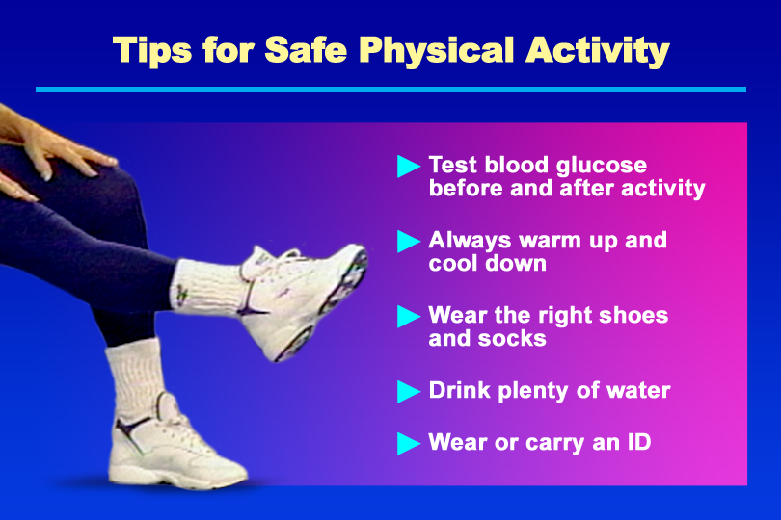
Tips for Safe Physical Activity
Notes:
KEY MESSAGE: To prevent injuries and complications, people with diabetes need to take precautions to ensure safe physical activity.
Supporting Points
To ensure safe physical activity, remind people to:
Test blood glucose before and after physical activity. Exercising while blood glucose is outside the target range (too high or too low) increases the risk of acute complications. In people with type 1 diabetes, exercise can lead to hyperglycemia and ketoacidosis, especially if the blood insulin level is low. Exercise also increases the risk of hypoglycemia, especially in people who use insulin or some oral diabetes medications (sulfonylureas or meglitinides).
Always warm up and cool down. Before physical activity, people should warm up with easy, low-intensity movements. Once muscles are warm, gentle stretching is recommended. When ready to cool down, the activity should not be stopped abruptly. Rather, advise people to slow down the activity, then stretch their muscles again while they are still warm.
Reduce the risk of injury with appropriate clothing and equipment, including well-fitting athletic shoes and absorbent socks. People with diabetes should examine their feet daily and after physical activity to check for redness, blisters, cuts, and sores. Advise them to check inside their shoes before wearing and remove any foreign objects, such as a pebble.
Prevent dehydration. People should begin physical activity well hydrated, and replace body fluids during activity. Water is the best fluid replacement. Adequate hydration helps to prevent muscle cramping and maintain body temperature and blood volume.
Wear or carry diabetes identification, such as a Medic Alert bracelet or an information card that can assist with treatment should an emergency occur. Also, advise people to bring money for a phone call or consider carrying a cell phone during physical activity.
Tip: During physical activity, a person should be able to sing or carry on a conversation with a partner. If a person is too short of breath to talk during the activity, he or she may be overdoing it and should slow down or rest briefly.

Slide 147
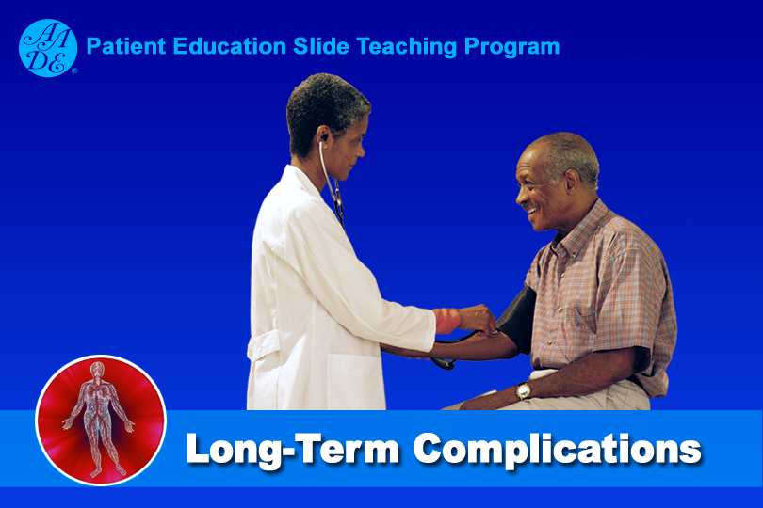
Long-Term Complications
Notes:
Overview of Long-Term Complications Section
Over time, hyperglycemia can damage blood vessels and nerves, leading to serious medical problems. However, the Diabetes Control and Complications Trial (DCCT) and the United Kingdom Prospective Diabetes Study (UKPDS) showed that the risk of most complications can be reduced by achieving tight glycemic control and controlling other risk factors, such as hypertension, dyslipidemia, and smoking.
Although hyperglycemia plays an important role in the etiology of all complications, other risk factors also are important. For this reason, people with diabetes need to be educated about steps to reduce all modifiable risk factors, including high blood pressure, smoking, dyslipidemia, and obesity.
Early detection and prompt treatment of complications are crucial to reduce such adverse outcomes as blindness, kidney failure, and amputation. Encourage people to see their diabetes care team for regular follow-up visits to assess their diabetes management skills, evaluate their overall health, and check for the presence of complications.
Further Readings
American Diabetes Association. Position statement. Diabetic nephropathy. Diabetes Care. 2002;25(suppl 1):S85–S89.
American Diabetes Association. Position statement. Implications of the Diabetes Control and Complications Trial Study. Diabetes Care. 2002;25(suppl 1):S25–S27
American Diabetes Association. Position statement. Implications of the United Kingdom Prospective Diabetes Study. Diabetes Care. 2002;25(suppl 1):S28–S32.
American Diabetes Association. Position statement. Screening for diabetic retinopathy. Diabetes Care. 2002;25(suppl 1):S90–S93.
American Diabetes Association. Position statement. Standards of medical care for patients with diabetes mellitus. Diabetes Care. 2002;25(suppl 1):S33–S49.
American Diabetes Association. Position statement. Treatment of hypertension in adults with diabetes. Diabetes Care. 2002;25(suppl 1):S71–S73.
Diabetes Control and Complications Trial Research Group. The effect of intensive treatment of diabetes on the development and progression of long-term complications in insulin-dependent diabetes mellitus. N Engl J Med. 1993;329:977–986.
Franz MJ, ed. Diabetes and Complications. A CORE Curriculum for Diabetes Educators. Vol. 1. 4th ed. Chicago, Ill.: American Association of Diabetes Educators; 2001.
United Kingdom Prospective Diabetes Study Group. Intensive blood glucose control with sulphonylureas or insulin compared with conventional treatment and risk of complications in patients with type 2 diabetes (UKPDS 33). Lancet. 1998;352:837–853.
United Kingdom Prospective Diabetes Study Group. Tight blood pressure control and risk of macrovascular and microvascular complications in type 2 diabetes (UKPDS 38). BMJ. 1998;317:703–713.

Slide 148
Hyperglycemia Can Cause Serious Long-Term Problems
Notes:
KEY MESSAGE: Over time, high blood glucose can lead to serious medical problems.
Foot care from NIH 2011:
NIH Clinical Management of HTN:
Supporting Points
Over time, hyperglycemia can damage large blood vessels, leading to stroke, heart attack, and loss of circulation in the arms and legs. According to the ADA, heart disease is the leading cause of diabetes-related deaths. People with diabetes are two to four times more likely to die of heart disease than those without diabetes.
Hyperglycemia also can damage small blood vessels and nerves, causing blindness, kidney disease, and other problems. Diabetes is the leading cause of kidney disease (nephropathy) and blindness (retinopathy) in adults under age 75. Diabetes also is a major cause of lower limb amputation. Other complications (not shown) include dental disease, complications of pregnancy, and sexual dysfunction.
Untreated diabetes can cause serious complications even if a person feels fine. Type 2 diabetes has been called a “silent killer” because many people are not aware they have the disease until they develop serious complications.
People with diabetes can reduce the risk of long-term complications by following their recommended diabetes care plans. For both type 1 and type 2 diabetes, major studies have shown that people who maintain their blood glucose as close to normal as possible reduce their risk of serious long-term complications.

Slide 149
Diabetes-CVD Facts
Nearly all adults with diabetes have one or more cholesterol problems, such as:
high triglycerides
low HDL (“good”) cholesterol
high LDL (“bad”) cholesterol
4

Slide 150
ABC’s
A – A1c, or hemoglobin A1c test.
ADA goal is 7% or less.
AACE goal is 6.5% or less.
B – Blood pressure
< 130/80 mmHg for non-pregnant adults.
C – Cholesterol
HDL (good) cholesterol – >40 mg/dl (men); >50 mg/dl (women)
LDL (bad) cholesterol – <100 mg/dl
Triglycerides – <150 mg/dl

Slide 151
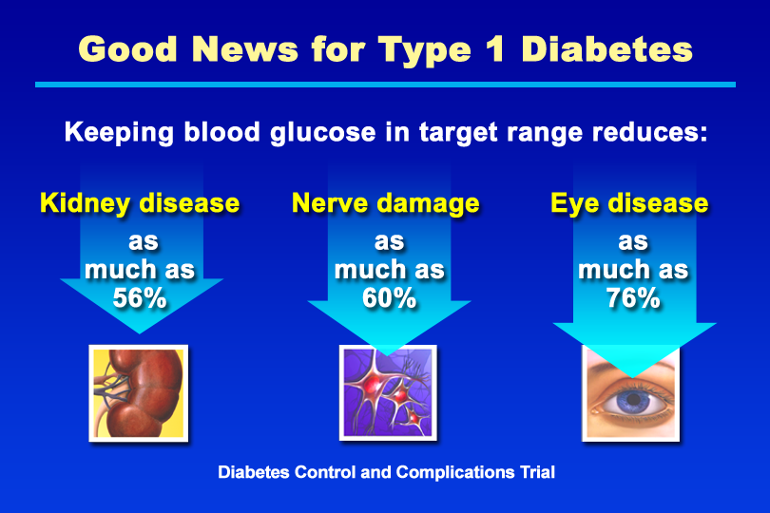
Good News for Type 1 Diabetes
Notes:
KEY MESSAGE: The DCCT showed that people with type 1 diabetes who followed an intensive therapy regimen that lowered their A1c values had fewer long-term complications.
Supporting Points
The DCCT is the longest and largest study to show that lowering blood glucose to improve A1c results slows or prevents the development of complications in type 1 diabetes. The DCCT examined more than 1,400 people with type 1 diabetes for 10 years. Two groups of patients were followed: one treated conventionally and another treated intensively. The volunteers in the intensive treatment group tested their blood more often and followed a more stringent schedule for insulin injection (multiple daily insulin injections or treatment with an insulin pump). Compared with people who had conventional therapy, the intensive treatment group had 35% to 56% less kidney damage (decreases in microalbuminuria and albuminuria, respectively), 60% less nerve damage (clinical neuropathy), and 76% less eye disease (retinopathy).
Improved glycemic control also was associated with fewer cardiovascular events in the DCCT. However, this finding was not statistically significant, perhaps because the study volunteers were young adults in whom the incidence of heart disease would be expected to be low.

Slide 152
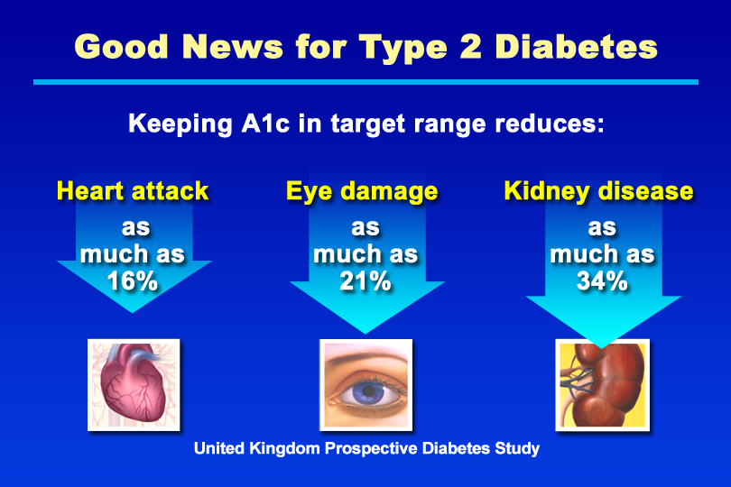
Good News for Type 2 Diabetes
Notes:
KEY MESSAGE: The UKPDS showed that tight control of blood glucose reduces long-term complications in people with type 2 diabetes.
Supporting Points
The UKPDS showed that long-term complications in type 2 diabetes are not inevitable. The UKPDS studied more than 5,000 people with type 2 diabetes for an average of 10 years to learn if intensive management would help delay or prevent complications. Those people who kept their blood glucose levels as close to normal as possible (A1c at 7% or less) had less eye disease, kidney disease, and nerve damage.
The UKPDS also showed the importance of blood pressure management in reducing cardiovascular complications. People with type 2 diabetes who followed an intensive regimen to manage blood glucose and blood pressure significantly reduced their risk of macrovascular disease (heart attack and stroke). Controlling high blood pressure further reduced the risk of microvascular complications, such as eye and kidney disease.

Slide 153
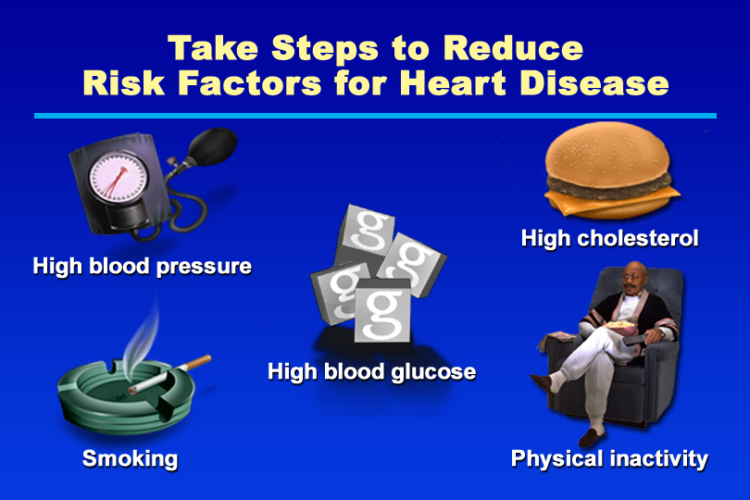
Take Steps to Reduce Risk Factors for Heart Disease
Notes:
KEY MESSAGE: By recognizing and reducing modifiable risk factors for heart disease, people with diabetes can prevent or delay the onset of complications.
Supporting Points
Most risk factors for heart disease can be modified through lifestyle changes and, often, use of medications. Modifiable risk factors for heart disease include hyperglycemia, hypertension, high cholesterol, high triglycerides, physical inactivity, obesity, and smoking. Only a few risk factors, such as a family history of heart disease, cannot be changed.
Help people with diabetes identify their modifiable risk factors and take steps to reduce them. By working with their diabetes educators, people can choose targeted interventions to improve their individual risk profiles.
Tip: The American Diabetes Association and the American College of Cardiology have recently begun a public education campaign to increase awareness of the link between diabetes and heart disease. The Make the Link campaign provides a number of useful educational resources, available by calling the American Diabetes Association at 800-DIABETES (800-342-2383) or using the Internet site www.diabetes.org/makethelink.

Slide 154
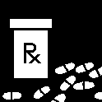

Aspirin Therapy
Recommended dose: 81-325 mg /day
Should not be used in people with: Aspirin allergies, a history of gastric bleeding, clotting disorders, or people already taking a blood-thinning agent.

Slide 155
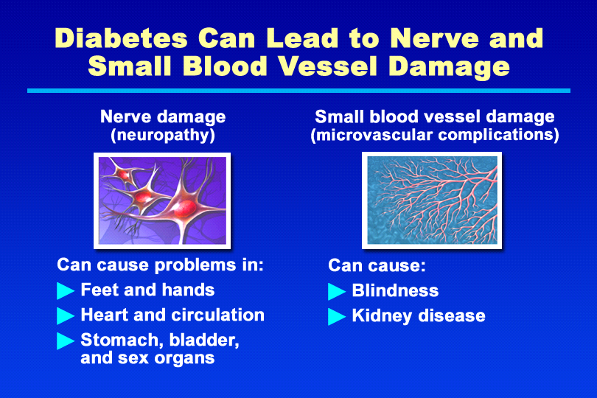
Diabetes Can Lead to Nerve and Small Blood Vessel Damage
Notes:
KEY MESSAGE: In people with diabetes, damage to small blood vessels (microvascular complications) and nerves (neuropathy) can occur, increasing the risk of eye disease, kidney disease, sexual dysfunction, and other serious medical problems.
Supporting Points
Hyperglycemia, often acting in concert with hypertension, can lead to small blood vessel damage. Microvascular complications include:
Eye disease. Eye disease is 25 times more common in people with diabetes than in the general population. Diabetic retinopathy (a term for disorders of the retina associated with diabetes) is the leading cause of blindness in the United States for people between 20 and 74. In addition, people with diabetes are twice as likely to develop glaucoma and cataracts as those without diabetes.
Kidney disease. About 20% to 30% of people with diabetes develop nephropathy (kidney damage), and diabetes is the leading cause of end-stage renal disease.
Hyperglycemia can lead to nerve damage. Diabetes is the most common cause of peripheral neuropathy. Peripheral neuropathy of the sensory nerves contributes to the development of foot ulcers, which can lead to amputation. Lower extremities tend to be more seriously affected than upper extremities, but neuropathy also can affect the hands and arms. Diabetes-related damage to nerves that supply internal body organs (autonomic neuropathy) also may occur. Autonomic neuropathy can lead to problems with regulation of blood pressure, heart rate, bladder emptying, and digestion. Sexual dysfunction, including erectile dysfunction in men and a number of female sexual problems, is another common long-term complication of diabetes.

Slide 156
Getting regular medical care
Schedule for routine medical care
HbA1c
2-4 times/year
Blood pressure
At least 2 times/year
Cholesterol
At least every other year
Dilated eye exam
1 time/year
Foot exam
At least 1 time/year
Dental exam
2 times/year
Urine microalbumin/ creatinine ratio
1 time/year
Flu shot
1 time/year
76
Pneumococcal vaccine
Once (repeat at age 65)

Slide 157
Tuberculosis

Slide 158
Tuberculosis
Specific infectious disease caused by M. tuberculosis
It primarily affects the lungs and causes pulmonary tuberculosis (Pulmonary tuberculosis (TB) is a contagious bacterial infection that involves the lungs).
It also affects intestine, meninges (Three layers of membranes known as meninges protect the brain and spinal cord), bones and joints
The disease also affects animals like cattle is known as “ Bovine tuberculosis”
Sometimes it may communicated to man

Slide 159
Symptoms
Coughing for three or more weeks
Coughing up blood or mucus (Mucus is a normal, slippery and stringy fluid substance produced by many lining tissues in the body).
Chest pain, or pain with breathing or coughing
Unintentional weight loss
Fatigue
Fever
Night sweats
Chills
Loss of appetite

Slide 160
Classification
Classification on the basis of Anatomical site of disease
I) Pulmonary tuberculosis : Any bacteriologically confirmed or clinically diagnosed case of TB involving the lung parenchyma (The lung parenchyma is that portion of the lungs involved in gas exchange)
II) Extrapulmonary tuberculosis : Involved other than lungs e.g. lymph nodes (A small bean-shaped structure that is part of the body's immune system. Lymph nodes filter substances that travel through the lymphatic fluid, and they contain lymphocytes (white blood cells) that help the body fight infection and disease. There are hundreds of lymph nodes found throughout the body), abdomen, skin, joints and bones.

Slide 161
History of previous TB treatment
I) New patients : Patients who have never been treated for TB or have taken anti-TB drugs for less than one month
II) Previously treated patients: Patients who have received 1 month or more of anti-TB drugs in the past.

Slide 162
Classification on the basis of drug resistance(Drug resistance is the reduction in effectiveness of a medication such as an antimicrobial (antimicrobial is an agent that kills microorganisms or stops their growth ) or an antineoplastic in treating a disease or condition.
Monoresistance : Resistance to one first line anti TB drug only
Polydrug resistance: Resistance to more than one first line anti TB drug
Multidrug resistance: Resistance to at least both isoniazid and rifampicin
Extensive drug resistance: Resistance to any fluoroquinolone and at least one of three second line injectable drugs
Rifampicin resistance : Resistance to rifampicin detected using phenotypic or genotypic methods with or without resistance to other anti-TB drugs

Slide 163
Classification based on HIV Status
HIV positive TB patients : Bacteriologically confirmed or clinically diagnosed case of TB has positive result from HIV testing at the time of TB diagnosis
HIV negative TB patients : Refers to any bacteriologically confirmed or clinically diagnosed case of TB who has a negative result from HIV testing at the time of TB diagnosis
HIV unknown TB patients: Bacteriologically confirmed or clinically diagnosed case of TB who has no result of HIV .

Slide 164
Source of Infection
Human source
Bovine source
The bovine source of infection is usually infected milk

Slide 165
Mode of transmission
Droplet infection and droplet nuclei
Coughing
Ventilation of the environment

Slide 166
Diagnosis
Bacteriological test
Zeihl-Neelsen stain
Auramine stain
Sputum culture test
Radiography
Nucleic and amplification
Tuberculosis skin test

Slide 167
Bacteriological test
Microscopic examination and culture are still today essential elements of the bacteriological diagnosis of tuberculosis.
Microscopic examination of a Ziehl fuchsin or auramine stained specimen allows detection of most strains in less than an hour.

Slide 168
Sputum culture test
A sputum culture is a test that checks for bacteria or another type of organism that may be causing an infection in your lungs or the airways leading to the lungs.
Sputum, also known as phlegm, is a thick type of mucus made in your lungs.

Slide 169
How is sputum culture done?
You will be asked to cough deeply and spit any phlegm that comes up from your lungs into a special container.
The sample is sent to a lab.
There, it is placed in a special dish (culture).
It is then watched for two to three days or longer to see if bacteria or other disease-causing germs grow

Slide 170
What does a positive sputum test mean?
A sputum culture is a test to find germs (such as TB bacteria) that can cause an infection.
A sample of sputum is added to a substance that promotes the growth of bacteria. If no bacteria grow, the culture is negative.
If bacteria grow, the culture is positive.
If TB bacteria grow, then the person has tuberculosis.

Slide 171
What is a normal sputum culture?
Normal: Sputum that has passed through the mouth normally contains several types of harmless bacteria.
These include some types of strep (Streptococcus) and staph (Staphylococcus).
The culture should not show any harmful bacteria or fungi.
Normal culture results are negative.

Slide 172
What color is sputum of tuberculosis?
Tuberculosis (TB) If someone has TB, they may cough up green or bloody phlegm.
They will also experience symptoms that can include: weight loss. night sweats.

Slide 173
Radiography
Chest radiography, or chest X-ray (CXR) is a rapid imaging tool that allows for easy identification of lung abnormalities.
CXR is an essential tool for early detection of tuberculosis (TB).

Slide 174
WHAT IS A NAAT FOR TB?
A nucleic acid amplification test, or NAAT, for tuberculosis (TB) is a molecular test used to detect the DNA (deoxyribonucleic acid) of Mycobacterium tuberculosis complex (MTBC) in a sputum or other respiratory sample.
Because the amount of DNA in a sample is very small, NAA testing includes a step that amplifies (or copies) the genetic material.
Polymerase Chain Reaction (PCR) is a common form of NAAT used in laboratory diagnosis.
GeneXpert® MTB/RIF test is a PCR that simultaneously detects MTBC and the genetic mutation that confers rifampin (RIF) resistance.

Slide 175
What is the tuberculosis skin test?
The tuberculosis skin test determines if someone has developed an immune response to the bacterium that causes tuberculosis (TB).
This response can occur if someone currently has TB, if they were exposed to it in the past, or if they received the BCG vaccine against TB (which is not administered in the U.S.).
Estimates indicate that one-third of the world's population has latent TB, and around 1.3 million people worldwide die of TB each year.
The tuberculin test or PPD (purified protein derivative) test are other names for the tuberculosis skin test.

Slide 176
Prevention and Treatment
Elimination of Reservoir
Breaking the chain of transmission
Protection of susceptible
Mask
BCG Vaccine
Regular medical check up
Ventilation

Slide 177
Continues…
Natural sunlight
Personal hygiene
Immunization
Healthy life style and environment
Immunization

Slide 178
Treatment
For latent tuberculosis - the standard treatment six to nine months of isoniazid alone.
First line drugs – Ethambutol, isoniazid, pyrazinamide, rifampicin

Slide 179
POLIOMYELITIS

Slide 180
POLIOMYELITIS
Acute viral infection caused by an RNA virus
Virus infect the central nervous system
Primarily an infection of the human alimentary tract
Polio, or poliomyelitis, is a disabling and life-threatening disease caused by the poliovirus. The virus spreads from person to person and can infect a person's spinal cord, causing paralysis
During January 2020–April 30, 2022, a total of 1,856 paralytic cVDPV cases were reported globally: 1,113 in 2020 and 688 in 2021
The last case of polio in India was reported in Howrah, West Bengal on 13 January 2011

Slide 181
PROBLEM STATEMENT
The extensive use of polio vaccine eliminated the disease in developed countries
World Health Assembly resolved and eradicated the polio globally in 1988
Total of 22 cases reported globally in 2017
Polio eradication and endgame strategic plan 2013-2018 represents major mile stone in polio eradication
Specifics steps and strategic plan of action successfully eradicated the polio

Slide 182
EPIDEMIOLOGICAL DETERMINANTS
AGENT
3 stereotype causative agents are in polio
Stereotype 1,2 and 3 virus
RESERVOIR OF INFECTION
Human being is the only one known reservoir of polio virus infection

Slide 183
INFECTIOUS MATERIAL
The virus found in the faeces and oropharyngeal secretion of an infected person
PERIOD OF COMMUNICABILITY
The virus excreted commonly 2 to 3 weeks
Sometimes as long as 3 to 4 months

Slide 184
HOST FACTORS
AGE
Children are mostly susceptible rather than adult
In India polio essentially a disease among infants and childhood
SEX
Sex ration is an important factor
3 male to 1 female
RISK FACTOR
Fatigue, trauma, intramuscular injection

Slide 185
Mode of Transmission
Faecl- Oral route
Environmental factors
Infected source, contaminated food and water
Droplet infection

Slide 186
Prevention
Immunization is only effective means of prevention
Preventive vaccine is available and useful to effective eradication of polio
Essential to immunize all infants by 6 months of age to protect them from polio
Two types of vaccines are available
Inactivate Polio Vaccine (IVP)
Oral Polio Vaccine (OPV)

Slide 187
Inactivate Polio Vaccine (IVP)
Intramuscular injection vaccine
Primary or initial course of immunization consists of 4 inoculations
First 3 doses are given at interval of 1-2 months
4th dose 6-12 month after the first dose
First dose given the infant is 6 weeks old
Additional dose are recommended prior to school entry and then every 5 years until the age of 18

Slide 188
Oral Polio Vaccine (OPV)
Described by Sabin in 1957
Primary course of 3 dose vaccine are recommended
One month interval respectively the infant is 6 week is old
Recommended to give all the infants at the time of before they leave from the hospital after delivery
The vaccine should be given in the maternity ward
Newborn should take the vaccine to prevent and avoid the infection
It is very important to complete vaccination of all infants before 6 months age
Polio cases mostly reported in 6 months to 3 years.
2 drop is given by orally

Slide 189
ADVANTAGE OF OPV
Development of immunity
Easy to transmit into body by orally
Induces both humoral and intestinal immunity
Antibodies will produce large amount very quickly even in a single dose
Useful in control epidemic
Relatively inexpensive

Slide 190
STRATEGIES OF POLIO ERADICATION IN INDIA
Conduct pulse polio immunization day every year until polio is eradicated
Sustain high level of routine immunization coverage
Monitor OPV coverage at district level and below
Improve the surveillance
Ensure rapid case investigation
Arrange and maintain follow up cases

Slide 191
EPIDEMIOLOGICAL INVESTIGATION
LINE LISTING CASE
MOPPING UP
AWARE NESS
VACCINATION

Slide 192
PULSE POLIO IMMUNIZATION PROGRAM IN INDIA
The pulse polio immunization program introduced in India 1995
First PPI aims to find out the whole children under the age of 3 years in the country
Later as per the recommendation of WHO it was decided to increase 3 to 5 years
All states and UT in India developed a Rapid Response Team
Conducted immunization campaign from the village level in the states
Environmental surveillance has been started
107 high risk polio blocks where found in different states of India
Social mobilizing programs and activities are conducted with the support of social influencers and community, religious leaders
As a result wide and strong campaign the polio has been eradicated in India in 2013

Slide 193

Leprosy

Slide 194
Leprosy
Chronic infectious disease
Caused by M. leprae
It affects peripheral nerves
It also affects the skin, muscles, eyes, bones and internal organs
Leprosy is widely prevalent in India

Slide 195
Agent factors
Leprosy is caused by M. leprae
Acid
Fast and occur in the human host both intracellularly and extracellularly

Slide 196
Source of Infection
In lepromatous and borderline lepromatous cases are the most important source of the infection in the community
The inapparent infections are also source of infection
The individuals with active leprosy considered as infectious

Slide 197
Classification
Indeterminate type
Tuberculoid type
Borderline type
Lepromatous type
Pure neuritic type

Slide 198
Classification
Indeterminate type
Early cases
One or two vague hypo pigmented macules
definite sensory impairment
The lesions are bacteriologically negative

Slide 199
Tuberculoid type
On or two defined lesions
Flat or raised / hypo-pigmented
The lesions are bacteriologically negative

Slide 200
Borderline type
Four or more lesions, which may be flat or raised
Well or ill defined
Hypo-pigmented
Sensory impairment or loss
The bacteriological positivity of these lesions variable

Slide 201
Lepromatous type
Diffuse infiltration or numerous flat or raised
Poorly defined, shiny, smooth, symmetrically distributed lesions
Bacteriologically negative

Slide 202
Pure neuritic type
Those cases of leprosy shows nerve involvement
Do not have any lesion in the skin
Bacteriologically negative

Slide 203
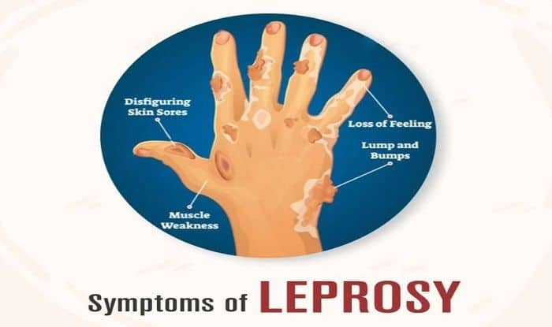
Symptoms
Disfiguring Skin Sores
Loss of Feeling
Lump and Bumps
Muscle Weakness

Slide 204
Mode of Transmission
Droplet Infection
Contact Transmission
Other Routes ( insect vectors, tattooing needles

Slide 205
Diagnosis
Clinical examinations
a) Interrogation b)Physical examinations
Bacteriological examinations
Foot pad culture
Histamine Test
Biopsy
Immunological Test

Slide 206
Prevention
Early detection and treatment of cases
Health education and Counselling
Control of patient, contacts and immediate environment

