Slide 1
MICRO ECONOMICS - I
Dr. K. Vetrivel
Assistant professor,
Department of Economics,
Bharathidasan University,
Tiruchirappalli – 620 024
Tamil Nadu, India
Email: vetrivelkvr@gmail.com

Slide 2
Perfect Competition
One in which the number of buyers and sellers is very large ,all engaged in buying and selling a homogeneous product in the market.
Characteristics:
  Large number of firms
  Products are identical – consumer has no reason to express a preference for any firm
  Freedom of entry and exit into and out of the industry
  Firms are price takers – have no control
  over the price they charge for their product
  Each producer supplies a very small proportion
  of total industry output
  Consumers and producers have perfect knowledge about the market

Slide 3
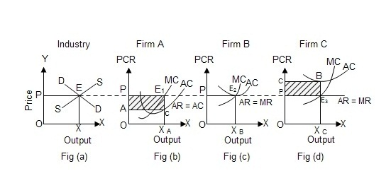
Short run equilibrium of firm and industry

Slide 4
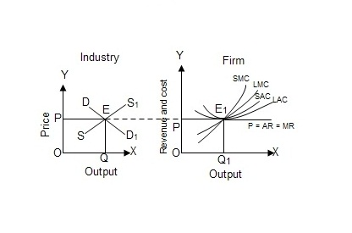
Long run equilibrium of firm and industry

Slide 5
Monopoly
Monopoly refers to a situation where there is a single producer and seller of a producer. The single producer –seller may be an individual or a partnership company or a joint stock company or a state.

Slide 6
Characteristics of Monopoly :
One Seller and Large Number of Buyers
Price Maker
Difficulty of Entry of New Firms
There are no close substitutes for the product.
Absence of Competition

Slide 7
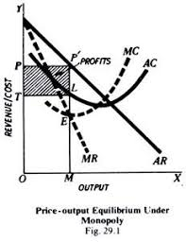

Slide 8
Price discrimination
Selling the same commodity at different price to different buyers is known as price discrimination . Price Discrimination is defined as ,“the sale of technically similar product at prices which are not in proportion to marginal cost”. Price discrimination is also called discriminating monopoly.
Types of Price Discrimination:
Price discrimination may be of various types. It may either be (i) personal (ii) trade discrimination (iii) Place discrimination.

Slide 9
(1) Price discrimination. It is persona!, when separate price is charged from each buyer according to the intensity of his desire or according to the size of his pocket.
For instance, a doctor may charge $20000 from a rich person for an eye operation and $500 only from a poor man for the similar operation.
(2) Trade discrimination. It may take place when a monopolist charges different prices according to the uses to which the commodity is put.
Example, an electricity company may charge low rate for electric current used in an industrial concern than for the electricity used for the domestic purpose.

Slide 10
3) Place discrimination.
It occurs when a monopolist charges different prices for the same commodity at different places. This type of discrimination is called dumping.
In Economics, a monopolist sells the same commodity at a higher price in one market and at a lower price in the other. Dumping may be undertaken due to several reasons,
(a) a monopolist may resort to dumping in order to dispose off the accumulated stock or
(b) he may, dump the commodity with a desire to capture the foreign market,
(c) dumping may also be done to drive the competitors out of the market,
(d) the motive may also be to reap. the economies of large scale production, etc.

Slide 11
Baumol’s Theory of Sales Revenue Maximization
Maximize sales revenue subject to minimum profit constraint
Why sales revenue and not profits??
  Sales are good general indicatof of organizational performance
  Executive power, influence, status tend to be linked to the sales performance
  Lenders tend to rely on sales data

Slide 12
Assumptions:
There is a single period time horizon of the firm.
The firm aims at maximising its total sales revenue in the long run subject to a profit constraint.
The firm’s minimum profit constraint is set competitively in terms of the current market value of its shares.
The firm is oligopolistic whose cost cures are U-shaped and the demand curve is downward sloping. Its total cost and revenue curves are also of the conventional type.

Slide 13
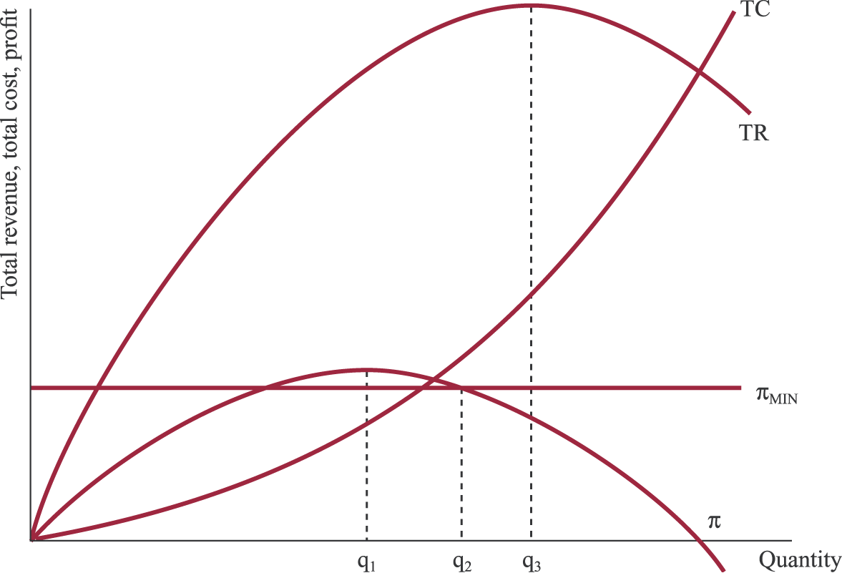
Baumol’s sales revenue maximization model

Slide 14
Game Theory
Game theory is a framework for hypothetical social situations among competing players. In some respects, game theory is the science of strategy, or at least the optimal decision-making of independent and competing actors in a strategic setting. The key pioneers of game theory were mathematicians John von Neumann and John Nash, as well as economist Oskar Morgenstern.
Examples of Game Theory.Both players have a dominant strategy.
A dominant strategy occurs when there is an optimal choice of strategy for each player no matter what the other does.

Slide 15
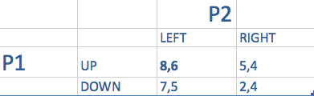
If P2 chooses left P1 will choose UP
If P2 chooses right P1 will choose UP
Therefore UP is a dominant strategy for P1
P2 will always choose right no matter what P1 does
The unique equilibrium is (up, left). This is best for both

Slide 16
Nash Equilibrium
There are many games which don’t have a dominant strategy.
Definition: A Nash equilibrium occurs when the payoff to player one is the best given the other’s choice.

Slide 17
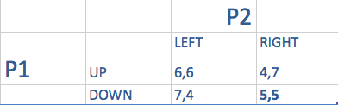
In this case If P1 chooses down, P2 will choose right
If P1 choose UP, P2 will choose right. But, if P2 choose right, P1 will want to choose down.
The nash equilibirum will be down right, (5,5) despite UP left being the optimal Pareto outcome.

Slide 18
Actions by everyone involved directly alter dynamics of the game, and hence the players are all interdependent. The games can be broadly classified into two categories: zero-sum and non-zero-sum. In zero-sum games, the loss of one is gain of another. It is not the case in non-zero-sum games, there can be a net gain or net loss.
John von Neumann is the pioneer of the field of game theory. It is distantly related to the rational-agent model in traditional Economics and gave an impetus to Bernoulli’s theory of utility. There are two main branches of game theory: cooperative and non-cooperative.

