Slide 1
MICRO ECONOMICS - I
Dr. K. Vetrivel
Assistant professor,
Department of Economics,
Bharathidasan University,
Tiruchirappalli – 620 024
Tamil Nadu, India
Email: vetrivelkvr@gmail.com

Slide 2
Basic Economic Principles:
What to produce?
How to produce?
For whom to produce?

Slide 3
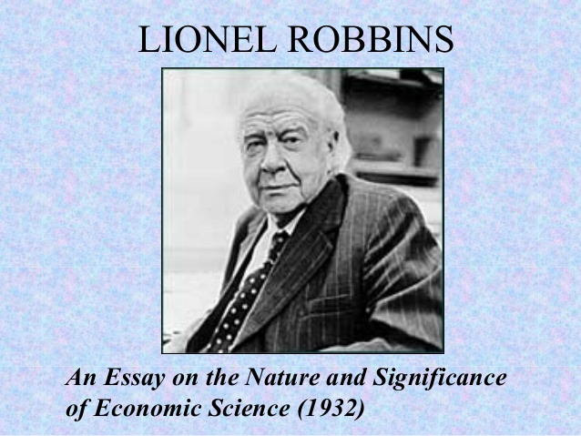
Scarcity
scarcity means that people want more than is available, scarcity limits us both as individuals and as a society.
That the demand for something is much greater than the supply ,or there is not enough money to buy it.
Choice
Economics concern situations in which choices must be made about how to use limited resource, when to use them ,and for what purpose.

Slide 4
Deductive methods
Deduction means reasoning or inference from the general to the particular or from the universal to the individual.
Deduction involves four steps:
Selecting the problems
The formation of assumptions on the basis of which the problem is to be explored
The formation of hypothesis through the process of logical reasoning whereby inferences are drawn.
Verifying the hypothesis

Slide 5
Deductive Method
Demerits
Merits:
Real
Simple
Powerful
Exact
Indispensable
Universal
Unrealistic assumption
Not universally applicable
Incorrect verification
Abstract method
Static method
Intellectually

Slide 6
Inductive Method
Inductive means is the process of reasoning from a part of the whole from particulars to general or from individual to the universal.
The inductive methods involves the following steps:
The problem
Data
Observation
Generalisation

Slide 7
Inductive Method
Merits:
Demerits
Realistic
Future enquiries
Statistical method
Dynamic
Historical-Relative
Misinterpretation
Uncertain conclusions
Lacks concreteness
Costly methods
Difficult to prove hypothesis
Controlled experimental not possible in economics

Slide 8
Base of difference
Difference between Inductive and Deductive method
Inductive theory is an approach to research that starts with the observation and the end results of the research is theory.
Deductive theory is an approach to research that starts with the proposition of hypothesis and the end results of the research is confirmation/rejection
Meaning
Hypothesis
Structure
Size of sample
Scrutiny
Time factor
Theory
Approach

Slide 9
Base of difference
Inductive approach to research does not have any place for hypothesis. So, researcher is free to alter direction of the study.
Deductive approach to research starts with the hypothesis itself .Research is bounded not to alter direction of he study.
Meaning
Hypothesis
Structure
Size of sample
Scrutiny
Time factor
Theory
Approach

Slide 10
Base of difference
Inductive approach is less structured as there is no guiding factor .
Deductive approach is highly structured because there is some specific aim to be accomplished.
Meaning
Hypothesis
Structure
Size of sample
Scrutiny
Time factor
Theory
Approach

Slide 11
Base of difference
Inductive approach is appropriate for small sample project because small number of samples are analysed with greater gravity.
Deductive approach is appropriate for large sample project because large number of samples are analysed with less depth.
Meaning
Hypothesis
Structure
Size of sample
Scrutiny
Time factor
Theory
Approach

Slide 12
Base of difference
More scrutinized information about the subject matter.
Less scrutinized in getting information regarding subject matter.
Meaning
Hypothesis
Structure
Size of sample
Scrutiny
Time factor
Theory
Approach

Slide 13
Base of difference
Inductive approach assumes that there is abundance of time; so depth analysis is possible.
Deductive approach assumes that there is shortage of time; so depth analysis of large number of sample is unattainable.
Meaning
Hypothesis
Structure
Size of sample
Scrutiny
Time factor
Theory
Approach

Slide 14
Base of difference
Inductive approach is concerned with building a new theory.
Deductive approach is concerned with testing an existing theory.
Meaning
Hypothesis
Structure
Size of sample
Scrutiny
Time factor
Theory
Approach

Slide 15
Base of difference
Meaning
Hypothesis
Structure
Size of sample
Scrutiny
Time factor
Theory
Approach
Inductive approach to research is bottom- up approach .
Observation
Pattern
Theory
General to Particular

Slide 16
Base of difference
Deductive approach to research is top –down approach .
Meaning
Hypothesis
Structure
Size of sample
Scrutiny
Time factor
Theory
Approach
Theory
Hypothesis
Observation
Particular to General
Confirm/reject

Slide 17
S.NO | POSITIVE ECONOMICS | NORMATIVE ECONOMICS
1 | Classical and modern economists describe economics as a positive science. | Neo-classical economist describe economics as normative science
2 | Positive economics studies what is ? | Normative economics studies what ought to be?
3 | Statement can be empirically verified | Statement may or may not be verified
4 | It is universal and value does not differ from person to person. | It is related to personal belief and value judgement and may differ from person to person
5 | It is depends upon scientific logic or fact | It is depends upon ethical logic or values
6 | It is objective and quantitative in nature | It is subjective and descriptive in nature
7 | It is studies causes and effect relationship | It is studies the outcomes which is right or wrong
8 | It deals with how economic problems are solved | It deals with how economic problems should be solved
9 | Positive analysis is interdependent of normative analysis | Normative analysis depends upon positive analysis,

