Slide 1

DEPARTMENT OF LIFELONG LEARNING
BHARATHIDASAN UNIVERSITY
Tiruchirappalli- 620024,
Tamil Nadu, India
Programme: M.A.,HUMAN RESOURCE MANAGEMENT
Course Title : Welfare and Safety
Course Code : 22HRM3EC2
Unit-III
Understanding Social Security
Dr. T. KUMUTHAVALLI
Associate Professor
Department of Lifelong Learning

Slide 2



Understanding Social Security
Social security is a system of government programs designed to provide a basic level of economic security and social welfare for all citizens. It encompasses a range of benefits and protections to support people throughout their lives.
by Presentation

Slide 3
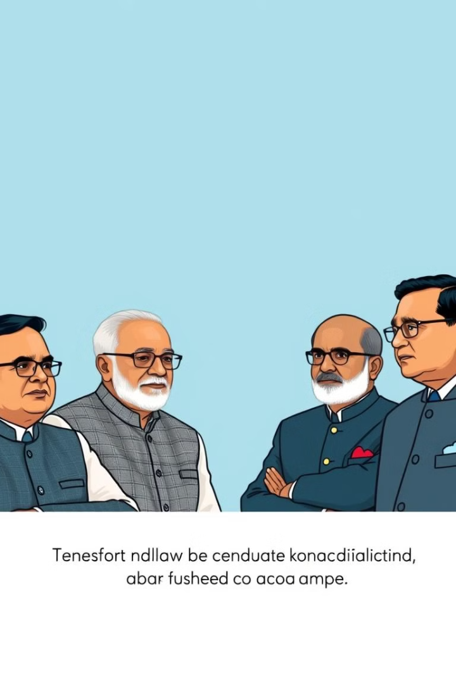
Development of Social Security in India
1
Beginnings
Social security in India has its roots in the 19th century with the introduction of pension schemes for civil servants and military personnel.
2
Expansion
Over time, the system has expanded to include various programs and benefits, with the goal of providing a social safety net for all citizens.
3
Challenges
However, the system still faces challenges in terms of coverage, adequacy of benefits, and effective implementation across the diverse and large population of India.

Slide 4
Income Security
Pensions
Unemployment Benefits
Disability Payments
Retirement pensions provide income security for those who have contributed to the social security system during their working years.
Temporary income support is provided to those who have lost their jobs, helping to bridge the gap until they find new employment.
Individuals with disabilities are provided with financial assistance to cover their basic needs and healthcare expenses.

Slide 5

Social Insurance
Health Insurance
Retirement Savings
Mandatory health insurance schemes ensure that all citizens have access to affordable medical care, reducing the financial burden of healthcare costs.
Compulsory contributions to pension funds and other retirement savings programs help to provide a secure financial future for workers.
Workplace Injury Coverage
Maternity Benefits
Workers' compensation programs provide financial support and medical care for those who sustain injuries or illnesses related to their employment.
Paid leave and financial assistance are provided to new mothers, ensuring their well-being and that of their newborn children.

Slide 6




Social Assistance
Poverty Alleviation
Social assistance programs, such as cash transfers and subsidized food, help to lift individuals and families out of poverty and provide a basic standard of living.
Childcare Support
Subsidized childcare services and allowances help to ensure that all children have access to quality care and education, regardless of their family's financial situation.
Disability Support
Non-contributory social assistance provides essential services and resources to individuals with disabilities, enabling them to live with dignity and independence.

Slide 7
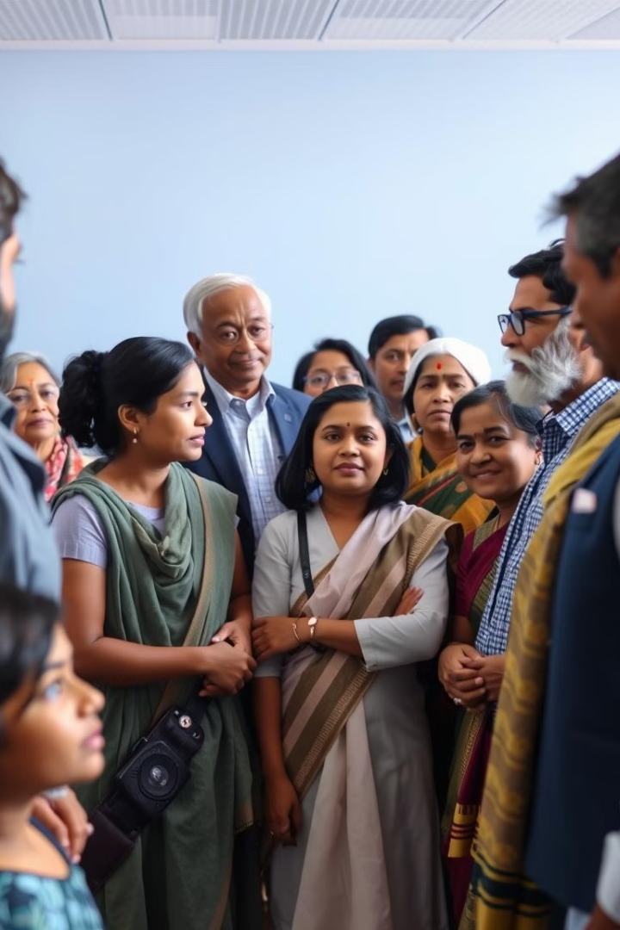




Social Security Measures in India
Retirement Pensions
Health Insurance
Schemes like the Employees' Provident Fund and the National Pension System provide retirement income security for workers.
Programs such as the Ayushman Bharat scheme offer comprehensive health coverage to millions of Indians.
Income Assistance
Disability Support
Cash transfer programs and food subsidies help to alleviate poverty and ensure a basic standard of living.
Specialized schemes provide financial and social support to individuals with disabilities and their families.

