Slide 1

DEPARTMENT OF LIFELONG LEARNING
BHARATHIDASAN UNIVERSITY
Tiruchirappalli- 620024,
Tamil Nadu, India
Programme: M.A.,HUMAN RESOURCE MANAGEMENT
Course Title : Welfare and Safety
Course Code : 22HRM3EC2
Unit-V
Monitoring Safety, Health & Environment
Dr. T. KUMUTHAVALLI
Associate Professor
Department of Lifelong Learning

Slide 2



Monitoring for Safety, Health & Environment
Maintaining a safe and healthy work environment is crucial for any organization, not just for the well-being of employees but also for the long-term sustainability of the business and the surrounding community. This section will explore the key aspects of occupational safety and environmental management systems, as well as the relevant standards and guidelines that organizations can follow to ensure they are meeting their responsibilities.
by Presentation

Slide 3
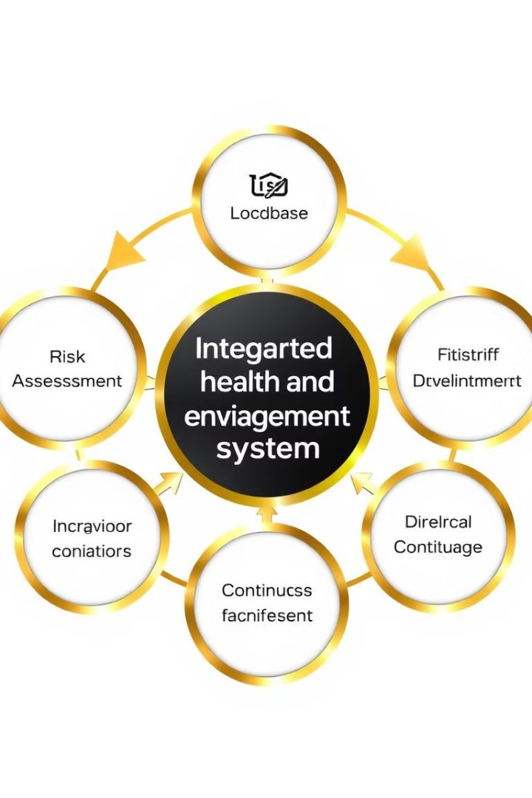
Comprehensive Health and Environment Management Systems
1
Risk Assessment
Identify and evaluate potential health and environmental hazards in the workplace through thorough risk assessments.
2
Policy Development
Establish clear policies and procedures to address identified risks and ensure compliance with relevant regulations.
3
Continuous Improvement
Regularly monitor and review the management system, implementing necessary changes to drive continuous improvement in health and environmental performance.

Slide 4
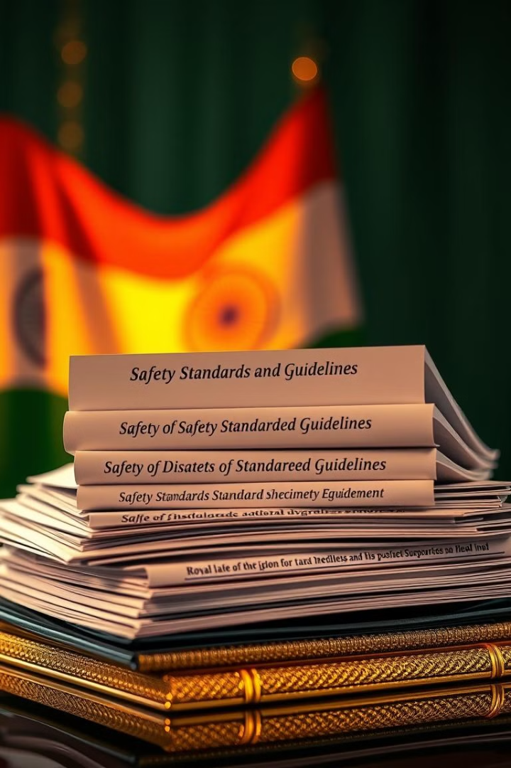
Bureau of Indian Standards on Safety and Health
1
IS 18001:2007 - Occupational Health and Safety Management Systems
2
IS 16001:2012 - Environmental Management Systems
Establishes requirements for an effective environmental management system to help organizations achieve their environmental goals.
Provides a framework for organizations to manage their occupational health and safety responsibilities.
3
IS 15001:2013 - Safety Management Systems for Construction Sites
4
IS 14489:1998 - Code of Practice on Occupational Safety and Health Audit
Outlines specific safety requirements and best practices for construction projects to protect workers and the public.
Provides guidance on conducting comprehensive audits to evaluate the effectiveness of an organization's safety and health management system.

Slide 5
International Standards and Best Practices
ILO Standards
EPA Regulations
ISO 45001 and 14001
The International Labor Organization (ILO) has developed a range of occupational safety and health conventions and recommendations, such as the Occupational Safety and Health Convention (No. 155) and the Promotional Framework for Occupational Safety and Health Convention (No. 187).
The United States Environmental Protection Agency (EPA) sets strict standards and regulations to protect the environment, including the Clean Air Act, the Clean Water Act, and the Comprehensive Environmental Response, Compensation, and Liability Act (CERCLA).
The International Organization for Standardization (ISO) has developed two key management system standards: ISO 45001 for occupational health and safety, and ISO 14001 for environmental management. These standards provide a framework for organizations to improve their performance in these areas.

