Slide 1
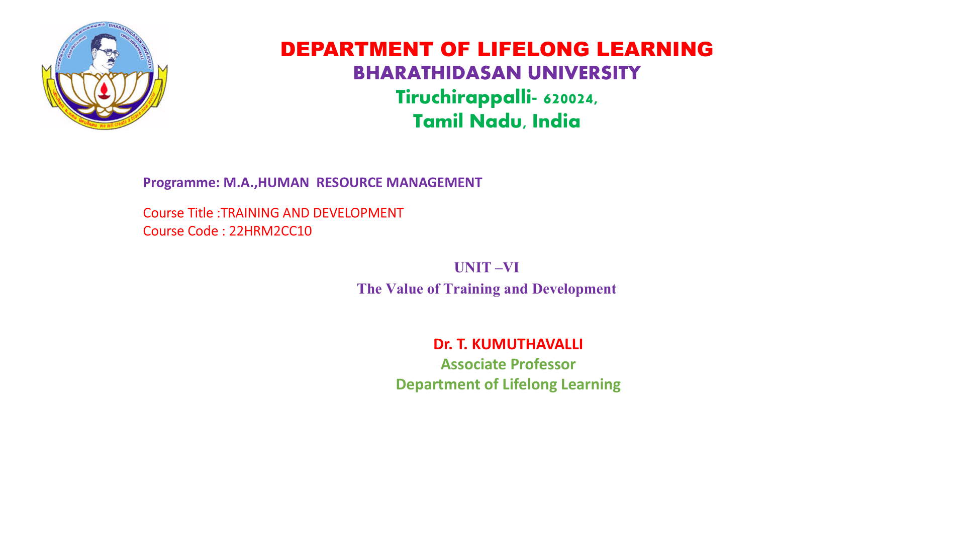

Slide 2
The Strategic Value of Training and Development
Increased Productivity
Enhanced Employee Retention
Improved Innovation
Training empowers employees with the skills and knowledge needed to perform their jobs effectively, leading to increased productivity and efficiency.
Investing in employee development demonstrates a commitment to their growth, fostering a sense of belonging and encouraging them to stay with the organization.
Training provides opportunities for employees to learn new skills and perspectives, fostering creativity and innovation to meet evolving business demands.

Slide 3



Aligning Training with Organizational Goals
Organizational Goals
1
Identify the strategic objectives and priorities that training should support.
Training Objectives
2
Develop specific training objectives that align with those goals, ensuring that training activities are focused and relevant.
Performance Metrics
3
Define measurable metrics to track the effectiveness of training and assess its impact on achieving organizational goals.

Slide 4

Identifying Skill Gaps and Training Needs
1
Performance Reviews
2
Employee Surveys
Review employee performance data to identify areas where skills gaps exist and where training would be beneficial.
Conduct employee surveys to gather feedback on skills development needs, preferences, and areas for improvement.
3
Industry Trends
Stay abreast of industry trends and emerging technologies to ensure training is relevant to current and future needs.

Slide 5

Designing Effective Training Programs
Learning Objectives
Interactive Content
Set clear and measurable learning objectives to guide the development of training content and activities.
Incorporate interactive elements such as simulations, case studies, and group activities to enhance engagement and knowledge retention.
Assessment Strategies
Develop assessment strategies to measure learning outcomes and provide feedback to participants, ensuring that the training is effective.

Slide 6




Delivering Training Across Different Modalities
Classroom Training
Traditional classroom training provides a structured learning environment for interactive discussions and practical exercises.
Online Courses
Online courses offer flexibility and accessibility, allowing employees to learn at their own pace and on their own schedules.
Video Tutorials
Video tutorials can effectively convey technical skills, demonstrating procedures and best practices in a clear and engaging manner.

Slide 7

Evaluating Training Effectiveness
1
Pre-Training Assessment
2
Post-Training Assessment
3
Performance Metrics
4
Feedback Surveys

Slide 8




Fostering a Culture of Continuous Learning
Mentorship Programs
Internal Knowledge Sharing
Learning Incentives
Establish mentorship programs to provide ongoing support and guidance to employees, fostering a collaborative learning environment.
Encourage knowledge sharing within the organization through internal platforms, workshops, and peer-to-peer learning initiatives.
Recognize and reward employees for their commitment to continuous learning, promoting a culture where development is valued.

Slide 9

The Future of Training and Development
1
Personalized Learning
AI-powered platforms will personalize learning paths, adapting to individual needs and learning styles.
2
Virtual Reality Training
VR technology will provide immersive training experiences, simulating real-world scenarios for skill development.
3
Microlearning
Short, focused learning modules will cater to the attention spans of today's workforce, providing bite-sized knowledge.

