Slide 1
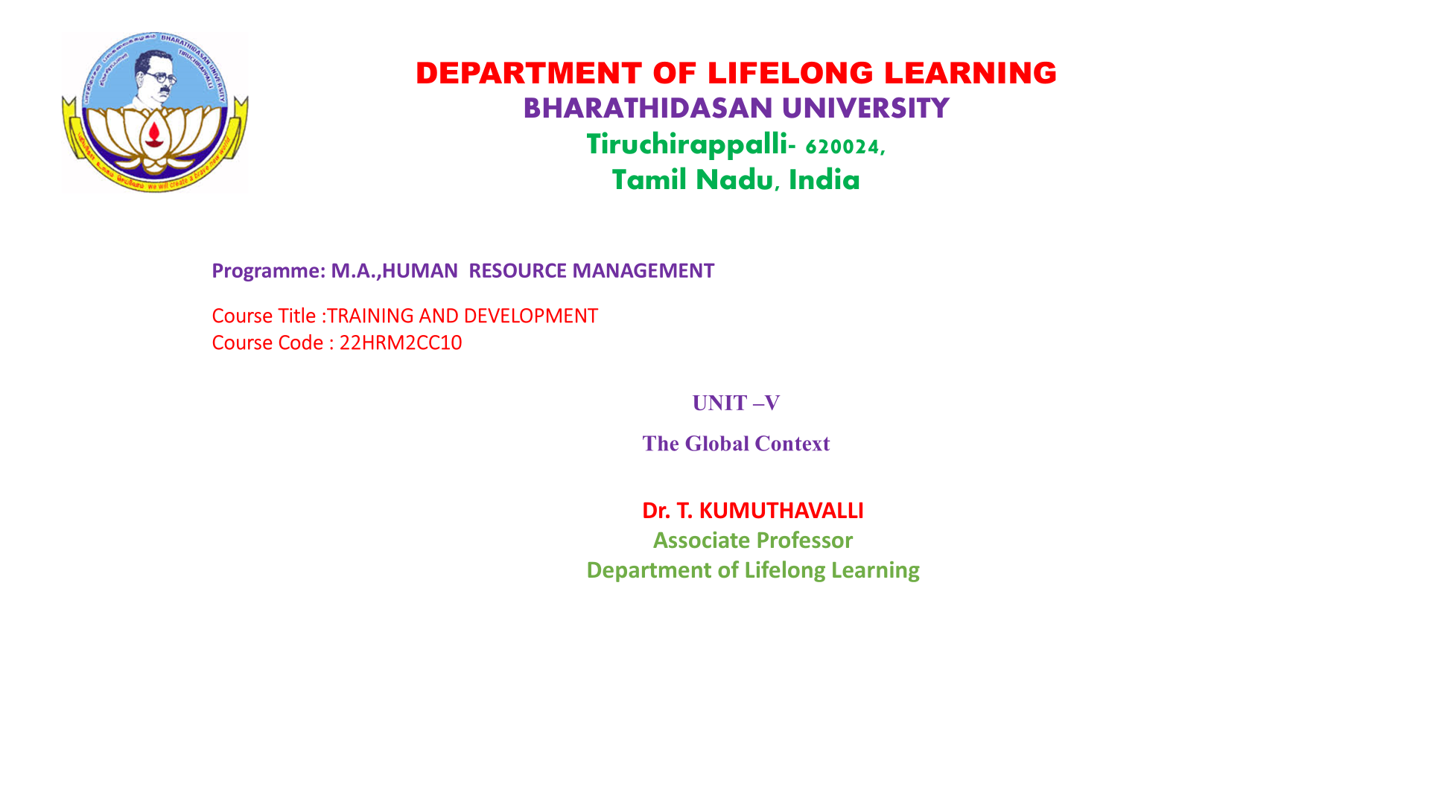

Slide 2
The Changing Nature of Management Development
Digital Transformation
Global Collaboration
Focus on Agility
Skills Gap
Increased globalization requires managers to collaborate across borders and work effectively with diverse teams.
Businesses need to respond quickly to change. Adaptability and flexibility are key skills for successful managers in today's dynamic environment.
The skills needed for success are evolving. Managers must prioritize development of their leadership, communication, and problem-solving skills.
The rise of technology has fundamentally altered how we work. Managers must adapt to a digital world and embrace new tools and practices.

Slide 3





The Responsive Manager & Global Job Rotation
Adaptability
The ability to thrive in diverse environments and adapt to new cultures and workflows.
Cultural Intelligence
Understanding and navigating different cultural norms and perspectives.
Communication Skills
The ability to effectively communicate across cultures and build strong relationships with international colleagues.
Global Mindset
A broad perspective on business challenges and opportunities, informed by global context and diverse viewpoints.

Slide 4





Executive Development in Global Companies
Global Leadership Programs
Mentorship and Coaching
Immersive experiences that develop leaders with a global perspective and cross-cultural skills.
Pairing executives with seasoned mentors to guide their development and provide global insights.
Strategic Alignment
Diversity and Inclusion
Developing leadership competencies that align with the company's global strategic goals and vision.
Fostering a culture of inclusivity and embracing diverse perspectives to drive innovation and performance.

Slide 5

Application of Executive Development Strategies in a Small Company
Identify Core Needs
Focus on Targeted Training
Determine the specific skills and knowledge gaps that need to be addressed in the company.
Develop customized training programs that meet the specific needs of the company and its employees.
Embrace Technology
Promote Continuous Learning
Leverage online learning platforms and virtual collaboration tools to make development more accessible.
Create a culture of continuous learning and development, encouraging employees to invest in their skills.

Slide 6

Training for International Business: Global/Overseas Training Programs
1
Cultural Awareness
Develop a deep understanding of the target country's cultural norms, values, and business practices.
2
Language Training
Equip employees with essential language skills to effectively communicate with local counterparts.
3
Practical Skills Training
Develop skills specific to the target market, such as negotiation, marketing, or sales techniques.
4
Networking Opportunities
Facilitate connections with industry professionals and potential business partners in the target country.

Slide 7





Training in Important Areas: Culture, Values Diversity, Customer Service, Teamwork and Empowerment
1
Culture
2
Values Diversity
3
Customer Service
4
Teamwork
5
Empowerment

Slide 8

Moving Beyond Training: Performance Consulting
1
2
Assessment
Action Planning
Identifying areas for improvement in employee performance, skills, and behaviors.
Developing customized plans to address identified performance gaps.
3
4
Coaching and Support
Evaluation and Iteration
Providing ongoing coaching and support to employees as they implement action plans.
Monitoring progress, evaluating results, and adapting plans as needed.

Slide 9

Conclusion
By embracing the changing landscape of management development, organizations can equip their leaders with the skills and perspectives needed to thrive in a globalized world. This investment in talent will not only benefit the organization, but also contribute to a more connected and collaborative global economy.

