Slide 1

DEPARTMENT OF LIFELONG LEARNING
BHARATHIDASAN UNIVERSITY
Tiruchirappalli- 620024,
Tamil Nadu, India
Programme: M.A.HUMAN RESOURCE MANAGEMENT
Course Title :Total Quality Management
Course Code :22HRM4CC17
UNIT – VI
Case Studies
Dr. T. KUMUTHAVALLI
Associate Professor
Department of Lifelong Learning

Slide 2
Introduction: Real-World Examples of Success
Zappos
Tesla
Toyota
Demonstrating how culture drives exceptional customer service and a unique brand identity.
Illustrating how disruptive innovation and a clear vision can revolutionize an industry.
Showcasing the power of continuous improvement and employee engagement through the Kaizen philosophy.

Slide 3

Changing Company Culture: The Zappos Story
Customer-Centric Values
Empowered Employees
Open and Transparent Communication
Zappos prioritizes customer happiness above all else, empowering employees to go the extra mile to provide excellent service.
Employees are encouraged to be creative and take initiative, fostering a culture of innovation and ownership.
Zappos encourages open communication between employees and leaders, building trust and a sense of community.

Slide 4




Competitive Strategy: Tesla's Disruptive Approach
Vertical Integration
Controlling the entire supply chain, from battery production to vehicle manufacturing, allows Tesla to optimize efficiency and innovate rapidly.
Direct-to-Consumer Model
Eliminating intermediaries and selling cars directly to customers allows Tesla to control pricing and marketing strategies.
Sustainable Focus
Tesla's commitment to clean energy and sustainable transportation has resonated with environmentally conscious consumers.

Slide 5



Secrets to Total Quality Management: Toyota's Kaizen
Continuous Improvement
1
Constantly seeking ways to improve processes, products, and services, driving efficiency and quality.
Employee Empowerment
2
Encouraging all employees to contribute ideas and participate in the improvement process.
Respect for People
3
Valuing all employees and recognizing their contributions to the company's success.

Slide 6
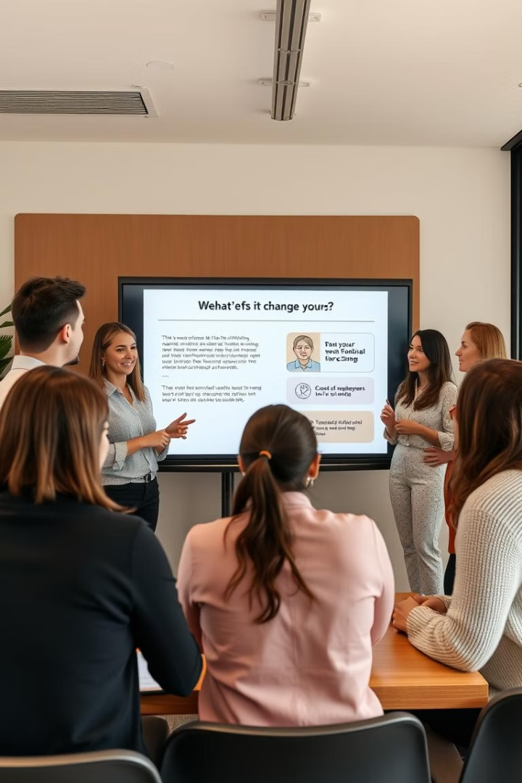



Implementing Change: Overcoming Resistance
Open Communication
Clearly communicate the rationale for change, emphasizing the benefits for employees.
Employee Training
Provide employees with the necessary training and resources to adapt to new processes or technologies.
Feedback and Recognition
Encourage employees to provide feedback, and recognize and reward their contributions to the change process.

Slide 7
Lessons Learned: Takeaways for Modern Leaders
Culture is Critical
1
A strong culture, built on shared values, is essential for driving change and success.
Innovation is Key
2
Staying ahead of the curve requires continuous innovation and adaptation to evolving market trends.
People Are Assets
3
Investing in employees, fostering their development, and empowering them to contribute is crucial for long-term success.

Slide 8

Conclusion: Applying Case Study Insights
By learning from these case studies, organizations can gain valuable insights and strategies to drive their own transformations. These insights can be applied to create a customer-centric culture, develop a competitive strategy, and implement a total quality management system.

