Slide 1

DEPARTMENT OF LIFELONG LEARNING
BHARATHIDASAN UNIVERSITY
Tiruchirappalli- 620024,
Tamil Nadu, India
Programme: M.A.HUMAN RESOURCE MANAGEMENT
Course Title :Total Quality Management
Course Code :22HRM4CC17
UNIT - IV
Statistical Process Control Tools and Techniques
Dr. T. KUMUTHAVALLI
Associate Professor
Department of Lifelong Learning

Slide 2
Understanding Statistical Process Control
Identifying Trends
Predicting Issues
Continuous Improvement
Use statistical process control tools to track and analyze data trends to spot potential deviations from expected performance.
These tools help anticipate problems and prevent them before they significantly impact production or service quality.
Statistical process control empowers continuous improvement by providing insights to make data-driven decisions and optimize processes.

Slide 3
Problem Solving: A Structured Approach
Problem Definition
1
Clearly define the problem, identifying its root cause and desired outcome.
Data Collection
2
Gather relevant data to understand the problem thoroughly and form a basis for analysis.
Solution Development
3
Generate and evaluate potential solutions, considering feasibility and impact.
Implementation and Evaluation
4
Implement the chosen solution, monitor results, and adjust as needed.

Slide 4

Kaizen: Continuous Improvement
Employee Empowerment
Focus on Efficiency
Incremental Change
Empower employees to identify and implement improvements in their daily work.
Eliminate waste and streamline processes to increase productivity and reduce costs.
Kaizen promotes small, incremental changes that contribute to continuous improvement.

Slide 5
Tools for Process Improvement
The 5's
The 4 M's
Seiri (sort), Seiton (set in order), Seiso (shine), Seiketsu (standardize), Shitsuke (sustain).
Manpower, Materials, Machine, Method.

Slide 6
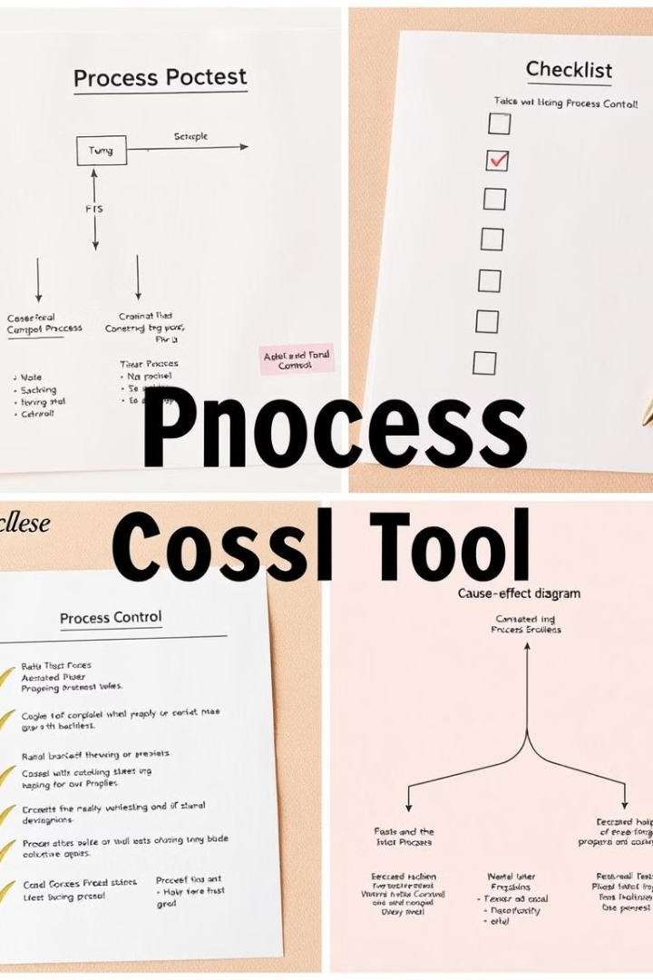



Visualizing Data for Better Understanding
Flow Chart
A visual representation of steps in a process, showing sequence and dependencies.
Cause and Effect Diagram
Identifies potential causes of a problem, branching out from the main effect.
Check Sheet
A structured form for recording data, used to track occurrences and patterns.

Slide 7
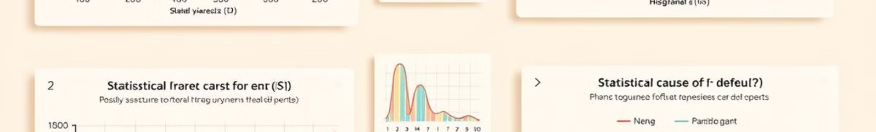
Statistical Tools for Data Analysis
1
2
Scatter Diagram
Pareto Chart
Shows the relationship between two variables, identifying potential correlations.
Prioritizes problems based on frequency or impact, focusing on the vital few.
3
4
Histogram
Control Chart
Displays the distribution of data, showing patterns and outliers.
Tracks data points over time, identifying shifts or trends in performance.

Slide 8

Improving Quality and Efficiency
Quality Circles
Six Sigma
Small groups of employees meet regularly to identify and solve problems in their work areas.
A rigorous methodology aimed at reducing defects and variability in processes.
Benchmarking
Brainstorming
Comparing processes and performance with best-in-class organizations to drive improvement.
A collaborative method for generating ideas and solutions to problems.

Slide 9



Transforming Business Processes
Business process reengineering fundamentally redesigns processes to improve efficiency, effectiveness, and customer satisfaction.

