Slide 1

DEPARTMENT OF LIFELONG LEARNING
BHARATHIDASAN UNIVERSITY
Tiruchirappalli- 620024,
Tamil Nadu, India
Programme : M.A.HUMAN RESOURCE MANAGEMENT
Course Title :Total Quality Management
Course Code :22HRM4CC17
UNIT - III
Models of TQM
Dr. T. KUMUTHAVALLI
Associate Professor
Department of Lifelong Learning

Slide 2
The Fuji Xerox Model
Focus on Customer Satisfaction
Continuous Improvement
Key Features
It promotes a culture of continuous improvement through employee involvement, data analysis, and problem-solving.
Key features include customer-centricity, teamwork, data-driven decision-making, and process optimization.
The Fuji Xerox model emphasizes customer satisfaction through a focus on quality, efficiency, and innovation.

Slide 3

The Eicher Group Model
Safety and Efficiency
Employee Involvement
The Eicher Group model prioritizes safety and efficiency as key components of quality.
It emphasizes employee involvement in quality initiatives through training, empowerment, and recognition.
Continuous Improvement
Customer Focus
It aims to meet and exceed customer expectations through quality products and services.
The model promotes continuous improvement through data analysis, process optimization, and problem-solving.

Slide 4
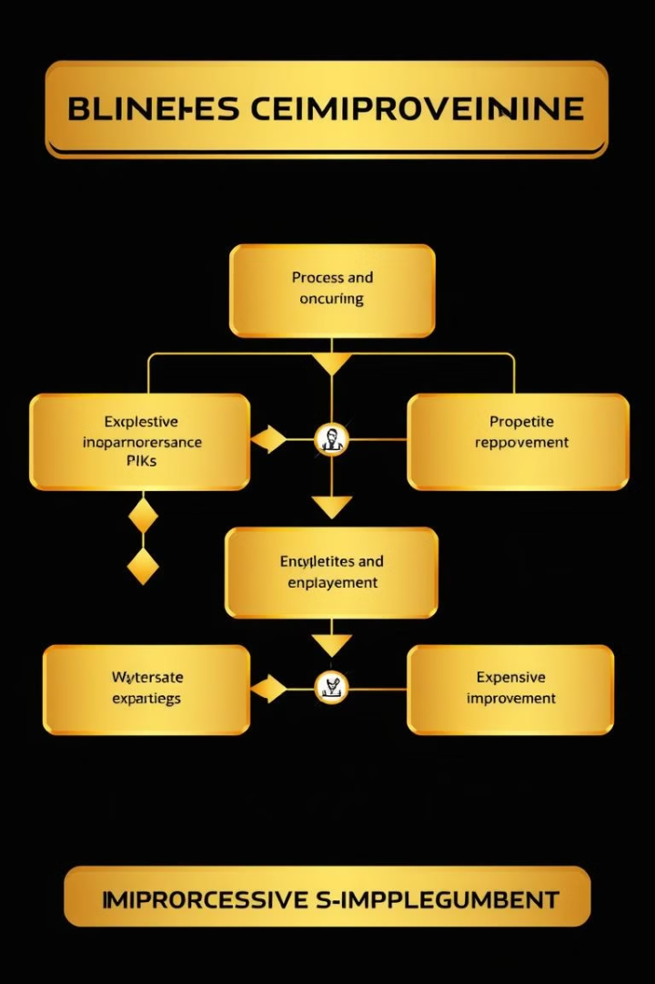




The Basic Frame Move Model
Planning
Execution
The Basic Frame Move Model starts with careful planning and defining clear goals for quality improvement.
It emphasizes the importance of implementing quality initiatives effectively.
Feedback
Improvement
Continuous feedback is crucial for identifying areas for improvement.
The model advocates for constant improvement through data analysis and process optimization.

Slide 5
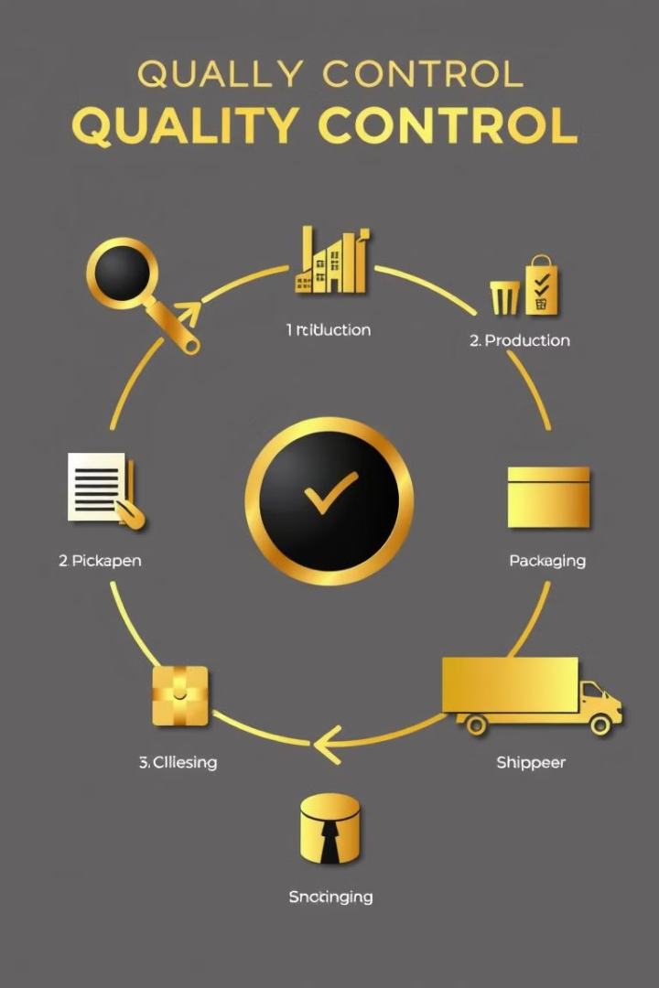
The Norman Rickad Model
1
Strategic Quality Management
2
Process Management
It emphasizes process improvement through careful planning, execution, feedback, and continuous improvement.
This model focuses on integrating quality management into the overall business strategy.
3
Employee Empowerment
It promotes employee empowerment and involvement in quality initiatives.

Slide 6
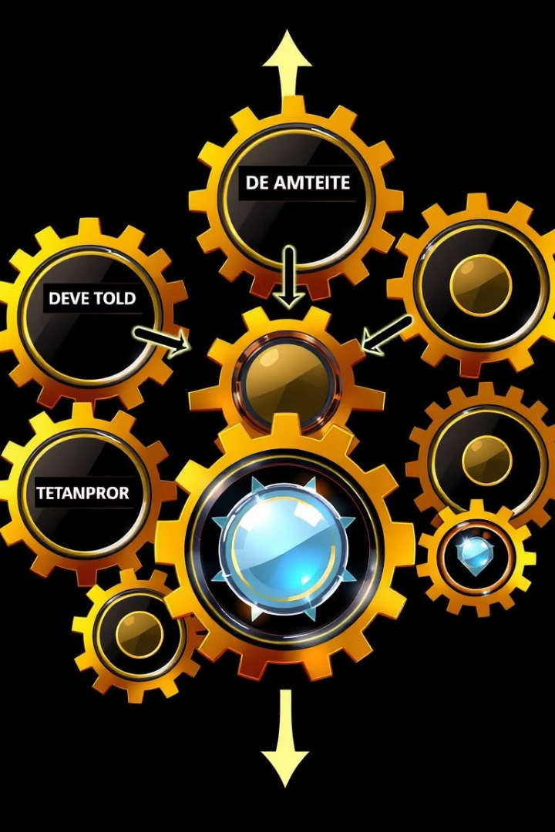
The Operational Model
1
Process Optimization
The Operational Model focuses on optimizing processes across all departments.
2
Data-Driven Decision-Making
It utilizes data analysis to identify areas for improvement and measure progress.
3
Cross-Functional Collaboration
The model emphasizes cross-functional collaboration to achieve quality goals.

Slide 7
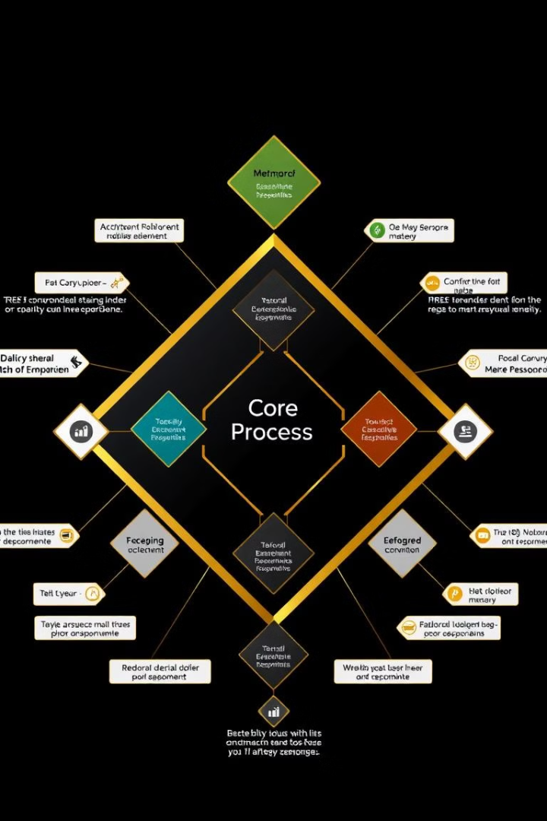




The Diamond Model
Customer Focus
The Diamond Model prioritizes customer satisfaction and understanding their needs.
Process Improvement
It focuses on continuous improvement of key processes.
Employee Empowerment
It emphasizes employee empowerment and involvement in quality initiatives.
Strategic Alignment
The model emphasizes aligning quality initiatives with the overall business strategy.

Slide 8





The Umbrella Model
Leadership
1
Strong leadership is essential for driving a culture of quality.
Process Management
2
Effective process management is crucial for achieving quality goals.
Employee Empowerment
3
Empowering employees to participate in quality initiatives is key.
Customer Focus
4
Understanding and meeting customer needs is a priority.
Continuous Improvement
5
A commitment to continuous improvement is essential.

