Slide 1

DEPARTMENT OF LIFELONG LEARNING
BHARATHIDASAN UNIVERSITY
Tiruchirappalli- 620024,
Tamil Nadu, India
Programme: M.A.,HUMAN RESOURCE MANAGEMENT
Course Title : Research Methodology
Course Code : 22HRM3CC10
Unit-VI
Statistical Applications
Dr. T. KUMUTHAVALLI
Associate Professor
Department of Lifelong Learning

Slide 2
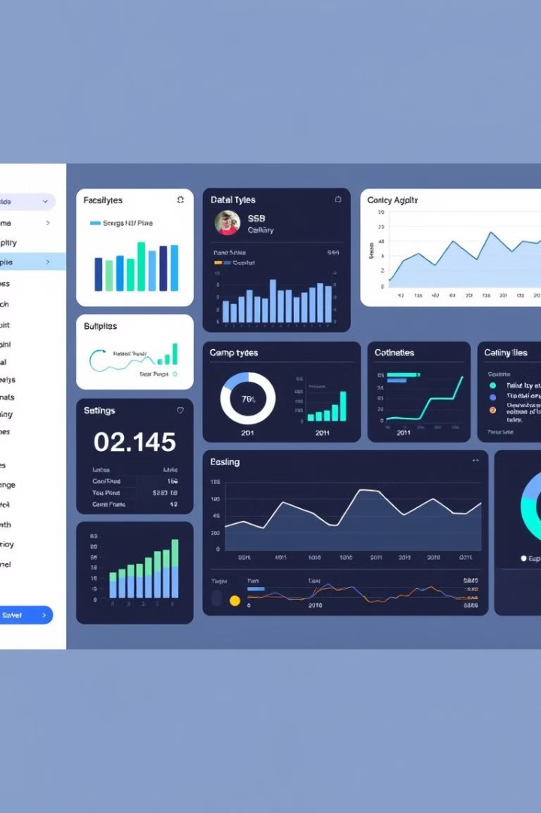
Statistical Applications
Welcome to our comprehensive statistical software suite, designed to empower your data-driven decision making. From intuitive data editing to multidimensional analysis, probability modeling, and seamless database integration, our suite offers a powerful array of tools to unlock the insights hidden within your data. Prepare to elevate your analytical capabilities and drive transformative business outcomes.

Slide 3

Precise Data Editing
Data Editor
Viewer
Our state-of-the-art data editor allows you to effortlessly manipulate and refine your datasets. Easily fix typos, recode variables, and perform complex transformations - all within a sleek and responsive interface.
Gain a comprehensive overview of your data with our advanced data viewer. Sort, filter, and explore your information in real-time, uncovering patterns and insights with just a few clicks.

Slide 4





Multidimensional Analysis
1
Pivottables
2
Cross-Tabulations
3
Cube Visualizations
4
Dimensional Drill-Down
5
Interactive Dashboards
Unlock the full potential of your data with our advanced multidimensional analysis tools. Effortlessly create pivottables, cross-tabulations, and cube visualizations to explore complex relationships. Drill down into specific dimensions and build interactive dashboards for powerful data storytelling.

Slide 5

Probability Modeling
1
Probability Distributions
2
Monte Carlo Simulations
3
Sensitivity Analysis
Leverage a comprehensive library of probability distributions to model and simulate complex scenarios. From normal to Poisson, our tools empower you to analyze likelihoods and make data-driven predictions.
Run sophisticated Monte Carlo simulations to assess risk, forecast outcomes, and stress-test your models. Gain deeper insights into the potential implications of your decisions.
Uncover the most influential variables in your models through advanced sensitivity analysis. Identify critical drivers and optimize your strategies for maximum impact.

Slide 6
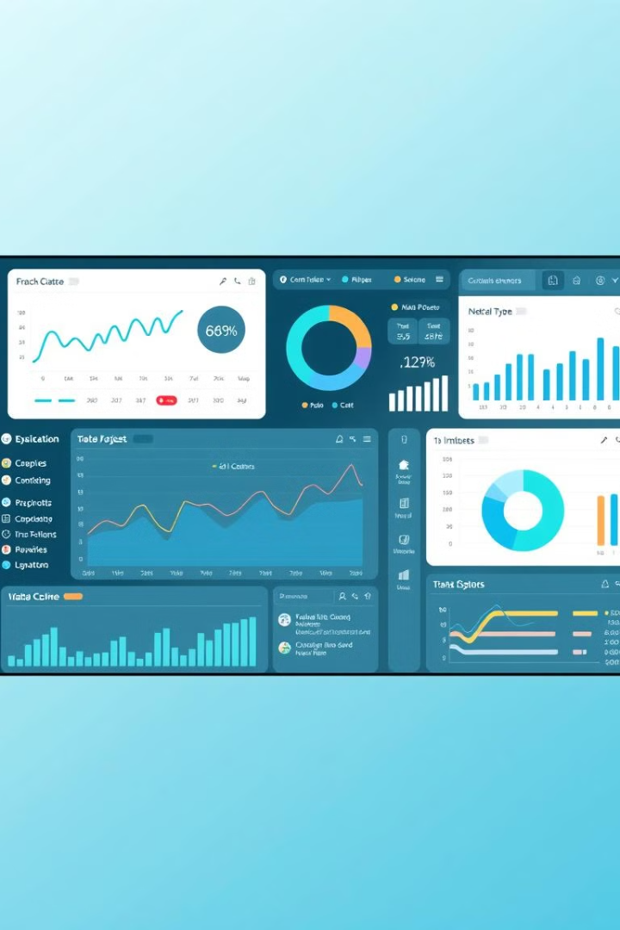



High-Resolution Graphics
Charts
Create rich, high-resolution charts and graphs to effectively communicate your findings. Our tools offer unparalleled customization and export options for stunning visualizations.
Dashboards
Build interactive, data-driven dashboards that bring your analyses to life. Seamlessly integrate multiple data sources and visualizations for comprehensive storytelling.
Geospatial
Leverage powerful geospatial capabilities to map and analyze location-based data. Uncover spatial patterns and trends to inform strategic decision-making.

Slide 7
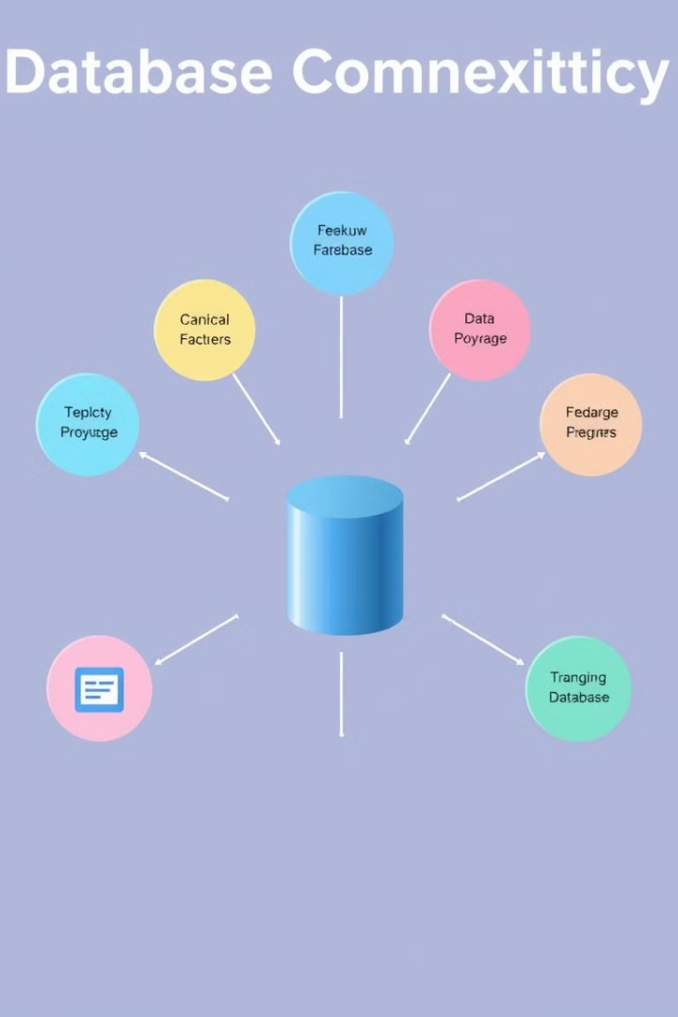
Database Integration
Database Connectivity
Data Transformation
Seamlessly connect to a wide range of databases, including SQL, NoSQL, and cloud-based solutions. Our tools enable you to access, query, and analyze data from disparate sources with ease.
Leverage our robust data transformation capabilities to clean, normalize, and prepare your data for analysis. Automate complex ETL processes and ensure data integrity across your organization.
Real-Time Insights
Unlock real-time insights by integrating your data sources with our platform. Monitor key metrics, track trends, and make informed decisions in the moment, powered by up-to-the-minute information.

Slide 8

Empowering Analysis
Data Exploration
Automation & Scripting
Dive deep into your data using our intuitive exploration tools. Uncover hidden patterns, identify outliers, and generate hypotheses to drive your analysis forward.
Streamline your analytical workflows through powerful automation and scripting capabilities. Reduce manual effort, ensure consistency, and scale your analyses with ease.
1
2
3
Statistical Modeling
Leverage our comprehensive statistical modeling capabilities to test theories, make predictions, and uncover the drivers behind your data. From regression to time series analysis, our tools provide cutting-edge techniques.

Slide 9

Unleash Your Analytical Potential
10+
100K
Years
Customers
99.9%
5M+
Uptime
Analyses
Our statistical suite has been empowering data-driven decision making for over a decade, serving a growing community of 100,000+ customers worldwide. With industry-leading reliability, scalability, and a wealth of advanced analytical capabilities, we are committed to helping you unlock the full potential of your data and drive transformative business outcomes.

