Slide 1

DEPARTMENT OF LIFELONG LEARNING
BHARATHIDASAN UNIVERSITY
Tiruchirappalli- 620024,
Tamil Nadu, India
Programme: M.A.,HUMAN RESOURCE MANAGEMENT
Course Title : Research Methodology
Course Code : 22HRM3CC10
Unit-V
Data Analysis and Report Writing
Dr. T. KUMUTHAVALLI
Associate Professor
Department of Lifelong Learning

Slide 2
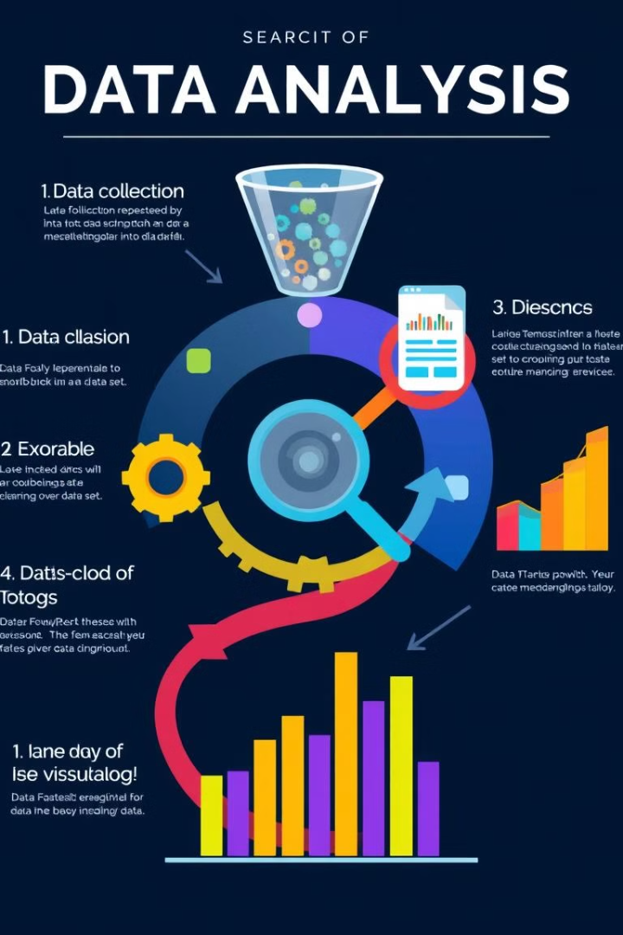


Data Analysis and Report Writing
In today's data-driven world, understanding and interpreting data is an essential skill. From businesses to research institutions, the ability to analyze data effectively is crucial for making informed decisions and uncovering hidden insights. This guide will explore key concepts in data analysis and report writing, providing you with the tools and knowledge to confidently navigate the process of turning raw data into actionable intelligence.
by Presentation

Slide 3
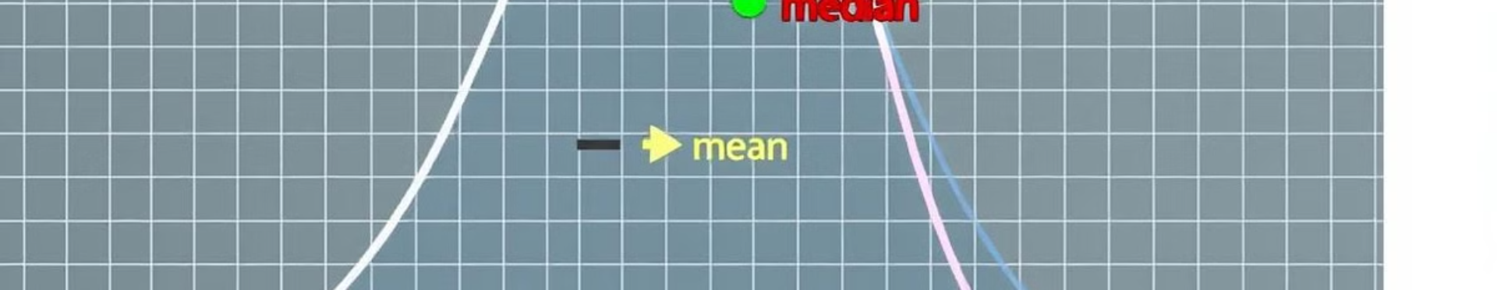
Measure of central tendency
1
Mean
2
Median
3
Mode
The mean, or average, is calculated by summing all values in a dataset and dividing by the number of values. It's useful for understanding the typical value in a dataset.
The median represents the middle value in a dataset when it's ordered from smallest to largest. It's less affected by outliers compared to the mean.
The mode is the value that appears most frequently in a dataset. It's useful for identifying the most common or popular values.

Slide 4
Orientation to Multi Variate Analysis
What is it?
Why use it?
Common techniques
Multi-variate analysis is a powerful statistical technique used to understand the relationships between multiple variables. It helps us identify patterns, trends, and dependencies between different factors.
This technique is crucial for businesses, researchers, and other professionals seeking to gain comprehensive insights from complex datasets. It can uncover hidden relationships, identify key drivers, and make better predictions.
Popular multivariate analysis techniques include Principal Component Analysis (PCA), Factor Analysis, Cluster Analysis, and Discriminant Analysis. Each technique has its own purpose and application depending on the data and research question.

Slide 5
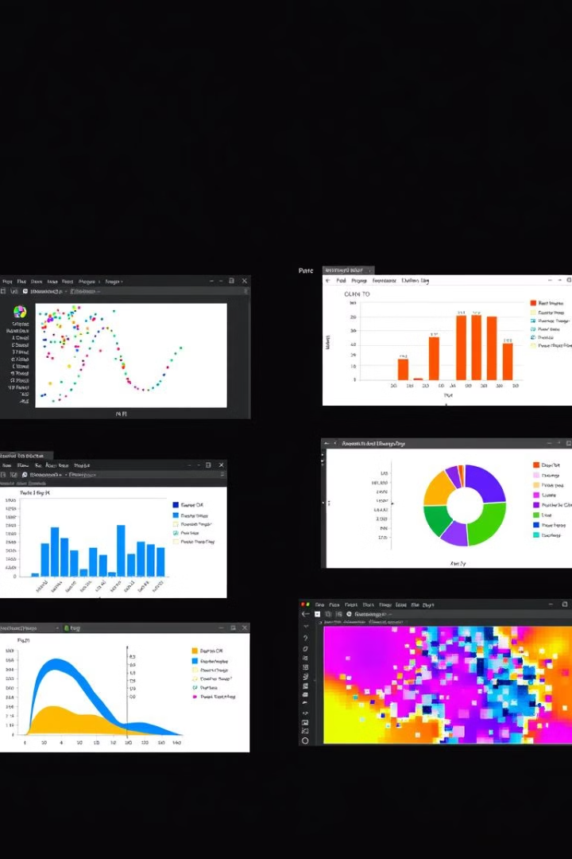
Different Software and its application
Software
Application
R
Open-source statistical programming language, widely used for data analysis, visualization, and machine learning.
Python
Versatile programming language with powerful libraries for data analysis, including NumPy, Pandas, and Scikit-learn.
SPSS
Statistical software package used for data analysis, hypothesis testing, and predictive modeling.
Tableau
Data visualization and business intelligence software, used for creating interactive dashboards and reports.

