Slide 1

DEPARTMENT OF LIFELONG LEARNING
BHARATHIDASAN UNIVERSITY
Tiruchirappalli- 620024,
Tamil Nadu, India
Programme: M.A.,HUMAN RESOURCE MANAGEMENT
Course Title : Research Methodology
Course Code : 22HRM3CC10
Unit-IV
Data Presentation
Dr. T. KUMUTHAVALLI
Associate Professor
Department of Lifelong Learning

Slide 2

Data Presentation
Welcome to this presentation on the essential role of statistics in social research. We'll explore the fundamental aspects of statistics, delve into data collection and presentation, and ultimately understand how statistics empower us to make informed decisions in the realm of social studies.

Slide 3

Understanding Statistics in Social Research
Meaning
Scope
Characteristics
Statistics involves the collection, organization, analysis, interpretation, and presentation of data. It helps us make sense of the world around us by uncovering patterns, relationships, and trends.
Statistics finds application in diverse social research areas, such as demographics, healthcare, education, economics, and public policy. It allows us to understand social phenomena and make informed decisions.
Statistics is characterized by its focus on numerical data, objective analysis, and the ability to generalize findings from samples to larger populations.

Slide 4

Coding, Classification, and Tabulation
1
Coding
2
Classification
Assigning numerical or alphabetical codes to data for efficient organization and analysis.
Grouping data into categories based on shared characteristics for better understanding and interpretation.
3
Tabulation
Arranging data in a systematic way, often in tables, to facilitate comparisons and analysis.

Slide 5
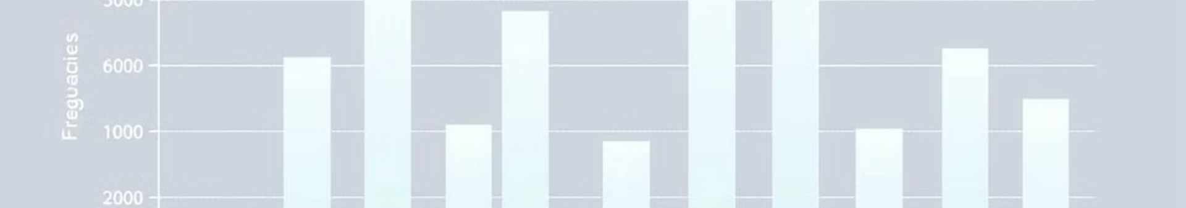
Frequency Distribution: Unveiling Data Patterns
Meaning
Objectives
Types
A frequency distribution summarizes how often different values occur in a dataset.
Provides a clear overview of data patterns, helps identify trends, and facilitates comparisons between groups.
Includes simple frequency distributions (for discrete data), grouped frequency distributions (for continuous data), and cumulative frequency distributions.

Slide 6
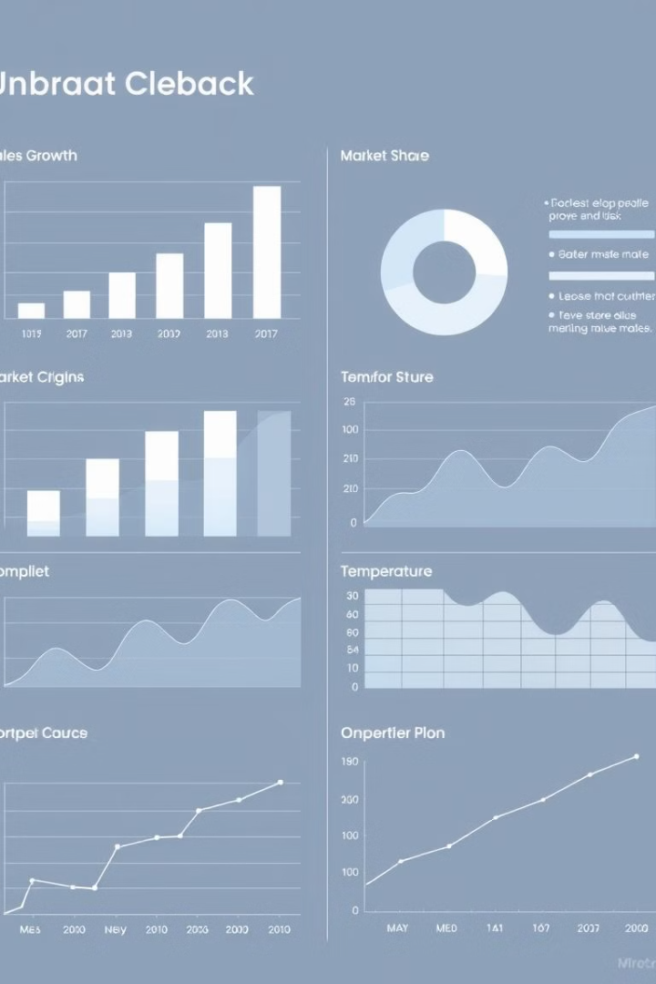



Visualizing Data: Diagrams & Graphs
Bar Graphs
Useful for comparing categorical data, showing changes over time, and highlighting differences between groups.
Pie Charts
Ideal for showing proportions or percentages of a whole, making it easy to visualize the distribution of data within a category.
Line Graphs
Effective for displaying trends over time, showing relationships between variables, and highlighting patterns and fluctuations.

Slide 7
Applications & Limitations of Statistics
Applications
1
Statistics is invaluable in making informed decisions, conducting research, developing public policy, and understanding social trends.
Limitations
2
Statistics can be misinterpreted, manipulated, or biased. It's essential to be critical of data and consider the context and methodology used.
Ethical Considerations
3
Statistics should be used responsibly and ethically, ensuring accuracy, transparency, and fair representation of data.

