Slide 1

DEPARTMENT OF LIFELONG LEARNING
BHARATHIDASAN UNIVERSITY
Tiruchirappalli- 620024,
Tamil Nadu, India
Programme: M.A.,HUMAN RESOURCE MANAGEMENT
Course Title : public speaking
Course Code : 22HRMVA1
Unit-VI
Effective public speaking
Dr. T. KUMUTHAVALLI
Associate Professor
Department of Lifelong Learning

Slide 2





Introduction to Public Speaking
Public speaking is a vital skill that can enhance your professional and personal life. This presentation will cover essential objectives, the importance of audience analysis, and the art of effective listening to help you become a more powerful speaker.

Slide 3
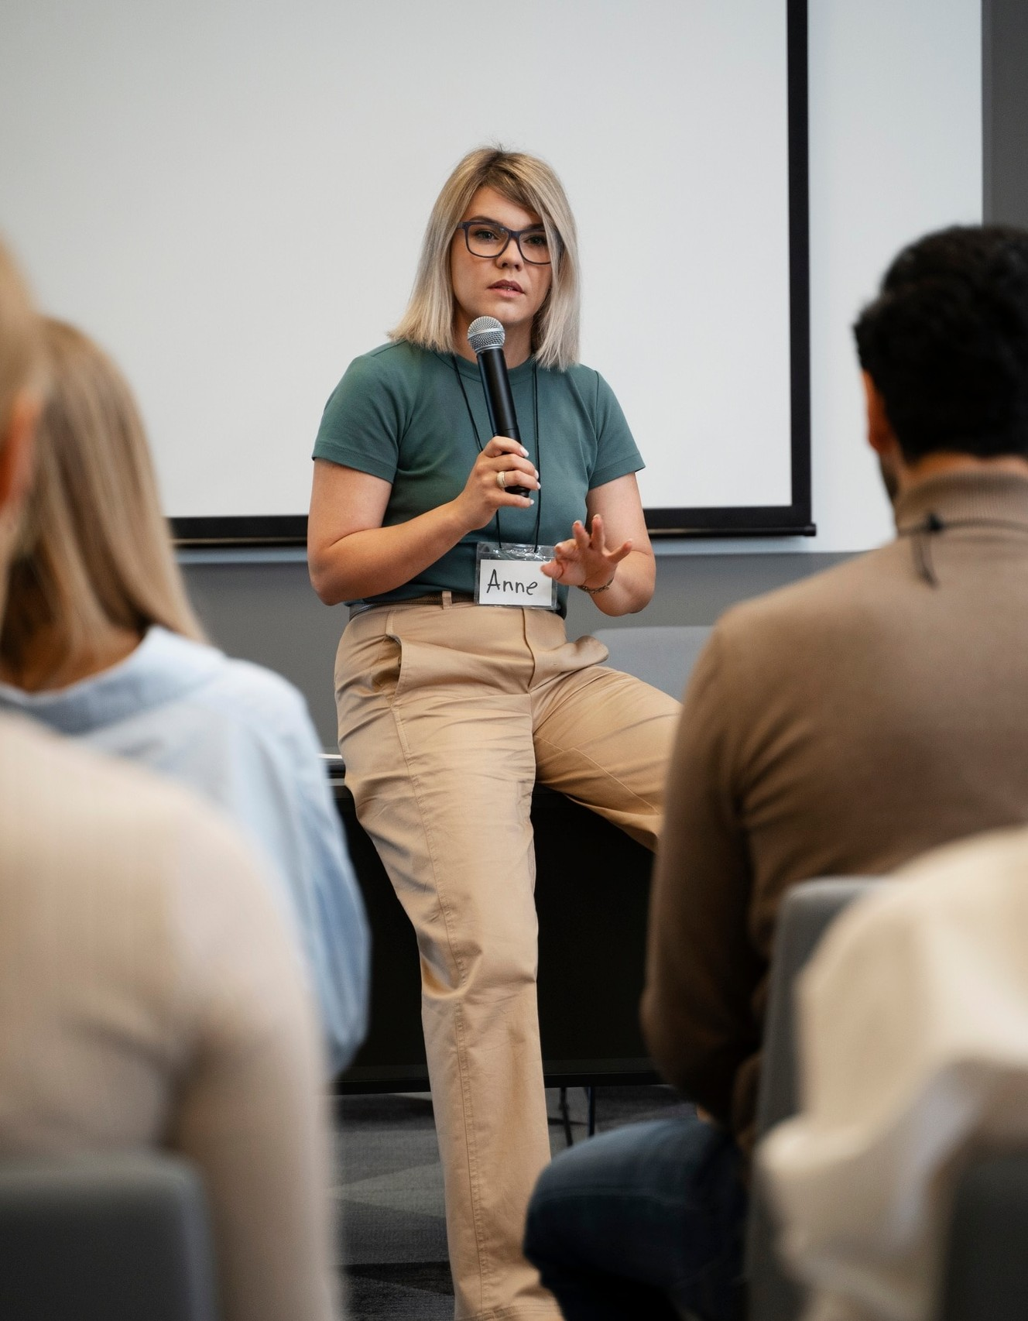




Objectives of Public Speaking
The primary objectives of public speaking include informing, persuading, and entertaining your audience.
Understanding these goals helps you shape your message and connect with listeners on a deeper level, ensuring your speech resonates and achieves its intended impact.

Slide 4


Understanding Your Audience
Effective audience analysis involves researching the demographics, interests, and expectations of your listeners. By tailoring your message to meet their needs, you can foster better engagement and ensure your speech is both relevant and impactful.

Slide 5


The Art of Effective Listening
Listening is just as important as speaking. Effective listening involves being fully present and engaging with the speaker's message. This skill helps you respond appropriately and fosters a positive communication environment, ultimately enhancing the speaking experience.

Slide 6




Overcoming Public Speaking Anxiety
Many individuals experience anxiety when public speaking. Techniques such as deep breathing, practice, and positive visualization can help you manage these feelings. Embracing your nervousness as a natural response can empower you to deliver more impactful presentations.

Slide 7





Conclusion: Mastering Public Speaking
Mastering public speaking requires understanding your objectives, analyzing your audience, and practicing the art of listening. By honing these skills, you can become a more effective communicator, inspiring and engaging those around you with conﬁdence.

