Slide 1

DEPARTMENT OF LIFELONG LEARNING
BHARATHIDASAN UNIVERSITY
Tiruchirappalli- 620024,
Tamil Nadu, India
Programme: M.A.,HUMAN RESOURCE MANAGEMENT
Course Title : public speaking
Course Code : 22HRMVA1
Unit-II
informative speech analysis
Dr. T. KUMUTHAVALLI
Associate Professor
Department of Lifelong Learning

Slide 2
Understanding Informative Speeches
I NFOR MAT IV E S P EE CH E S
Structure and Delivery

Slide 3
Introduction to Informative Speeches
I NFO R MAT IV E S P E E CH E S
Understanding the Definition and Importance of Informative Speeches
Definition of Informative Speech An informative speech is specifically crafted to convey knowledge and information about a particular topic to an audience, aiming to educate and inform. |  |  |  | Role in Education Informative speeches are essential in educational settings as they help students learn new concepts, skills, and knowledge effectively. |  |  |  | Importance in Professional Communication In professional contexts, informative speeches facilitate clear and effective communication of complex ideas and information among colleagues and stakeholders. |  |  |  | Impact on Public Discourse These speeches contribute significantly to public discourse, providing the audience with factual information to iTlake informed declslons on various issues. |  |  |  | Efficient Information Dissemination Informative speeclles play a crucial roie in efficiently disseminating information, ensurin¿ that audiences grasp essentiel points quickly and accurately.
GB

Slide 4
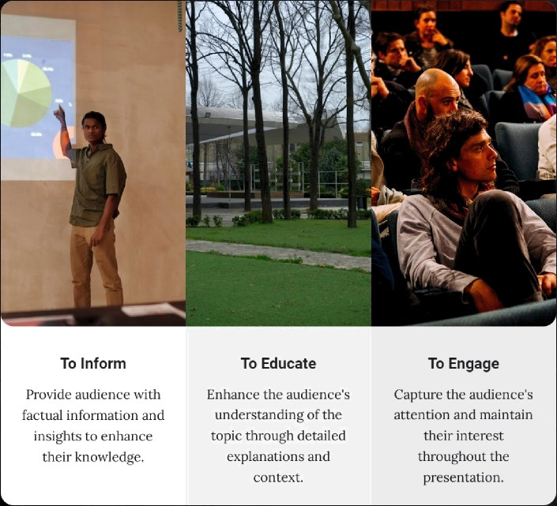
Primary Goals and Importance of Clarity
S PE E CH O BJ E CT IV E S
Understanding the Objectives

Slide 5





Key Components of a Structured Presentation
P R E SENTAT IO N ST RU CT U R E
Understanding the Importance of Structure
Introduction
begin with a captivating hook to grab attention, followed by a clear thesis statement that outhnes the purpose of the speech, and provide a preview of the main points to be discussed.
Body
1“his section involves a thorough exploration of each point, presenting detailed information supported by credible evidence to enhance the argument and engage the audience.
Conclusion
Wrap up by summarizing the key takeai\•ays from the speech and providing
c losing thoughts that reinforce the message, leaving a lasting impression on the audience.
'•c

Slide 6




Functions of Informative Speeches
I N FOR MAT IV E F U NCT IO NS
Key Concepts
Sharing new information, data, or perspectives on a topic to enhance
understanding and awareness.
Facilitating knowledge acquisition through structured inforiaiation, making complex subjects more accessible and understandable.

Slide 7
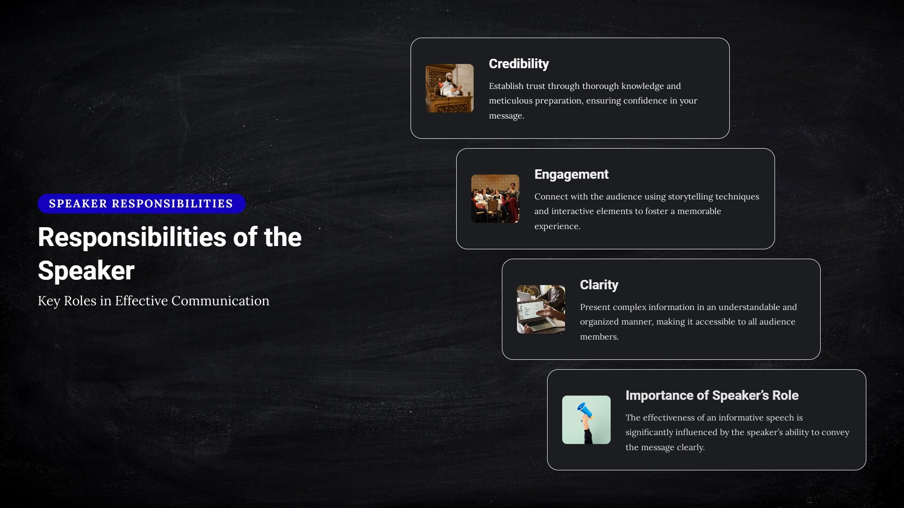

Slide 8
Types of Informative Speeches
TY P ES O F SP E EC H ES
Classification and Examples of Informative Speeches
Description Speeches
Demonstration Speeches
Providing detailed information about a person, place, or concept to enhance
Showing the audience how to do something step-by-step, making the
understanding.
process clear and actionable.
Report Speeches
Explanation Speeches
Presenting fac tual information on a specific topic or event, often based on
Clarify ing complex processes or ideas to help the audience understand
research or findings.
intricate subjects.

Slide 9
Developing Informative Speeches: Research
R ES EA R C H IM POR TANC E
Key Points and Techniques
Importance of Research
Primary Sources
Thorough research is crucial for gathering acc urate data and credible
Primary sources Incl ude orlgin al research, interviews, and surveys fileat
information, setting the foundation for a compelling informative speech.
provide firsthaiid information.
Thorough Research
Conducting thorough research ensures that your speech is based on reliable information, enhancing its credibility and effectiveness.
Secondary Sources
Secondary sources consist of hooks, articles, and docume rotaries that
unalvze or interpret pi iinar d‹it‹i.
Effective Research Techniques
Types of Sources
Utilizing effective research technique s is essentlal for patherin quality
Understanding the types of sources is vital for effective research. They
niforrnatioii. This inc'1udes think ac aden4ic’ dat‹ib ises ‹ind re}autab1e
are categorized into priiaiary and secondary sources.

Slide 10



Outlining
Create n structured outline to effectively map out your speech, ensuring logical progression and clarity.
S P E E CH O RGA N I ZAT I O N
Techniques for Organization
f4ote Cards
Utilize note cards to highlight key points and facilitate smooth transitions between topics during your presentation.
Effective Methods for Structuring Your Speech
Organizing Content Effectively
Group related inforination together to enhance flow›' and coherence, making it easier for the audience to follow’.
GB

Slide 11




Tips for Effective Delivery and Importance of Practice
E FF ECT I V E D E L I VERY
Mastering the Art of Informative Speech Delivery
Voice Modulation
Varying pitch and volume throughout your speech keeps the audience engaged and attentive to your message.
Body Language
Effective use of gestures and maintaining eye contact helps create a connection with the audience, making your message more iinpactful.
Engagement
Incorporating questions and encouraging audience participation fosters on interactive environ ment, enhancing the overall experience.
Importance of Practice
Regular practice not only iia4proves fluency but also builds confidence, allowing for a more polished delivery.

Slide 12

Types and Benefits of Visual Aids
V ISUA L A I DS OV E RV I EW
Enhancing Communication through Visual Representation
Slides
Images
PowerPoint presentations provide a sfiructured
V1sua1 representations enhance understanding
way to convey key points while incorporating
Charts
and retention, providing context and engagement
images for visual impact.
Graphs and charts effectively illustrate data
during the speech.
tre nds, mnking complex information more
digestible for the audience.

Slide 13
Importance of Conclusion
C ONC LUS I O N IM PO RTA NC E
Key Elements of a Strong Conclusion
Importance of Conclusion
The conclusion serves as the final opportunity to reinforce the main ideas and ensure the audience retains key messages.
Summarizing Key Points
A well-crafted summary highlights essential points, helping the audience to recall the core concepts of the speech.
Closing Thoughts
Conclude u Cth impactful statements or calls to action to leave a merrlorable iiaipression on your audience.
Reinforcing the Main Message
A strong concl usion ties the speech topethei‘ and emphasizes its significance, making it clear to the audience why the topic matters.

Slide 14




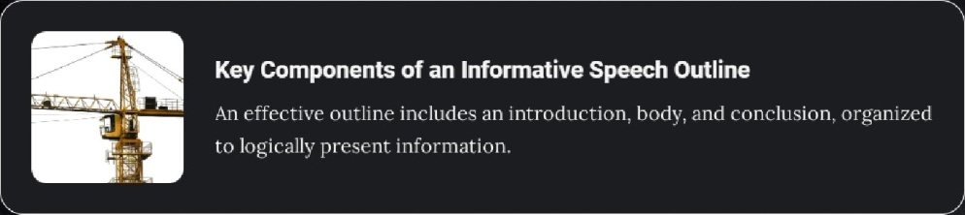



Questions to Assess Understanding
Engage with Essential Concepts of lnformative Speeches
I N F OR MAT IV E S PE E CH RE V IE W
Primary Objectives of Informative Speeches
Informative speeches aim to educate the audience on specific topics, enhanc irig their knowledge and understanding.
Key Components of an Informative Speech Outline
An effective outli ne includes an introdtiction. body, and conclusion. organized to logically present information.
Role of the Speaker in Effective Communication
The speaker must engine the audience and present information c1e‹ir1v to ensure effective understanding and retention.

Slide 15
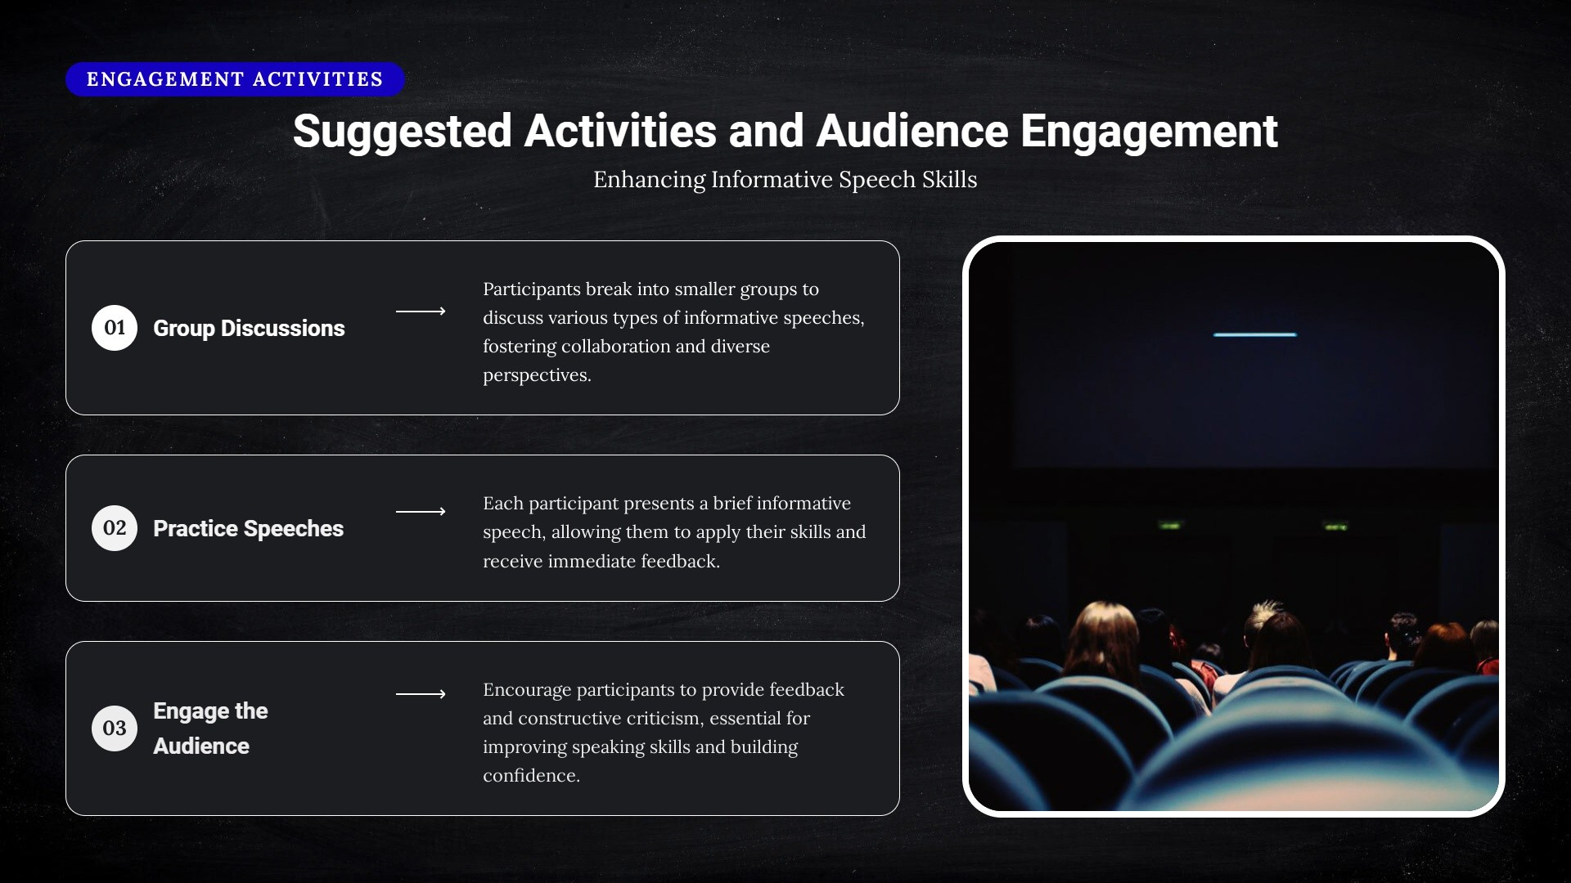

Slide 16






Summary of Main Points on Informative Speaking
I NFOR MAT IV E S P EA KI N G
Understanding the Structure and Importance of Informative Speeches
Objectives and Structure
Role of the Speaker
Research and Organization
Gain insight into the core objectives of informative speeches and their structured approach, which aids in organizing conte nt effectively.
Identify the critical role a speaker plays in delivering informative speeches and explore the various types that exist to engage different audiences.
Highlight the significance of thorough research and well-organized content, which are essential for delivering impactful presentations.
Value of Informative Speaking
Emphasize that informative speaking is a crucial skill that can be applied in various personal and protessional contexts.
Delivery Techniques
¿
Visual Aids
Understand the importance of effective delivery techniques including body language, tone, and pacing in making a presentation compelling.
Discuss how visual aids enhance understanding and retention, irtaking presentations more engaging and informative

Slide 17
Closing Remarks
Thank the audience for their participation and attention. Their engagement is invaluable and contributes to a vibrant discussion. Open the floor for any questions or further discussions to clarify any topics.
AU DI ENC E EN GAG EME IT
Closing Remarks and Invitation for Interaction
Thank You for Your Participation and Let's
Continue the Conversation
Invitation for Interaction
Encourage ongoing conversation about the topics covered. Invite participants to share their thoughts and insights, fostering a collaborative learning environment
i

Slide 18
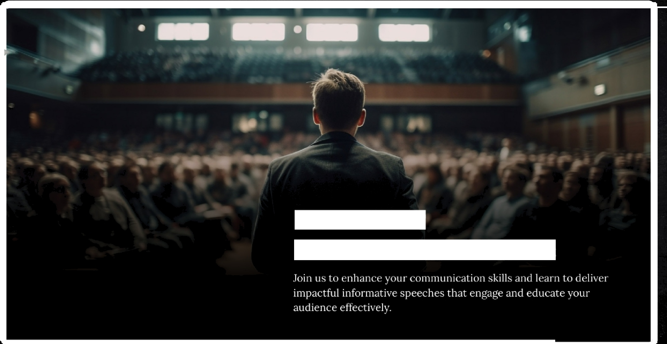
Boost Your
Communication Skills

