Slide 1

DEPARTMENT OF LIFELONG LEARNING
BHARATHIDASAN UNIVERSITY
Tiruchirappalli- 620024,
Tamil Nadu, India
Programme: M.A.,HUMAN RESOURCE MANAGEMENT
Course Title : public speaking
Course Code : 22HRM2VA1
Unit-I
Introduction to public speaking
Dr. T. KUMUTHAVALLI
Associate Professor
Department of Lifelong Learning

Slide 2

Introduction to Public
Equipping you with fundamental skills and knowledge for effective speaking and audience connection.
Speaking
c eased u »s
presentations GB

Slide 3

PU B LI C S PEA KI NG S KILLS
Welcome to Public Speaking
Embrace the Art of Communication to Enhance Your Life

Slide 4
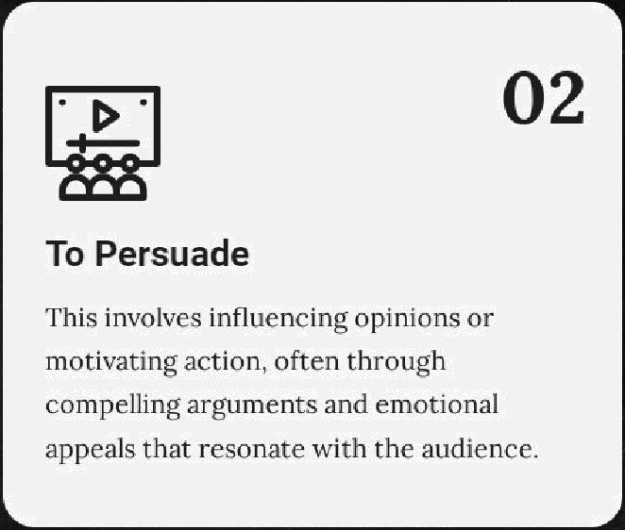

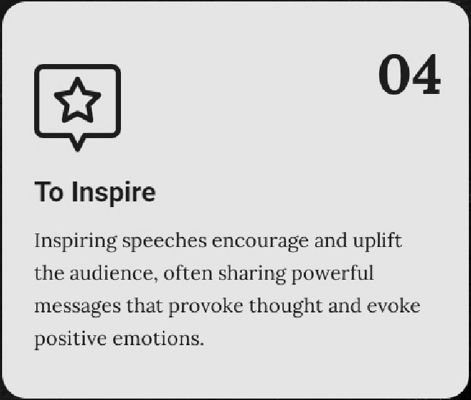
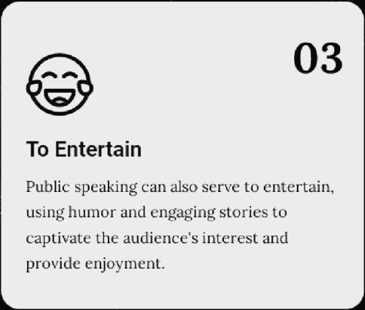
PUB LI C S P EA KI N G GOAL S
Objectives of Public
Speaking
Key Goals in Public Speaking
To Inform

Slide 5
Benefits of Public Speaking
PU B L IC S P EA KI N G B EN EF IT S
Key Advantages of Effective Communication
Improved Communication Skills
Articulating thoughts clearly and effectively enhances interactions both personally and professionally.
Increased Confidence
Overcoming the fear of public speaking leads to greater self-assurance in various life situations.
Career Advancement
Effective communication can open doors to new job opportunities and promotions, as it is a highly valued skill in the workplace.
Better Critical Thinking
Developing the ability to analyze and structure ideas logically enhances decision-making and problem- solving abilities.

Slide 6

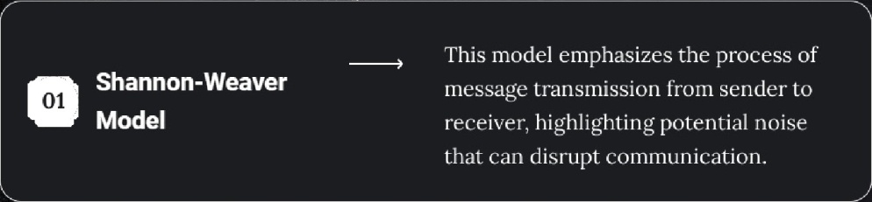
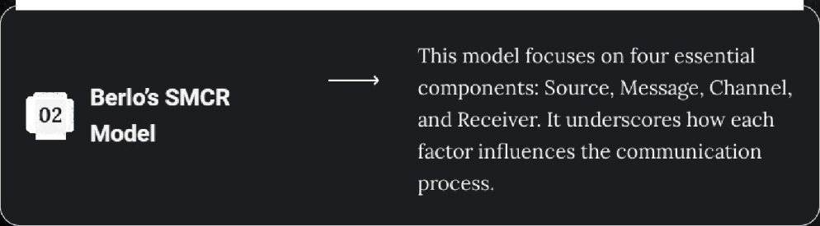
Models of Communication
CO M MU N I CAT IO N MO D E LS
Key Communication Models in Public Speaking
, This model emphasizes the process of message transmission from sender to receiver, highlighting potential noise that can disrupt communication.
Shannon-Weaver Model
This model focuses on four essential components: Source, Message, Channel, and Receiver. It underscores how each factor influences the comrnunic ation process.
Berlos SMCR Model

Slide 7
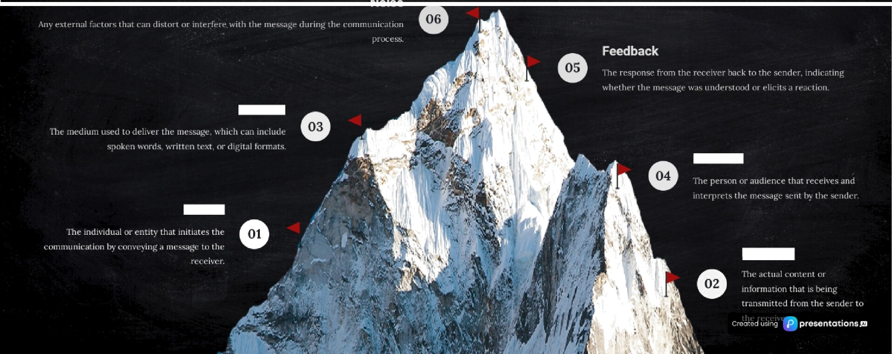
Elements of the Communication Process
CO M MU NI CAT IO N E LE MENT S
Understanding the Key Components of Effective Communication
Channel
Receiver
Sender
Message

Slide 8



Types of Speeches
S P EE C H T YP ES
Understanding Different Forms of Communication
"
Informative
Persuasive
Aimed at educating the audience about a specific topic, such as a lecture that provides detailed information and insights.
Designed to convince the audience to adopt a particular viewpoint or take action, like a campaign speech that motivates voters.
e•
.
°° Commemorative
Impromptu
Celebrates or honors a person, event, or occasion, such as a eulogy that pays tribute to someone's life and achievements.
Given without preparation, often in response to unexpected opportunities, such as a spontaneous toast aL a ¿atherlng'.

Slide 9
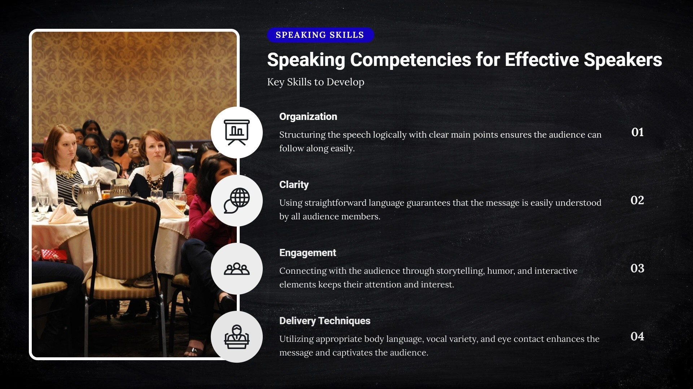

Slide 10





Organizing Your Speech
S PE E CH O R GA N I ZAT IO N
Key Components and ’l'ips
Introduction
Capture the audience's attention and introduce the topic clearly to engage listeners from the start.
Body
Present the main points with clarity, supported by evidence and examples to enhance credibility and understanding.
dO1'lCluSiOri
Summariz.e key points effectively and leave a lasting impression on the audience to reinforce your message.
Effective Transitions
Utilize phrases like 'First,' 'Next,' and 'In conclusion' to guide the audience through the speech smoothl .
Summarizing Points
Summarize key points before moving to the next section to ensure audience retention of information.

Slide 11

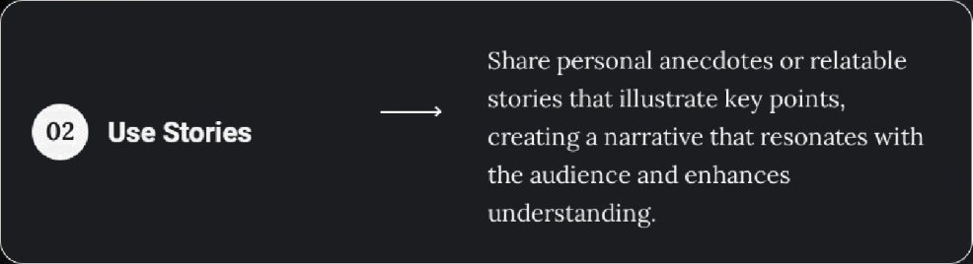

AU DI ENC E EN GAG E M ENT
Share personal anecdotes or relntable stories that illustrate key points, creating a narrative that resonates with the audience and enhances understanding.
Strategies for Engaging
Your Audience
Effective 'i'echniques to Connect
e
Use Stories

Slide 12

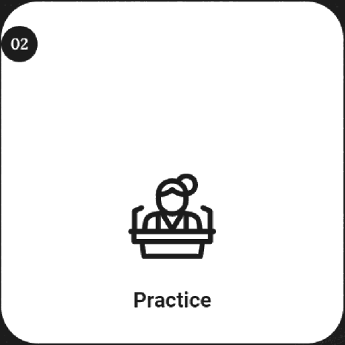

Overcoming Nervousness
M ANA G E ANX I ETY
7’echniques to Manage Anxiety
01
03
Practice deep breathing exercises to help calm
Rehearse your speech multiple times to build
Iimagine a successful delivery and positive
your nerves and reduce anxiety before speaking. confidence in your delivery and familiarity with audience reactions to foster a confident mindset.
your material.

Slide 13
Conclusion on Public Speaking
P UB L I C S P EA GK IN
S K I LLS
Key Takeaways
Enhances personal
and professional life
Public speaking can significantly improve your career prospects and personal relationships by enhancing communication skills.
Understanding objectives and benefits
Recognizing the goals of your message is crucial for effective communication and audience engagement.
Engaging and inspiring the audience
The ability to captivate vour audience is kev to effective public speaking, creating a memorable experience.
Continuous practice
leads to improvement
Every speaking opportunity is a chance to shine
Each speaking' engagement offei s the chance to showcase your skills and further develop your talent.
Regtilar practice allows you to refine your skills and gain confidence in your public speaking abilities.
c ease»s

Slide 14
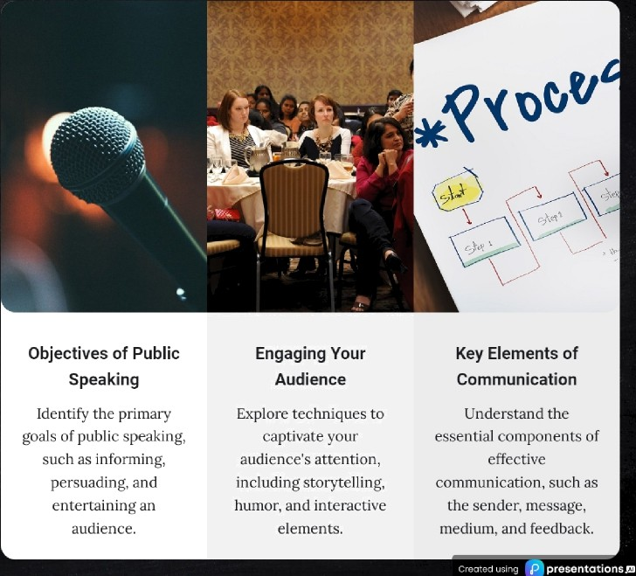
PUB LI C S P EA GKI N REV I E W
Review 9uestions Public Speaking
Reinforce Your Understanding
for

Slide 15
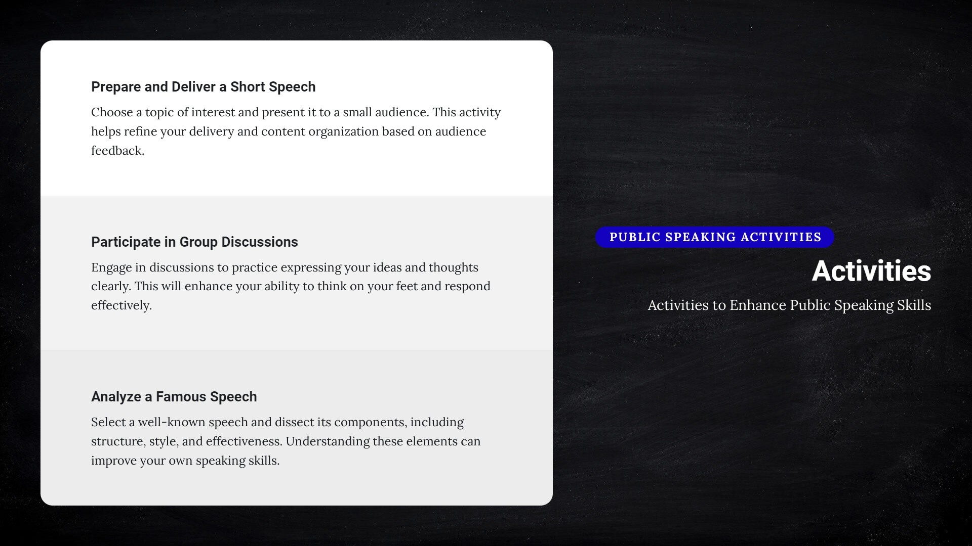

Slide 16







Final Thoughts on Public Speaking
P U B LI C S PE Aï( I N G T I PS
Key Takeaways for Aspiring Speakers
 | Embrace opportunities in pubiic speaking Public speaking opens doors for personal and professional froth, allowing you to share your ideas and connect with others. |  |  | Importance of practice and feedback Consistent practice and constructive feedback are essential to improve your speaking skills and build confidence. |  |  | Willingness to learn and grow Stay open to learning from each experience, as every speaking opportunity is a chance to refine your craft. |  |  | Every great speaker started somewhere Reireiaiber that all accomplished speakers beg'an as novices. Their journey emphasizes the value of persistence. |  |  | Encouragement to hone skills and seek new experiences Never shy a ay from nets speaking opportunities; each one contributes to our growth and expertise.

Slide 17
Enhance Your Public
Speaking Skills
Join us to master the art of effective communication and elevate your speaking abilities to new heights today

