Slide 1

DEPARTMENT OF LIFELONG LEARNING
BHARATHIDASAN UNIVERSITY
Tiruchirappalli- 620024,
Tamil Nadu, India
Programme: M.A.,HUMAN RESOURCE MANAGEMENT
Course Title : Principles of Management
Course Code : 22HRM1CC1
Unit-I
Introduction to Management
Dr. T. KUMUTHAVALLI
Associate Professor
Department of Lifelong Learning

Slide 2



Introduction to Management
Principles of management are fundamental guidelines and rules that guide managers in achieving organizational goals. These principles provide a framework for effective decision-making, planning, organizing, leading, and controlling resources. They are applicable to all types of organizations, from small businesses to large corporations, and encompass various management functions.
by Kaviyarasan R

Slide 3
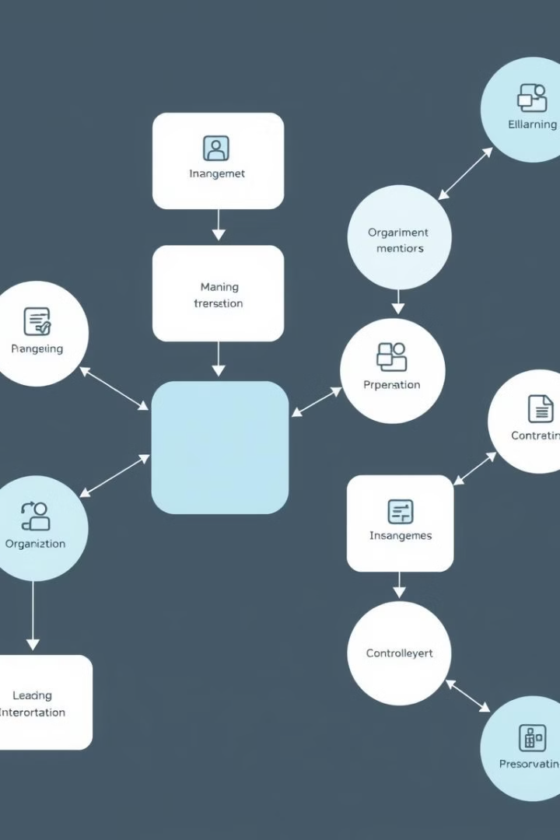
Management Functions and Process
1
Planning
Planning involves setting goals and outlining strategies to achieve them. It includes analyzing the environment, forecasting future trends, developing action plans, and allocating resources.
2
Organizing
Organizing involves structuring the organization to achieve planned goals. It includes defining roles and responsibilities, assigning tasks, coordinating activities, and building a strong team.
3
Leading
Leading involves motivating and guiding employees to achieve organizational goals. It includes communicating effectively, setting a vision, fostering teamwork, and providing feedback.
4
Controlling
Controlling involves monitoring progress, evaluating performance, and taking corrective actions to ensure that plans are executed as intended and goals are achieved.

Slide 4
Scientific Management
1
Focus on Efficiency
2
Selection and Training
Scientific management emphasizes maximizing efficiency by using scientific methods to analyze and optimize work processes. It involves breaking down tasks into smaller components and developing standardized procedures to improve productivity.
Scientific management stresses the importance of selecting and training employees based on their skills and abilities. It aims to ensure that workers are well-suited for their roles and equipped with the necessary knowledge and skills to perform effectively.
3
Work-Study and Standardization
4
Compensation and Incentives
Scientific management emphasizes the use of work-study techniques to analyze and standardize work methods. It involves observing and measuring work processes to identify areas for improvement and implement best practices.
Scientific management advocates for a fair and equitable compensation system, often based on output or productivity. It recognizes the importance of providing incentives to motivate employees and encourage higher performance levels.

Slide 5
Indian Management Thought - trends and issues
Trends
Issues
Increased focus on ethical and sustainable practices
Bridging the gap between traditional values and modern management practices
Growing adoption of technology and digital transformation
Managing a diverse workforce with varying skill sets and cultural backgrounds
Emphasis on innovation and entrepreneurship
Greater emphasis on employee well-being and work-life balance
Addressing the challenges of talent retention and skill development
Balancing economic growth with social responsibility and environmental sustainability

