Slide 1

DEPARTMENT OF LIFELONG LEARNING
BHARATHIDASAN UNIVERSITY
Tiruchirappalli- 620024,
Tamil Nadu, India
Programme: M.A.,HUMAN RESOURCE MANAGEMENT
Course Title : Personality and Soft Skills Development
Course Code : 22HRM2NME1
Unit-I
Foundation of Personality Development
Dr. T. KUMUTHAVALLI
Associate Professor
Department of Lifelong Learning

Slide 2



Foundations of Personality Development
Personality development is a lifelong journey of self-discovery, where individuals explore and refine their unique traits, values, and behaviors. This foundational understanding lays the groundwork for personal growth, healthy relationships, and success in various aspects of life.
by Kavin

Slide 3
Definition, Structure, Scope and Types of Personality
Definition
Structure
Scope
Personality is the unique combination of an individual's thoughts, emotions, and behaviors that shape their interaction with the world.
Personality is composed of traits, temperament, and individual differences that form the core of a person's identity.
Personality development encompasses the evolution of one's self-perception, interpersonal skills, and adaptability to various life situations.

Slide 4
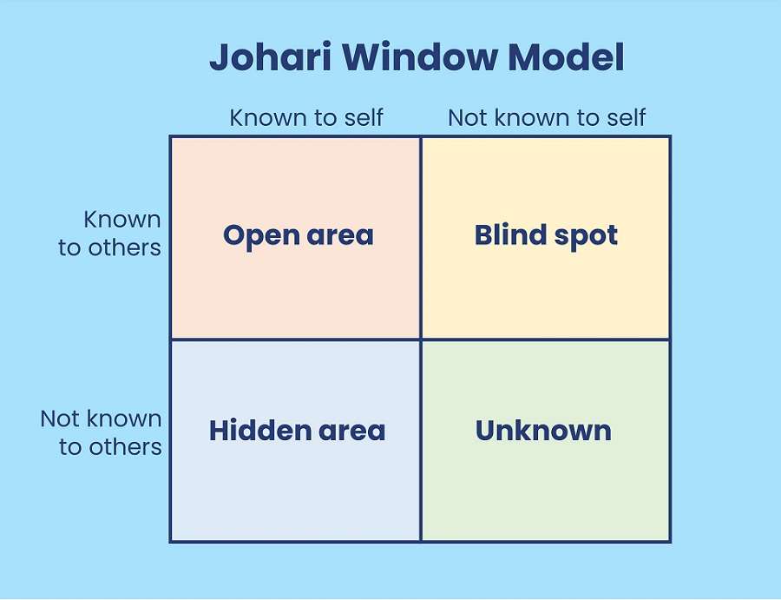
Johari Window
1
Open Self
Aspects of the self that are known to both the individual and others.
2
Blind Self
Traits or behaviors that are unknown to the individual but apparent to others.
3
Hidden Self
Private aspects of the self that are known to the individual but hidden from others.
4
Unknown
The Unknown Area of the Johari Window represents traits or potentials neither you nor others are aware of, revealed through self-discovery or new experiences.

Slide 5

SWOT Analysis & Scope
Strengths
Weaknesses
Identifying and leveraging one's innate talents and capabilities to achieve personal and professional goals.
Acknowledging areas for improvement and developing strategies to overcome personal limitations.
Opportunities
Threats
Recognizing external factors that can contribute to personal growth and career advancement.
Anticipating and mitigating potential obstacles or challenges that may impede personal development.

Slide 6




Self-Esteem and Self-Knowledge
Self-Awareness
Self-Acceptance
Self-Improvement
Understanding one's own values, beliefs, and personality traits is the foundation for personal growth.
Embracing one's strengths and weaknesses with compassion promotes a healthy sense of self-worth.
Continuously seeking to enhance personal skills and behaviors leads to greater confidence and fulfillment.

