Slide 1

DEPARTMENT OF LIFELONG LEARNING
BHARATHIDASAN UNIVERSITY
Tiruchirappalli- 620024,
Tamil Nadu, India
Programme: M.A.,HUMAN RESOURCE MANAGEMENT
Course Title : performance management
Course Code : 22HRM3CC14
Unit- V
Performance development
Dr. T. KUMUTHAVALLI
Associate Professor
Department of Lifelong Learning

Slide 2
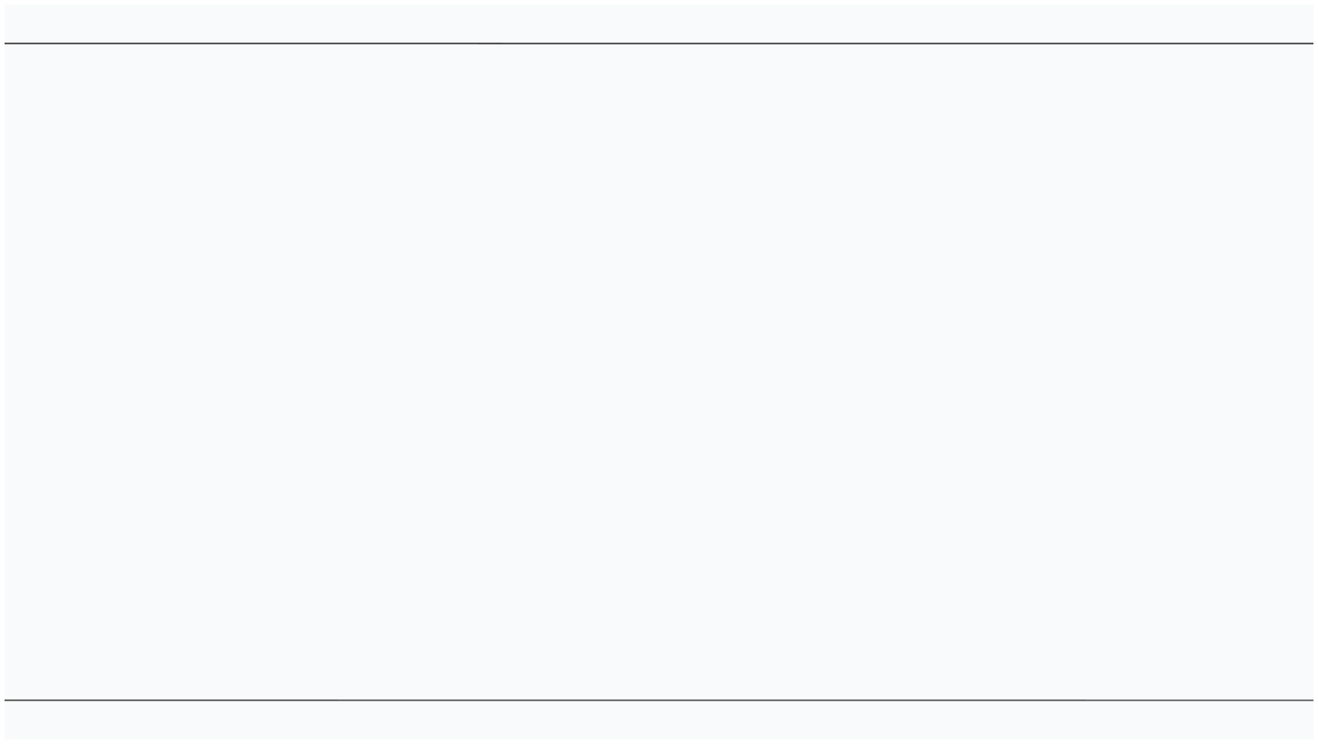




INTRODUCTION TO CAREER MANAGEMENT
Career Management is a strategic approach to developing and navigating one's professional journey. It encompasses a range of activities and strategies aimed at achieving career goals and enhancing organizational eﬀectiveness. This presentation will outline a framework for eﬀectively managing careers within organizations.

Slide 3
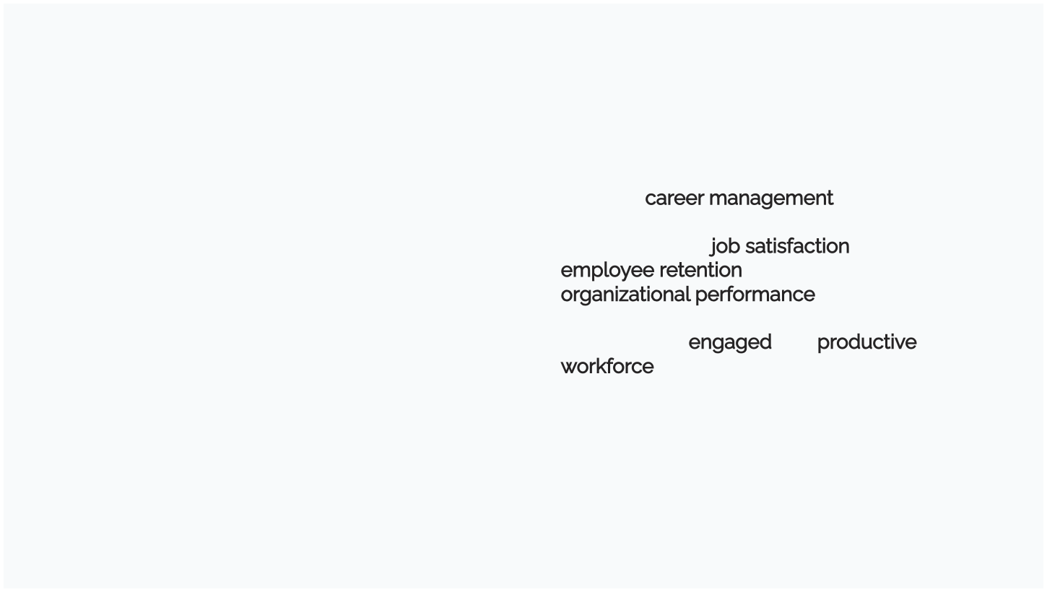

IMPORTANCE OF CAREER MANAGEMENT
Eﬀective career management is crucial for both employees and organizations. It leads to greater job satisfaction, improved employee retention, and enhanced organizational performance. By investing in career development, organizations can foster a more engaged and productive workforce.

Slide 4
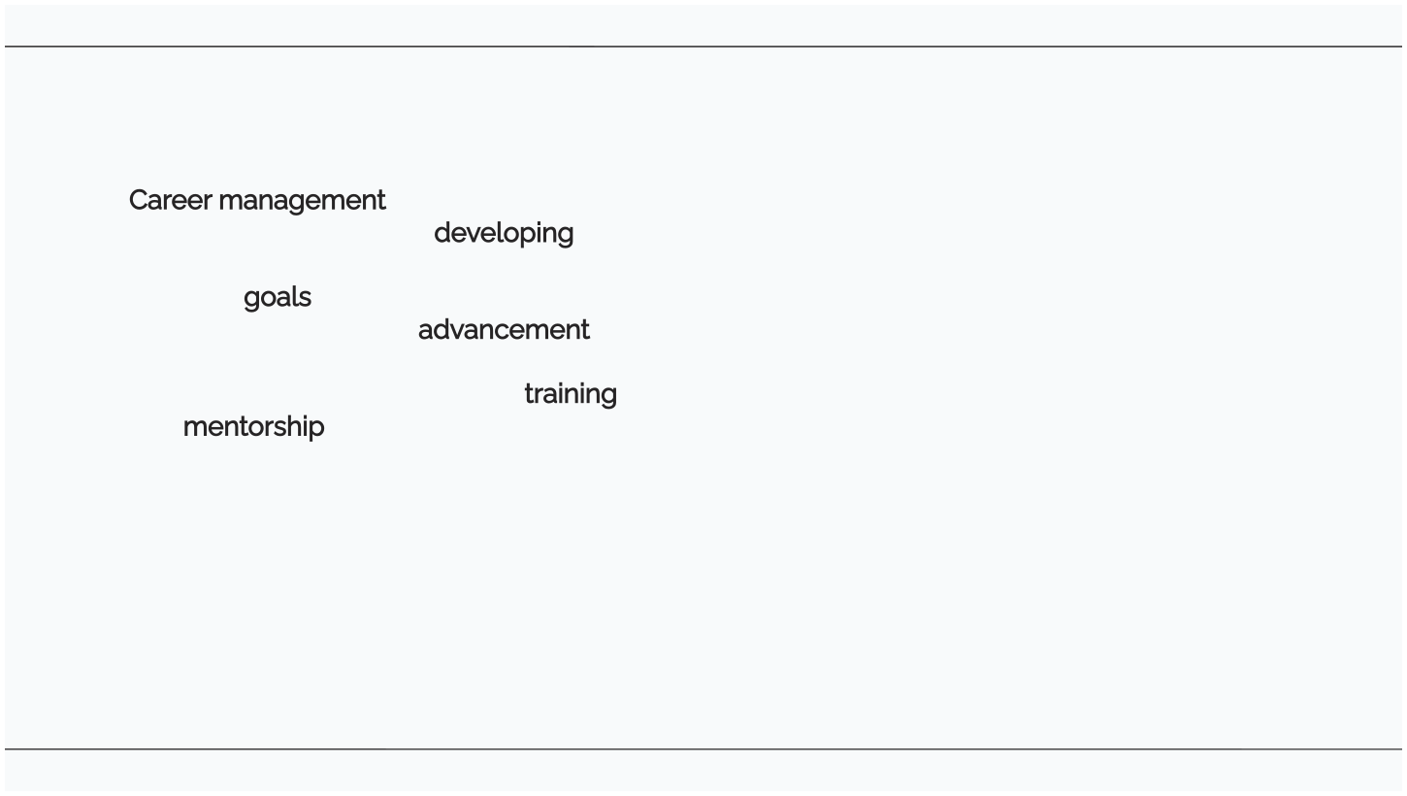



DEFINING CAREER MANAGEMENT
Career management involves the process of planning and developing one's career. It includes identifying personal goals, assessing skills, and creating a roadmap for advancement. Organizations play a key role in facilitating this process through training and mentorship programs.

Slide 5


CLASSIFYING CAREER STAGES
Careers can be classiﬁed into distinct stages: exploration, establishment, maintenance, and disengagement. Each stage presents unique challenges and opportunities that require tailored strategies for success and satisfaction in the workplace.

Slide 6

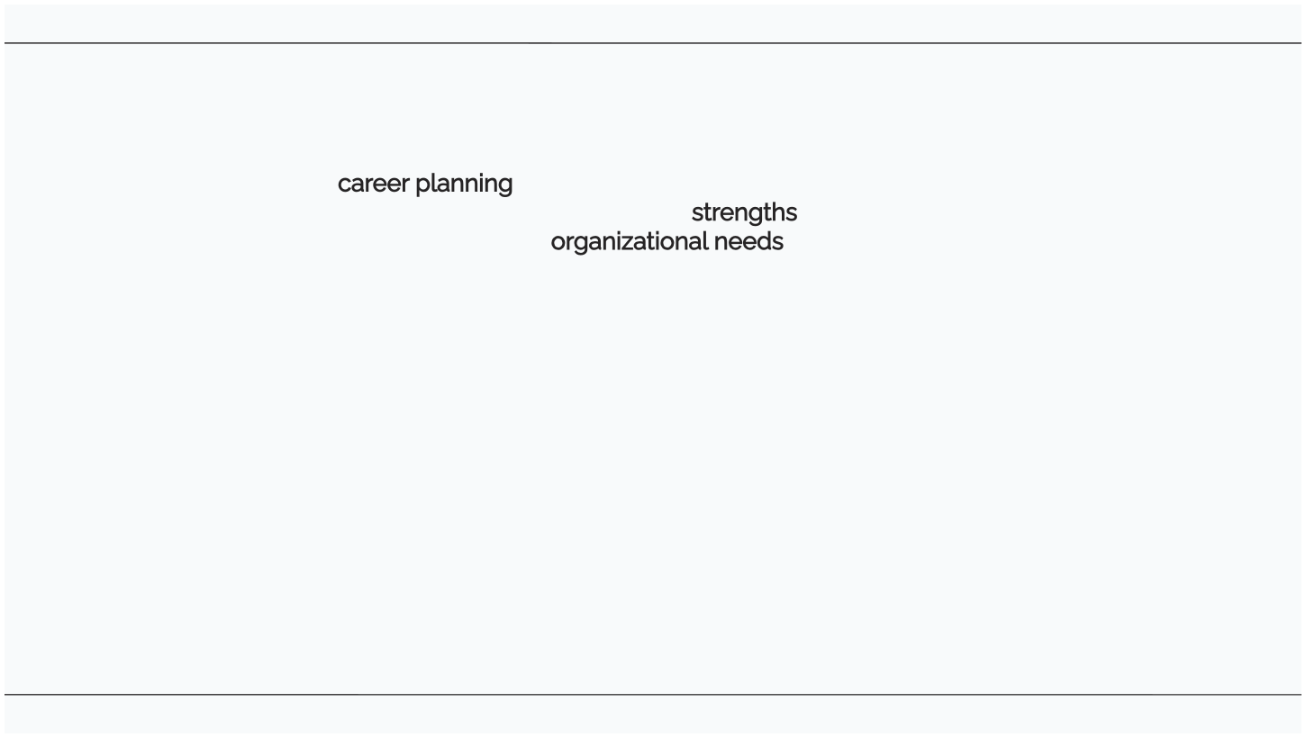

KEY COMPONENTS OF CAREER PLANNING
Eﬀective career planning includes self-assessment, goal setting, and action planning. Individuals must evaluate their strengths, interests, and values to align their career paths with organizational needs and personal aspirations.

Slide 7
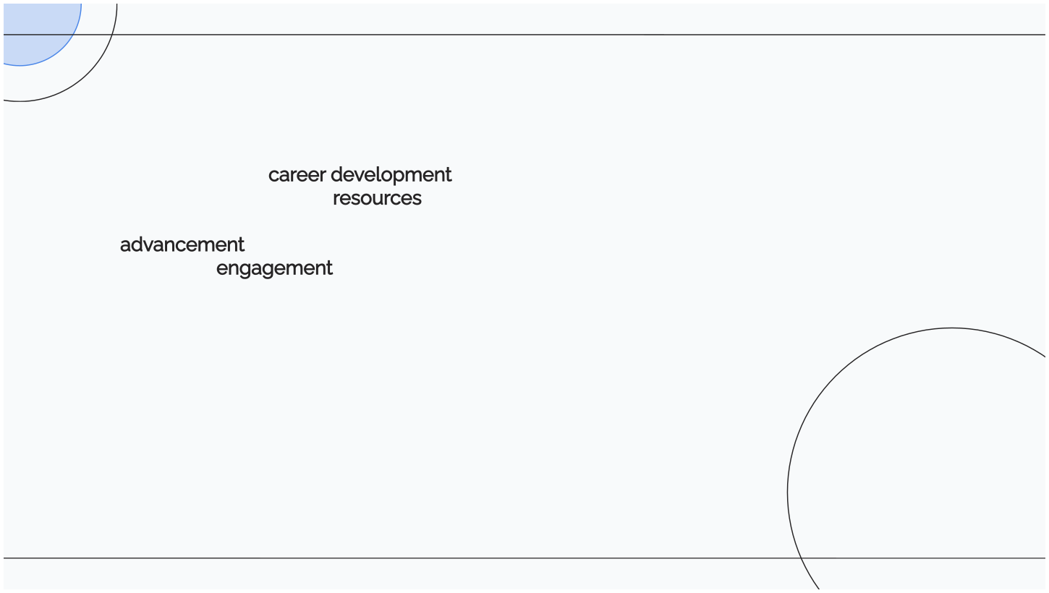

ROLE OF ORGANIZATIONS
Organizations must create a supportive environment for career development. This includes providing resources, mentorship, and opportunities for advancement. By doing so, they enhance employee engagement and ensure a more robust talent pipeline.

Slide 8
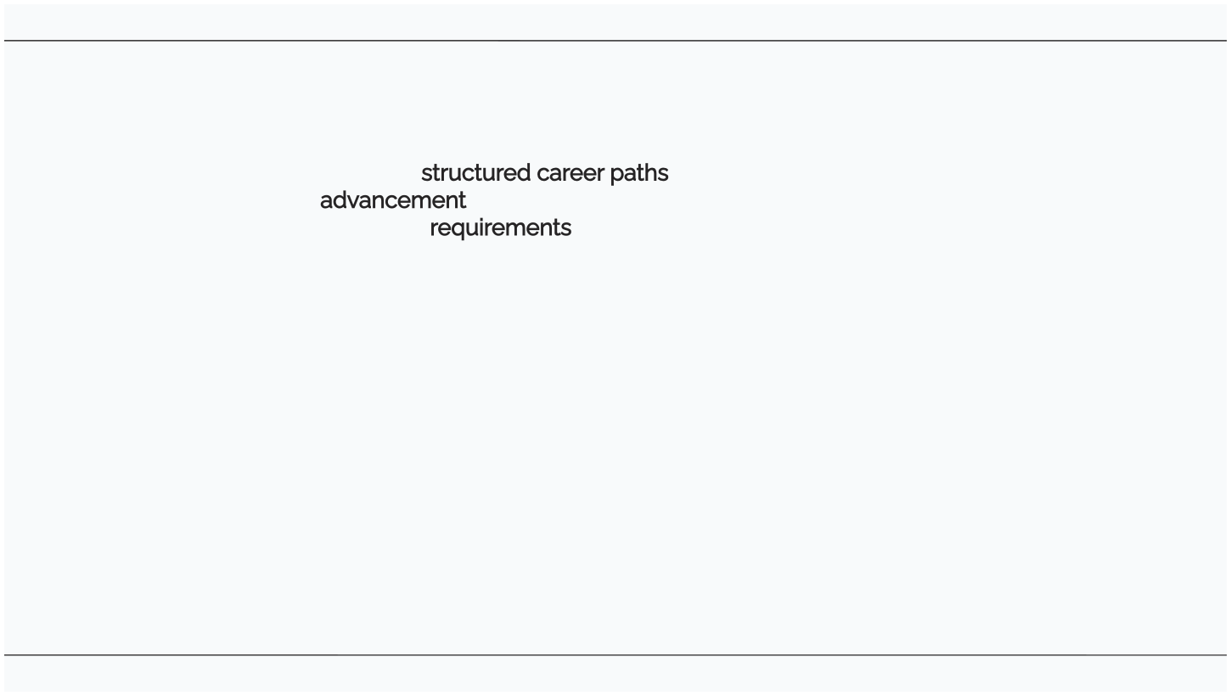

DEVELOPING CAREER PATHS
Creating clear and structured career paths helps employees understand potential advancement opportunities. Organizations should deﬁne roles, competencies, and requirements for each level, enabling employees to navigate their careers eﬀectively.

Slide 9
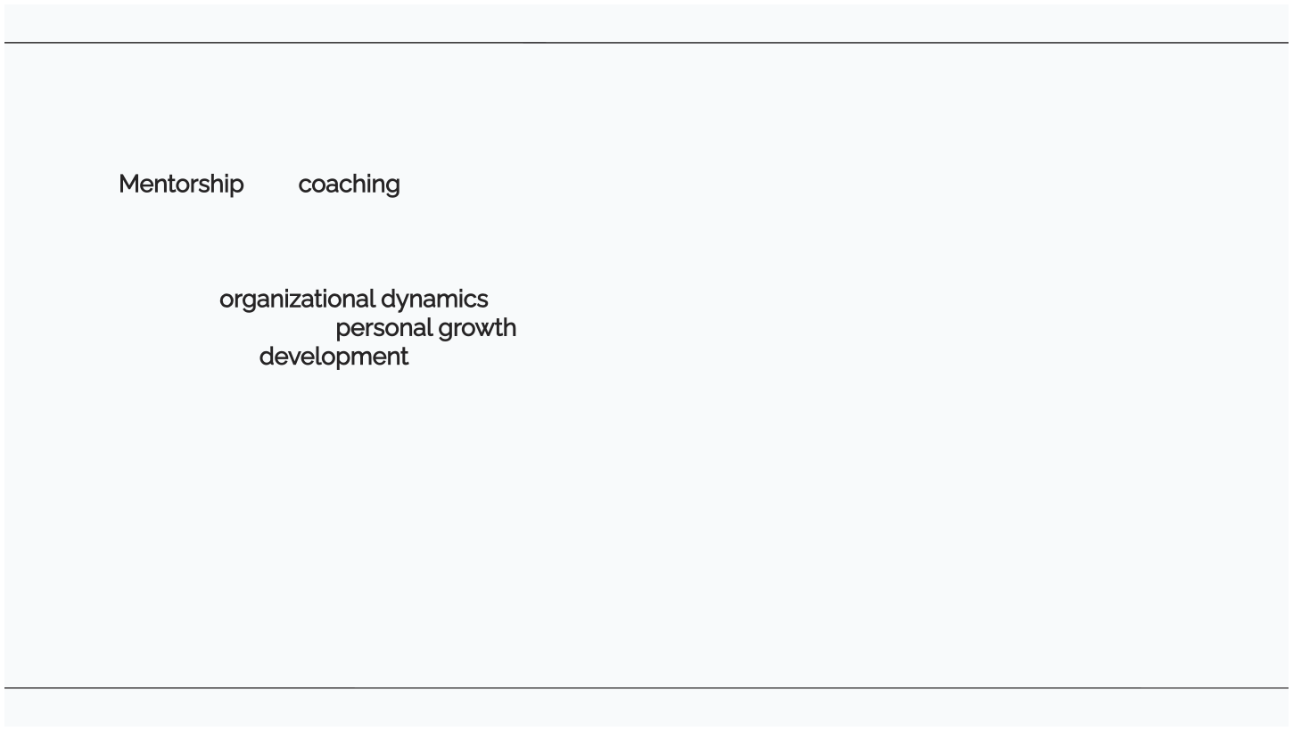

MENTORSHIP AND COACHING
Mentorship and coaching are vital for career development. Experienced professionals can provide guidance, share insights, and help mentees navigate organizational dynamics. This relationship fosters personal growth and professional development.

Slide 10

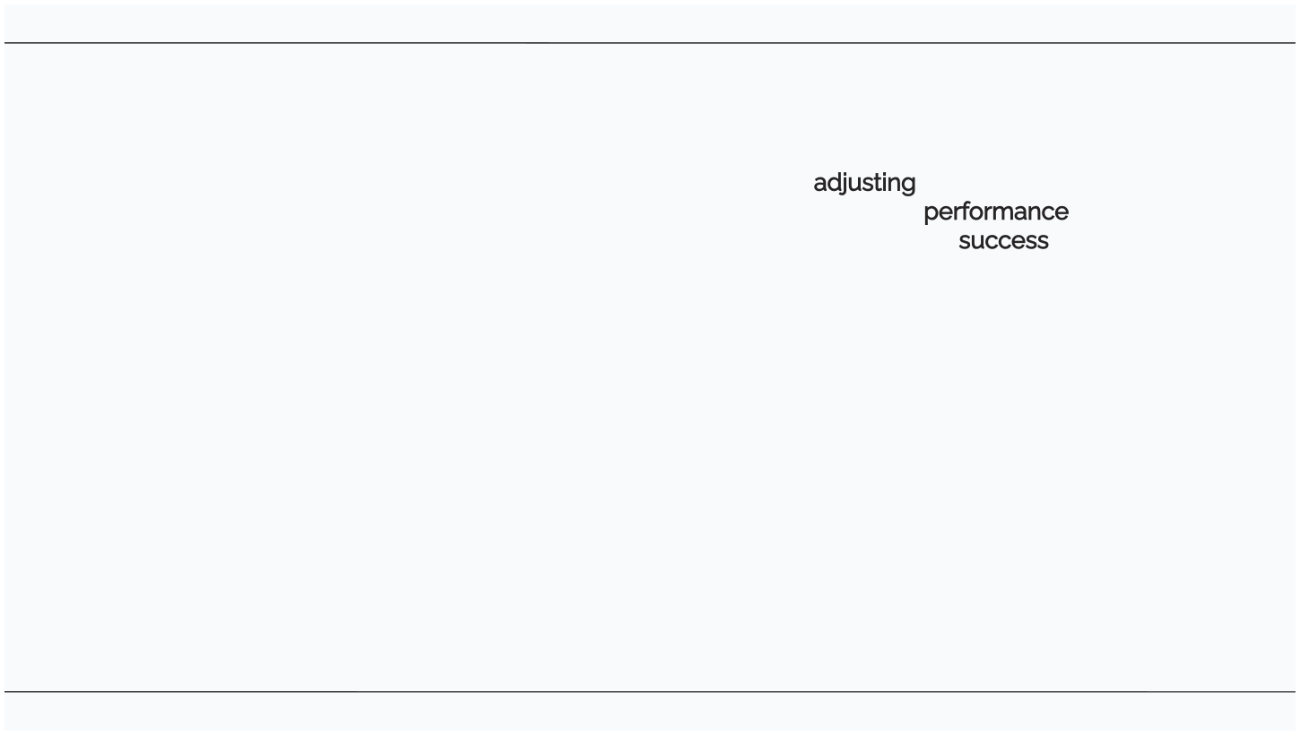

EVALUATING CAREER PROGRESS
Regularly evaluating career progress is essential for adjusting goals and strategies. Employees should seek feedback and assess their performance against established objectives to ensure they remain on track for success.

Slide 11
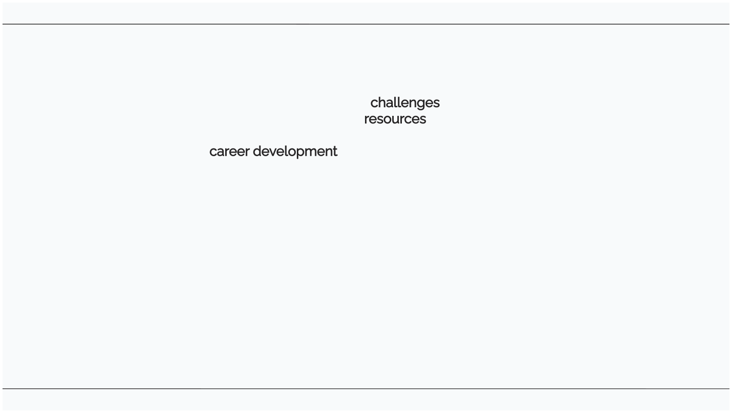

CHALLENGES IN CAREER MANAGEMENT
Career management is not without its challenges. Common issues include lack of clarity in career paths, limited resources, and insuﬃcient support from management. Identifying and addressing these challenges is crucial for eﬀective career development.

Slide 12

FUTURE TRENDS IN CAREER MANAGEMENT
The future of career management will likely involve increased digitalization, personalized career paths, and a focus on lifelong learning. Organizations must adapt to these trends to remain competitive and retain top talent.

Slide 13
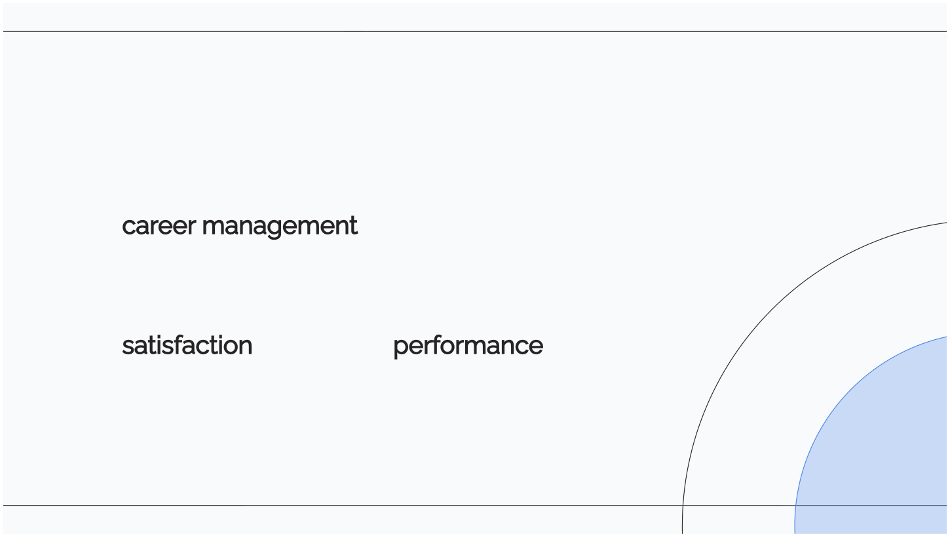
CONCLUSION
In conclusion, a strategic framework for career management is essential for both individuals and organizations. By deﬁning, classifying, and planning careers eﬀectively, organizations can enhance employee satisfaction and overall performance.

