Slide 1

DEPARTMENT OF LIFELONG LEARNING
BHARATHIDASAN UNIVERSITY
Tiruchirappalli- 620024,
Tamil Nadu, India
Programme: M.A.,HUMAN RESOURCE MANAGEMENT
Course Title : performance management
Course Code : 22HRM3CC14
Unit-III
Performance Appraisal
Dr. T. KUMUTHAVALLI
Associate Professor
Department of Lifelong Learning

Slide 2





In this presentation, we will explore the essentials of performance appraisal. Understanding the key components can help organizations unlock the full potential of their employees. Let's dive into the strategies that can lead to a more effective appraisal process.

Slide 3
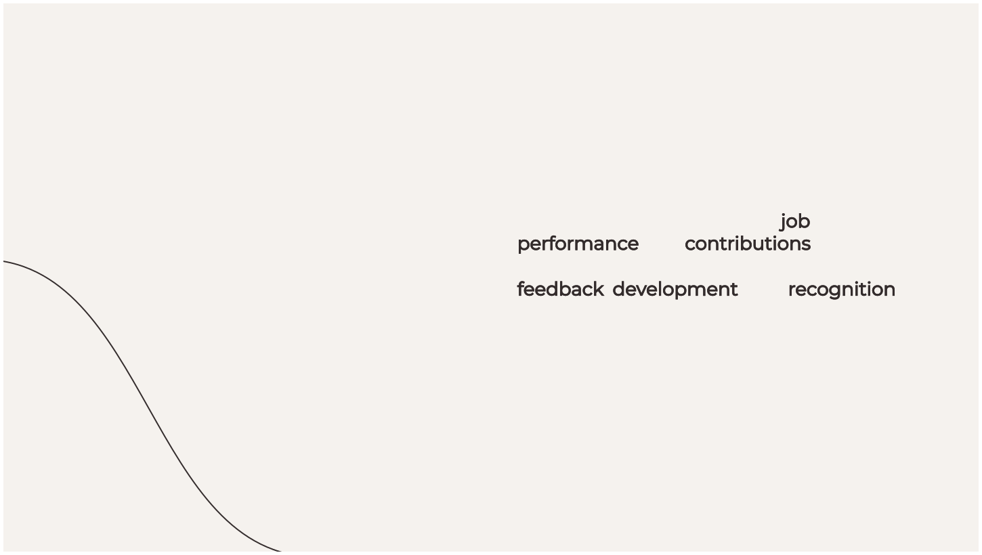

What is Performance Appraisal?
Performance appraisal is a systematic evaluation of an employee's job performance and contributions to the organization. It serves as a tool for feedback, development, and recognition of achievements, helping to align individual goals with organizational objectives.

Slide 4






Importance of Performance Appraisal
Performance appraisals are crucial for fostering a culture of feedback and growth. They help identify strengths and areas for improvement, ensuring that employees feel valued and motivated. This process ultimately contributes to organizational success.

Slide 5





There are several types of performance appraisals, including 360-degree feedback, self-assessment, and management by objectives. Each type offers unique insights and can be tailored to ﬁt the organizational culture and employee needs.

Slide 6


Setting Performance Goals
Effective performance appraisals begin with setting clear and measurable goals. These goals should be SMART: Speciﬁc, Measurable, Achievable, Relevant, and Time-bound. This clarity helps employees understand expectations and strive for excellence.

Slide 7




Conducting Effective Evaluations
To conduct effective evaluations, managers should focus on objective criteria and provide constructive feedback. It’s essential to create a safe environment where employees feel comfortable discussing their performance and aspirations for growth.

Slide 8



Utilizing effective feedback techniques can enhance the appraisal process. Techniques like the sandwich method (positive-negative-positive) can help deliver constructive criticism while maintaining a positive atmosphere, encouraging open communication.

Slide 9





Recognizing Employee Achievements
Recognition is a vital part of performance appraisal. Acknowledging employee achievements boosts morale and reinforces desired behaviors. Implementing a recognition program can motivate employees to continue performing at their best.

Slide 10

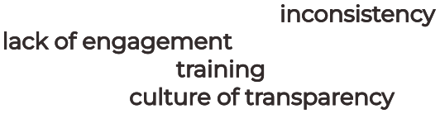
Overcoming Appraisal Challenges
Performance appraisals can face challenges such as bias, inconsistency, and lack of engagement. Addressing these issues requires training for evaluators and fostering a culture of transparency to ensure fair and accurate assessments.

Slide 11
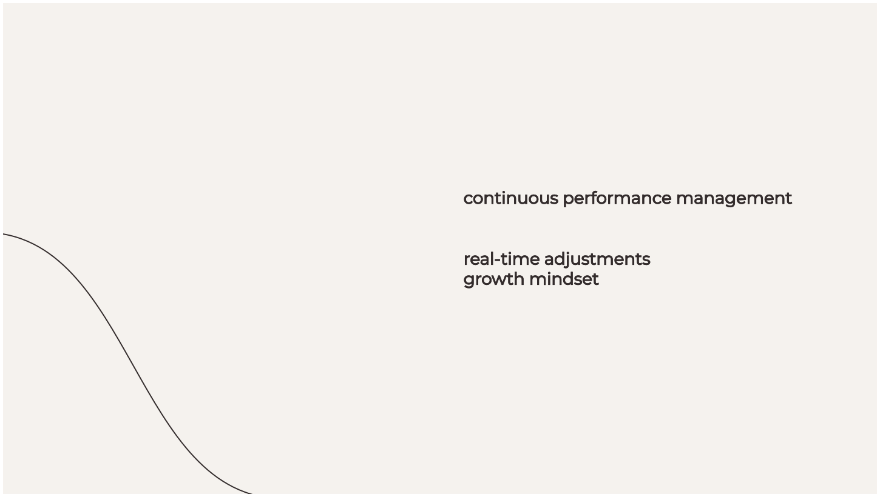

Continuous Performance Management
Shifting from annual reviews to continuous performance management promotes ongoing feedback and development. This approach allows for real-time adjustments and encourages a growth mindset, ultimately leading to improved performance.

Slide 12



Future Trends in Appraisal
The future of performance appraisal is evolving with technology. AI-driven tools and data analytics are becoming integral in providing insights and streamlining the appraisal process, making it more efﬁcient and effective.

Slide 13




Conclusion: Unlocking Potential
In conclusion, effective performance appraisals are essential for unlocking the full potential of employees. By focusing on clear goals, constructive feedback, and recognition, organizations can cultivate a high-performance culture that drives success.

