Slide 1

DEPARTMENT OF LIFELONG LEARNING
BHARATHIDASAN UNIVERSITY
Tiruchirappalli- 620024,
Tamil Nadu, India
Programme: M.A.,HUMAN RESOURCE MANAGEMENT
Course Title : performance management
Course Code : 22HRM3CC14
Unit-II
Performance management process
Dr. T. KUMUTHAVALLI
Associate Professor
Department of Lifelong Learning

Slide 2





Navigating the complex landscape of performance management requires understanding the unique roles of supervisors. This presentation explores how effective supervision can lead to enhanced productivity and a more engaged workforce.

Slide 3



Performance management is a continuous process that involves setting goals, monitoring progress, and providing feedback. It aims to align individual performance with organizational objectives, fostering a culture of accountability and growth.

Slide 4





The Supervisor's Role
Supervisors play a crucial role in performance management by acting as coaches, mentors, and evaluators. They are responsible for guiding their teams towards achieving organizational goals while also supporting individual development.

Slide 5
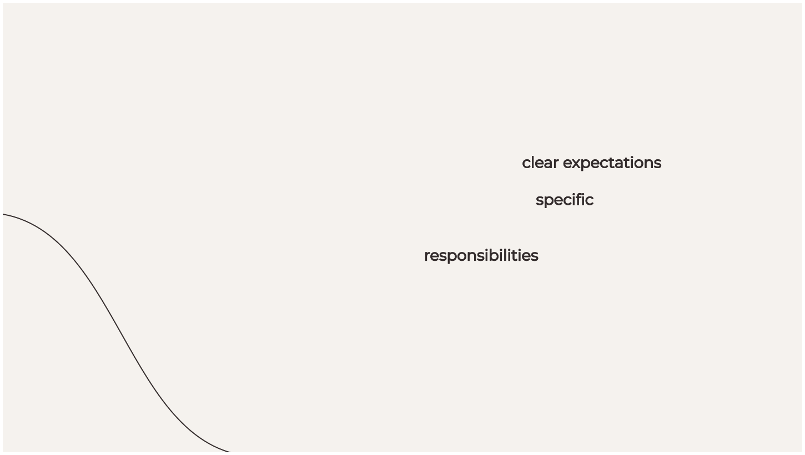

Setting Clear Expectations
Establishing clear expectations is essential for productivity. Supervisors must communicate speciﬁc goals and performance standards to ensure that team members understand their responsibilities and can work towards common objectives.

Slide 6




Effective communication and feedback are vital for performance improvement. Supervisors should provide regular, constructive feedback to help employees understand their strengths and areas for growth. This fosters a culture of transparency.

Slide 7




Motivation is key to achieving high productivity. Supervisors should recognize and reward efforts, create a positive work environment, and encourage collaboration to boost team morale and drive performance.

Slide 8
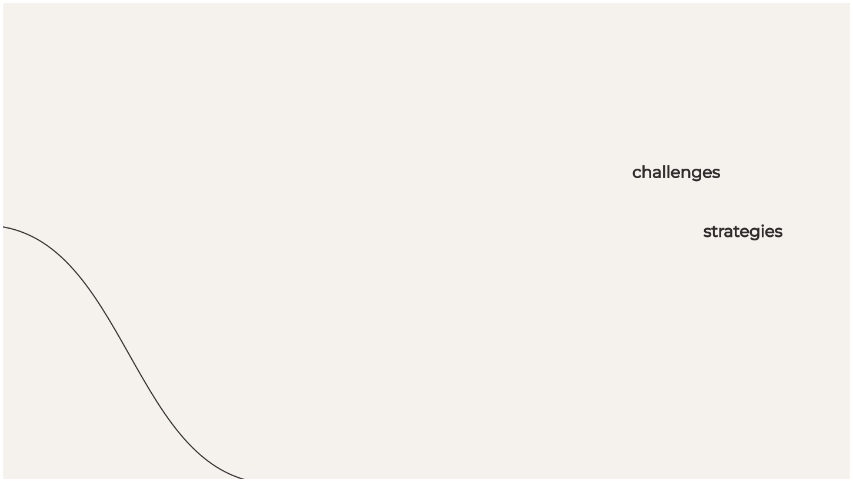

Overcoming Challenges
Supervisors often face challenges such as resistance to change, lack of resources, or low team morale. Identifying these obstacles early and developing strategies to address them is crucial for maintaining productivity.

Slide 9




Leveraging Technology
In today’s digital age, leveraging technology can enhance performance management. Tools for tracking progress, providing feedback, and facilitating communication can streamline processes and improve efﬁciency.

Slide 10
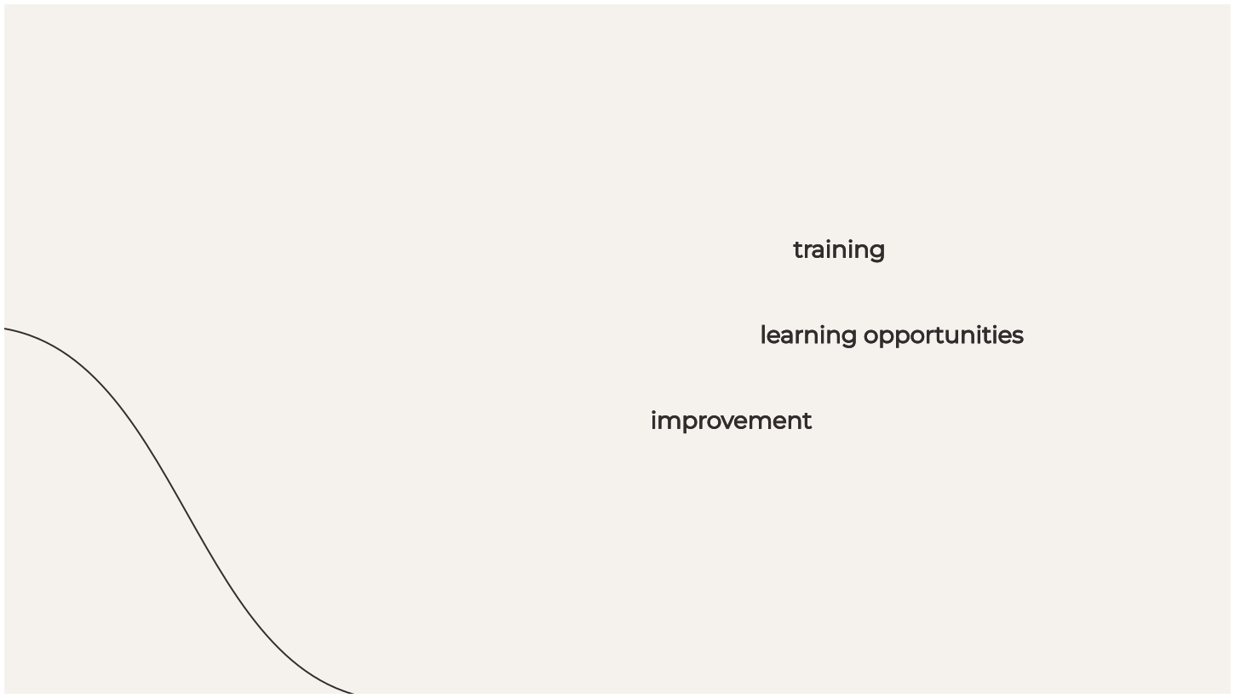

Training and Development
Investing in training and professional development is essential for enhancing team capabilities. Supervisors should prioritize learning opportunities that align with individual and organizational goals to foster a culture of continuous improvement.

Slide 11
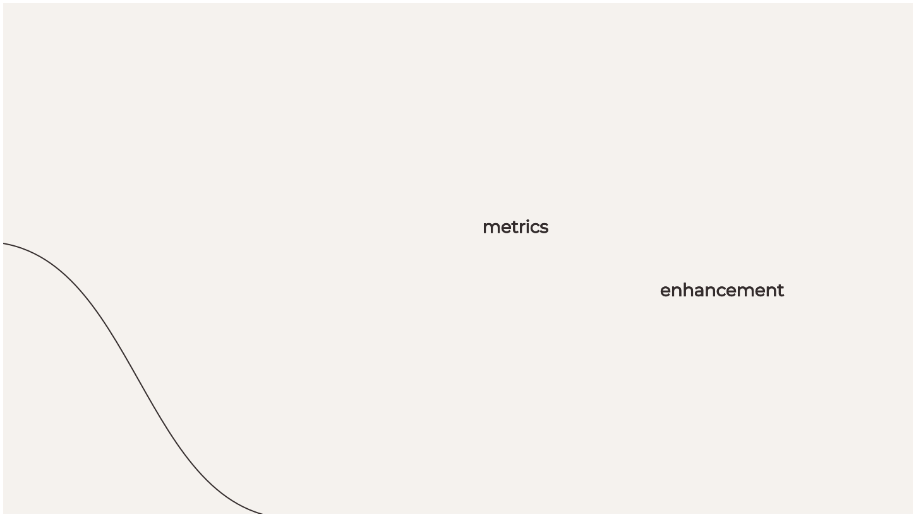

Measuring Success
To navigate the performance maze effectively, supervisors must establish metrics to measure success. Regularly assessing performance against set goals helps in understanding progress and identifying areas for enhancement.

Slide 12



Creating a Feedback Loop
A feedback loop ensures continuous improvement. Supervisors should encourage team members to share their insights and experiences, fostering an environment where learning and adaptation are prioritized for better performance.

Slide 13




Conclusion: The Path Forward
In conclusion, navigating the performance maze requires a strategic approach to supervision. By focusing on communication, motivation, and development, supervisors can lead their teams toward sustained productivity and success.

