Slide 1

DEPARTMENT OF LIFELONG LEARNING
BHARATHIDASAN UNIVERSITY
Tiruchirappalli- 620024,
Tamil Nadu, India
Programme: M.A.,HUMAN RESOURCE MANAGEMENT
Course Title : performance management
Course Code : 22HRM3CC14
Unit-I
PERFORMANCE MANAGEMENT
Dr. T. KUMUTHAVALLI
Associate Professor
Department of Lifelong Learning

Slide 2




Performance Management is not just a process; it's an art and a science. This presentation will explore how to effectively unleash potential in individuals and teams, driving success through innovative strategies and methodologies.

Slide 3
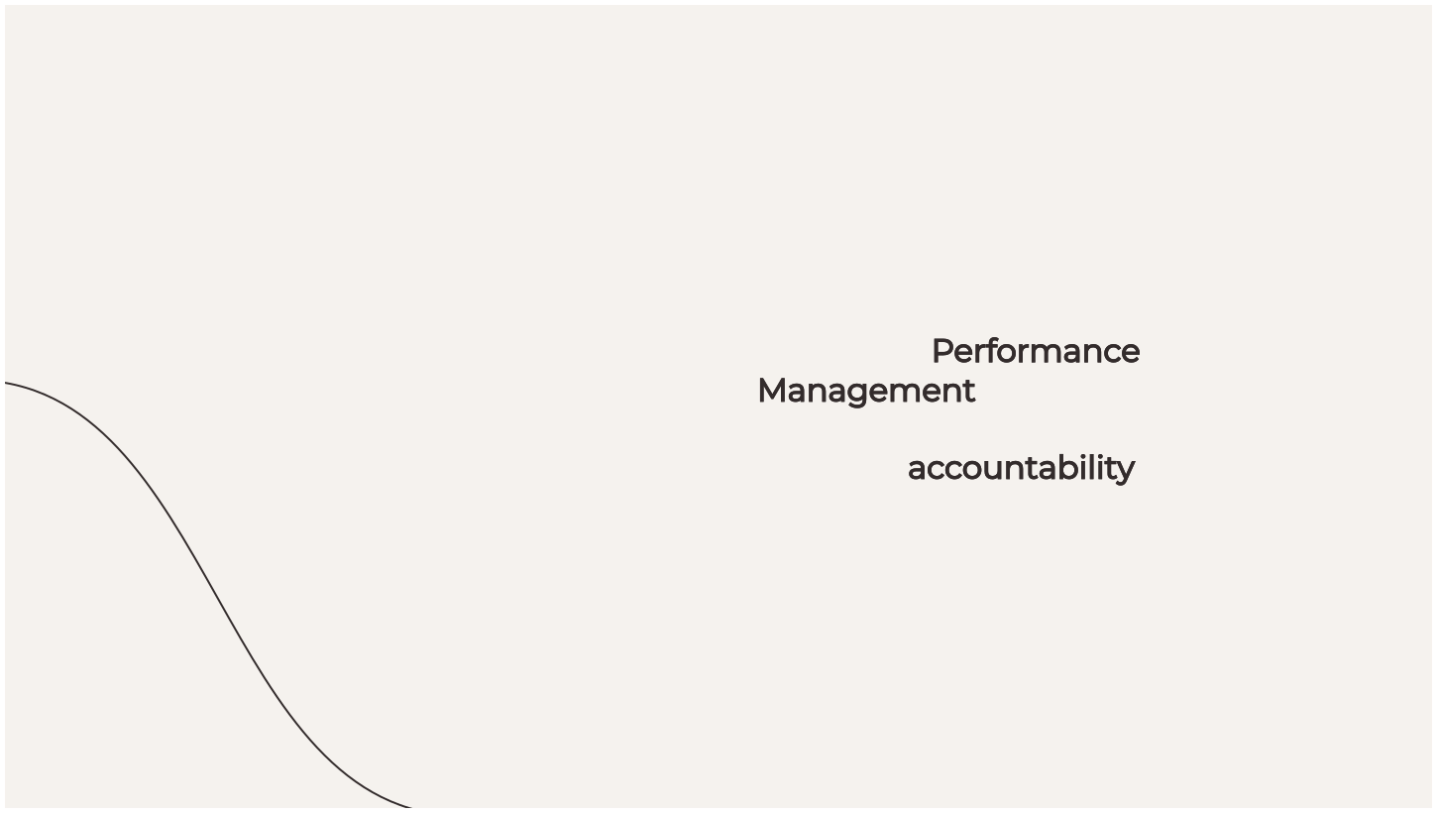

Understanding Performance Management
At its core, Performance Management involves setting clear goals, providing feedback, and fostering accountability. It’s essential to understand its components to unlock the full potential of your workforce.

Slide 4


Setting SMART goals—Speciﬁc, Measurable, Achievable, Relevant, and Time-bound—is crucial. They provide a clear direction and motivate individuals to reach their highest potential, aligning personal aspirations with organizational objectives.

Slide 5
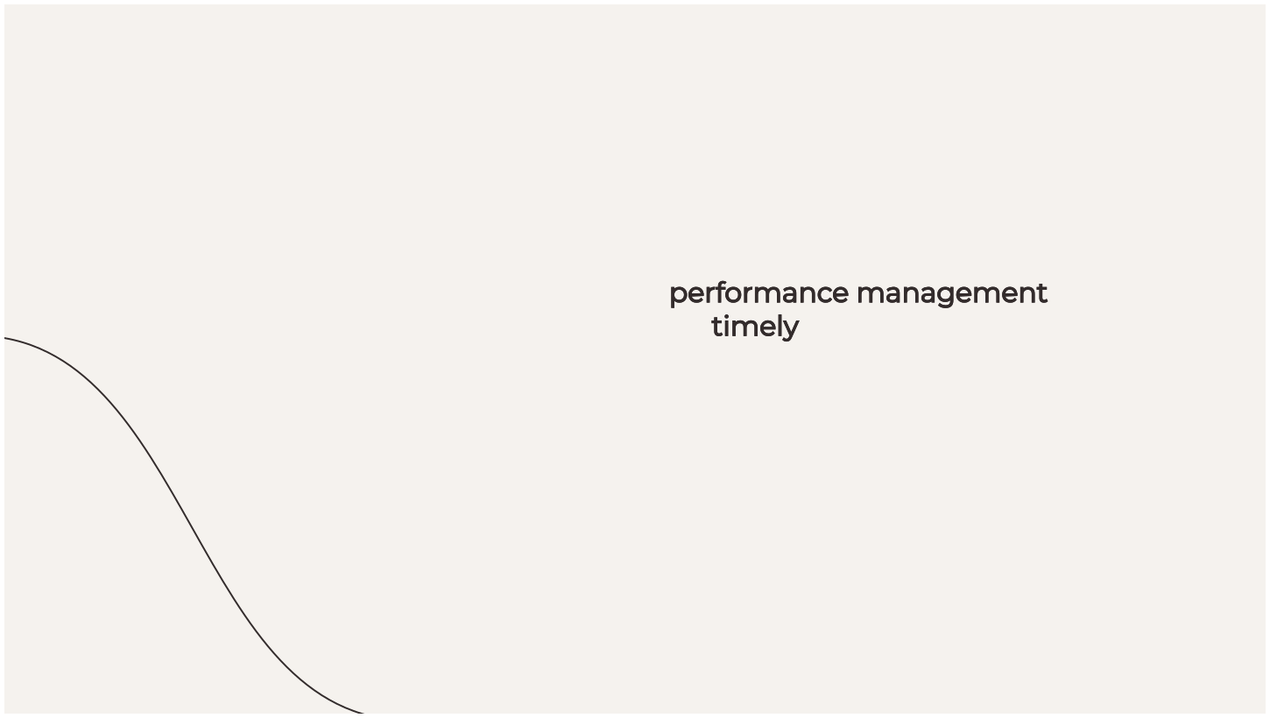

The Science of Feedback
Feedback is a powerful tool in performance management. It should be timely, constructive, and focused on behavior rather than personality. This helps individuals learn, grow, and improve their performance continuously.

Slide 6
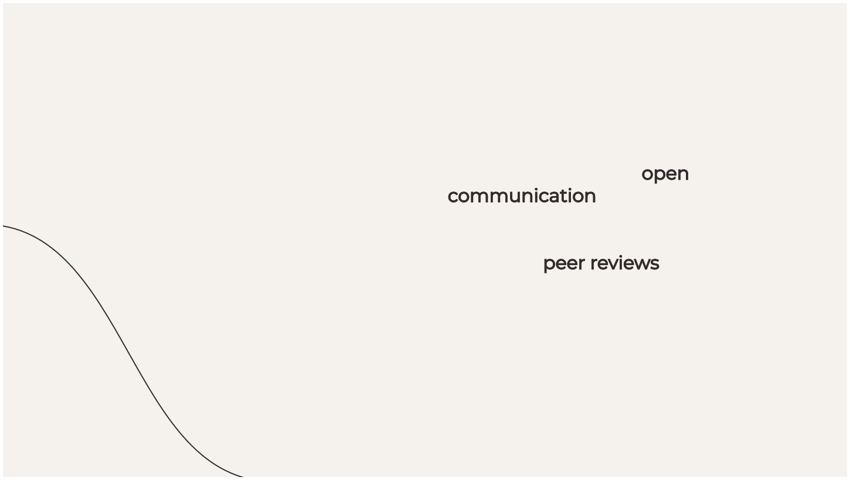

Building a Feedback Culture
Creating a culture of open communication fosters trust and encourages continuous improvement. Regular feedback loops and peer reviews can enhance team dynamics and overall performance, making everyone feel valued.

Slide 7


Performance Metrics and KPIs
Using Key Performance Indicators (KPIs) helps measure success objectively. They provide insights into performance trends and areas for improvement, enabling data- driven decisions that can signiﬁcantly enhance productivity.

Slide 8



Motivation and Engagement
To truly unleash potential, organizations must focus on motivation. Engaged employees are more productive, creative, and committed. Understanding what drives your team is key to enhancing overall performance.

Slide 9


Coaching and Development
Investing in coaching and development is essential for performance management. Providing opportunities for learning not only boosts skills but also fosters loyalty and
commitment among team
members.

Slide 10
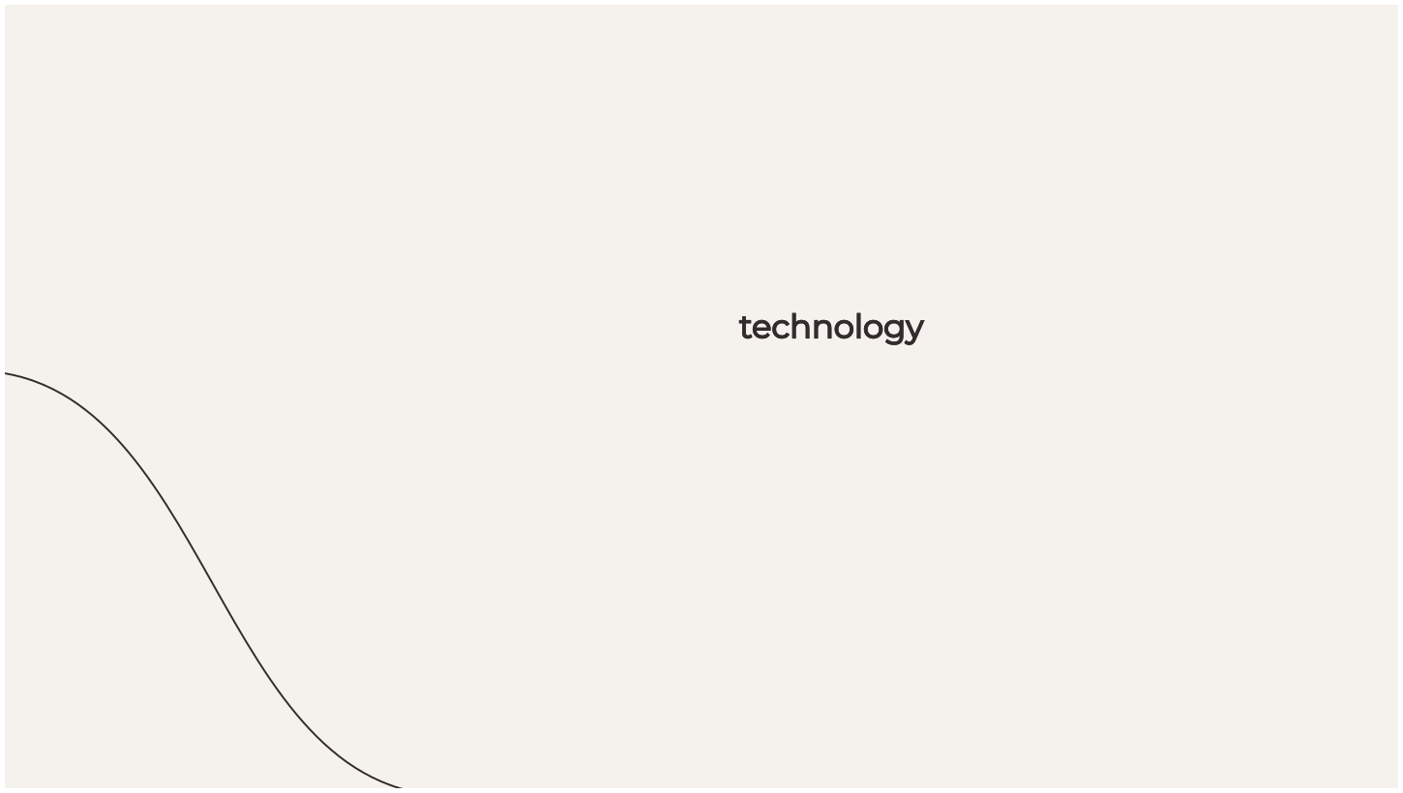

Leveraging Technology
In today’s digital age, leveraging technology can enhance performance management processes. Tools for tracking progress, providing feedback, and facilitating communication can streamline efforts and improve outcomes.

Slide 11




Challenges in Performance Management
Despite its beneﬁts, performance management can face challenges such as bias, lack of clarity, and resistance to feedback. Identifying these obstacles is the ﬁrst step towards creating a more effective system.

Slide 12


Success Stories
Many organizations have successfully transformed their performance management approaches. By embracing innovation and focusing on employee development, they have seen remarkable improvements in both morale and productivity.

Slide 13




Conclusion: The Future of Performance Management
In conclusion, unleashing potential through performance management is an ongoing journey. By blending the art and the science, organizations can create dynamic environments that foster growth, innovation, and success.

