Slide 1

DEPARTMENT OF LIFELONG LEARNING
BHARATHIDASAN UNIVERSITY
Tiruchirappalli-620024
Tamil Nadu, India
Programme: M.A.,HUMAN RESOURCE MANAGEMENT
Course Title : Organizational Development
Course Code : 22HRM3EC2
Unit-IV
Implementation and Assessment
Dr. T. KUMUTHAVALLI
Associate Professor
Department of Lifelong Learning

Slide 2



Implementation and Assessment
Organizational Development (OD) is a critical process for driving positive change and improving organizational performance. Implementing and assessing OD efforts requires a strategic, multifaceted approach that addresses both the structural and cultural aspects of an organization. From designing effective interventions to evaluating the impact on overall performance, every step is crucial in ensuring the success of OD initiatives.
by Presentation

Slide 3
Conditions for Failure and Success in OD Efforts
Conditions for Failure
Conditions for Success
Balancing Factors
Lack of leadership commitment, poor communication, resistance to change, inadequate resources, and a disconnect between OD initiatives and organizational goals can all contribute to the failure of OD efforts. Without a clear vision, buy-in from stakeholders, and a well-designed implementation plan, even the best-intentioned OD programs can fall short.
Successful OD initiatives require strong leadership support, a culture that embraces change, effective communication, ongoing employee engagement, and a data-driven approach to measure and assess the impact. When these elements are in place, organizations can experience improved productivity, enhanced employee morale, and sustainable competitive advantages.
The key is to carefully analyze the organization's readiness for change and address any potential roadblocks or resistance. By proactively addressing these conditions, organizations can increase the likelihood of successful OD implementation and achieve the desired outcomes.

Slide 4
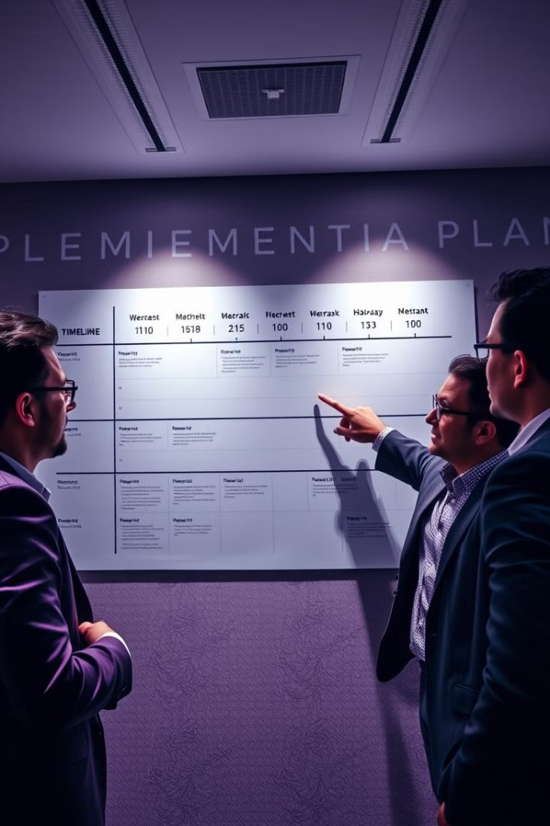
Building the Implementation Plan
1
Assess Organizational Needs
Conduct a thorough analysis of the organization's current state, identifying areas for improvement and potential opportunities for change. This assessment should inform the design of the OD intervention.
2
Develop a Roadmap
Create a comprehensive implementation plan that outlines the specific steps, timelines, resources, and responsibilities required to execute the OD initiative. This plan should be flexible and adaptable to address any unforeseen challenges.
3
Engage Stakeholders
Ensure buy-in and support from all stakeholders, including leadership, employees, and any external partners. Effective communication and change management strategies are crucial to securing commitment and mitigating resistance.

Slide 5

Assessment of OD and Change in Organizational Performance
1
Defined Metrics
2
Ongoing Evaluation
Establish clear, measurable KPIs (Key Performance Indicators) to track the progress and impact of the OD initiative. These metrics should be aligned with the organization's strategic objectives.
Regularly monitor and evaluate the effectiveness of the OD intervention, making adjustments as needed. This iterative process allows for continuous improvement and course corrections.
3
Data-driven Insights
4
Continuous Improvement
Analyze the collected data to gain valuable insights into the organization's performance, identify areas of success and opportunities for further development.
Use the assessment findings to inform future OD initiatives and drive ongoing organizational transformation. Maintain a culture of continuous learning and improvement.

Slide 6






The Impact of OD
Improved Leadership
Enhanced Teamwork
OD initiatives can enhance leadership capabilities, fostering a more engaged, empowered, and collaborative workforce.
OD interventions can promote better communication, alignment, and cooperation among teams, leading to increased productivity and innovation.
Increased Productivity
Adaptability to Change
By addressing organizational inefficiencies and implementing process improvements, OD can drive significant gains in productivity and overall performance.
OD fosters a culture of flexibility, enabling organizations to respond more effectively to evolving market conditions and industry disruptions.

