Slide 1
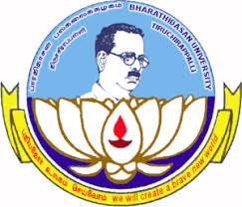
DEPARTMENT OF LIFELONG LEARNING
BHARATHIDASAN UNIVERSITY
Tiruchirappalli-620024
Tamil Nadu, India
Programme: M.A.,HUMAN RESOURCE MANAGEMENT
Course Title : Organizational Development
Course Code : 22HRM3EC2
Unit-III
OD Interventions
Dr. T. KUMUTHAVALLI
Associate Professor
Department of Lifelong Learning

Slide 2
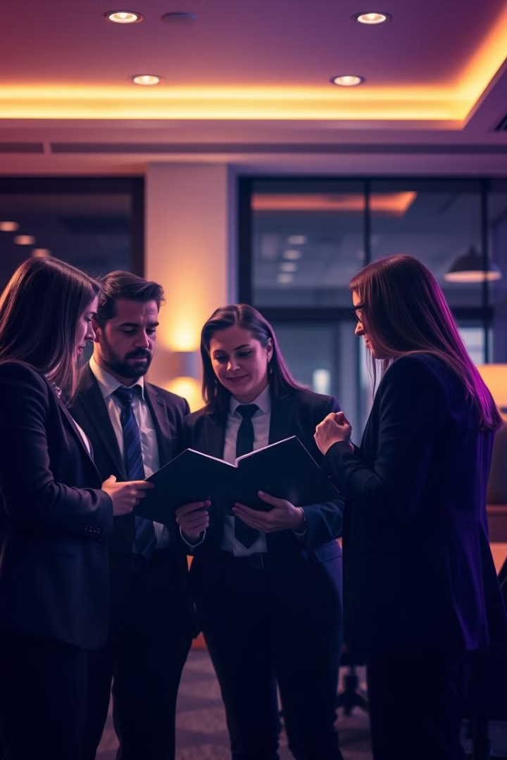


Organizational Development Interventions
Organizational Development (OD) interventions are a critical component of creating positive change within companies and teams. These strategic interventions target different areas, from individual employees to the entire organization, with the goal of improving productivity, fostering better collaboration, and driving sustainable growth. By understanding the various types of OD interventions, leaders can select the most impactful approaches to address their unique challenges and opportunities.
by Presentation

Slide 3
Interpersonal and Group Process Interventions
Team Building
Conflict Resolution
Group Dynamics
Helping teams develop stronger interpersonal relationships, improve communication, and enhance collaboration through activities and exercises designed to foster trust, cooperation, and a shared sense of purpose.
Guiding teams and individuals to constructively address and resolve conflicts, identifying the root causes, and developing strategies to improve conflict management skills and maintain a harmonious work environment.
Analyzing and optimizing the interactions, roles, and decision-making processes within groups to improve team dynamics, increase productivity, and foster a more collaborative and inclusive culture.

Slide 4

Comprehensive Interventions
Organizational Diagnosis
Change Management
Conducting a thorough assessment of the organization's current state, including its structure, culture, processes, and performance, to identify areas for improvement and opportunities for growth.
Developing and implementing a comprehensive change management strategy to ensure the successful adoption and sustainable implementation of organizational changes, minimizing resistance and maximizing the benefits.
1
2
3
Organizational Design
Redesigning the organizational structure, roles, and responsibilities to optimize efficiency, enhance communication, and support the company's strategic objectives.

Slide 5
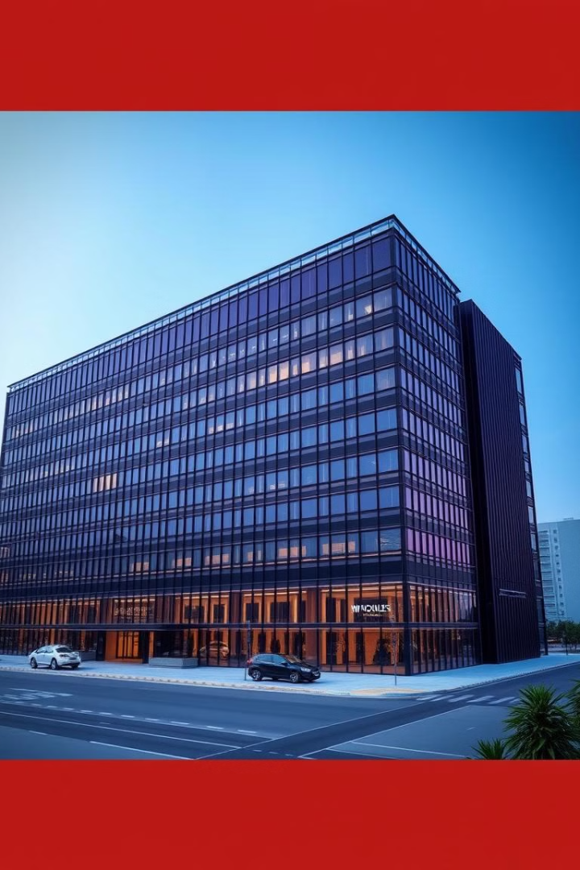
Total Organization Interventions
Strategic Planning
Leadership Development
Facilitating the development and alignment of the organization's long-term vision, goals, and strategies to ensure the company is well-positioned for growth and success in the changing market landscape.
Designing and implementing programs to enhance the skills, capabilities, and effectiveness of the organization's leaders, fostering a strong and visionary leadership team that can drive sustainable change.
Organizational Culture
Assessing and shaping the organization's values, beliefs, and behaviors to create a more positive, collaborative, and innovative culture that supports the company's strategic objectives and empowers employees.

Slide 6
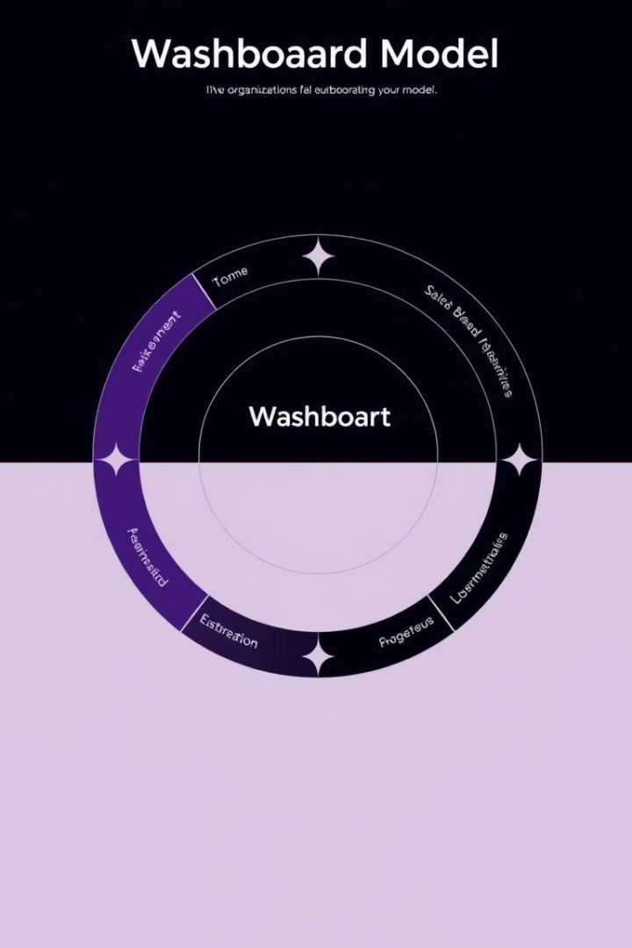
The Washboard Model
1
Data Collection
2
Data Analysis
Gathering comprehensive data about the organization's current state, including its processes, structures, and performance.
Thoroughly analyzing the collected data to identify patterns, trends, and areas for improvement.
3
Feedback and Planning
4
Implementation
Providing feedback to the organization and collaboratively developing a comprehensive action plan to address the identified issues.
Executing the agreed-upon interventions and change initiatives to drive the desired organizational transformation.

