Slide 1

DEPARTMENT OF LIFELONG LEARNING
BHARATHIDASAN UNIVERSITY
Tiruchirappalli-620024
Tamil Nadu, India
Programme: M.A.,HUMAN RESOURCE MANAGEMENT
Course Title : Organizational Development
Course Code : 22HRM3EC2
Unit-I
Introduction
Dr. T. KUMUTHAVALLI
Associate Professor
Department of Lifelong Learning

Slide 2



Introduction Of Organizational development
Organizational development is a planned process that helps organizations improve their performance and achieve their goals. This field focuses on changing the way an organization functions and addresses various aspects like leadership, culture, and communication.
by Presentation

Slide 3

Historical Perspective, Underlying Assumptions, and Values
1
Early Industrial Revolution
The focus was on efficiency and production, with little attention to worker needs.
2
Human Relations Movement
This era emphasized human needs, social interaction, and motivation in the workplace.
3
Modern Organizational Development
A focus on adaptation, learning, and continuous improvement in a rapidly changing world.

Slide 4
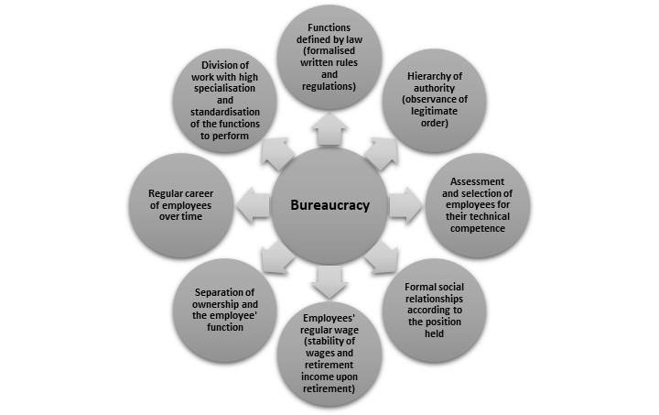
Features of Bureaucracy
Hierarchical Structure
Formal Rules and Procedures
Clear lines of authority with defined roles and responsibilities.
Standardized guidelines for decision-making and operations.
Impersonality
Specialization
Emphasis on objective criteria rather than personal relationships.
Employees have specific expertise in their respective areas.

Slide 5
Administrative Theory and Scientific Management
Administrative Theory
Scientific Management
Key Figures
Focused on the overall structure and processes of organizations.
Emphasized efficiency and optimization of work processes.
Henri Fayol, Frederick Winslow Taylor, and Max Weber.

Slide 6

The Human Relations Movement
1
Employee Motivation
2
Teamwork and Collaboration
Focus on human needs, social interactions, and worker morale.
Encouraging cooperation and communication between employees.
3
Employee Involvement
4
Leadership Styles
Emphasis on democratic and participative leadership.
Involving employees in decision-making and problem-solving.

