Slide 1

DEPARTMENT OF LIFELONG LEARNING
BHARATHIDASAN UNIVERSITY
Tiruchirappalli-620024
Tamil Nadu, India
Programme: M.A.,HUMAN RESOURCE MANAGEMENT
Course Title : Organizational Development
Course Code : 22HRM3EC2
Unit-VI
Oraganizational Change
Dr. T. KUMUTHAVALLI
Associate Professor
Department of Lifelong Learning

Slide 2



Why Organization Change
Organizational change is a crucial and often complex process that companies must navigate to stay competitive and adapt to evolving market demands. Whether it's adopting new technologies, streamlining operations, or shifting company culture, change can be both exciting and daunting for employees and leadership alike. Understanding the foundational reasons behind the need for change is the first step in successfully guiding an organization through a transformative journey.
by Presentation

Slide 3

The Need for Change
1
Staying Competitive
2
Improving Efficiency
3
Enhancing Culture
In today's fast-paced business landscape, organizations must continually adapt to emerging technologies, changing customer preferences, and the strategies of their competitors. Failing to evolve can lead to stagnation and loss of market share.
Outdated processes, siloed departments, and inefficient workflows can hinder an organization's ability to deliver products and services in a timely and cost-effective manner. Change initiatives can streamline operations and boost productivity.
A healthy, engaged, and adaptable company culture is essential for attracting and retaining top talent. Organizational change can help foster a more collaborative, innovative, and customer-centric mindset among employees.

Slide 4
Total Quality Management
Continuous Improvement
Customer-Centric Focus
Data-Driven Approach
Total Quality Management (TQM) is an organizational approach that emphasizes continuous improvement in all aspects of a business. This includes identifying and addressing areas for improvement, setting measurable goals, and empowering employees to contribute to the process.
TQM places the customer at the center of decision-making, ensuring that products and services consistently meet or exceed their expectations. This requires gathering customer feedback, understanding their needs, and aligning internal processes to deliver exceptional value.
TQM relies on data-driven analysis to identify and resolve quality issues. This includes collecting and analyzing performance metrics, monitoring key processes, and using statistical techniques to uncover root causes of problems and opportunities for improvement.

Slide 5




Overcoming Resistance to Change
Fear of the Unknown
Disruption to Routines
Perceived Lack of Benefits
Disruption to Social Dynamics
Change can be unsettling, as it often requires employees to adapt to new ways of working, different responsibilities, or unfamiliar technologies. Addressing this fear through clear communication and training can help ease the transition.
Established processes and routines provide a sense of comfort and control. Organizational change can disrupt these familiar patterns, leading to resistance. Involving employees in the change process and providing support can mitigate this challenge.
If employees do not see the tangible benefits of a change initiative, they may be less inclined to embrace it. Clearly communicating the value and positive outcomes of the change can help overcome this resistance.
Organizational changes can disrupt established social networks and working relationships. Addressing these interpersonal concerns and fostering a sense of community can facilitate a smoother transition.

Slide 6
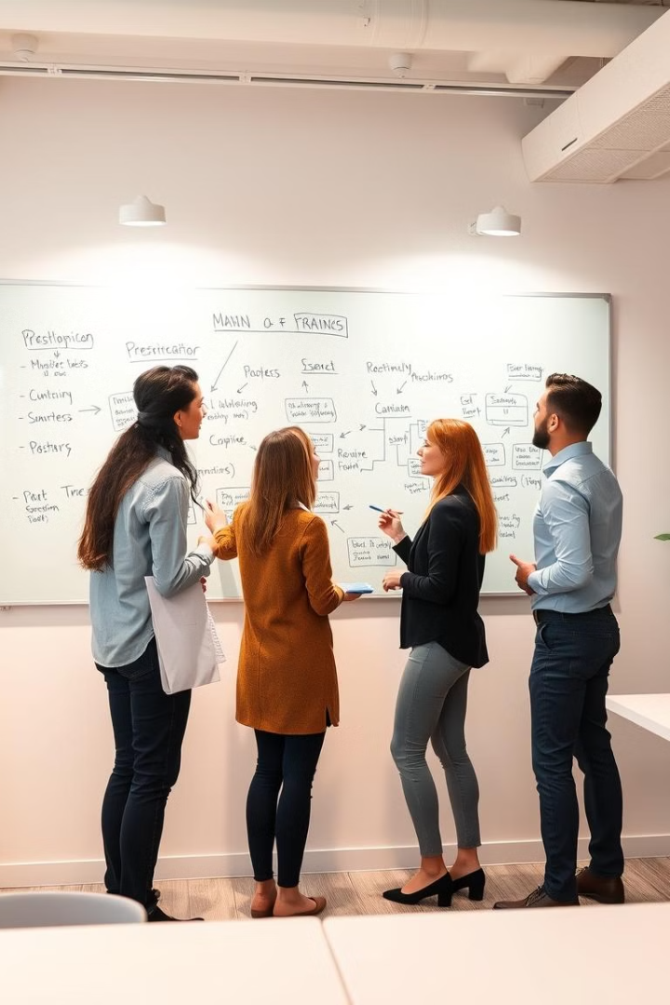
Guidelines for Facilitating Change
1
Establish a Clear Vision
Clearly communicate the rationale, objectives, and expected outcomes of the change initiative to all stakeholders. This provides a shared understanding and sense of direction.
2
Engage Employees
Involve employees in the change process, gather their feedback, and empower them to contribute ideas. This fosters a sense of ownership and commitment to the transformation.
3
Provide Necessary Support
Offer training, resources, and ongoing assistance to help employees navigate the changes. This ensures they have the knowledge and tools to adapt successfully.

