Slide 1

DEPARTMENT OF LIFELONG LEARNING
BHARATHIDASAN UNIVERSITY
Tiruchirappalli- 620024,
Tamil Nadu, India
Programme: M.A.,HUMAN RESOURCE MANAGEMENT
Course Title : Office Management
Course Code : 22HRM4EC5
Unit-VI
TPM (Talent Productive Maintenance) Application
Dr. T. KUMUTHAVALLI
Associate Professor
Department of Lifelong Learning

Slide 2
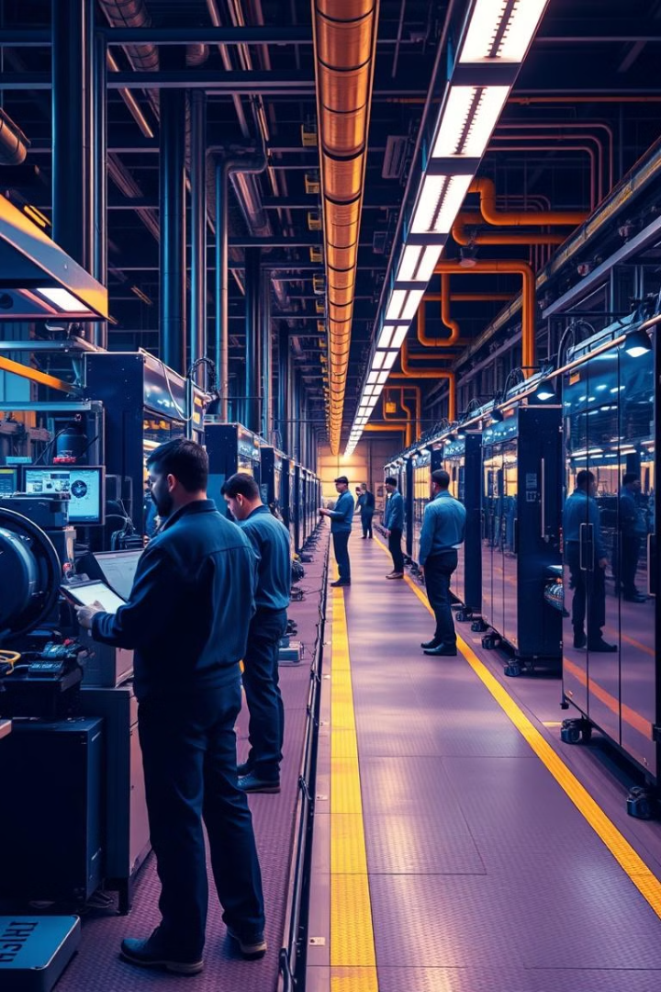
Total Productive Maintenance (TPM): Application
Welcome to our presentation on the power of Total Productive Maintenance (TPM). TPM is a comprehensive approach to equipment management that aims to maximize the overall effectiveness of production equipment. By implementing TPM, organizations can achieve zero breakdowns, zero defects, and maximize the efficiency of their assets.

Slide 3

Zero Breakdown Concepts in TPM
Proactive Maintenance
Autonomous Maintenance
The foundation of TPM is a proactive maintenance strategy that focuses on preventing breakdowns before they occur. This includes regular inspections, predictive maintenance techniques, and condition monitoring to identify and address potential issues early.
TPM empowers operators to take ownership of their equipment through autonomous maintenance. Operators are trained to perform basic maintenance tasks, enabling them to quickly identify and address minor issues before they escalate.

Slide 4
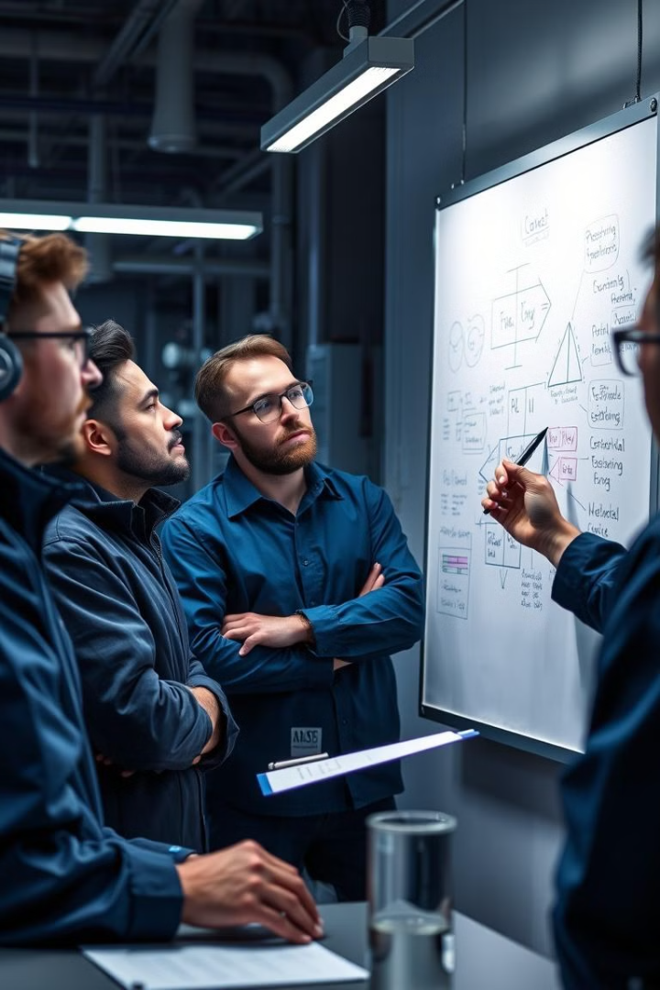
Achieving Zero Defects with TPM
1
Quality-Focused Maintenance
2
Mistake-Proofing
TPM incorporates mistake-proofing methods to eliminate the possibility of human error, such as poka-yoke devices that prevent incorrect assembly or operation of equipment.
TPM emphasizes a quality-focused approach to maintenance, ensuring that equipment is always in optimal condition to produce defect-free products. This includes implementing error-proofing techniques and continuous improvement processes.
3
Quality Circles
TPM encourages the formation of small, cross-functional teams (known as quality circles) to identify and solve quality-related issues. These teams foster collaboration and empower employees to drive continuous improvement.

Slide 5



Maximizing Equipment Effectiveness with TPM
Availability
1
Minimize unplanned downtime and increase the availability of equipment.
Performance
2
Improve the speed and output of equipment to achieve optimal performance.
Quality
3
Ensure that equipment consistently produces high-quality products with minimal defects.

Slide 6





The Five Pillars of TPM
Autonomous Maintenance
Planned Maintenance
Quality Maintenance
Training and Education
Implementing a proactive, preventive maintenance program to reduce breakdowns.
Ensuring that equipment consistently produces high-quality products with minimal defects.
Empowering employees with the knowledge and skills to maintain and improve equipment.
Empowering operators to take ownership of their equipment through basic maintenance tasks.
Continuous Improvement
Fostering a culture of continuous improvement to optimize equipment performance.

Slide 7

Driving TPM through Small Group Activities
Identify Issues
Small cross-functional teams work together to identify equipment-related problems and opportunities for improvement.
Develop Solutions
Teams collaborate to develop and test solutions, implementing appropriate corrective and preventive actions.
1
2
3
4
Analyze Root Causes
Implement Improvements
Teams use problem-solving techniques to analyze the root causes of issues, such as breakdowns, defects, or inefficiencies.
Successful solutions are implemented and standardized across the organization, driving continuous improvement.

