Slide 1

DEPARTMENT OF LIFELONG LEARNING
BHARATHIDASAN UNIVERSITY
Tiruchirappalli- 620024,
Tamil Nadu, India
Programme: M.A.,HUMAN RESOURCE MANAGEMENT
Course Title : Office Management
Course Code : 22HRM4EC5
Unit-V
Office Environment
Dr. T. KUMUTHAVALLI
Associate Professor
Department of Lifelong Learning

Slide 2
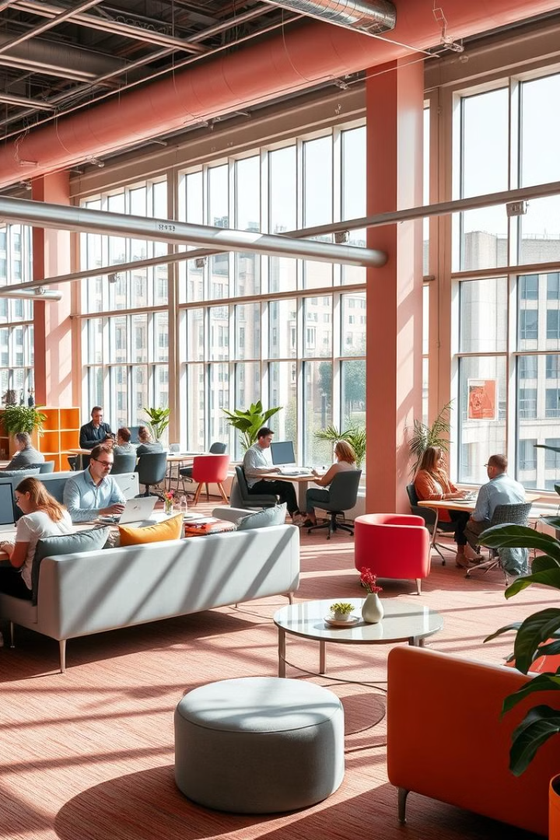


Office Environment: A Holistic Approach
An office environment encompasses a range of factors that collectively influence employee well-being, productivity, and overall job satisfaction. Creating a conducive and inspiring office space goes beyond aesthetics and involves careful consideration of elements like lighting, ventilation, color, and ergonomics.
by Presentation 4

Slide 3
Factors Influencing Office Location
Accessibility
Amenities
Business Hubs
Proximity to public transportation, including buses, trains, and subways, is crucial for employee convenience and reduces commute times. Easy access to highways and major roads is also beneficial for client meetings and business travel.
The presence of nearby restaurants, cafes, banks, retail stores, and other amenities enhances employee convenience and improves overall work-life balance. Easy access to gyms, parks, and recreational facilities promotes physical and mental well-being.
Locating the office in a thriving business hub offers advantages like networking opportunities, access to talent pools, and potential for collaboration with other businesses. It also fosters a sense of energy and dynamism.

Slide 4
Working Environment Factors
1
Ergonomics
2
Space Planning
Ergonomic furniture, adjustable workstations, and proper lighting contribute to a comfortable and supportive working environment, reducing the risk of injuries and promoting employee well-being.
Efficient space planning is vital for creating a balance between individual workspaces, collaborative areas, and breakout zones. This ensures a sense of privacy for focused work while providing opportunities for teamwork and social interaction.
3
Noise Control
4
Temperature Control
Managing noise levels is crucial for maintaining focus and productivity. Implementing sound-absorbing materials, creating designated quiet zones, and encouraging quiet work practices can minimize distractions and improve concentration.
Maintaining a comfortable temperature range, ideally between 68°F and 72°F, is essential for employee comfort and productivity. This can be achieved through efficient HVAC systems and proper insulation.

Slide 5
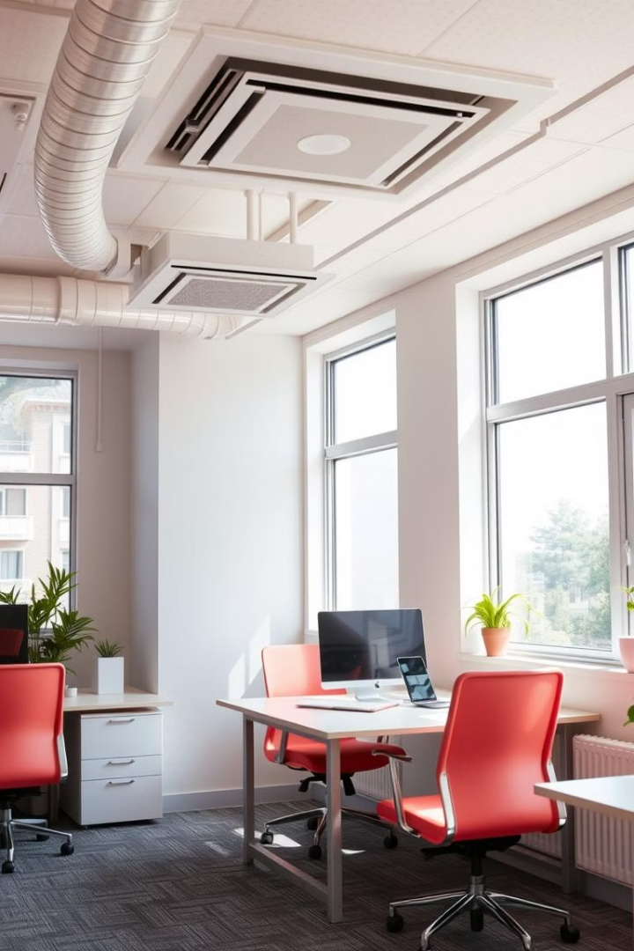



Ventilation: Promoting a Healthy Office
Natural Ventilation
Maximizing natural ventilation by using large windows and strategically placed doors allows fresh air to circulate, improving air quality and reducing reliance on mechanical systems.
Mechanical Ventilation
Employing efficient HVAC systems with air filters and proper airflow ensures adequate ventilation, even in closed spaces, and helps remove pollutants and maintain a comfortable temperature.
Air Quality Monitoring
Regularly monitoring indoor air quality through sensors or testing helps identify potential issues such as excessive humidity, carbon dioxide levels, or airborne contaminants. This allows for prompt corrective actions.

Slide 6

Color Conditioning in the Office: Creating the Right Atmosphere
Color
Effects
Suitable Areas
Blue
Calming, promotes focus
Quiet zones, individual workspaces
Green
Peaceful, enhances productivity
Meeting rooms, collaborative spaces
Yellow
Energizing, promotes creativity
Breakout areas, brainstorming spaces
Orange
Stimulating, boosts energy
Reception areas, waiting lounges

