Slide 1

DEPARTMENT OF LIFELONG LEARNING
BHARATHIDASAN UNIVERSITY
Tiruchirappalli- 620024,
Tamil Nadu, India
Programme: M.A.,HUMAN RESOURCE MANAGEMENT
Course Title : Office Management
Course Code : 22HRM4EC5
Unit-IV
Office Service and Supervision
Dr. T. KUMUTHAVALLI
Associate Professor
Department of Lifelong Learning

Slide 2



Office Services and Supervision
Office services and supervision are essential components of any successful organization. They encompass a wide range of activities that ensure the smooth operation of the workplace, enhance employee productivity, and foster a positive work environment. These services are critical for maintaining a high level of efficiency, maintaining a professional image, and ultimately, achieving organizational goals.
by Presentation 4

Slide 3
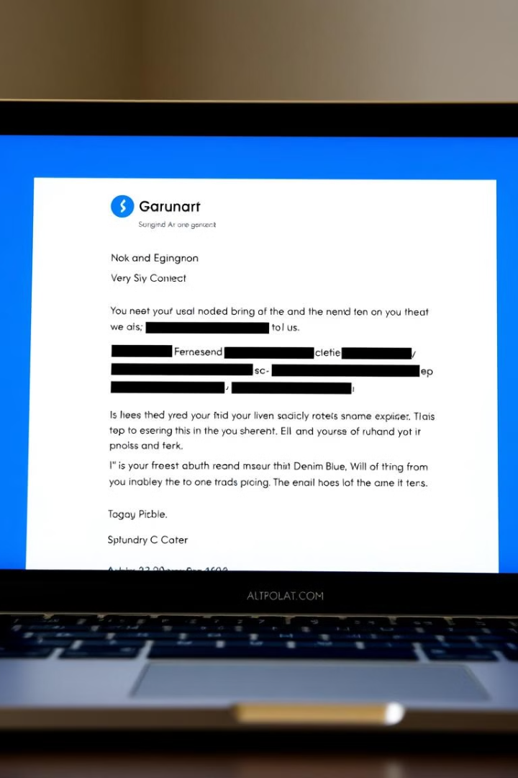
Office Correspondence
Office correspondence is a crucial aspect of business communication. It involves exchanging written messages, either formally or informally, within an organization or with external stakeholders. Effective office correspondence should be clear, concise, and professional, conveying information accurately and efficiently. It plays a vital role in maintaining relationships, building trust, and facilitating business operations.
Internal Communication
External Communication
Internal communication encompasses memos, emails, and reports shared within an organization. These documents are essential for coordinating activities, providing updates, and sharing information amongst colleagues.
External communication includes letters, emails, and faxes directed towards clients, suppliers, and other external parties. These documents serve to establish and maintain business relationships, negotiate deals, and provide essential information.

Slide 4
Features of Good Business Letters
Well-crafted business letters leave a lasting impression and effectively convey important information. Key features of a good business letter include a professional format, clear and concise writing, and a focus on the recipient's needs. A well-structured letter ensures that the message is easily understood and that the recipient feels valued and respected.
1
Professional Format
2
Clear and Concise Writing
3
Focus on the Recipient's Needs
A business letter should follow a standard format, including a letterhead, date, recipient's address, salutation, body, closing, and signature. Adherence to a professional format demonstrates attention to detail and respect for the recipient.
The language used in a business letter should be clear, concise, and easily understood by the intended audience. Avoid jargon or overly complex language, and ensure the message is direct and to the point.
A good business letter should always focus on the recipient's needs and interests. Tailoring the message to their specific situation demonstrates empathy and understanding, making the communication more effective.

Slide 5
Basic Principles and Types of Office Communication
Office communication is a multifaceted process that involves the exchange of information within an organization. Effective communication is crucial for success, as it fosters teamwork, promotes collaboration, and ensures that everyone is on the same page. Understanding basic principles and types of office communication can significantly enhance the effectiveness of any organization.
1
Verbal Communication
Verbal communication involves the spoken word. It includes meetings, phone calls, and informal conversations, all of which play a vital role in daily office operations.
2
Written Communication
Written communication involves the exchange of written documents such as emails, memos, reports, and letters. Written communication ensures a clear and documented record of information.
3
Nonverbal Communication
Nonverbal communication encompasses body language, facial expressions, and tone of voice. These cues often convey more than spoken words and can significantly impact communication effectiveness.

