Slide 1

DEPARTMENT OF LIFELONG LEARNING
BHARATHIDASAN UNIVERSITY
Tiruchirappalli-620024
Tamil Nadu, India
Programme: M.A.,HUMAN RESOURCE MANAGEMENT
Course Title : Natural Resource Management
Course Code : 22HRM4EC4
Unit-VI
Sustainable NRM and Management of CIR
Dr. T. KUMUTHAVALLI
Associate Professor
Department of Lifelong Learning

Slide 2


Sustainable Natural Resource Management (NRM)
Natural resources are the foundation of our planet's ecosystems and economies. Sustainable NRM is critical to ensuring the long-term viability of these precious resources. In this presentation, we'll explore key aspects of sustainable NRM and how to effectively manage our shared global resources.

Slide 3
Sustainable Agriculture
Soil Health
Water Conservation
Promoting soil health through sustainable farming practices like no-till, cover cropping, and organic amendments helps improve soil fertility and water retention while reducing erosion and runoff.
Efficient irrigation techniques, water harvesting, and crop selection tailored to local climates can significantly reduce agricultural water usage and ensure long-term water security.

Slide 4

Sustainable Water Management
1
Resource Assessment
Comprehensive evaluation of water availability, quality, and demand to inform sustainable management strategies.
2
Infrastructure Upgrades
Modernizing water delivery systems, wastewater treatment, and stormwater management to reduce waste and improve efficiency.
3
Conservation Initiatives
Promoting water-saving practices, incentivizing efficient use, and protecting critical watersheds and aquifers.

Slide 5
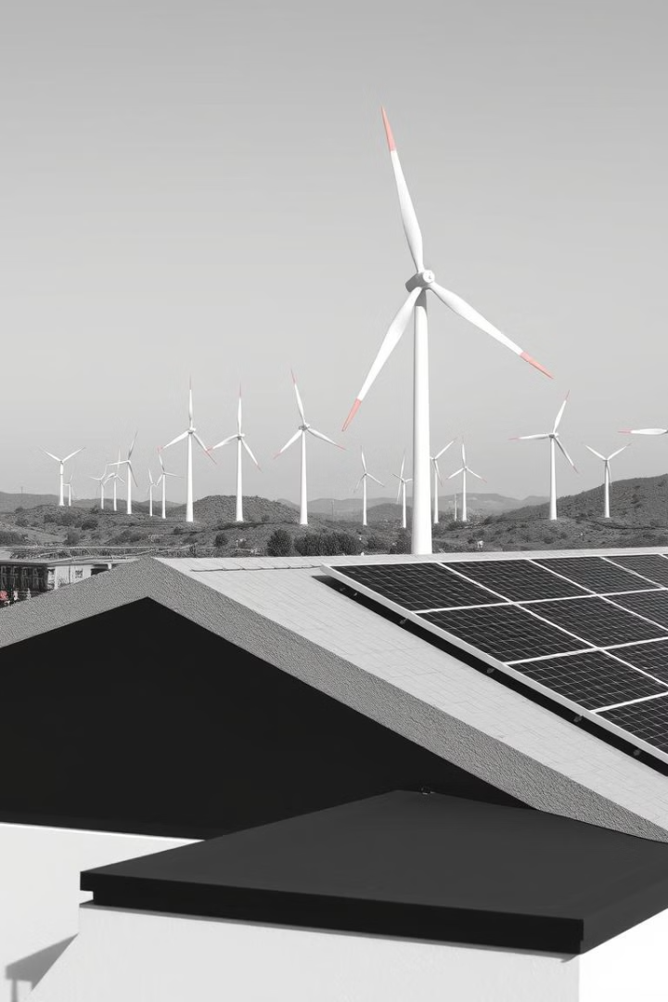
Sustainable Energy Solutions
Renewable Energy
Energy Efficiency
Harnessing the power of solar, wind, hydroelectric, and other renewable sources to reduce dependence on fossil fuels and mitigate climate change.
Implementing energy-efficient technologies, building designs, and behavior changes to minimize energy consumption and environmental impact.
Energy Storage
Advancing battery storage and other energy storage solutions to enable the widespread adoption of renewable energy and grid modernization.

Slide 6




Awareness and Education Programs
Schools
Community Outreach
Policy Engagement
Integrating sustainability education into curricula and empowering students to become champions of environmental stewardship.
Organizing public workshops, events, and campaigns to raise awareness and inspire sustainable behavior changes among citizens.
Collaborating with policymakers to develop and implement effective regulations, incentives, and programs that support sustainable NRM.

Slide 7





Managing Common International Resources
1
Global Cooperation
2
International Law
3
Shared Responsibility
4
Sustainable Practices
5
Environmental Stewardship
Effective management of shared global resources, such as the oceans, atmosphere, and Antarctica, requires a multilateral approach built on international cooperation, legal frameworks, and a shared sense of responsibility for environmental stewardship.

Slide 8
International Fisheries and Management
Data Collection
1
Comprehensive monitoring and assessment of fish stocks and marine ecosystems.
Catch Limits
2
Establishing science-based quotas and catch limits to ensure sustainable harvesting.
Enforcement
3
Robust enforcement mechanisms to deter illegal, unreported, and unregulated (IUU) fishing.
International Cooperation
4
Collaborative management through regional fisheries management organizations (RFMOs) and multinational agreements.

