Slide 1

DEPARTMENT OF LIFELONG LEARNING
BHARATHIDASAN UNIVERSITY
Tiruchirappalli-620024
Tamil Nadu, India
Programme: M.A.,HUMAN RESOURCE MANAGEMENT
Course Title : Natural Resource Management
Course Code : 22HRM4EC4
Unit-V
Experiential Learning
Dr. T. KUMUTHAVALLI
Associate Professor
Department of Lifelong Learning

Slide 2
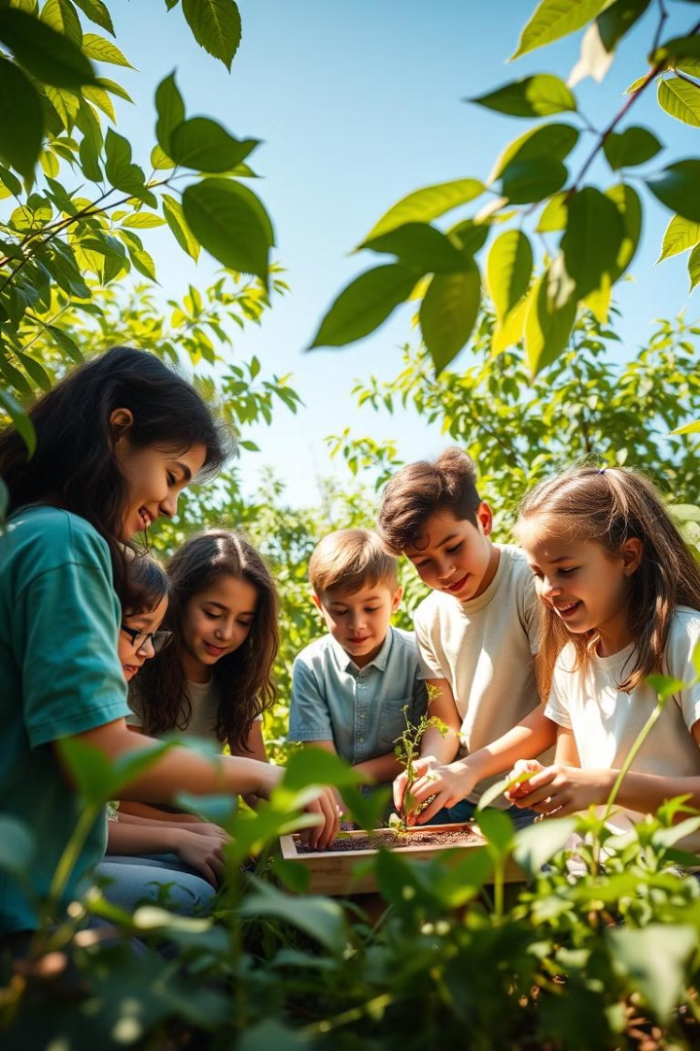


Experiential Learning
Experiential learning is a powerful educational approach that involves actively engaging with real-world experiences. By immersing themselves in authentic scenarios, learners gain valuable knowledge, develop critical skills, and foster a deeper understanding of concepts.
by Presentation 4

Slide 3
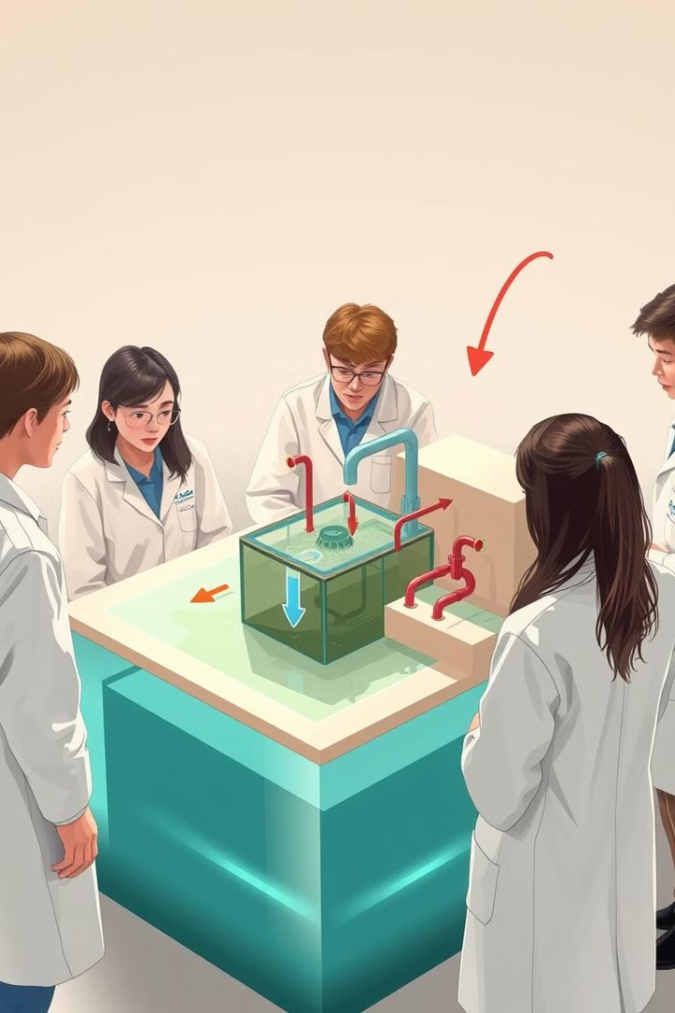
Experiential Learning in Sewage Treatment Plants
1
Site Visit
Students can tour a sewage treatment plant, observing the various stages of the process, from wastewater collection to final discharge. This provides a real-world understanding of how sewage is treated and the importance of sanitation.
2
Hands-on Experiments
Students can conduct experiments simulating different stages of sewage treatment, such as sedimentation, filtration, and disinfection. This allows them to apply scientific principles and gain a deeper understanding of the process.
3
Data Collection and Analysis
Students can collect water samples from different stages of the treatment process and analyze them in a laboratory setting. This helps them understand the impact of treatment on water quality and develop critical thinking skills.

Slide 4
Experiential Learning in Home Gardening
Plant Propagation
Soil Science
Sustainable Gardening Practices
Students can learn about different methods of plant propagation, such as seed sowing, cuttings, and division. They can experiment with various techniques and observe the growth of their plants.
Students can analyze different types of soil, testing pH levels, texture, and nutrient content. They can learn about soil amendments and how to create optimal growing conditions for different plants.
Students can implement sustainable gardening practices, such as composting, water conservation, and pest control. They learn about the environmental benefits of these practices and how to care for the ecosystem.

Slide 5
Experiential Learning in Horticulture
1
Greenhouse Management
2
Plant Identification
Students can learn about the principles of greenhouse management, including temperature control, humidity regulation, and irrigation systems. They can assist in maintaining a healthy greenhouse environment.
Students can identify different species of plants, learning about their characteristics, growth habits, and cultivation requirements. They can develop their knowledge of plant taxonomy and diversity.
3
Crop Production
4
Plant Propagation and Breeding
Students can participate in the production of various crops, from seed sowing to harvesting. They learn about the challenges of growing crops and the importance of responsible agricultural practices.
Students can experiment with different plant propagation techniques, such as grafting and layering. They can also learn about plant breeding and the development of new cultivars.

Slide 6




Experiential Learning in National Parks
Nature Observation
Students can participate in guided hikes or nature walks, observing different plant and animal species in their natural habitat. They can learn about the ecological relationships within the park and develop their observational skills.
Environmental Stewardship
Students can engage in conservation activities, such as trail maintenance, litter cleanup, or invasive species removal. They can learn about the importance of protecting natural resources and become responsible stewards of the environment.
Data Collection
Students can collect data on wildlife sightings, plant diversity, or environmental conditions. This helps them understand the role of scientific research in park management and develop their analytical skills.

