Slide 1

DEPARTMENT OF LIFELONG LEARNING
BHARATHIDASAN UNIVERSITY
Tiruchirappalli-620024
Tamil Nadu, India
Programme: M.A.,HUMAN RESOURCE MANAGEMENT
Course Title : Natural Resource Management
Course Code : 22HRM4EC4
Unit-IV
FFO Resources
Dr. T. KUMUTHAVALLI
Associate Professor
Department of Lifelong Learning

Slide 2



FFO
Resources
Forests are vital ecosystems that cover a significant portion of the Earth's surface. They are diverse habitats teeming with life, providing countless benefits to humans and the planet. Understanding the various forest types and their characteristics is crucial for their sustainable management and conservation.
by Presentation 4

Slide 3

Forest Exploitation
1
Deforestation
2
Illegal Logging
The clearing of forests for various purposes such as agriculture, logging, and urbanization, leading to the loss of biodiversity and ecosystem services.
Unregulated and unauthorized logging activities, often involving corruption and exploitation, leading to unsustainable forest depletion.
3
Wildlife Habitat Loss
4
Climate Change Impact
Forest fragmentation and destruction displace and threaten countless species, leading to biodiversity decline and ecological imbalances.
Deforestation exacerbates climate change by reducing carbon sinks and releasing greenhouse gases into the atmosphere, contributing to global warming and its detrimental effects.

Slide 4
Effects of Human Activities on Forests and Tribal People
Timber Extraction
Mining
Dam Construction
Logging operations can lead to habitat fragmentation, soil erosion, and water pollution, negatively impacting forest biodiversity and threatening the livelihoods of indigenous communities dependent on forest resources.
Mining activities can destroy forests, contaminate water sources, and displace indigenous communities, leading to social and environmental conflicts.
Large dams can flood vast areas of forest land, displacing wildlife and disrupting the flow of rivers, impacting fish populations and the livelihoods of downstream communities.

Slide 5

Unsustainable Harvesting
1
Over-Exploitation
Harvesting timber or other forest resources at a rate exceeding the forest's capacity for regeneration, leading to long-term depletion.
2
Lack of Forest Management
Insufficient or ineffective forest management practices, leading to the degradation of forest ecosystems and loss of biodiversity.
3
Illegal Trade
The illegal trade of timber and other forest products, often driven by corruption and lack of enforcement, contributing to unsustainable harvesting and forest loss.

Slide 6
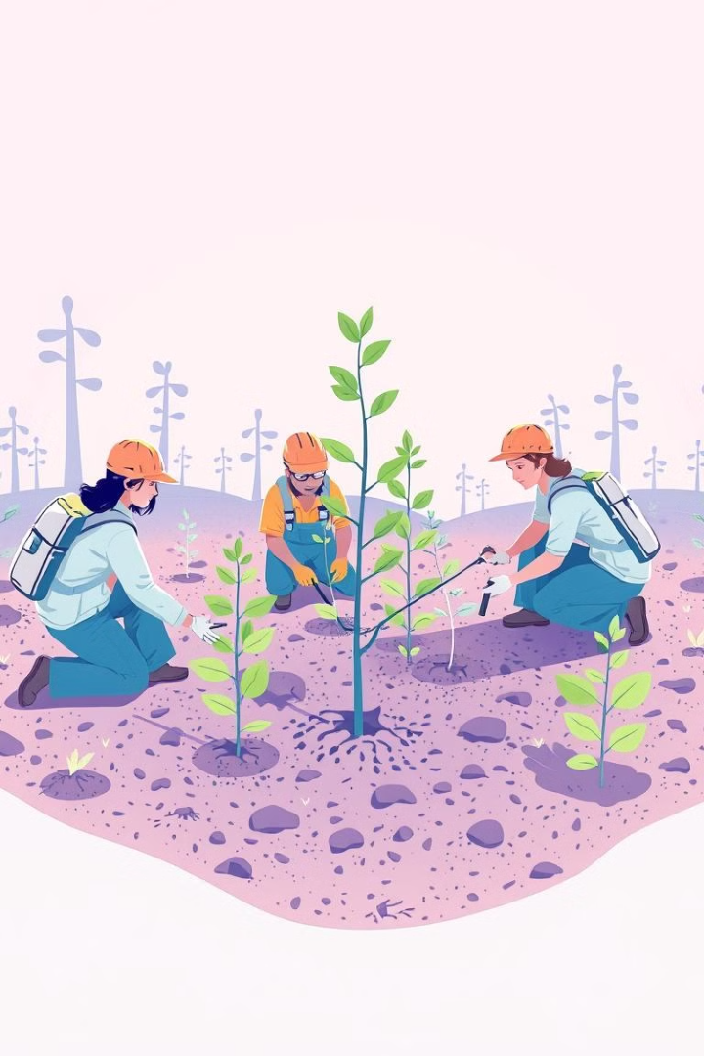




New Prospects for Sustainable Forest Management
Sustainable Forestry Practices
Implementing responsible forest management practices, such as selective logging, reforestation, and agroforestry, to ensure the long-term health of forests.
Community Involvement
Engaging local communities in forest management decisions, empowering them to be stewards of their forests and ensuring equitable benefits.
Conservation Efforts
Establishing protected areas, promoting conservation initiatives, and raising awareness about the importance of forests to protect biodiversity and ecosystem services.
Forest Certification
Certifying sustainably managed forests, promoting responsible forestry practices and ensuring consumers can choose wood products from well-managed sources.

