Slide 1

DEPARTMENT OF LIFELONG LEARNING
BHARATHIDASAN UNIVERSITY
Tiruchirappalli-620024
Tamil Nadu, India
Programme: M.A.,HUMAN RESOURCE MANAGEMENT
Course Title : Natural Resource Management
Course Code : 22HRM4EC4
Unit-II
Introduction to Livehoods and Relation with Natural Resource Management
Dr. T. KUMUTHAVALLI
Associate Professor
Department of Lifelong Learning

Slide 2



Introduction to Livelihoods and Relation with Natural Resource Management
Livelihoods encompass the means by which individuals and communities secure their basic needs, such as food, water, shelter, and income. It's a multifaceted concept that involves various aspects, including economic activities, social relationships, and access to natural resources. Sustainable livelihoods depend on a healthy environment and responsible management of natural resources.
by Presentation 4

Slide 3
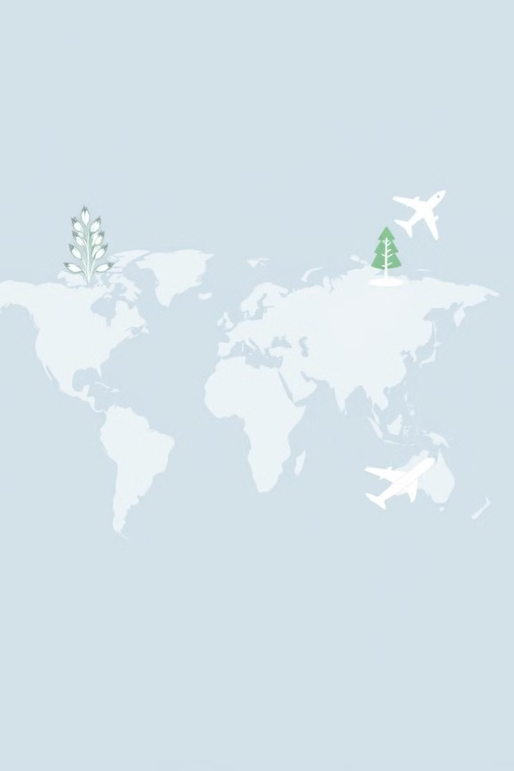
Concepts and Scope of Livelihood
Sustainable Livelihoods
Vulnerable Livelihoods
Focuses on meeting current needs without compromising future generations' ability to do the same. It emphasizes long-term sustainability, resource conservation, and equitable distribution of benefits.
Refers to livelihoods that are highly susceptible to shocks and stresses, such as climate change, economic downturns, or conflict. These livelihoods often depend heavily on natural resources and are vulnerable to environmental degradation.
Livelihood Diversification
Involves expanding income sources and reducing dependence on a single source of income. It can involve exploring new economic activities, developing new skills, or accessing new markets. This helps to reduce vulnerability and enhance resilience.

Slide 4
Threats of Traditional Livelihoods from Globalization
1
Market Competition
2
Loss of Traditional Knowledge
Globalization can introduce competition from cheaper imported goods, impacting local producers and traditional markets. This can disrupt livelihoods and force individuals to adapt to new economic realities.
Globalization can lead to the erosion of traditional knowledge and practices, as communities adopt new technologies and lifestyles. This loss can undermine the foundation of sustainable livelihoods and ecological understanding.
3
Environmental Degradation
4
Exploitation and Inequality
Increased demand for resources, driven by globalization, can lead to unsustainable practices like deforestation, overfishing, and pollution. This threatens the very foundation of livelihoods that depend on healthy ecosystems.
Globalization can create inequalities and exploit vulnerable populations. This can lead to the displacement of traditional livelihoods, social unrest, and exacerbate poverty.

Slide 5
Climate Change and Its Impacts
1
2
3
4
Increased Frequency and Intensity of Extreme Weather Events
Changes in Rainfall Patterns
Rising Sea Levels
Impact on Biodiversity
Rising sea levels threaten coastal communities, leading to flooding, erosion, and saltwater intrusion, impacting agriculture, fisheries, and tourism. This can force displacement and lead to economic hardship.
Shifting rainfall patterns can disrupt agricultural cycles, leading to crop failures and water scarcity, particularly in regions already experiencing water stress. This can lead to food insecurity and migration.
Climate change is altering ecosystems, leading to shifts in species distribution, changes in plant growth, and increased risk of extinction. This impacts livelihoods that depend on biodiversity, such as fishing and forestry.
Climate change is leading to more frequent and intense droughts, floods, heat waves, and storms, all of which can disrupt agricultural production, damage infrastructure, and threaten human lives.

