Slide 1

DEPARTMENT OF LIFELONG LEARNING
BHARATHIDASAN UNIVERSITY
Tiruchirappalli-620024
Tamil Nadu, India
Programme: M.A.,HUMAN RESOURCE MANAGEMENT
Course Title : Natural Resource Management
Course Code : 22HRM4EC4
Unit-III
LWF Resources
Dr. T. KUMUTHAVALLI
Associate Professor
Department of Lifelong Learning

Slide 2
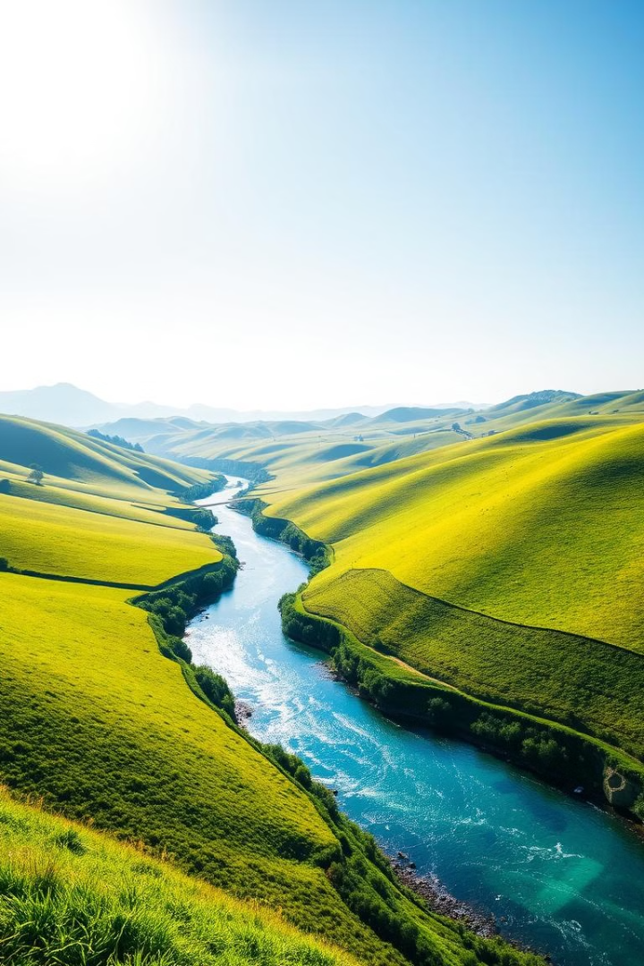


Land, Water, and Food Resources
This presentation explores the challenges of managing land, water, and food resources for a growing global population.
by Presentation 4

Slide 3
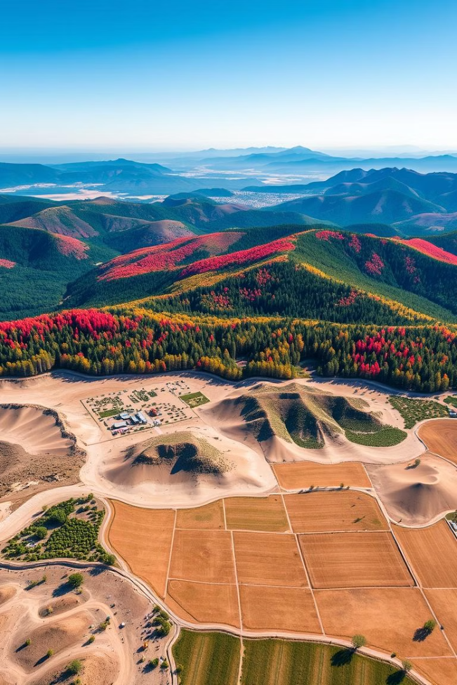
Land Resources
1
Land Degradation
2
Land Use Change
Soil erosion, deforestation, and desertification threaten the availability of fertile land for agriculture.
Urban sprawl, mining, and infrastructure development are altering land use patterns, impacting ecosystems.
3
Sustainable Land Management
Conservation practices, such as agroforestry and sustainable agriculture, are crucial for preserving land resources.

Slide 4
Water Resources
Surface Water
Groundwater
Water Quality
Rivers, lakes, and wetlands provide vital freshwater sources for drinking, agriculture, and industry.
Aquifers hold vast reserves of water, but over-extraction can lead to depletion and saltwater intrusion.
Pollution from industrial activities, agriculture, and sewage threatens the availability of clean water.

Slide 5




Over-Utilization of Surface and Groundwater
Increased Demand
Depletion of Water Sources
Environmental Consequences
Population growth, urbanization, and agricultural expansion are driving up water demand.
Over-extraction of surface water and groundwater is leading to declining water levels and water scarcity.
Reduced water flow in rivers and streams impacts ecosystems, and groundwater depletion causes land subsidence.

Slide 6
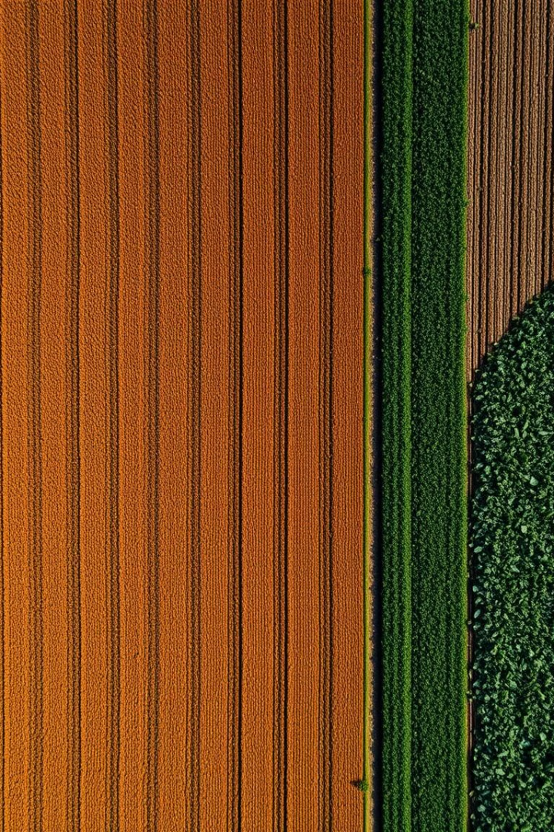
Food Resources
Food Production
Food Security
Food Distribution
Meeting the global demand for food requires efficient and sustainable agricultural practices.
Ensuring access to sufficient, safe, and nutritious food for all people is a critical global challenge.
Food distribution systems need to be equitable and efficient to deliver food to those in need.

Slide 7

World Food Problems
1
Hunger and Malnutrition
Millions of people worldwide lack access to sufficient food, leading to hunger and malnutrition.
2
Food Waste
Food waste occurs at all stages of the food chain, contributing to food insecurity and resource inefficiency.
3
Climate Change
Climate change impacts food production, leading to crop failures, water scarcity, and increased food prices.

Slide 8




Effects of Modern Agriculture
Technological Advancements
Precision agriculture, biotechnology, and genetic engineering are revolutionizing food production.
Environmental Impacts
Pesticide use, fertilizer runoff, and intensive irrigation have environmental consequences.
Social Implications
Industrialized agriculture has contributed to rural decline, monoculture, and the loss of biodiversity.

