Slide 1

DEPARTMENT OF LIFELONG LEARNING
BHARATHIDASAN UNIVERSITY
Tiruchirappalli- 620024,
Tamil Nadu, India
Programme: M.A.,HUMAN RESOURCE MANAGEMENT
Course Title : Managerial Economics
Course Code : 22HRM2CC7
Unit-VI
Emerging Trends
Dr. T. KUMUTHAVALLI
Associate Professor
Department of Lifelong Learning

Slide 2


Emerging Trends in the Industrial Landscape
Join us as we delve into the dynamic world of industrial trends shaping the global economy. This presentation will explore key factors driving transformation at both national and international levels, highlighting the impact of recent budgets on various sectors.

Slide 3
Trends at National and International Level
National Trends
International Trends
Domestically, we see a surge in automation and Industry 4.0 adoption across manufacturing, logistics, and agriculture. Government initiatives focused on promoting clean energy, circular economy practices, and skill development are shaping the landscape.
Globally, the focus is on sustainability, digitalization, and global supply chain resilience. The emergence of new technologies like artificial intelligence, robotics, and advanced materials is revolutionizing industrial processes.

Slide 4
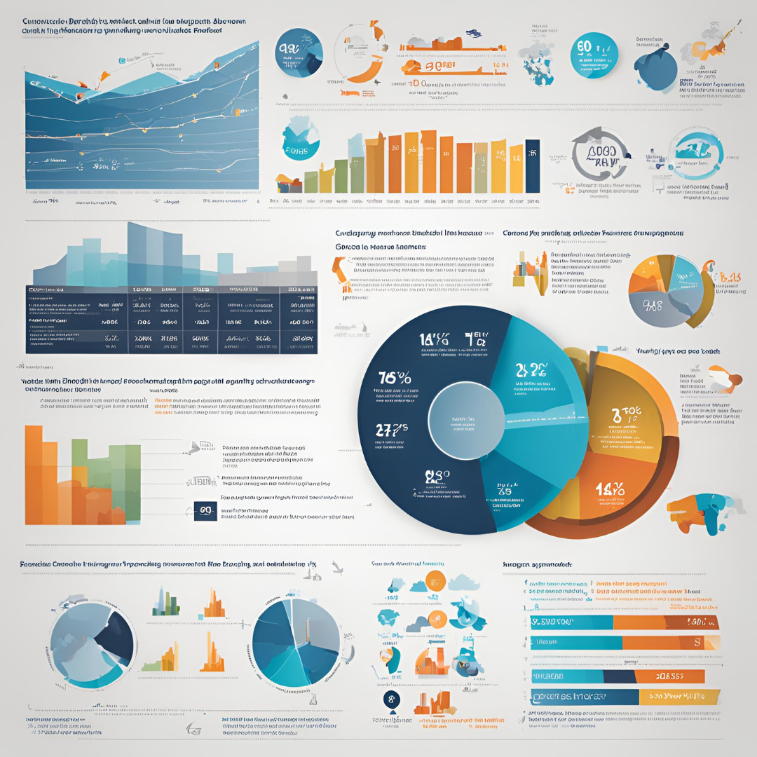

Recent Budgets and its Impact at Various Levels
Infrastructure
Education and Skill Development
Increased funding for infrastructure projects, including transportation networks, energy grids, and digital infrastructure, is expected to drive economic growth and create jobs.
Investment in education and skill development programs aims to address the talent gap in emerging technologies, equipping the workforce for the future of work.
Healthcare
Green Technology
Focus on improving healthcare infrastructure, technology, and research, with a particular emphasis on addressing emerging health challenges and promoting wellness.
Allocations for clean energy solutions, renewable energy sources, and sustainable technologies are pivotal in achieving environmental goals and promoting a greener future.

