Slide 1

DEPARTMENT OF LIFELONG LEARNING
BHARATHIDASAN UNIVERSITY
Tiruchirappalli- 620024,
Tamil Nadu, India
Programme: M.A.,HUMAN RESOURCE MANAGEMENT
Course Title : Managerial Economics
Course Code : 22HRM2CC7
Unit-V
Recent and Indian Economic Policies
Dr. T. KUMUTHAVALLI
Associate Professor
Department of Lifelong Learning

Slide 2

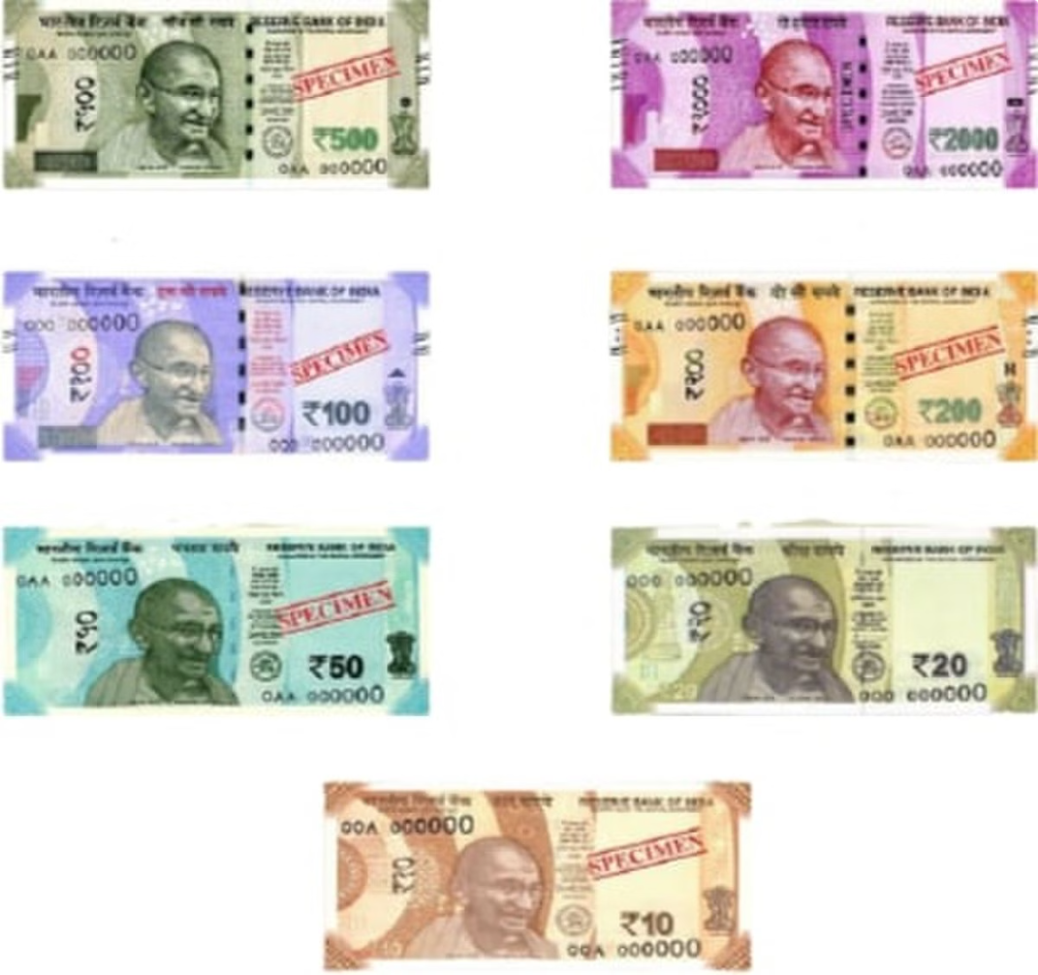


Recent and Indian Economic Policies
India's economic policies have evolved significantly over the past few decades, driven by a mix of internal and external factors. These policies have shaped the nation's economic landscape, influencing growth, development, and the lives of its citizens. This presentation delves into the significant milestones and recent trends in Indian economic policies, analyzing their impact and implications for the future.
by Kavin

Slide 3
The New Economic Policy of 1991
The New Economic Policy (NEP) of 1991 marked a turning point in India's economic history. This policy shift, driven by the country's economic crisis, aimed to liberalize and globalize the Indian economy. Key components of the NEP included deregulation, privatization, and opening up foreign investment. This resulted in a significant increase in economic growth, attracting foreign investment and creating new opportunities for businesses and individuals.
1
Deregulation
2
Privatization
3
Foreign Investment
The NEP reduced government control over industries, allowing for greater market forces to determine prices and production. This facilitated competition and encouraged innovation.
The NEP aimed to transfer ownership and control of state-owned enterprises to private entities. This move aimed to improve efficiency and productivity in these sectors.
The NEP encouraged foreign direct investment, providing foreign companies access to the Indian market. This brought in capital, technology, and management expertise.

Slide 4
Liberalization
Liberalization is a key tenet of the New Economic Policy and refers to the process of removing restrictions and barriers to trade, investment, and economic activities. This policy aimed to create a more open and competitive business environment, both domestically and internationally. It involved reducing tariffs, simplifying import-export procedures, and promoting free trade agreements.
Deregulation of Industries
1
Liberalization involved removing bureaucratic hurdles and regulations that hindered industrial growth and competitiveness. This paved the way for businesses to operate more freely and efficiently.
2
Trade Liberalization
Liberalization resulted in the reduction of tariffs and import quotas, fostering greater international trade. This allowed Indian consumers to access a wider range of goods and services.
Foreign Investment Promotion
3
Liberalization made it easier for foreign companies to invest in India, leading to increased capital inflows and access to advanced technology.

Slide 5
Globalization and Privatization
Globalization refers to the increasing interconnectedness of economies, societies, and cultures worldwide. It has been a significant driver of economic growth in India, leading to greater integration with the global economy. Privatization, on the other hand, involves the transfer of ownership and management of state-owned enterprises to private entities.
Globalization
Privatization
Globalization has led to increased trade, investment, and technology transfer, fostering economic growth and creating new job opportunities.
Privatization aimed to improve efficiency, increase competition, and raise capital for the government.
It has had mixed results, with some privatized companies performing better, while others have faced challenges.
However, globalization also raises concerns about potential job displacement and income inequality.

Slide 6



Recent Trends in Industrial Policy and Foreign Exchange Management
India's industrial policy has undergone a shift towards a more focused approach, encouraging innovation, promoting manufacturing, and facilitating the growth of small and medium enterprises (SMEs). The government has introduced various schemes and initiatives to support these goals, including the "Make in India" campaign.
Skill Development
Infrastructure Development
Ease of Doing Business
To support the growth of manufacturing and technology-driven industries, the government has implemented various skill development programs to equip the workforce with the necessary skills.
The government has focused on improving infrastructure, including transportation, energy, and communication networks, to create a more conducive environment for industrial growth.
The government has undertaken reforms to improve the ease of doing business in India, streamlining regulations, and simplifying processes for businesses.

Slide 7
Demonetization-Effect and Consequences of GST
Demonetization, the withdrawal of high-denomination banknotes from circulation, was a major policy decision in 2016. It aimed to curb corruption, counterfeit currency, and black money. The GST (Goods and Services Tax) introduced in 2017, was a major tax reform designed to simplify India's indirect tax system and create a unified national market.
Demonetization
GST
Aimed to curb corruption, counterfeit currency, and black money.
Simplified India's indirect tax system and created a unified national market.
Led to temporary disruptions in the economy, particularly in cash-intensive sectors.
Brought about a significant increase in tax compliance and transparency.
Had a mixed impact on the economy, with some sectors benefiting while others experienced a slowdown.
Promoted a more efficient supply chain and reduced the cost of doing business.

Slide 8





Bitcoin-Cryptocurrency
Bitcoin, a decentralized digital currency, has emerged as a prominent cryptocurrency, gaining significant traction worldwide. In India, the government is taking a cautious approach towards cryptocurrencies, with regulations still evolving. The Reserve Bank of India (RBI) had initially banned banks from dealing with cryptocurrency businesses, but this was later overturned by the Supreme Court.
Security Concerns
Concerns about the security of cryptocurrencies and the risk of fraud and hacking continue to be a major focus for regulators and investors.
Price Volatility
The price of Bitcoin and other cryptocurrencies is highly volatile, making them a risky investment.
Regulatory Uncertainty
The lack of clear regulatory frameworks for cryptocurrencies creates uncertainty for businesses and investors.

