Slide 1

DEPARTMENT OF LIFELONG LEARNING
BHARATHIDASAN UNIVERSITY
Tiruchirappalli- 620024,
Tamil Nadu, India
Programme: M.A.,HUMAN RESOURCE MANAGEMENT
Course Title : labour laws
Course Code : 22HRM3CC13
Unit-I
Basic concept
Dr. T. KUMUTHAVALLI
Associate Professor
Department of Lifelong Learning

Slide 2

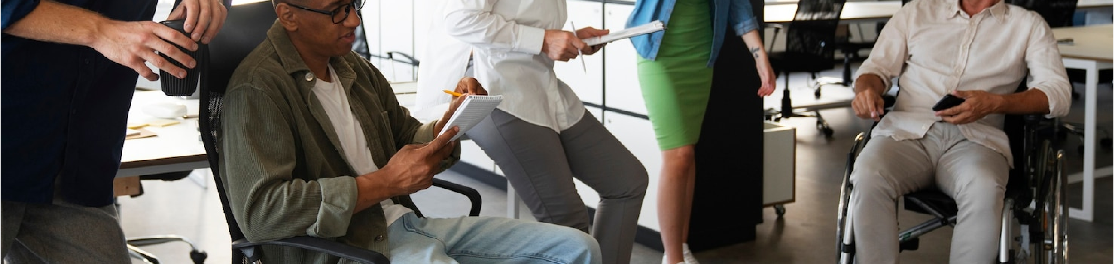
INTRODUCTION TO LABOR LANDSCAPE
Navigating the complexities of the modern workplace is essential. This presentation explores the interplay between wages, welfare, and rights, shedding light on how these elements shape employee experiences. Join us as we embark on this enlightening journey through the current labor market.

Slide 3





THE WAGE DILEMMA
Understanding wages is crucial in today's economy. Many employees face challenges such as income inequality and stagnant salaries. This slide delves into the factors inﬂuencing wage structures and how they aﬀect workers' ﬁnancial stability and overall well-being.

Slide 4



WELFARE IN THE WORKPLACE
Employee welfare plays a vital role in job satisfaction and productivity. Companies are increasingly recognizing the importance of providing beneﬁts such as healthcare, paid leave, and mental health support. This slide highlights innovative welfare programs that enhance workplace morale.

Slide 5
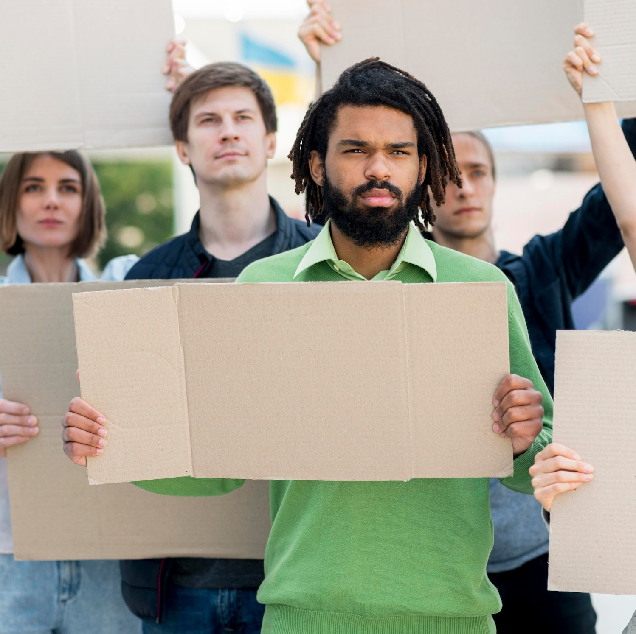

RIGHTS OF WORKERS
Workers' rights are the cornerstone of fair labor practices. This section discusses essential rights such as collective bargaining, anti-discrimination laws, and safe working conditions. Understanding these rights empowers employees to advocate for themselves and their colleagues.

Slide 6



THE ROLE OF TECHNOLOGY
Technology is reshaping the workplace, inﬂuencing wages, welfare, and rights.
Automation and remote work are creating new
opportunities and challenges. This slide examines how digital tools can enhance employee experiences while also posing risks to job security.

Slide 7

CONCLUSION: THE FUTURE OF LABOR
As we navigate the landscape of labor, the interconnection between wages, welfare, and rights becomes increasingly clear. By fostering a culture of equity and inclusivity, we can create a more just workplace for all. The future of labor depends on our collective eﬀorts to champion these values.

