Slide 1

DEPARTMENT OF LIFELONG LEARNING
BHARATHIDASAN UNIVERSITY
Tiruchirappalli- 620024,
Tamil Nadu, India
Programme: M.A.HUMAN RESOURCE MANAGEMENT
Course Title :Information Technology for Managers
Course Code :22HRM4CC18
UNIT VI
Current Development
Dr. T. KUMUTHAVALLI
Associate Professor
Department of Lifelong Learning

Slide 2
Client-Server Architecture: The Foundation of Modern Applications
Client Side
Server Side
The client is the user interface, interacting with the server to request information or services.
The server stores data and processes requests, providing information and services to the client.

Slide 3
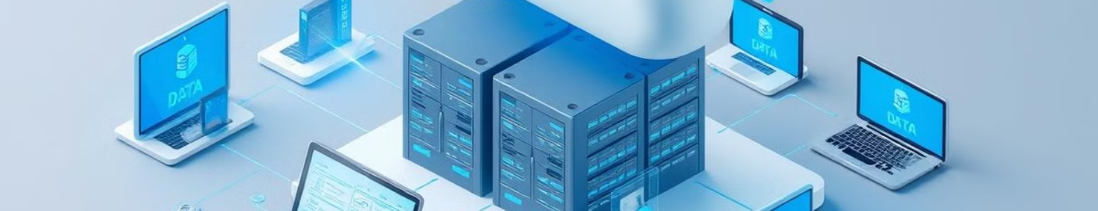
Cloud Computing: A Revolution in Data Storage and Processing
1
Scalability
2
Cost-Effectiveness
Cloud services can easily scale to accommodate growing data needs and traffic demands.
Pay-as-you-go models eliminate the need for expensive upfront investments in hardware.

Slide 4
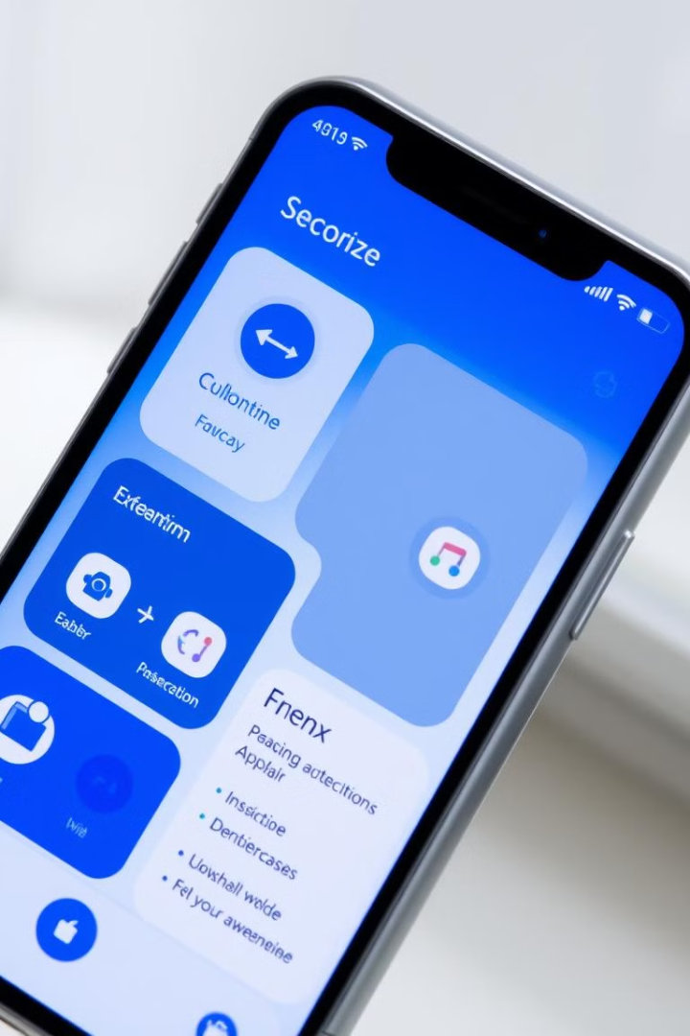


Mobile Applications and User Interface Design
User-Centric
Responsive
Design mobile apps with a focus on usability, accessibility, and intuitive navigation.
Ensure smooth functionality and optimal display across various devices and screen sizes.

Slide 5
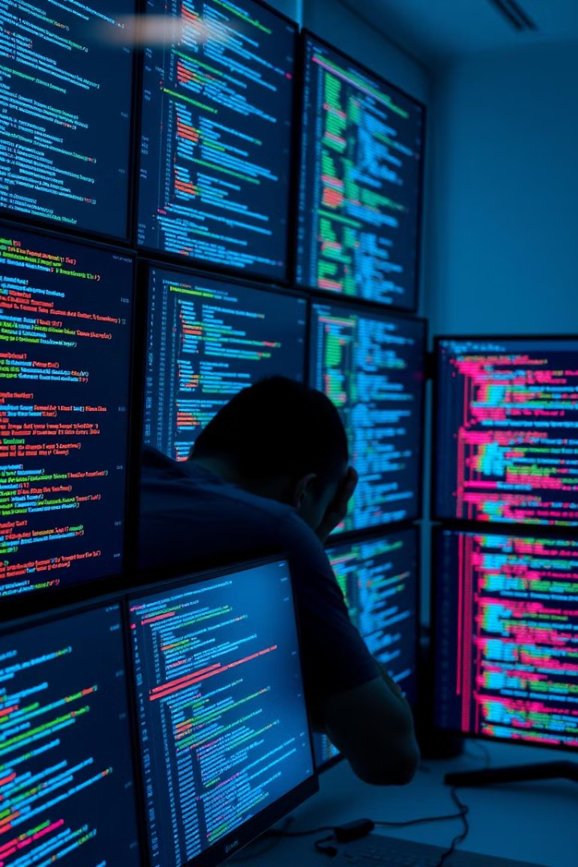
Leveraging Popular Software Frameworks and Libraries
React
Angular
A JavaScript library for building user interfaces, known for its component-based architecture and virtual DOM.
A TypeScript-based framework for creating complex and highly scalable web applications, with powerful features and comprehensive tooling.

Slide 6
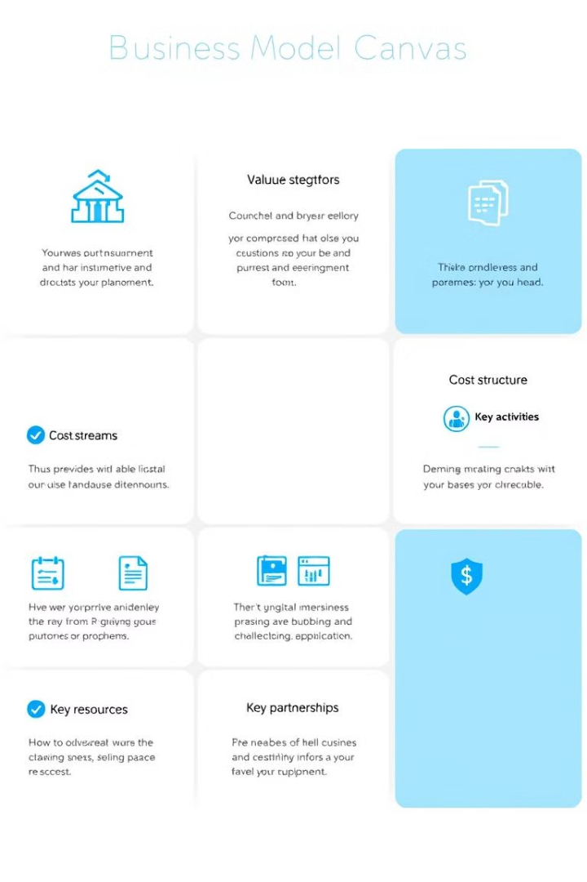
Innovative Business Models in the Digital Era
1
Subscription models provide recurring revenue streams, offering value-added services to customers.
2
Freemium models attract users with basic free features and offer premium paid options for enhanced functionality.
3
Platform-based models connect businesses and customers, facilitating transactions and fostering community engagement.

Slide 7
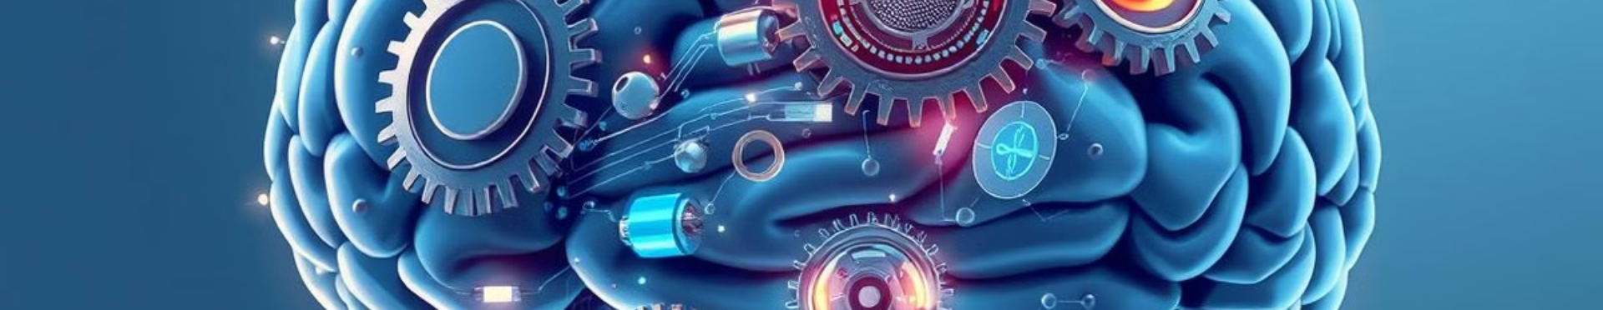


IT as an Enabler for Innovation
Data analytics provides insights for informed decision-making and helps identify new opportunities.
Artificial intelligence (AI) automates tasks, optimizes processes, and enhances efficiency through machine learning.

Slide 8



Common Issues and Solutions in IT Usage
Security
1
Implementing robust security measures to protect sensitive data and prevent unauthorized access.
Scalability
2
Ensuring that systems can handle increasing data volumes and user traffic without performance degradation.
Integration
3
Seamlessly integrating various IT systems and applications to optimize workflows and improve data sharing.

Slide 9
Successful Stories of IT Utilization by Managers
Increased Efficiency
1
By automating tasks and streamlining processes, businesses can improve productivity and reduce costs.
Enhanced Customer Experience
2
Personalized services and streamlined customer interactions improve satisfaction and loyalty.
Data-Driven Decisions
3
Data analytics provides actionable insights to support strategic planning and improve operational effectiveness.

