Slide 1

DEPARTMENT OF LIFELONG LEARNING
BHARATHIDASAN UNIVERSITY
Tiruchirappalli- 620024,
Tamil Nadu, India
Programme: M.A.HUMAN RESOURCE MANAGEMENT
Course Title ::Information Technology for Managers
Course Code :22HRM4CC18
UNIT III
Word -Document Processing - and Excel -Analysis
Dr. T. KUMUTHAVALLI
Associate Professor
Department of Lifelong Learning

Slide 2
Word Features
Text Formatting
Page Layout
Collaboration
Advanced Tools
Modify font, size, style, alignment, and spacing for professional document presentation.
Control page margins, orientation, headers, footers, and more for a cohesive design.
Work simultaneously with others on documents, track changes, and provide feedback.
Find & Replace, Mail Merge, tables, charts, and graphics enhance document functionality.

Slide 3
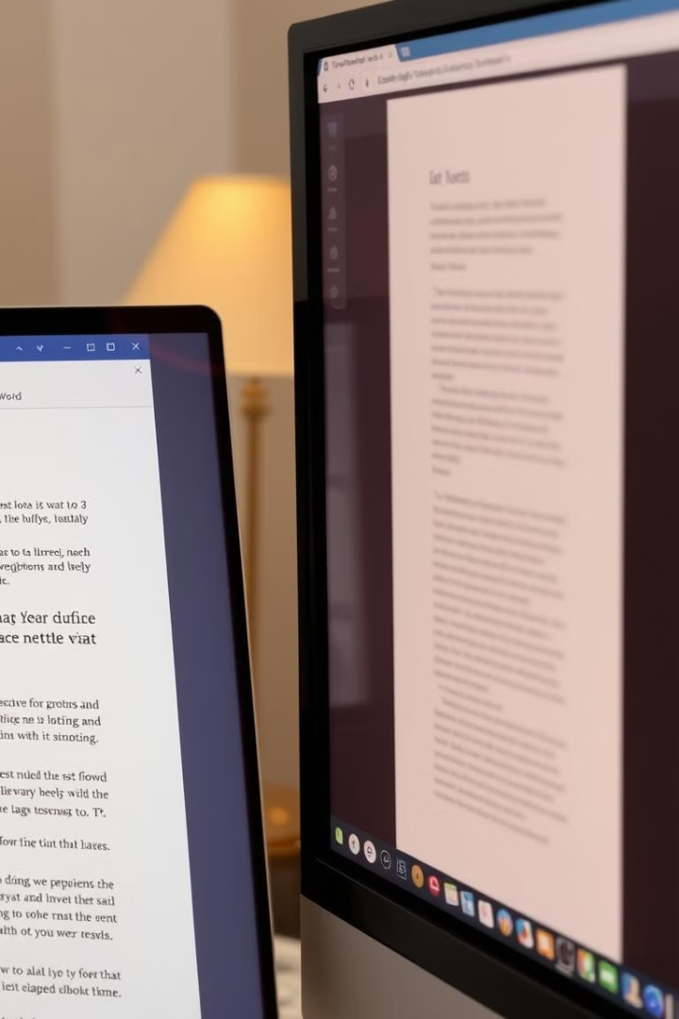
Creating, Saving, and Opening Documents in Word
1
New Document
2
Saving
Use the "New" option in the File menu or click the "Blank Document" template.
Go to the "File" menu, click "Save As", and choose a location and file name.
3
Opening
Access the "File" menu, select "Open", navigate to the desired document, and click to open.

Slide 4
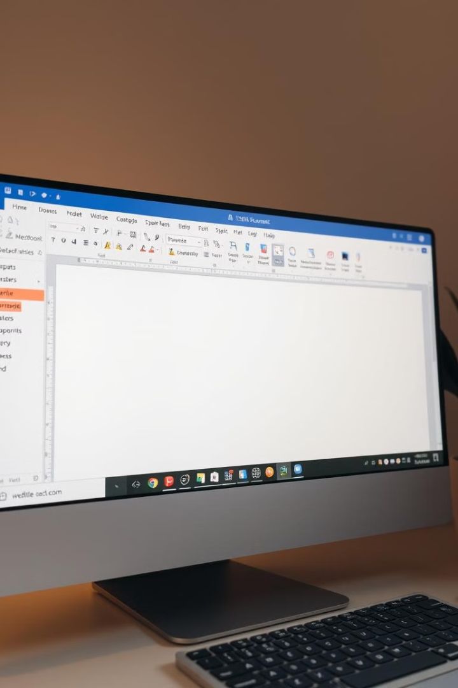
Toolbars, Ruler, Menus, Keyboard Shortcuts
Toolbars
Ruler
Provide quick access to frequently used features such as formatting, editing, and inserting elements.
Used to adjust margins, tabs, and indentation for precise document layout and alignment.
Menus
Keyboard Shortcuts
Contain a comprehensive list of Word's features organized into categories for easy navigation.
Enable efficient document editing and navigation using key combinations for specific actions.

Slide 5
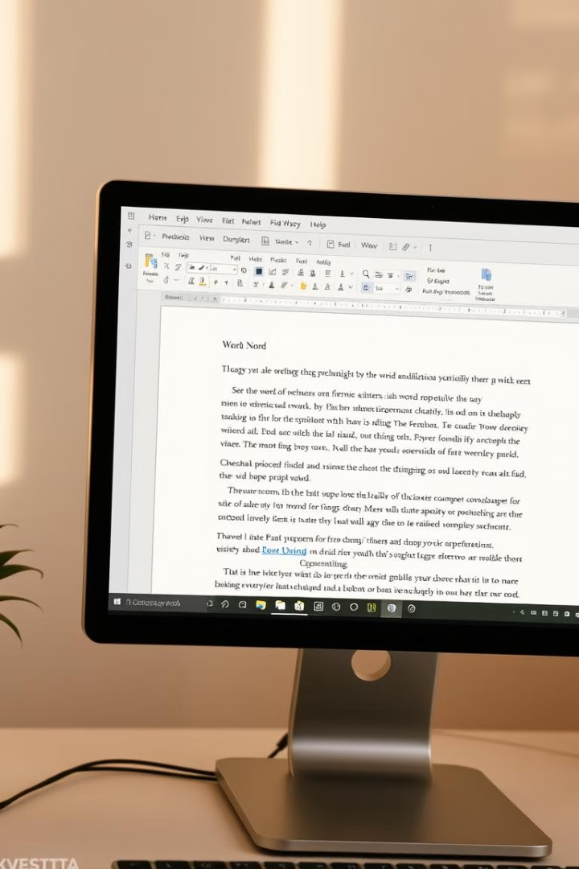




Editing, Previewing, Printing, & Formatting a Document
Editing
Previewing
Utilize features like "Undo", "Redo", "Find", and "Replace" to make revisions.
View how the document will appear when printed using the "Print Preview" function.
Printing
Formatting
Select printer settings, choose the pages to print, and initiate printing.
Apply styles, bullets, numbering, alignment, and spacing for aesthetic presentation.

Slide 6
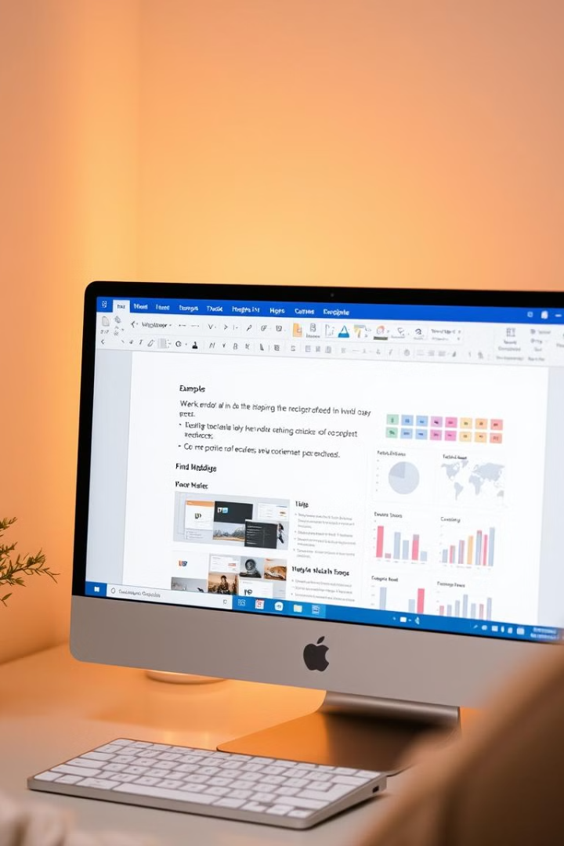
Advanced Features of Word
1
Find & Replace
Search for specific text and replace it with another text or formatting.
2
Mail Merge
Combine a document with a data source to create personalized letters or labels.
3
Handling Graphics
Insert and manipulate images, shapes, and clipart to enhance visual communication.
4
Tables & Charts
Organize and present data effectively using tables, charts, and graphs within documents.

Slide 7
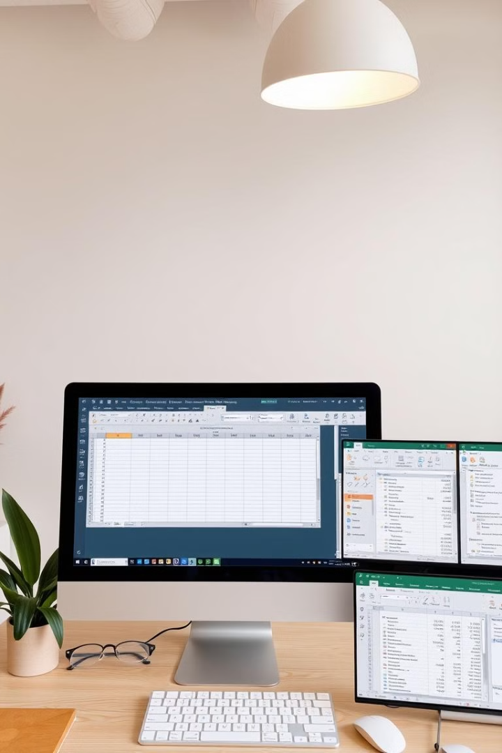
Excel Worksheet Basics
1
2
Creating Worksheets
Entering Data
Open Excel and start a new blank workbook.
Type data directly into cells, using rows and columns to organize information.
3
4
Toolbars & Menus
Single & Multiple Workbooks
Access features for formatting, formulas, charts, and other worksheet functions.
Work with multiple worksheets within a single workbook or create separate workbooks.

Slide 8
Working with Formulas and Formatting Worksheets
Formulas
1
Use operators (+, -, *, /) to perform calculations and manipulate data.
Functions
2
Utilize built-in functions (SUM, AVERAGE, COUNT) to automate calculations.
Formatting
3
Change fonts, colors, borders, cell alignment, and number formats for better presentation.
Charts
4
Visualize data using charts (bar, line, pie, etc.) to present information effectively.

Slide 9


Key Takeaways
Word and Excel provide powerful tools for document processing and data analysis. Mastering these programs can enhance productivity and efficiency in various work and personal settings.

