Slide 1

DEPARTMENT OF LIFELONG LEARNING
BHARATHIDASAN UNIVERSITY
Tiruchirappalli- 620024,
Tamil Nadu, India
Programme: M.A.HUMAN RESOURCE MANAGEMENT
Course Title ::Information Technology for Managers
Course Code :22HRM4CC1
UNIT II
Windows XP
Dr. T. KUMUTHAVALLI
Associate Professor
Department of Lifelong Learning

Slide 2
Windows Concepts and Features
File System
User Interface
Multitasking
A hierarchical structure that organizes files and folders into a tree-like arrangement.
Graphical elements like the desktop, taskbar, and windows allow users to interact with the operating system.
Allows users to run multiple programs simultaneously, enabling efficient task management.

Slide 3



Windows Structure: Hierarchy and Organization
Root Directory
1
The top-level directory containing all other directories and files on the drive.
Subdirectories
2
Folders within the root directory, organized by program, user, or file type.
Files
3
Data stored within folders, representing programs, documents, images, and more.

Slide 4



Desktop and Taskbar: The User Interface
Desktop
Taskbar
The primary workspace for launching applications and managing files.
Displays currently running applications, quick launch icons, and the Start Menu.

Slide 5
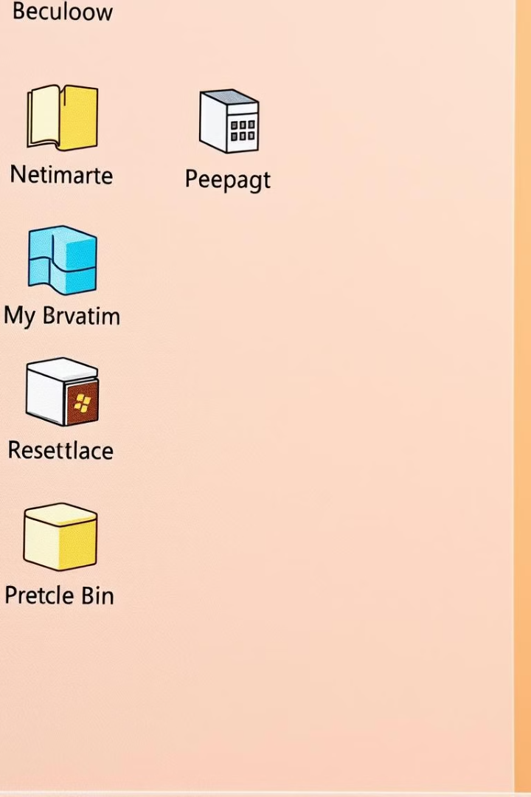
Start Menu: Accessing Programs and Settings
1
Start Menu
2
Programs
Provides access to programs, system settings, and search functionality.
Lists installed applications for quick launching.
3
Settings
Offers configuration options for various system aspects.

Slide 6
My Computer and Recycle Bin: File Management
My Computer
Recycle Bin
Displays a list of drives and folders for browsing and managing files.
A temporary storage location for deleted files, allowing recovery or permanent deletion.

Slide 7
Windows Accessories: Productivity Tools
Calculator
Notepad
Paint
Basic and scientific calculator for calculations.
Simple text editor for creating and editing plain text documents.
Basic image editor for drawing, editing, and viewing images.
WordPad
Windows Explorer
A word processor that combines basic text editing with some formatting options.
File and folder management tool for browsing, copying, and deleting files.

Slide 8
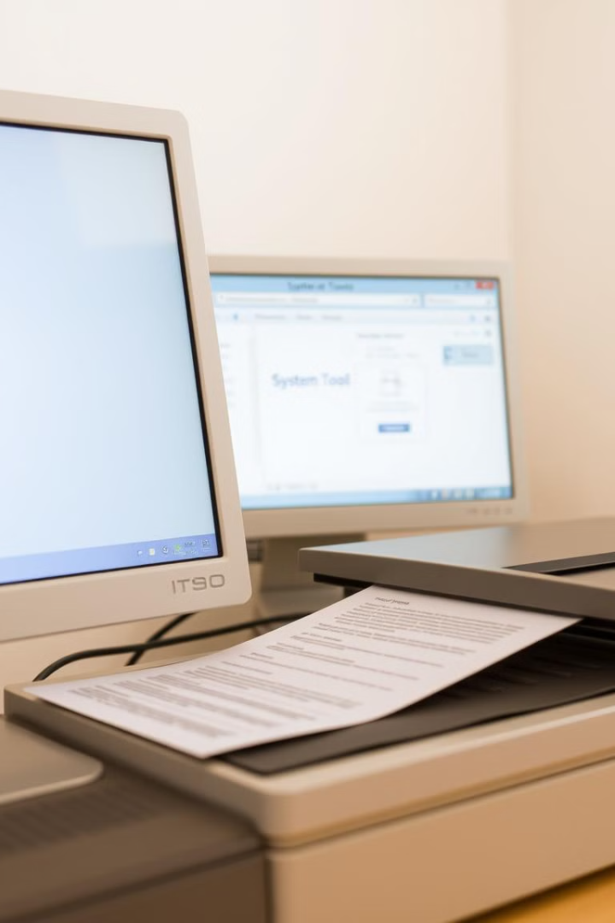
Hardware and Software Installation, Scanning, and System Tools
1
Hardware Installation
Adding new devices like printers, scanners, or webcams.
2
Software Installation
Installing new programs, games, or applications.
3
Scanning
Using a scanner to digitize documents and images.
4
System Tools
Utilities for managing system resources, disk cleanup, and troubleshooting.

