Slide 1

DEPARTMENT OF LIFELONG LEARNING
BHARATHIDASAN UNIVERSITY
Tiruchirappalli- 620024,
Tamil Nadu, India
Programme: M.A.HUMAN RESOURCE MANAGEMENT
Course Title :Information Technology for Managers
Course Code :22HRM4CC18
UNIT I
Basics of Computer & Internet
Dr. T. KUMUTHAVALLI
Associate Professor
Department of Lifelong Learning

Slide 2
Desktop Computers: The Foundation
Essential Components
Functionality
Desktop computers are comprised of a system unit, monitor, keyboard, and mouse. They are powerful machines designed for demanding tasks and creative pursuits.
Desktop computers are used for a wide range of activities, from browsing the web and creating documents to gaming and video editing. They offer greater processing power and expandability compared to laptops.

Slide 3
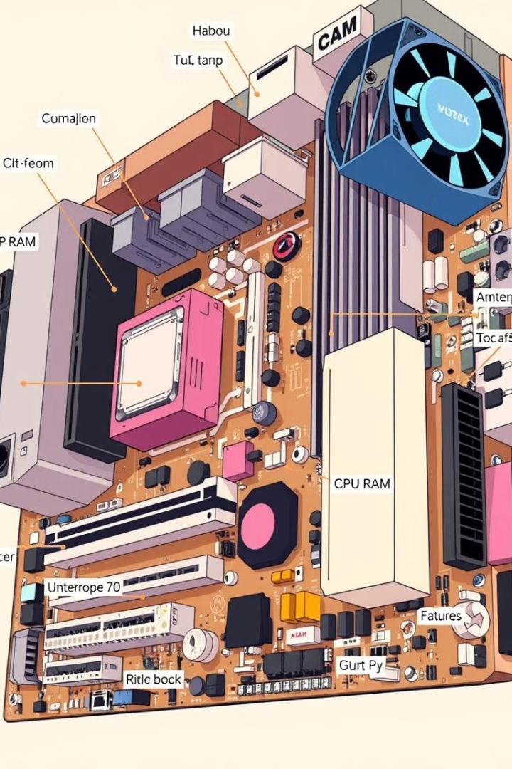
Exploring the Computer's Inner Workings
1
1. Central Processing Unit (CPU)
2
2. Random Access Memory (RAM)
The brain of the computer, responsible for processing instructions and calculations.
Temporary storage for data and programs currently in use, providing quick access to frequently used information.
3
3. Motherboard
4
4. Power Supply
The main circuit board that connects all the components and allows them to communicate.
Converts AC power to DC power, supplying electricity to the computer's components.

Slide 4
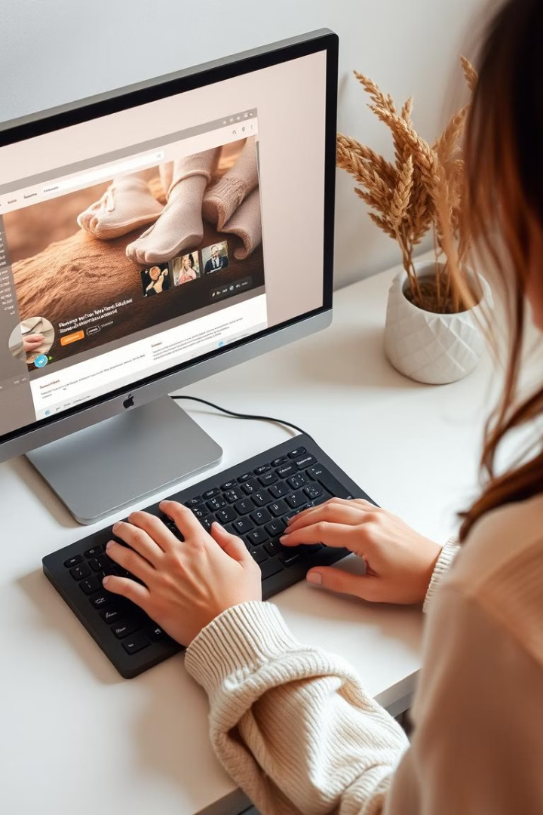




Input and Output: Interacting with the Machine
Keyboard
Mouse
For entering text, numbers, and commands.
Used to control the cursor and interact with objects on the screen.
Monitor
Printer
Displays visual output from the computer.
Creates physical copies of documents and images.

Slide 5
Memory and Storage: Where Data Resides
RAM (Random Access Memory)
Storage Devices
Temporary storage for actively used data and programs, crucial for fast performance.
Long-term storage for files, programs, and operating systems, including Hard Disk Drives (HDD) and Solid-State Drives (SSD).

Slide 6
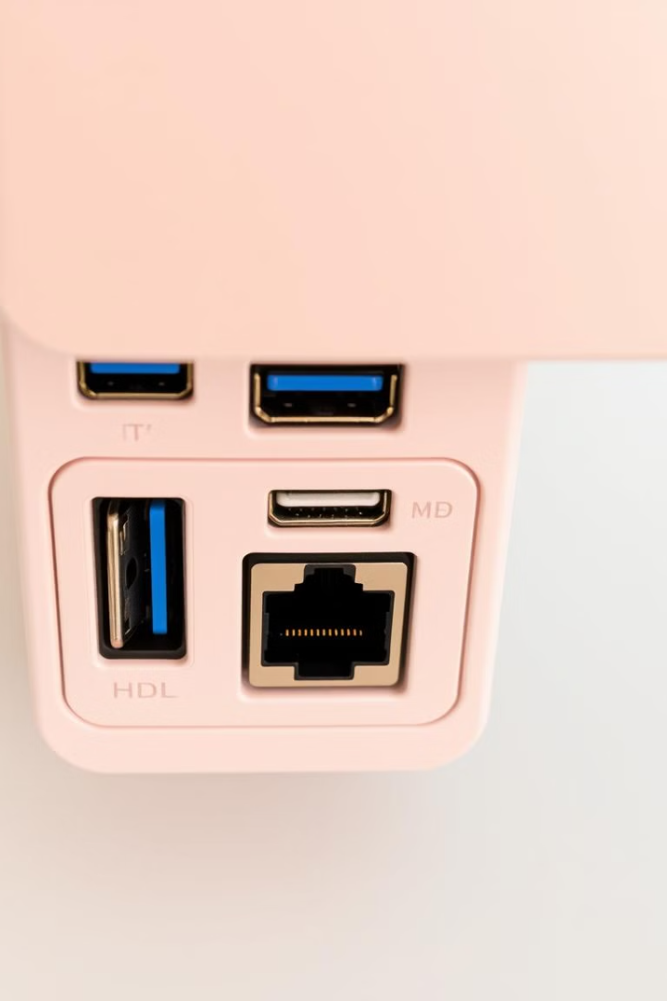
Connecting the Dots: Ports and Connectivity
USB (Universal Serial Bus)
HDMI (High-Definition Multimedia Interface)
Versatile port used for connecting a wide range of peripherals, including keyboards, mice, printers, and external hard drives.
Used for connecting monitors and TVs to display high-resolution video and audio.
Ethernet
Wi-Fi
Provides a wired network connection for high-speed data transfer.
Wireless network connectivity for accessing the internet and connecting to other devices.

Slide 7
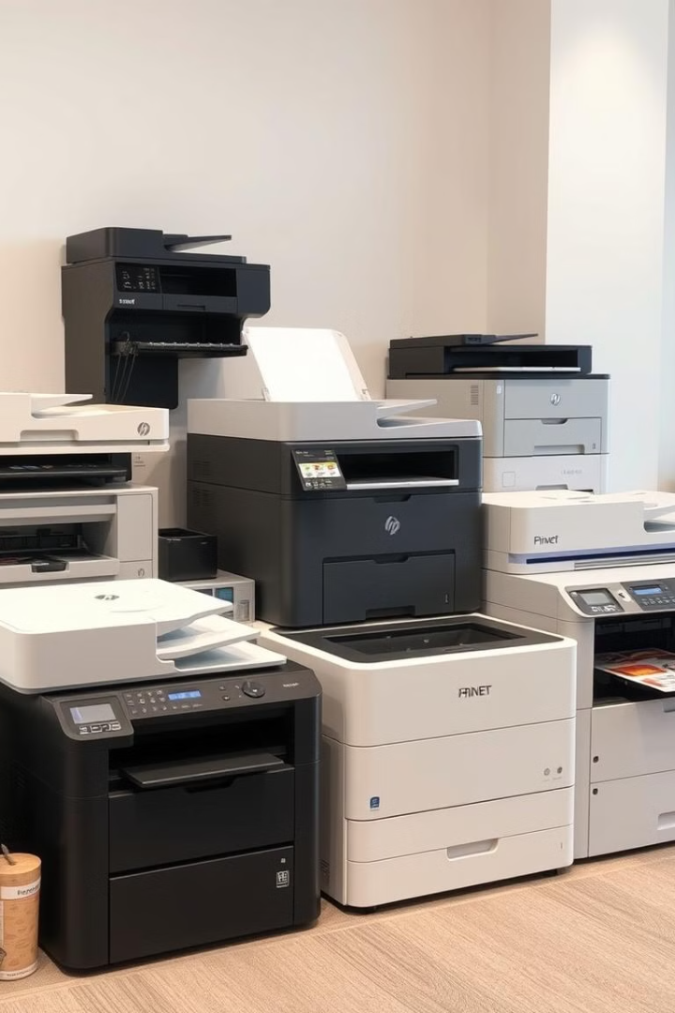
Printing Your Creations: Types of Printers
1
Inkjet Printers
Affordable and versatile, ideal for home use and occasional printing. They use ink cartridges to create images and text on paper.
2
Laser Printers
Offer high-speed printing and sharp text quality, suitable for businesses and demanding users. They use toner cartridges for printing.
3
3D Printers
Cutting-edge technology that allows you to create physical objects from digital designs, opening new possibilities in manufacturing, prototyping, and art.

Slide 8




The Operating System: The Foundation of Your Digital Experience
Operating Systems
Windows OS
Other Operating Systems
The software that manages the computer's hardware and provides a platform for running other programs. Popular options include Windows, macOS, and Linux.
Microsoft's widely used operating system, known for its user-friendly interface and compatibility with a vast range of applications.
macOS (Apple), Linux (open-source), and Android (mobile) are other popular operating systems with their own strengths and features.

Slide 9




Expanding Your Digital Capabilities: Application Software
Office Suites
1
Software packages that include applications for word processing, spreadsheets, presentations, and more, such as Microsoft Office and Google Workspace.
Web Browsers
2
Software that allows you to access and browse the World Wide Web, such as Google Chrome, Mozilla Firefox, and Safari.
3
Media Players
Software for playing audio and video files, such as VLC Media Player and iTunes.
Other Applications
4
There are countless specialized applications available for specific tasks, including graphics editing, programming, accounting, and more.

Slide 10
Connecting the World: Networking and the Internet
1
Networking
The process of connecting multiple computers and devices together to share resources and communicate.
2
LAN (Local Area Network)
A network that connects devices within a limited area, such as a home or office.
3
WAN (Wide Area Network)
A network that spans a larger geographical area, often connecting multiple LANs together.
The Internet
4
A global network of networks that connects billions of devices and provides access to a vast amount of information and services.
Hypertext
5
A system of linked documents that allow users to navigate seamlessly between related information, a key feature of the World Wide Web.

