Slide 1

DEPARTMENT OF LIFELONG LEARNING
BHARATHIDASAN UNIVERSITY
Tiruchirappalli- 620024,
Tamil Nadu, India
Programme: M.A.HUMAN RESOURCE MANAGEMENT
Course Title :Information Technology for Managers
Course Code :22HRM4CC18
UNIT V
Internet and e-governance
Dr. T. KUMUTHAVALLI
Associate Professor
Department of Lifelong Learning

Slide 2
Internet, Intranet, and Extranet: The Foundation of Connectivity
Internet
Intranet
Extranet
A global network connecting billions of devices and users. It's the public access point to information and services.
A private network within an organization, used for internal communication, collaboration, and data sharing.
A secure network that allows controlled access to external partners, like suppliers or customers. It's a bridge between the organization and its external world.

Slide 3
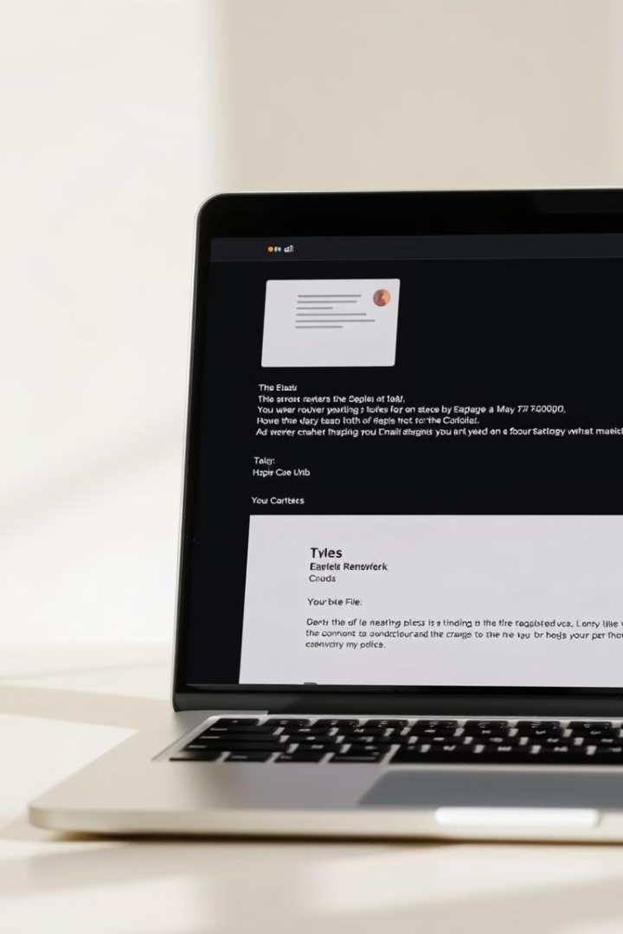
Email: The Cornerstone of Digital Communication
1
Addresses
2
Attachments
Each user has a unique email address for sending and receiving messages.
Files can be attached to emails, enabling the sharing of documents and other data.
3
Account Management
Users can manage their email accounts, setting up filters, managing contacts, and adjusting settings.

Slide 4
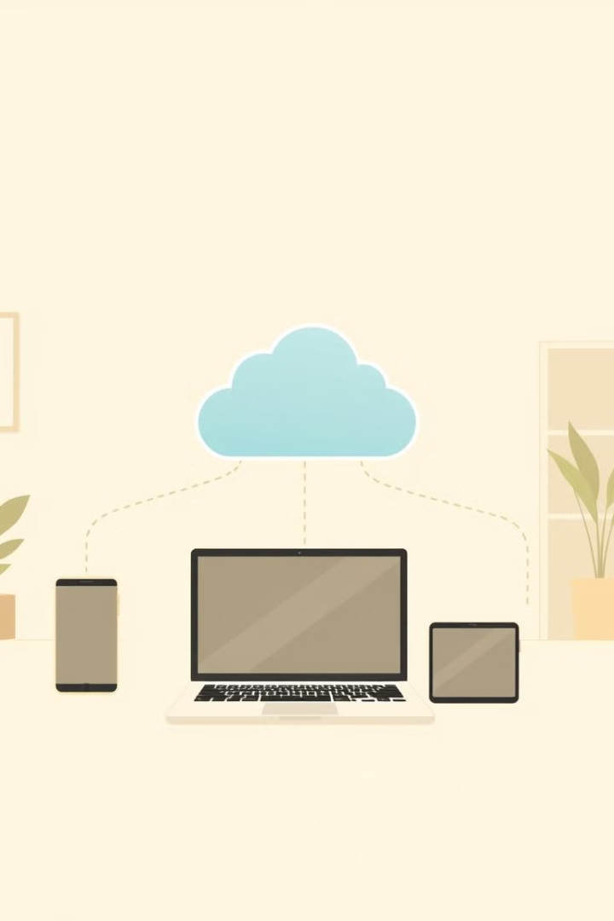


Web Mail and File Sharing: Expanding Communication Horizons
Web Mail
File Sharing
Access email accounts through web browsers, simplifying access on different devices.
Cloud-based platforms allow sharing of files with colleagues or clients, increasing efficiency.

Slide 5
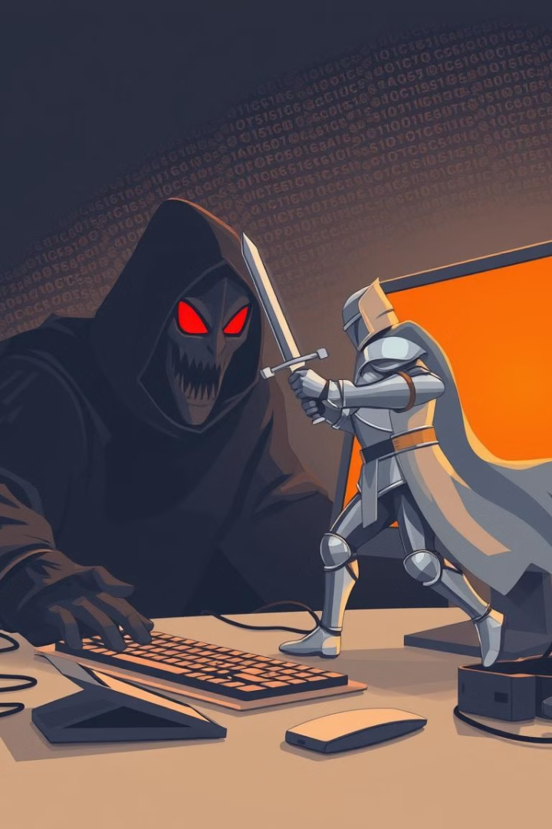
Computer Viruses and Antivirus Software: Protecting Your Digital Assets
Viruses
Antivirus Software
Malicious software that can replicate itself and damage computer systems. They often spread through email attachments or downloads.
Software that protects computers from viruses by detecting and removing threats, ensuring data security.

Slide 6

E-Government: Bringing Government Services Online
1
2
3
Transparency
Efficiency
Accessibility
Citizens have access to government information and processes, fostering trust and accountability.
Streamlines government operations, reducing paperwork and time for both citizens and officials.
Government services are available anytime, anywhere, bridging the gap between citizens and services.

Slide 7
E-Administration, E-Services, and Mobile Government: Delivering Services Digitally
E-Administration
1
Government departments using technology to manage their internal processes and resources.
E-Services
2
Online platforms for citizens to access government services like tax filing, passport applications, and more.
Mobile Government
3
Government services optimized for mobile devices, ensuring access through smartphones and tablets.

Slide 8

IT Act, E-Filing, and E-Governance Implementations: Shaping the Future of Governance
1
2
3
IT Act
E-Filing
Implementation
Provides the legal framework for e-governance, regulating online activities and data protection.
Digital submission of documents, simplifying administrative processes and reducing paperwork.
Successful e-governance requires careful planning, stakeholder engagement, and continuous evaluation.

