Slide 1

DEPARTMENT OF LIFELONG LEARNING
BHARATHIDASAN UNIVERSITY
Tiruchirappalli- 620024,
Tamil Nadu, India
Programme: M.A.,HUMAN RESOURCE MANAGEMENT
Course Title : Human resource management
Course Code : 22HRM1CC2
Unit-IV
STRATEGIC HRM
Dr. T. KUMUTHAVALLI
Associate Professor
Department of Lifelong Learning

Slide 2


Slide 3
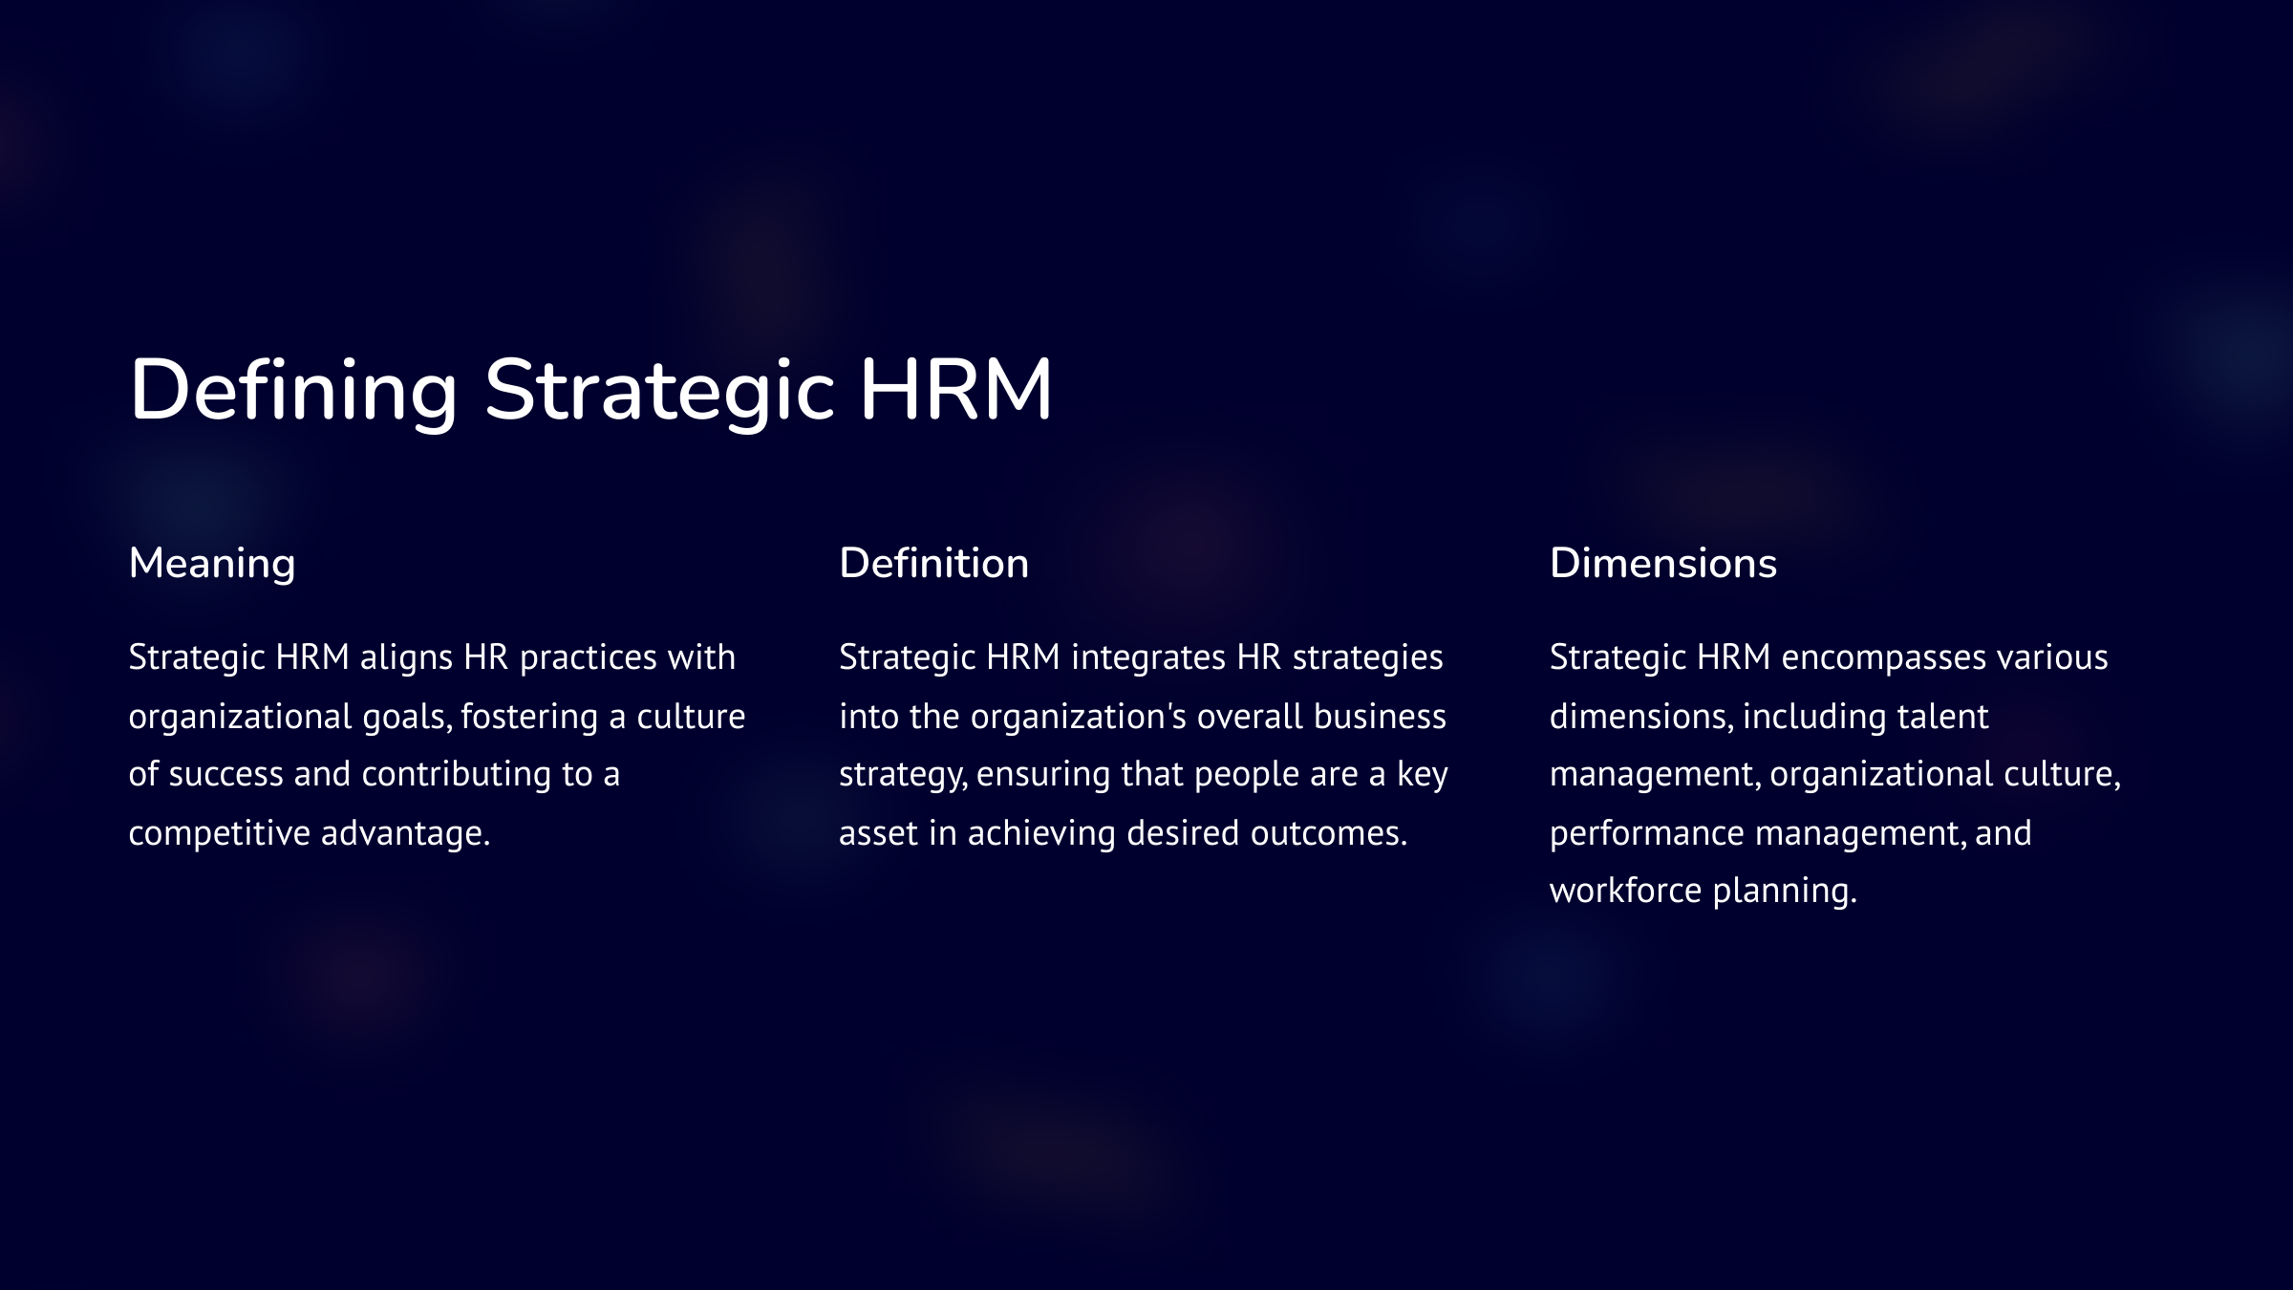

Slide 4
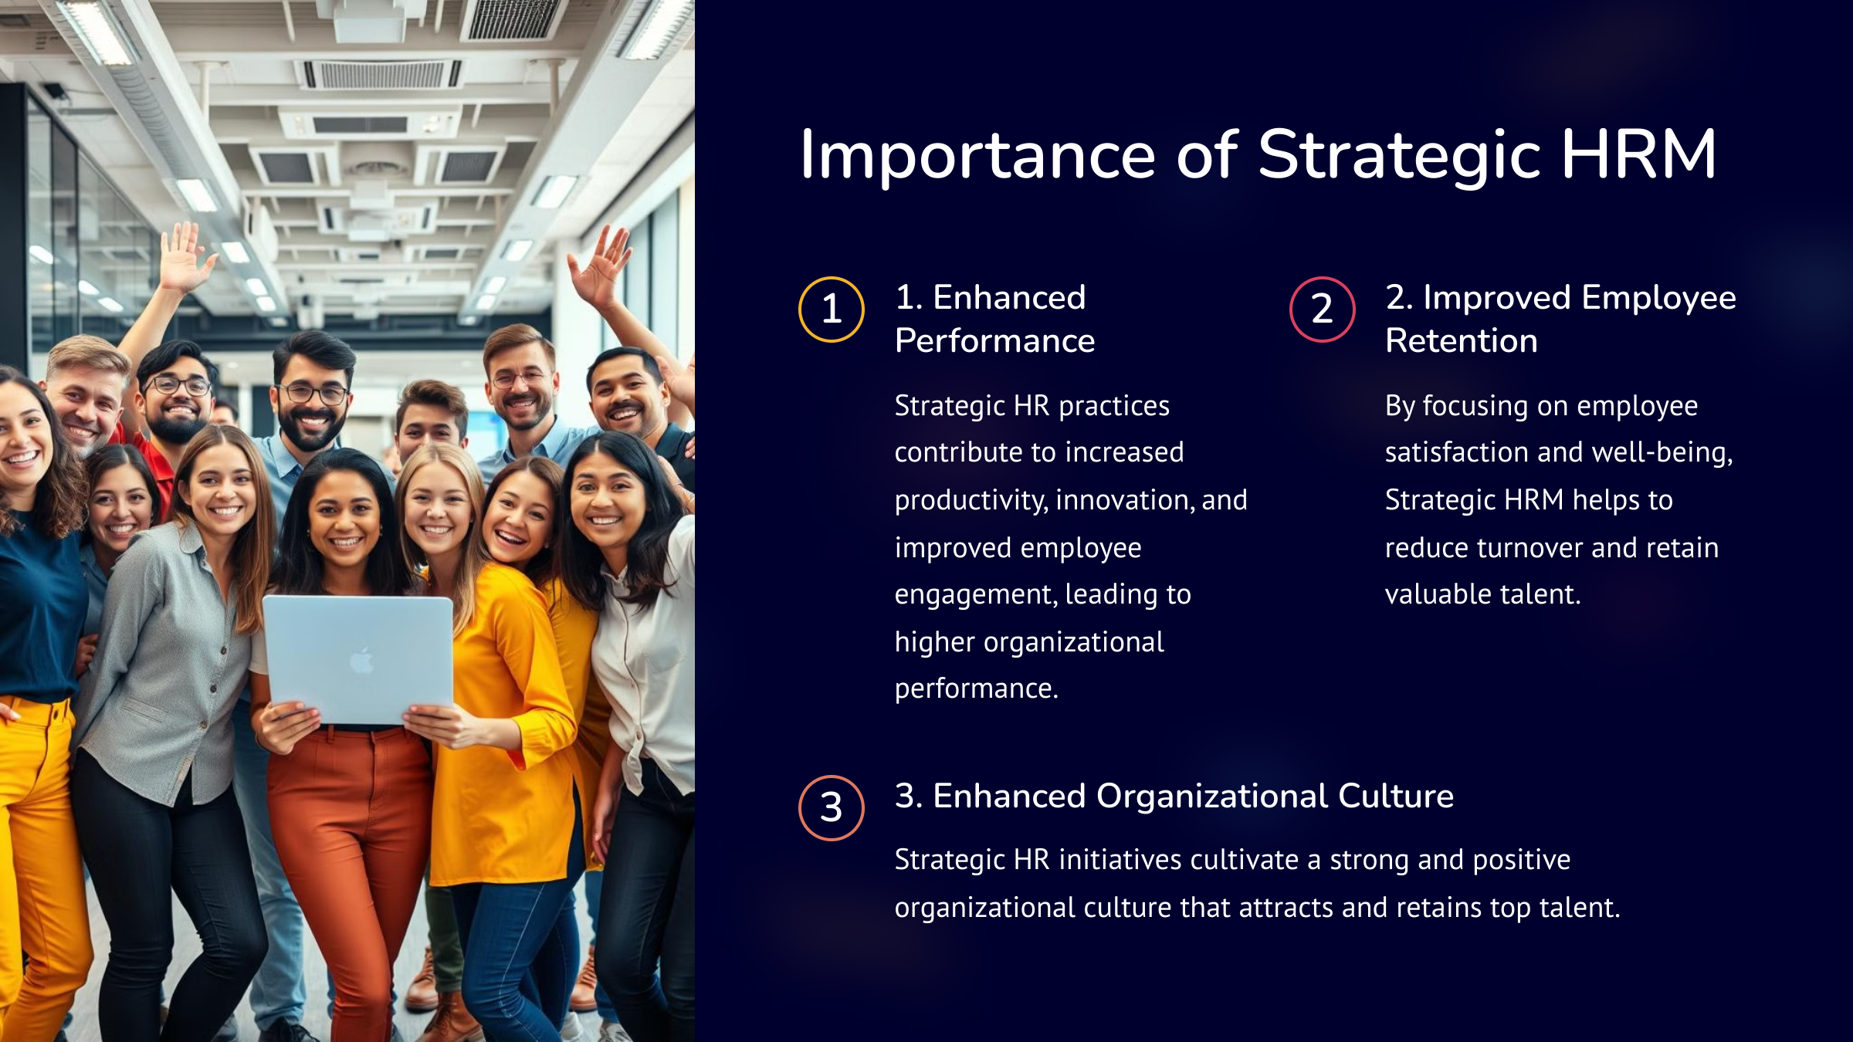

Slide 5
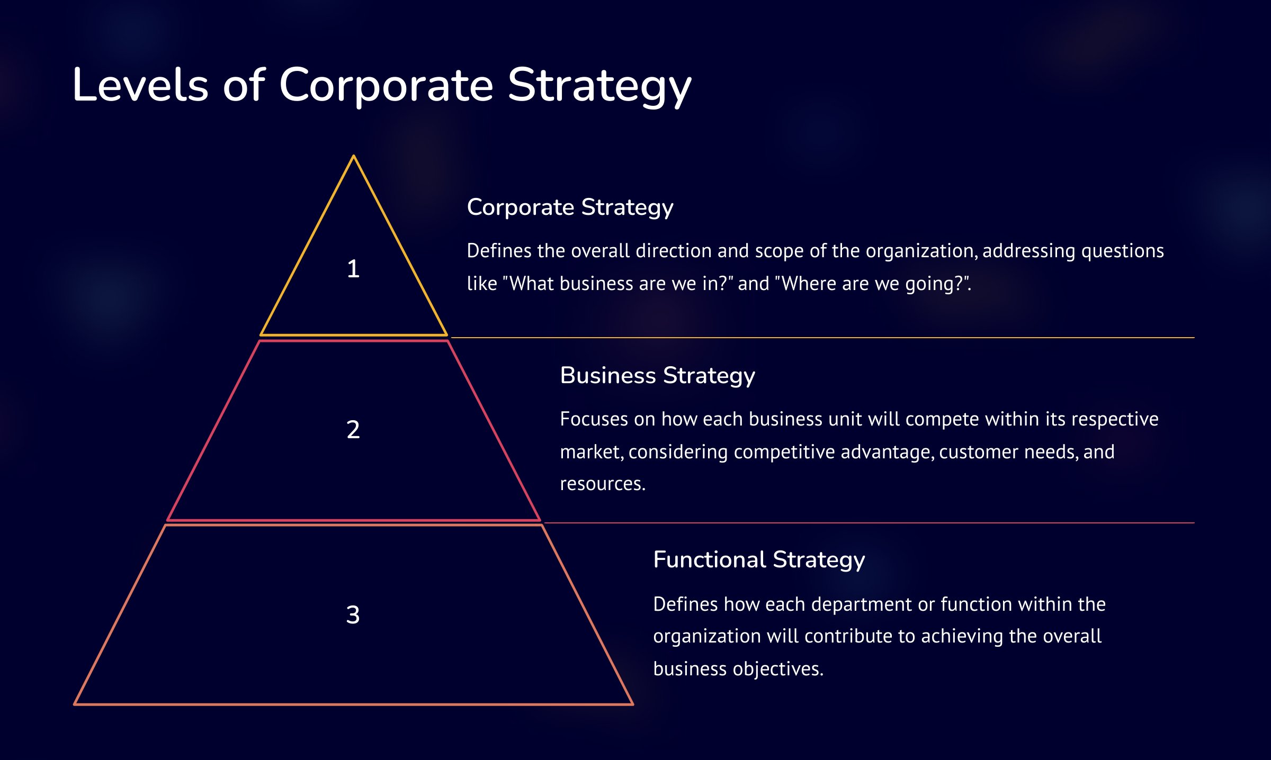

Slide 6
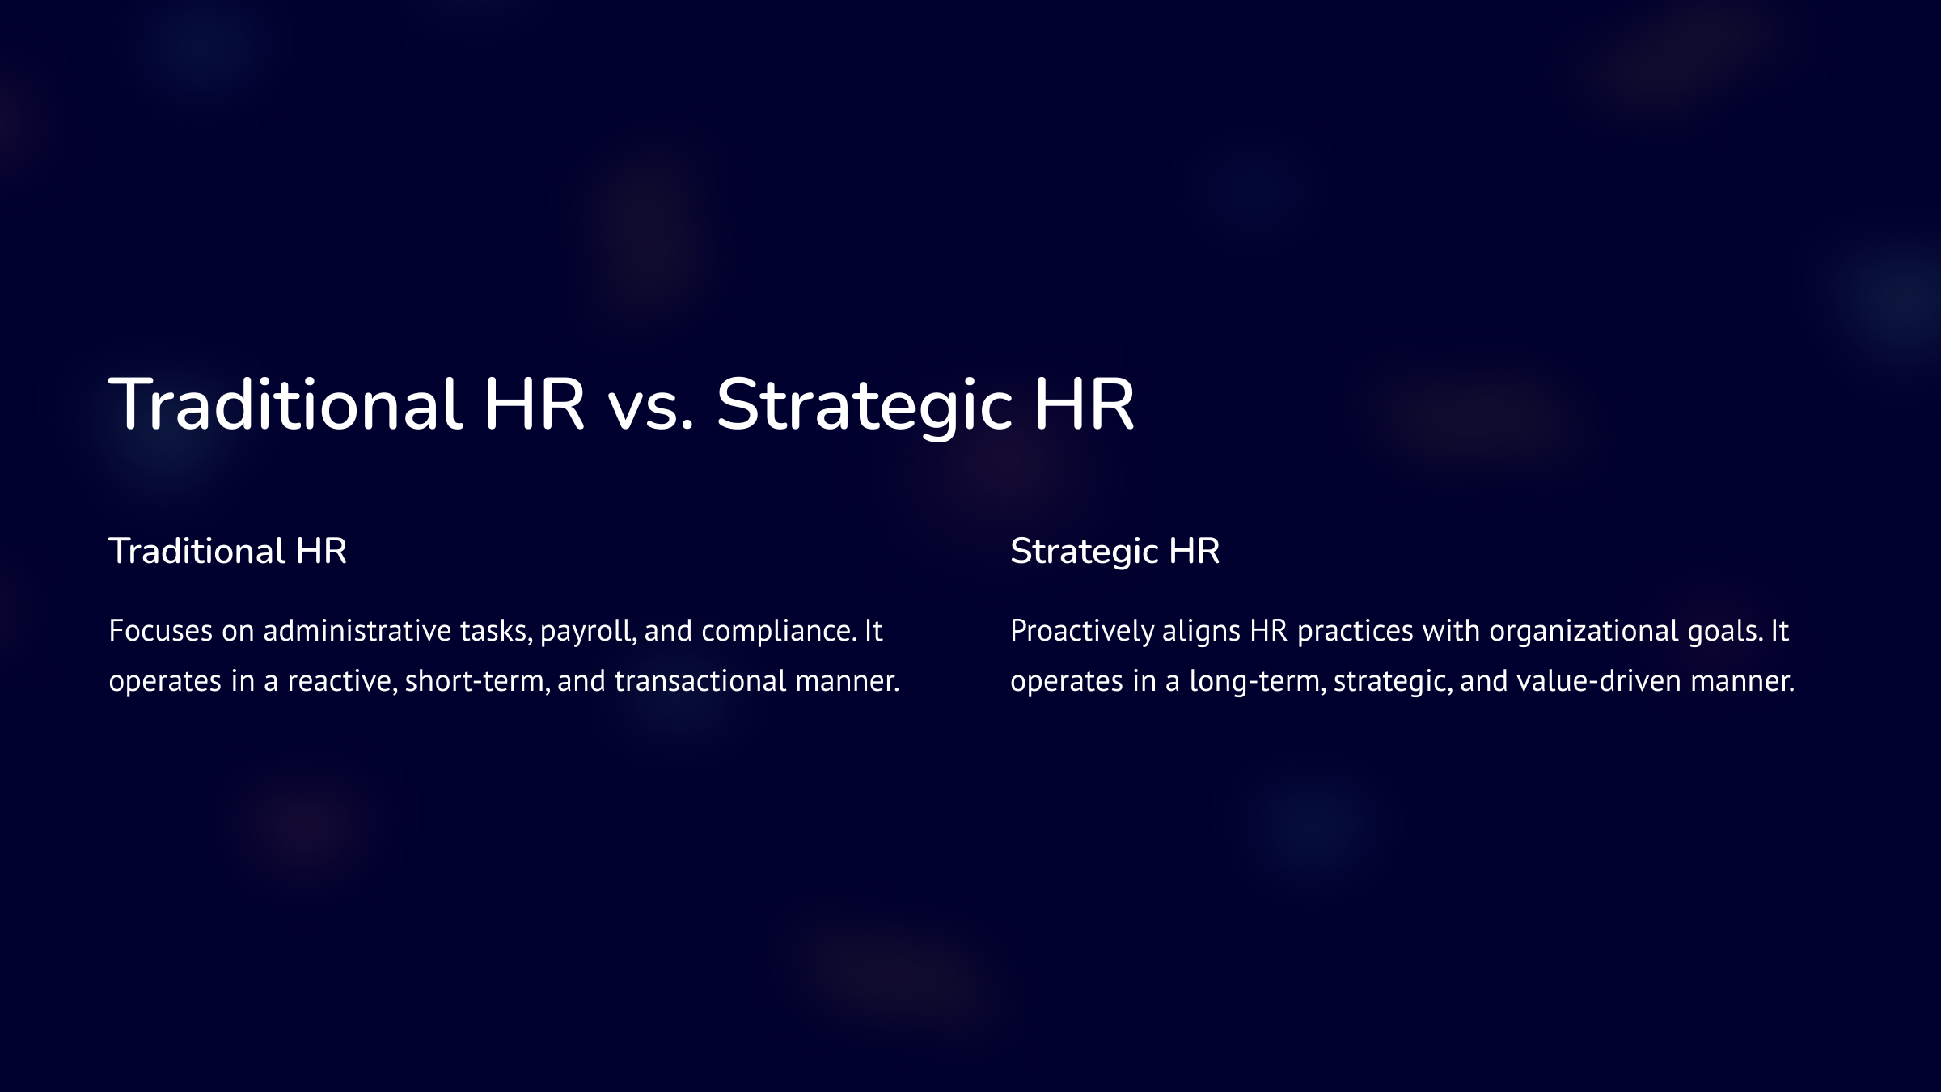

Slide 7
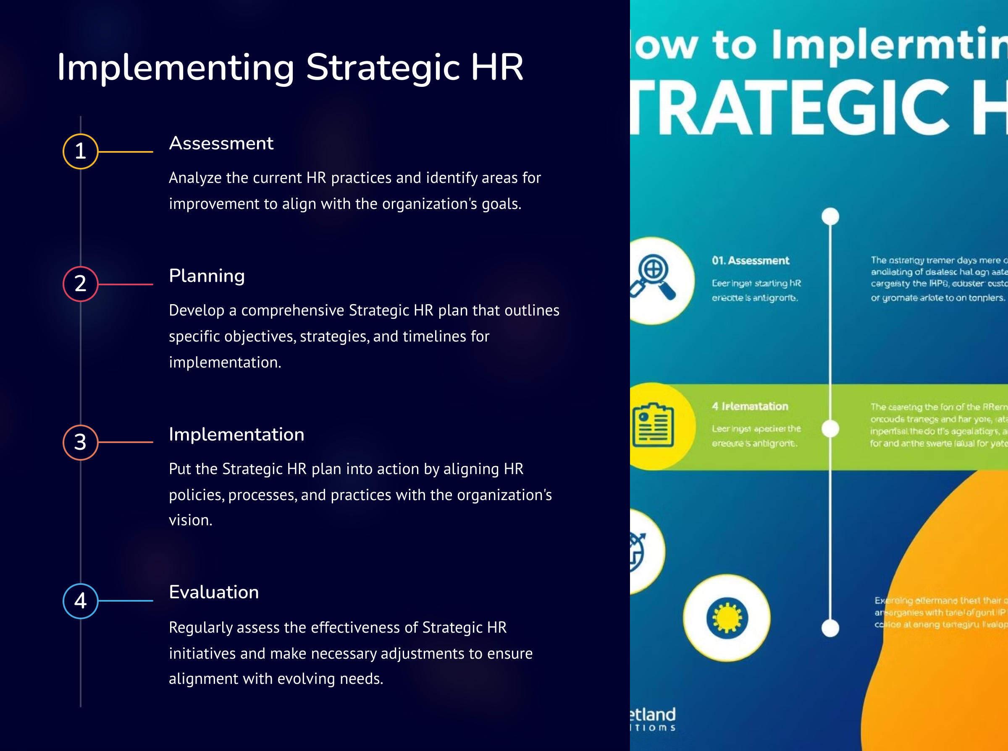

Slide 8
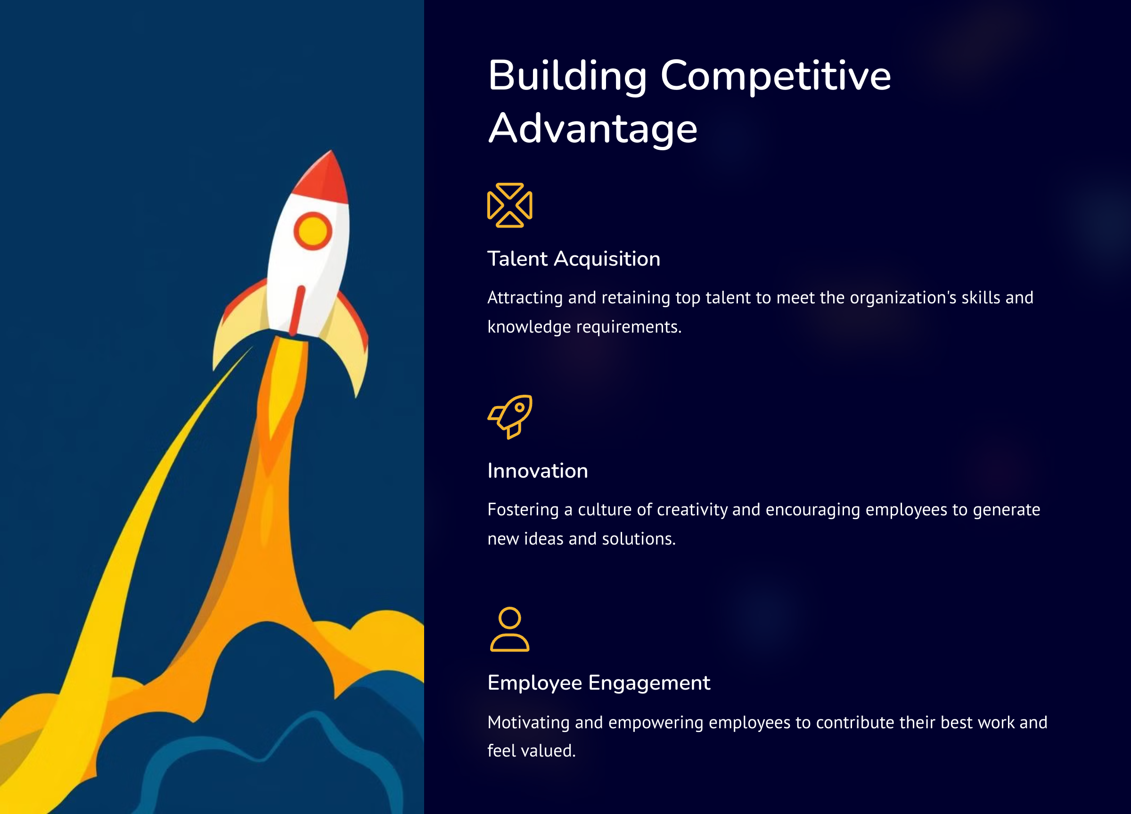

Slide 9
