Slide 1

DEPARTMENT OF LIFELONG LEARNING
BHARATHIDASAN UNIVERSITY
Tiruchirappalli- 620024,
Tamil Nadu, India
Programme: M.A.HUMAN RESOURCE MANAGEMENT
Course Title : HUMAN RESOURCE INFORMATION RESOURCE SYSTEMS
Course Code :22HRMEC6
UNIT-VI
SECURITY AND HRIS
Dr. T. KUMUTHAVALLI
Associate Professor
Department of Lifelong Learning

Slide 2
Security Considerations for All Organizations
Data Protection
Operations Security
Implement comprehensive security measures to safeguard sensitive employee data, including encryption, access controls, and regular audits. This includes adhering to industry standards such as GDPR and HIPAA.
Ensure secure network infrastructure, robust firewalls, and continuous monitoring to protect HRIS systems from cyber threats. This includes implementing strong passwords and two-factor authentication.

Slide 3

Overcoming Adoption Challenges
1
1. Resistance to Change
2
2. User Interface Complexity
3
3. Data Migration Issues
Address concerns, provide clear benefits, and offer effective training to overcome resistance.
Plan meticulously, leverage expert support, and validate data integrity after migration.
Choose an intuitive HRIS platform, provide comprehensive tutorials, and offer ongoing support.

Slide 4




Orientation & Training
Documentation
Develop detailed user manuals, quick guides, and interactive tutorials.
Video Tutorials
Create engaging video guides to demonstrate key features and functionalities.
Live Workshops
Offer hands-on training sessions with experts to answer questions and provide guidance.

Slide 5





Analytical Framework for Evaluation & Implementation
1
Strategic Alignment
2
Process Optimization
3
Data Integrity
4
User Adoption
5
Return on Investment

Slide 6

Synergistic Collaboration
HR Expertise
ITES Expertise
Understanding employee needs, workflows, and regulatory compliance.
Technical knowledge, systems integration, and data security.

Slide 7

Ensuring HRIS Compliance
GDPR
1
Data protection and privacy rights for individuals in the EU.
2
HIPAA
Protection of health information in the US.
FCRA
3
Fair Credit Reporting Act for background checks and employment screening.

Slide 8
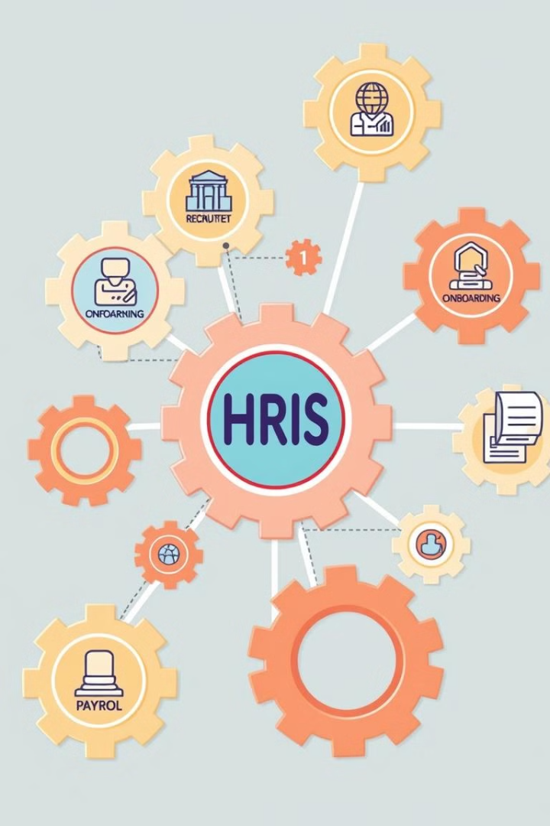




Integrated HRIS: Holistic People Management
Talent Acquisition
Streamlined recruitment and onboarding processes.
Performance Management
Automated performance reviews and feedback mechanisms.
Compensation & Benefits
Payroll processing, benefits administration, and compensation management.
Learning & Development
Online training programs and skills development resources.

