Slide 1

DEPARTMENT OF LIFELONG LEARNING
BHARATHIDASAN UNIVERSITY
Tiruchirappalli- 620024,
Tamil Nadu, India
Programme: M.A.,HUMAN RESOURCE MANAGEMENT
Course Title : HUMAN RESOURCE INFORMATION RESOURCE SYSTEMS
Course Code :22HRMEC6
UNIT - I
Introduction to Information Systems
Dr. T. KUMUTHAVALLI
Associate Professor
Department of Lifelong Learning

Slide 2
Establishing the Framework
Understanding Information Systems
The Core Components
Information systems are the backbone of modern organizations, encompassing hardware, software, data, people, and processes to manage and process information.
These systems serve diverse functions including collecting, storing, processing, and disseminating information, enabling organizations to operate efficiently and make informed decisions.

Slide 3
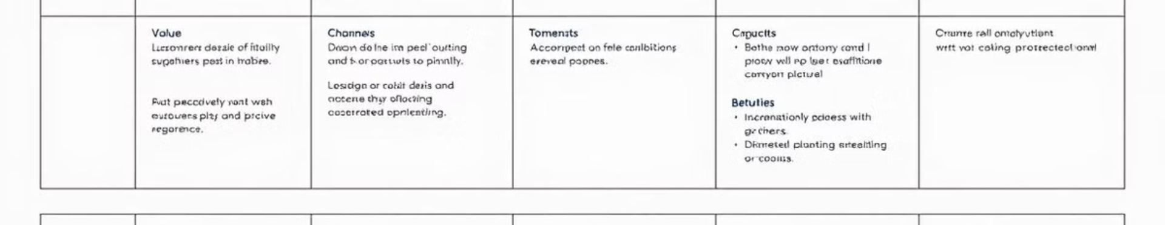
Business Models and Information Systems
Business Model Canvas
Value Proposition Design
The Business Model Canvas provides a structured framework for understanding how organizations create, deliver, and capture value.
Information systems play a crucial role in supporting various aspects of the business model, including customer relationships, value propositions, and revenue streams.

Slide 4





Information System Architecture
Data
1
The foundation of any information system, representing raw facts and figures.
2
Software
The programs and instructions that enable data processing and manipulation.
Hardware
3
The physical components that support the system, including servers, workstations, and networking devices.
4
People
The users and professionals who interact with the system.
5
Processes
The defined methods and procedures for managing and operating the system.

Slide 5
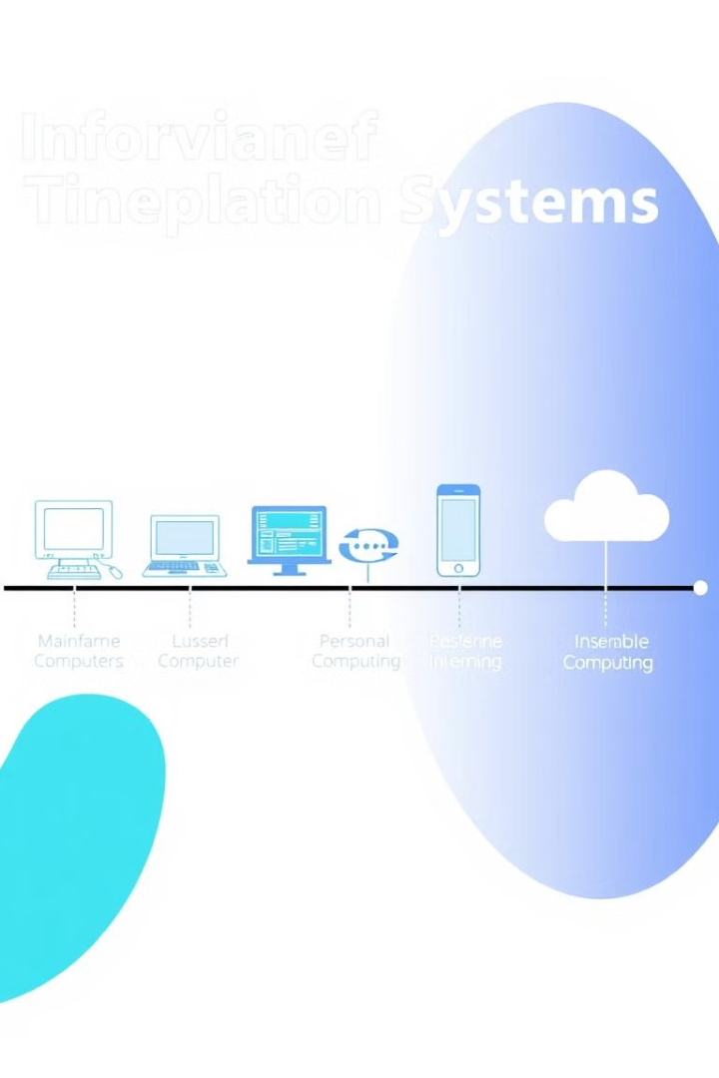
Evolution of Information Systems
1
Early information systems were primarily manual and paper-based, limiting efficiency and access to information.
2
The rise of computers in the 1960s and 1970s led to the development of automated systems, transforming data processing and management.
3
The advent of the internet in the 1990s ushered in a new era of interconnectedness, enabling real-time access and global communication.
4
Today, information systems are increasingly interconnected, relying on cloud computing, artificial intelligence, and data analytics to drive innovation and growth.

Slide 6
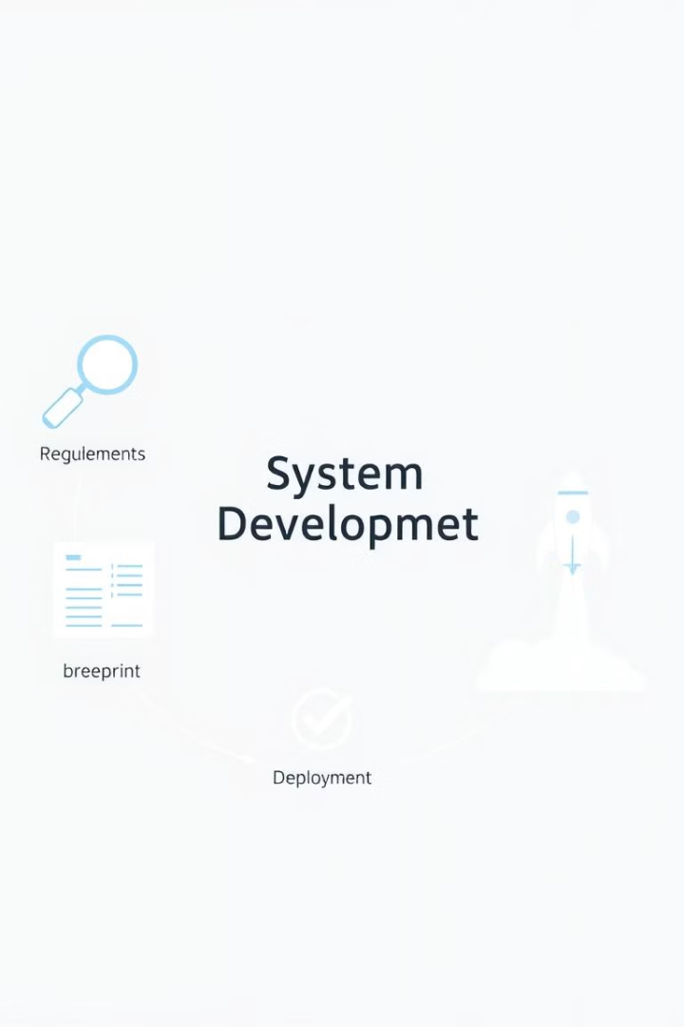




System Development: Building Information Systems
Requirements Gathering
Defining the needs and expectations of the system users and stakeholders.
System Design
Creating a blueprint for the system, specifying its components, interactions, and functionality.
Implementation
Building the system using programming languages, databases, and other technologies.
Testing and Deployment
Rigorously evaluating the system's functionality and performance before releasing it to users.

Slide 7





Modern Information Systems: Shaping the Digital World
Cloud Computing
Data Analytics
On-demand access to computing resources over the internet, enhancing scalability and flexibility.
Extracting insights and patterns from data, enabling better decision-making and predictive analysis.
Artificial Intelligence
Mobile Technologies
Developing systems that can learn, reason, and solve problems, automating tasks and improving efficiency.
Accessing information and services anytime, anywhere, through mobile devices.

Slide 8
System Development Life Cycle (SDLC)
Planning
1
Defining the project scope, objectives, and resources.
Analysis
2
Gathering and analyzing user requirements to understand the system's needs.
Design
3
Developing the system architecture, data models, and interfaces.
Implementation
4
Building and coding the system using programming languages and tools.
Testing
5
Validating the system's functionality and performance before deployment.

Slide 9

Structured Methodologies: Designing Efficient Systems
1
Structured Programming
A disciplined approach to coding, emphasizing modularity, readability, and maintainability.
2
Data Modeling
Defining the structure and relationships of data within the system, ensuring data integrity and consistency.
3
Process Modeling
Visualizing and documenting the system's workflows and business processes.

