Slide 1

DEPARTMENT OF LIFELONG LEARNING
BHARATHIDASAN UNIVERSITY
Tiruchirappalli- 620024,
Tamil Nadu, India
Programme : M.A.,HUMAN RESOURCE MANAGEMENT
Course Title : HUMAN RESOURCE INFORMATION RESOURCE SYSTEMS
Course Code :22HRMEC6
UNIT –III
Human Capital Accounting
Dr. T. KUMUTHAVALLI
Associate Professor
Department of Lifelong Learning

Slide 2
Measuring Human Resource Strength
Skills Inventory
Performance Evaluation
Create a comprehensive database of employee skills and experience, including technical expertise, soft skills, and certifications.
Implement a robust performance review process that assesses individual and team contributions, identifying areas for growth and development.

Slide 3

Skills and Company Measurement
1
Skills Mapping
2
Talent Gap Analysis
Align employee skills with organizational goals and strategic objectives, ensuring that the workforce is equipped to meet current and future demands.
Identify any skill gaps within the organization and develop strategies to address them through training, recruitment, or other initiatives.

Slide 4
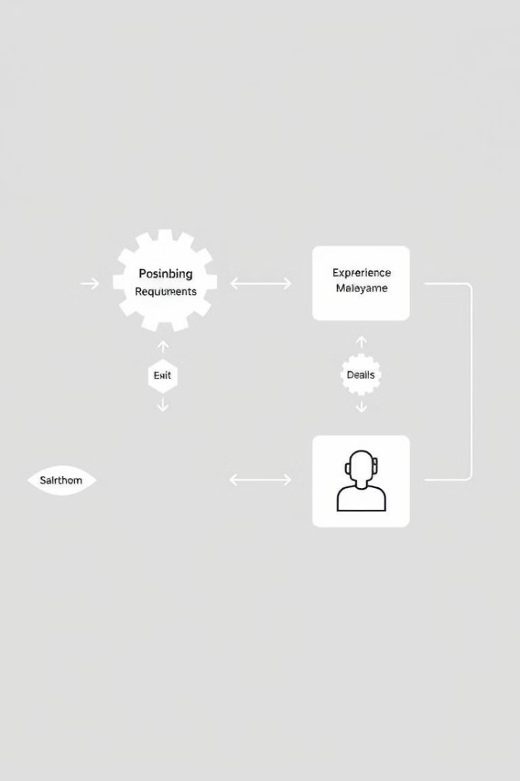



Matching Project Requirements
Project Needs
Clearly define the skills, experience, and qualifications required for each project.
Skill Matching
Utilize the skills inventory and talent pool to identify individuals who possess the necessary skills for each project.
Team Formation
Assemble high-performing teams with the right combination of expertise, experience, and soft skills.

Slide 5
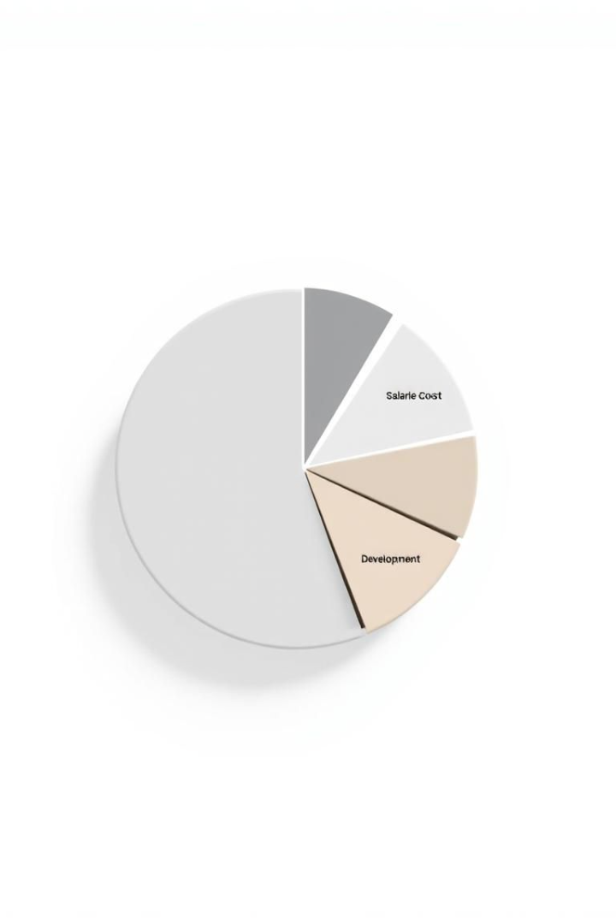
Measuring the Cost of Human Capital
1
Salary
Calculate the total compensation costs for all employees, including salaries, bonuses, and other benefits.
2
Benefits
Include the cost of health insurance, retirement plans, and other benefits provided to employees.
3
Training
Factor in the cost of training and development programs to enhance employee skills and knowledge.

Slide 6

Principles of Human Capital Accounting
Valuation
Reporting
Integration
Develop a methodology for valuing human capital based on its contribution to the organization's profitability and success.
Establish a system for transparently reporting human capital metrics to stakeholders, including investors, employees, and the board of directors.
Integrate human capital accounting into the organization's overall financial reporting framework.

Slide 7




Accounting for Flexible Work Arrangements
Time Tracking
Remote Access
Communication
Implement accurate time tracking systems to ensure that employees are compensated for their work hours.
Provide employees with secure remote access to company systems and resources, enabling them to work effectively from any location.
Maintain clear and frequent communication with remote employees, ensuring that they feel connected and informed.

Slide 8
Compensation Accounting for Flexible Office Employment
Salary
1
Develop a salary structure that is competitive and fair, taking into account the skills and experience of employees.
Benefits
2
Offer a comprehensive benefits package that meets the needs of employees, including health insurance, retirement plans, and paid time off.
Incentives
3
Consider implementing performance-based incentives and bonuses to motivate employees and recognize their contributions.

