Slide 1

DEPARTMENT OF LIFELONG LEARNING
BHARATHIDASAN UNIVERSITY
Tiruchirappalli- 620024,
Tamil Nadu, India
Programme: M.A.,HUMAN RESOURCE MANAGEMENT
Course Title : Global Human Resource Management
Course Code : 22HRM4EC5
Unit-IV
International Employment Process
Dr. T. KUMUTHAVALLI
Associate Professor
Department of Lifelong Learning

Slide 2



International Employment
Process
International employment encompasses the complex processes and considerations involved in hiring, managing, and relocating employees across borders. This presentation delves into the multifaceted aspects of repatriation, exploring the unique challenges and opportunities associated with returning employees to their home countries after an international assignment.
by Presentation

Slide 3
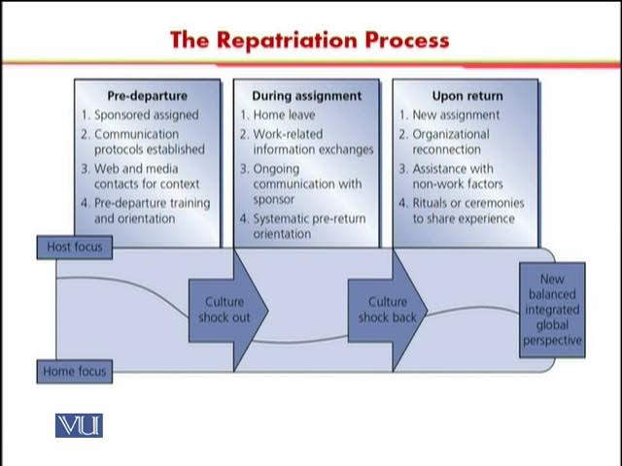

The Repatriation Process
1
Pre-Departure Planning
This crucial phase involves assessing the employee's needs and expectations, preparing them for the cultural transition, and outlining a clear return plan. Effective communication, career development guidance, and financial planning are essential components.
2
Repatriation Arrival and Integration
Upon arrival, employees need support in settling back into their home country, including housing, logistics, and cultural re-adjustment. Organizations can offer practical assistance and facilitate connections with family, friends, and professional networks.
3
Post-Repatriation Support
Continued support is critical in the months following repatriation. This includes addressing any challenges faced during the transition, assisting with career development, and ensuring a smooth re-integration into the workforce. Organizations can provide mentoring, coaching, and networking opportunities.

Slide 4
Individual Reactions to Re-entry
1
Cultural Shock
2
Career Adjustments
Individuals may experience reverse culture shock, facing challenges in adapting to their home country's customs, values, and norms. They may find it difficult to relate to familiar social interactions and re-establish their personal identities.
Returning employees may face challenges in finding suitable employment or navigating career transitions. Their overseas experience might not translate seamlessly into opportunities within their home country.
3
Family Dynamics
4
Emotional Well-being
Repatriation can impact family dynamics. Spouses and children may have difficulty adjusting to a new environment, particularly after experiencing a different culture and lifestyle abroad. The family's overall well-being needs careful consideration.
Repatriation can evoke a mix of emotions, ranging from excitement to anxiety, loneliness, or even depression. Organizations should offer support resources and counseling to assist employees in managing their emotional well-being during this transitional phase.

Slide 5
Multinational Responses
Repatriation Programs
Global Mobility Strategies
Cross-Cultural Training
Many multinational organizations have developed comprehensive repatriation programs to facilitate a smooth transition for returning employees. These programs include career guidance, financial planning, and cultural re-integration support.
Multinationals are increasingly adopting global mobility strategies that consider repatriation as an integral part of their international workforce management. These strategies aim to ensure seamless transitions and maintain employee satisfaction throughout the global mobility lifecycle.
Cross-cultural training plays a crucial role in preparing employees for overseas assignments and supporting their return. This training helps them understand cultural differences, build effective communication skills, and navigate potential challenges.

Slide 6

The global legal and regulatory context of MNEs
Country
Legal Considerations
United States
Tax implications, visa requirements, employment laws, and labor standards.
European Union
Data protection regulations, employment regulations, and anti-discrimination laws.
China
Labor contracts, social insurance contributions, and intellectual property rights.
India
Immigration regulations, employment laws, and tax compliance.

Slide 7




Response of Trade Unions to MNE‘s
Labor Rights Advocacy
Trade unions play a critical role in advocating for the rights of workers employed by multinational companies. They strive to ensure fair wages, safe working conditions, and equal opportunities for all employees.
Collective Bargaining
Trade unions engage in collective bargaining with multinational companies to negotiate terms and conditions of employment, including repatriation policies. These negotiations aim to protect workers' interests during international assignments and transitions.
International Collaboration
Trade unions often collaborate with their counterparts in other countries to address issues related to multinational employment practices. This collaboration facilitates cross-border advocacy and promotes global labor standards.

