Slide 1

DEPARTMENT OF LIFELONG LEARNING
BHARATHIDASAN UNIVERSITY
Tiruchirappalli- 620024,
Tamil Nadu, India
Programme: M.A.,HUMAN RESOURCE MANAGEMENT
Course Title : Global Human Resource Management
Course Code : 22HRM4EC5
Unit-III
Developing Global Mindset
Dr. T. KUMUTHAVALLI
Associate Professor
Department of Lifelong Learning

Slide 2



Developing Global Mindset
In today's interconnected world, developing a global mindset is essential for individuals and organizations alike. This means being able to understand, appreciate, and effectively interact with people from different cultures. It involves recognizing and respecting cultural differences, adapting communication styles, and embracing diverse perspectives. A global mindset fosters collaboration, innovation, and success in the increasingly globalized marketplace.
by Presentation

Slide 3
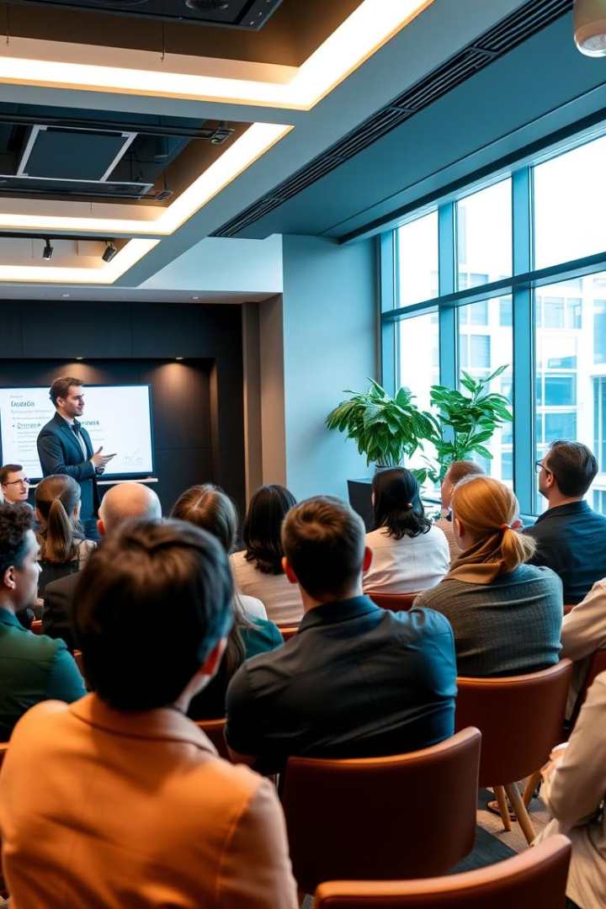
Role of Training
1
Cultural Sensitivity
2
Intercultural Communication
Training programs can help participants develop cultural sensitivity by providing them with an understanding of different cultural norms, values, and communication styles.
Training programs should focus on effective communication strategies in cross-cultural settings, emphasizing clear and respectful communication.
3
Global Business Practices
4
Building Global Networks
Training programs should provide insights into global business practices, including negotiation styles, ethical considerations, and legal frameworks in different countries.
Training can foster networking opportunities with individuals from diverse backgrounds, creating a global network of support and collaboration.

Slide 4

Staff Development Through International Assignments
Preparation
Repatriation
This phase involves providing comprehensive training, language instruction, and cultural immersion experiences to prepare assignees for their new environment.
Upon returning from their assignment, assignees need support to reintegrate into their home organization, share their acquired knowledge and skills, and transition back to their home culture.
1
2
3
Deployment
Once the assignee arrives at their new location, ongoing support and mentorship are provided to help them adjust to the culture, build relationships, and excel in their role.

Slide 5
Career Development, Repatriate Training
Career Advancement
Knowledge Sharing
Global Leadership
International assignments can significantly enhance career prospects, providing valuable experience, expanded networks, and a competitive edge.
Repatriate training helps assignees share their acquired knowledge and experiences, enriching the organization's global perspective and competitiveness.
International assignments equip individuals with the skills and experience to become global leaders, fostering cross-cultural collaboration and innovation.

Slide 6




Knowledge Transfer in Multinational Companies
Formal Channels
This includes training programs, workshops, and documentation to share best practices, policies, and technical knowledge across different locations.
Informal Networks
Encouraging informal communication and networking among employees in different locations allows for spontaneous knowledge exchange and collaboration.
Mentoring Programs
Establishing mentoring programs between employees from different countries fosters knowledge transfer, cultural understanding, and career development.

